Slide 1
The Reporting System—Working with Interim Tests and Item-Level Data
Mini Training Module
2022–2023
Copyright © 2022 Cambium Assessment, Inc. All rights reserved.
Notes:
Welcome to this mini training module on the Reporting System—Working with Interim Tests and Item-Level Data.
This training module is based on the Reporting System User Guide for Summative and Interim Assessments, 2022–2023, which is available on your assessment portal.

Slide 2
Objectives
Understand Types of Tests with Item-Level Data
How to View Items and Student Responses
How to View Standards
How to Score Unscored Items
How to Modify Scores
Notes:
Here are the objectives for this mini training module. First, we explain the different types of tests with item-level data, then show you how to view the items themselves, the student responses, and the standards aligned to each item. The second half of this module explains how to score unscored items and how to modify existing scores.

Slide 3
Types of Non-Summative Tests that Report Item-Level Data
All Tests
Non-Summative Tests
Benchmarks:
—Fixed-form tests with 8–12 items within a specific reporting category (topic or skill area)
—Users can compare item-level scores across all students
—a.k.a. module, modular, Interim Assessment Block (IAB), benchmark module, benchmark, diagnostic
Interims:
—Fixed-form or adaptive tests that cover some or all of the standards students are required to learn
—Users can see item-level scores for individual students who took an adaptive interim
—a.k.a. Interim Comprehensive Assessment (ICA), interim
Summative Tests
Our Focus:
Item-Level Data Included on Benchmark and Interim Test Reports
Notes:
The focus of this section will be on non-summative test reports that contain item-level data, access to the items themselves, and access to student responses to the items. This chart shows how tests in Reporting can be categorized.
All tests are either summative or non-summative assessments. Summative tests are end-of-year or end-of-course comprehensive tests that assess the student’s command of an entire subject. Non-summative tests vary by state and district and can be divided into benchmark and interim tests.
Benchmarks are small tests in single reporting categories with non-secure items. Users can compare item-level scores and the items themselves for all their students.
Interims are larger than benchmarks but smaller than summative tests. Many interim tests will report item-level data, depending on the type of test and on state and district policies.

Slide 4
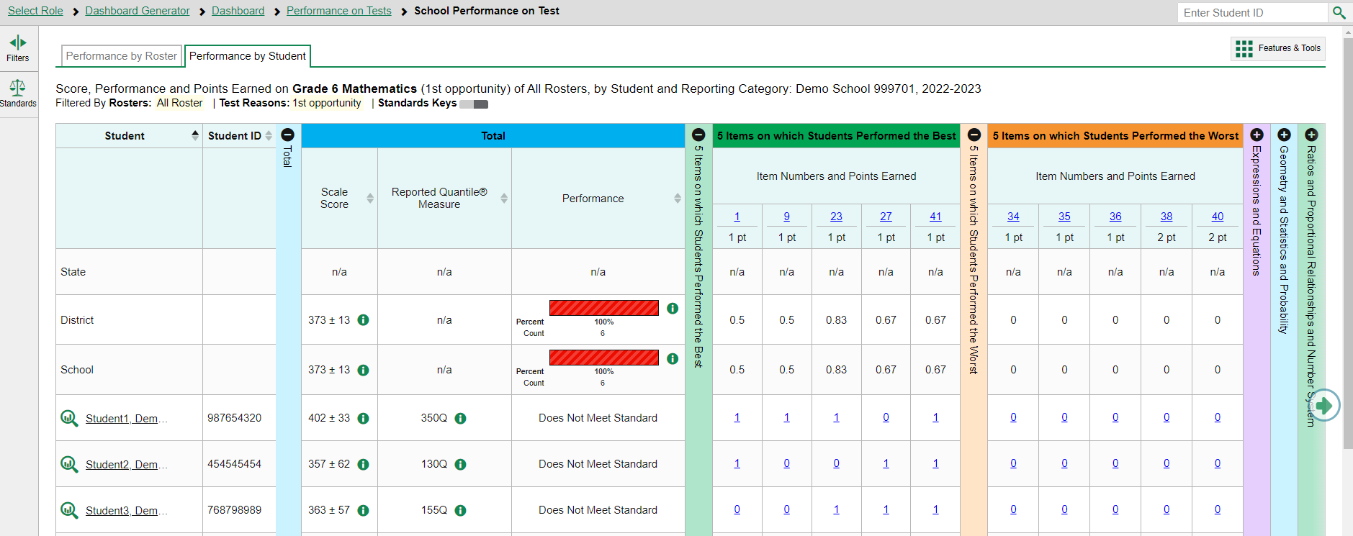
Reports with Item-Level Data
Notes:
Here is the School Performance on Test report, by student, for students who took the interim Grade 6 Mathematics Test. The report displays item-level data at the student level, and you can access the items themselves and the student responses to the items.
The colored sections in the table include a blue Total performance section, a green section for 5 Items on which Students Performed the Best, an orange section for 5 Items on which Students Performed the Worst, and other reporting categories. You can expand or collapse the sections by clicking the vertical section bars, which display plus and minus signs. Clicking the green arrow button on the right allows you to scroll right.
To show you how to analyze your results, we focus first on the green section, showing the five items on which students performed the best.
The first two rows under the section header, 5 Items on which Students Performed the Best, list the item number and the number of points earned for the item. The students on this roster performed the best on items 1, 9, 23, 27, and 41.
For example, Demo Student 1 earned 1 out of 1 points on item 23.
In reports with item-level data, you may occasionally see “n/a” instead of a score for an item. It means that the student did not respond to the item, or the item was not included in that form of the test.

Slide 5
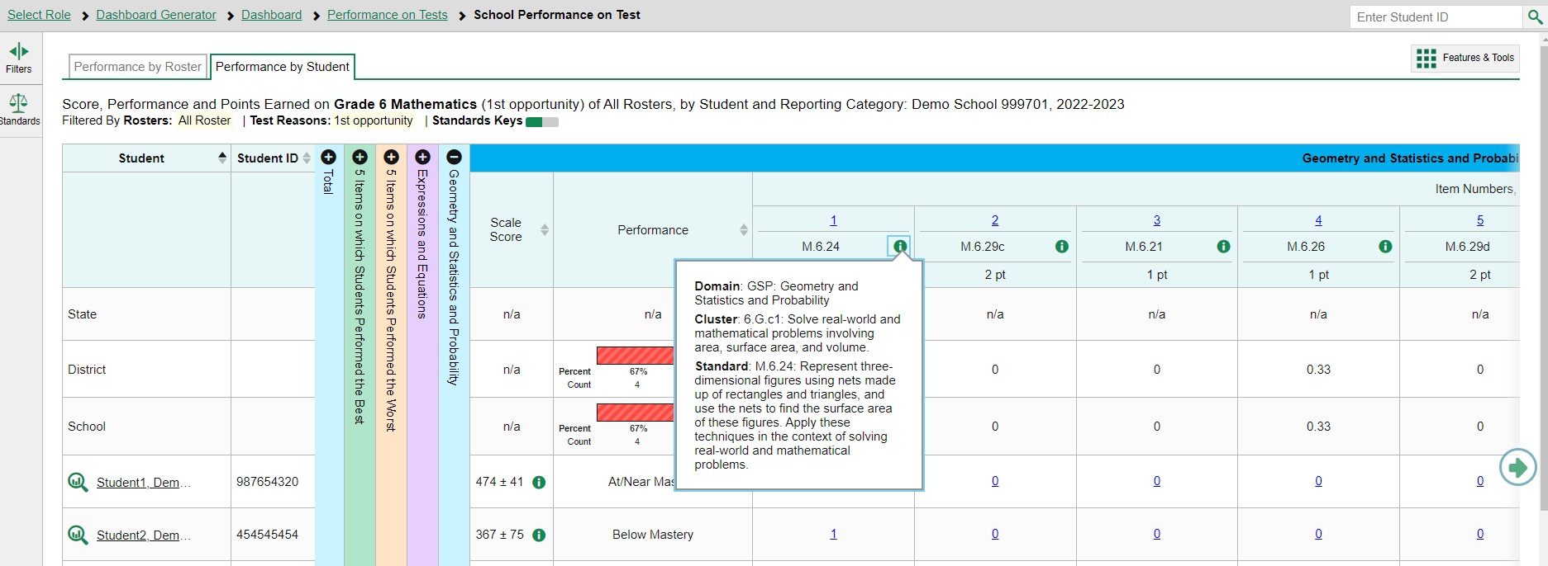
How to View Standards for Each Item
Notes:
In a report displaying item-level data, you can view the standard to which each item is aligned. This allows you to determine at a glance what the item measures. To show or hide item standards, click the Standards Keys toggle in the row of filter details below the report table heading. The standards display beneath the blue item numbers. Click the more information buttons beside the standard keys to view the legend for each standard.

Slide 6
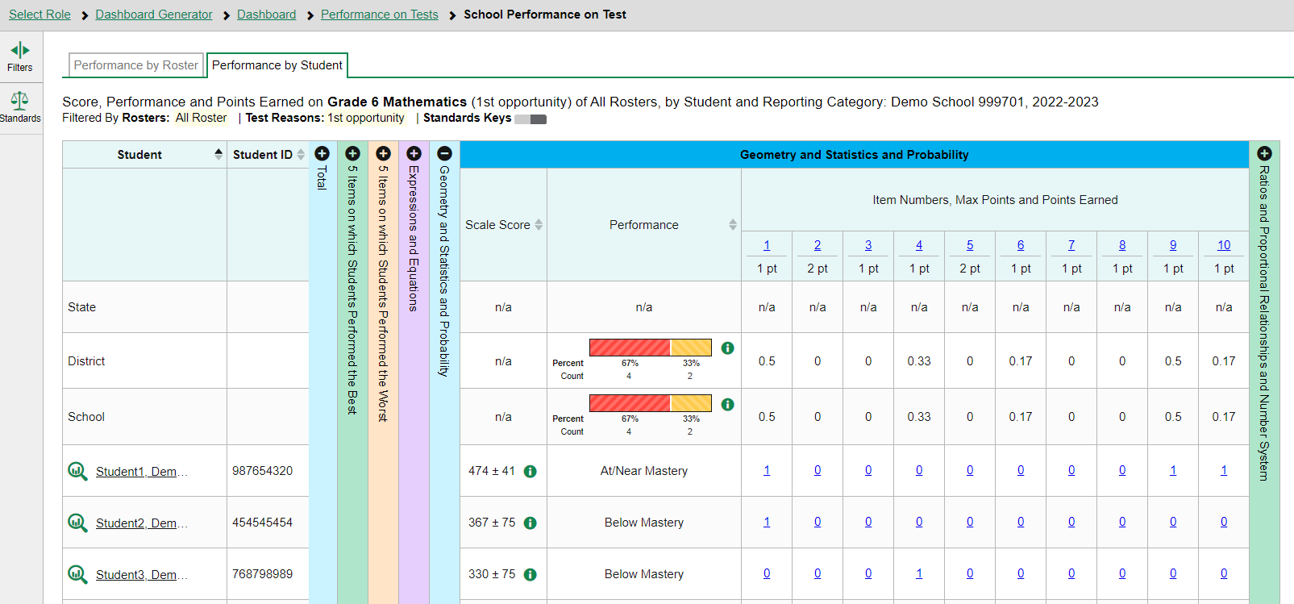
Reports with Multiple Reporting Categories
Notes:
When data includes reporting categories, you may see sortable columns for Scale Score and Performance level, along with the item-level data in each section, as shown here in this interim Grade 6 Mathematics test.

Slide 7
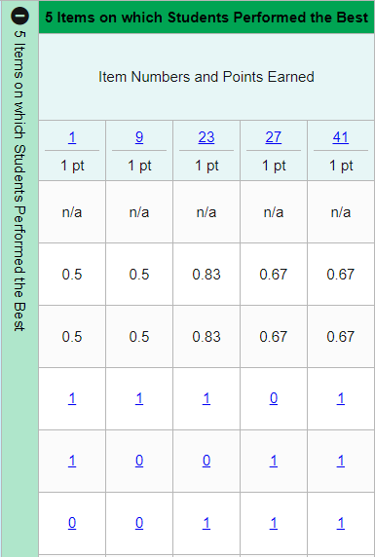
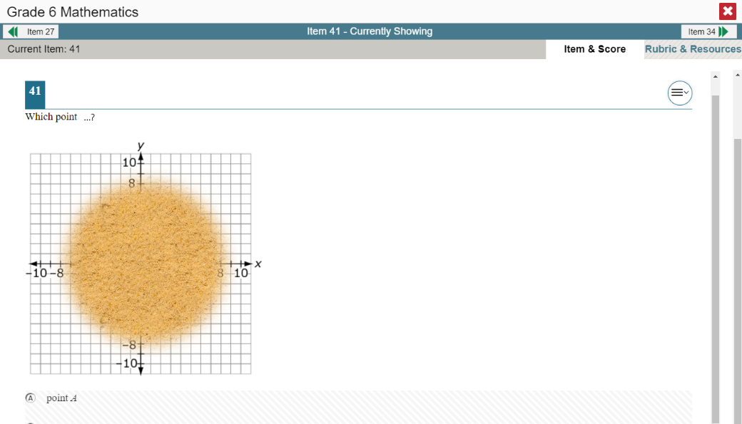
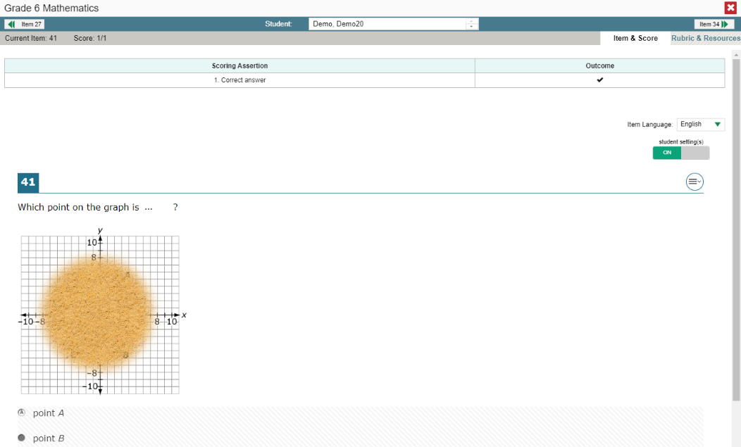
Viewing an Item and Student Response
Notes:
To view a test item in a blank, unanswered state, click the item number link in the first row of a report table. The item view window displays the test question as it appeared on the assessment on the Student Testing Site.
To view an item with a student’s response, find that student’s name in the Student column on the left. Then click the blue score link under the numbered item. In this example, we look at item 41 for the last student listed.
The item view window displays the item along with the answer provided by that student.
On the next slide, we will explain the features of an item view window that includes the student’s response.

Slide 8
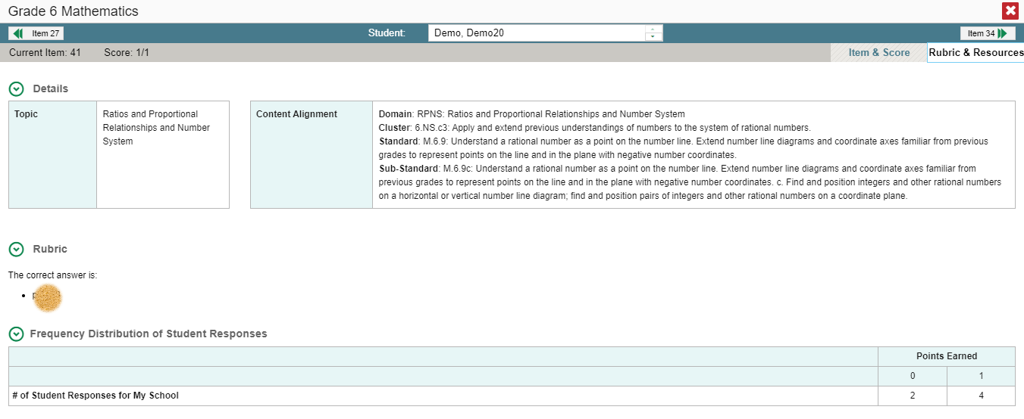
Item & Score Tab
Notes:
You can see the current item number and the score for that item in the gray bar in the banner. The student answered correctly for a score of 1 out of 1 point on item 41.
Moving to the right in the gray bar, you see two tabs, Item & Score and Rubric & Resources. You can toggle between these tabs to display associated content. The Item & Score tab is open in the upper-left image, and the Rubric & Resources tab is open in the lower-right image.
Underneath the teal and gray banners, the scoring assertions are displayed with their outcomes.
In the Scoring Assertion column, each assertion states exactly what the student must do to earn points. The Outcome column shows a checkmark for a correct answer, or an X for each incorrect answer. This item has a single scoring assertion.
Below, the test item is displayed along with the student’s response. Reviewing a student’s response may provide clues to the student’s thinking.
You can show or hide a student’s visual settings, like large fonts, different color contrasts, or Spanish language, on a per-item basis. To do so, click the toggle above the item on the right side.
The Rubric & Resources tab has the same teal and gray banner features and is divided into multiple sections, which may include Details, Resources, Rubric, and Frequency Distribution of Student Responses. The sections are expanded and collapsed using the circled arrows to the left. The information included in each section varies, depending on the test item.
The Topic lists the skill area to which the item belongs. The Content Alignment section describes, in detail, the academic or learning standard to which the item is aligned.
The Rubric displays the criteria used to score the item. A simple correct answer may be listed, or this section may include a score breakdown, a human-readable rubric, or an exemplar, which provides an example of a response for each point value.
Frequency Distribution of Student Responses provides a breakdown of how many students earned each possible point value available for the item. In this example, six students in the school responded to item 15 on this mathematics test. Four of them earned one point for the item and two of them earned 0 points.

Slide 9
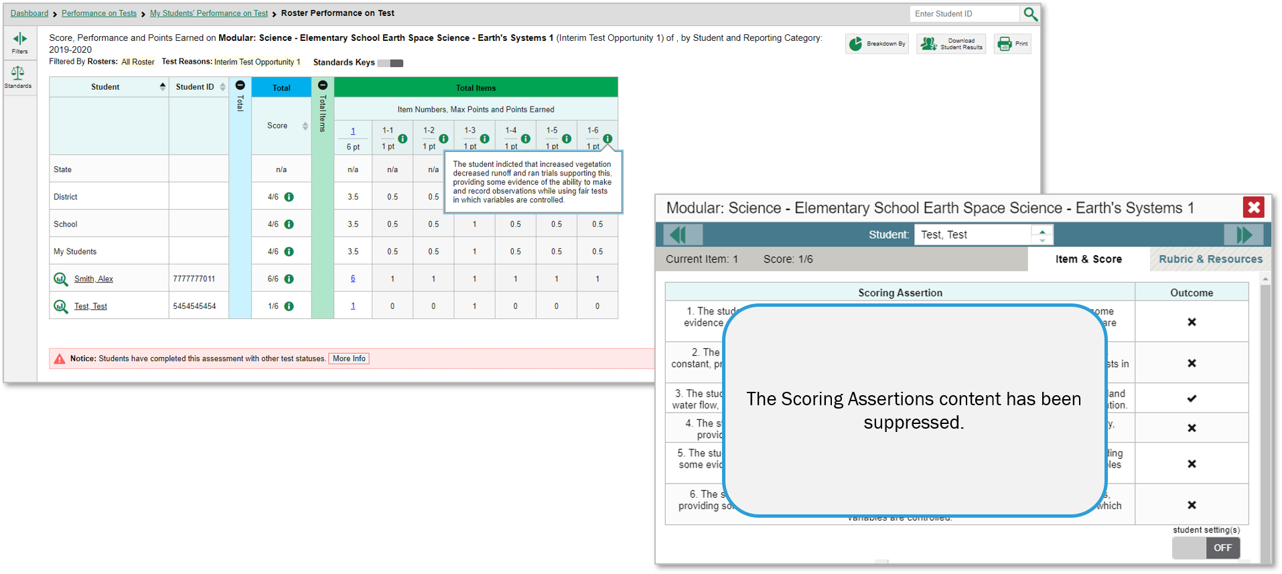
Multiple Scoring Assertions
Notes:
Some test items have Multiple Scoring Assertions. Typically, these items feature a reading passage, along with graph images like a map, table, or illustration. Several test items are then associated with this prompt. Students are instructed to use what they have learned from the stimuli to perform the associated sub-item tasks.
Each scoring assertion contains both a statement that provides information about what the student did in their response, and the content knowledge, skills, or ability that is evidenced by their response. This slide shows the Scoring Assertions window from question 1 on the Elementary School Earth Space Science modular test. It features a reading passage, a graphic, and five sub-items. Each sub-item is worth 1 point. The sub-items are listed as 1-1, 1-2, 1-3, and so on. The information pop-up displays the scoring assertions associated with each of the sub-items. The Item & Score page shows all five scoring assertions listed in that section of the page. It shows that this student answered 1 of the 5 sub-items correctly, item 1-5.

Slide 10
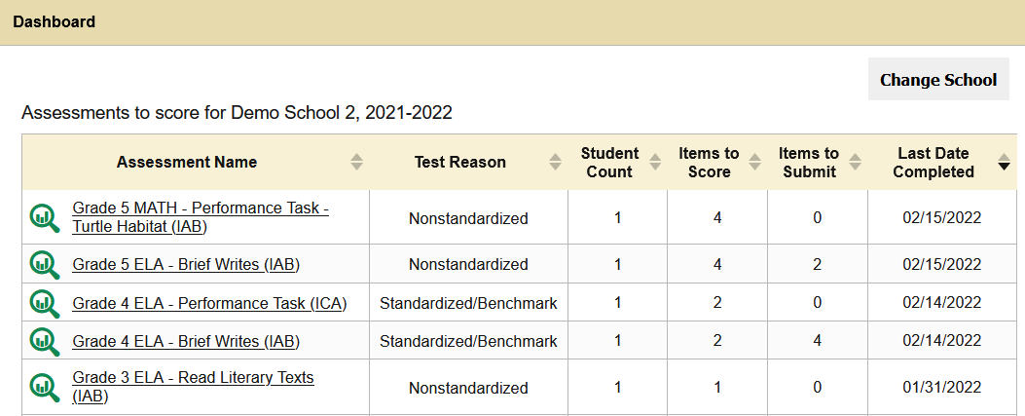
Tests to Score—Dashboard
Tests to Score Process = Scoring + Submitting the Scores
Assessments to score for Demo School 2, 2022–2023
02/15/2023
02/15/2023
02/14/2023
02/14/2023
01/30/2023
Notes:
The Reporting system allows users (with appropriate permission) to handscore unscored test items. It also allows modification of some automated scores suggested by the machine-scoring system. If a test contains unscored items, its performance data are excluded from your Dashboard and Assessment Reports until you or another user with scoring permissions enters scores for all the unscored items in at least one opportunity of that test.
When you have tests awaiting item scoring, click the Tests to Score notification that appears in the banner. The process consists of two steps: scoring the unscored items and then submitting them so that they can be officially recorded.
The Dashboard opens with a list of tests with unscored items. Click the name of the test you wish to score.

Slide 11
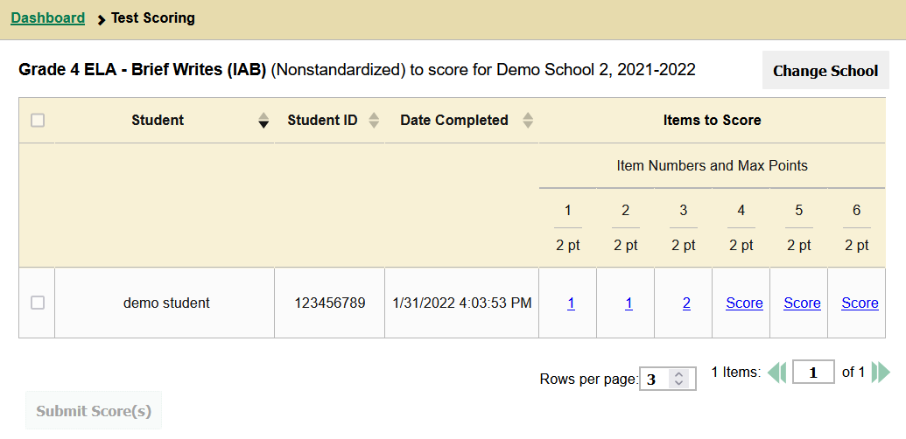
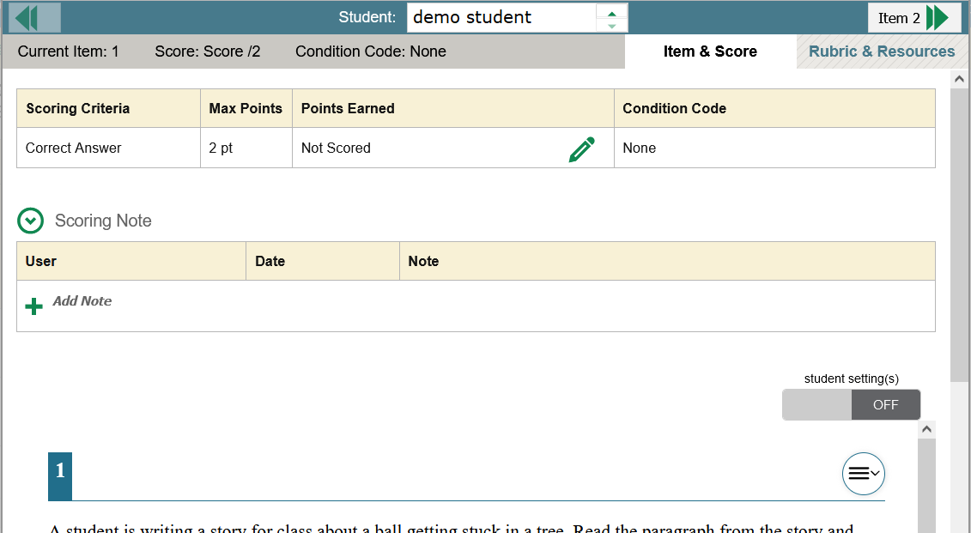
Test Scoring Page and Scoring Window
Grade 4 ELA—Brief Writes (IAB) to score for Demo School 2, 2022—2023
Item 5
Notes:
The Test Scoring window now displays a list of students and items awaiting scoring for the selected test. Items 1, 2, and 3 for the demo student have already been scored but not submitted. Items 4, 5, and 6 need to be scored. The Submit Scores button will remain grayed out until all the unscored items have been scored.
To enter scores for an item, click the Score link. The scoring window opens to the Item & Score tab. You can toggle to the Rubric & Resources tab to review the item’s scoring rubric and any other available resources for help in scoring the item.
Click the edit icon in the Scoring Criteria table to score the item.

Slide 12
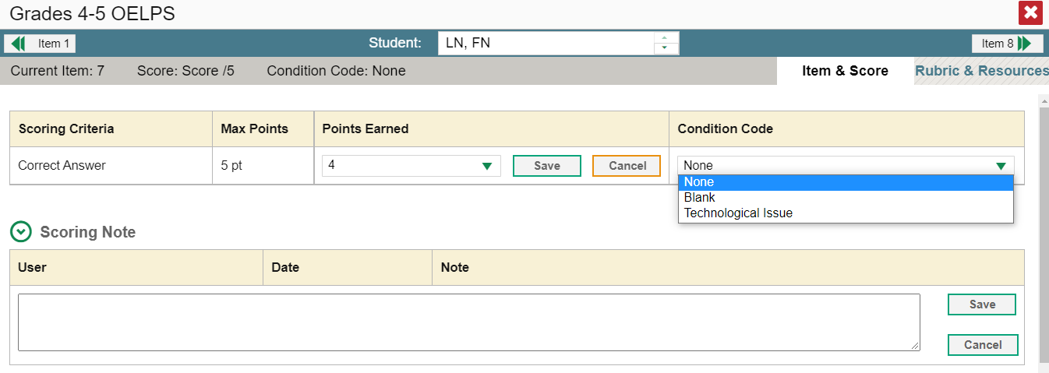
Scoring Window (cont.)
Grade 4 ELA—Brief Writes (IAB)
Item 3
demo student
Item 5
4
/2
2 pt
1
Children were playing outside. They spotted a cat in a tree. It was white. They called a grown up for help. Fireman came and got it out of the tree.
Notes:
When you click the pencil icon, the scoring criteria table adjusts to display a drop-down menu for adding Points Earned, and a drop-down menu for selecting a Condition Code if the student response is un-scorable. Below those fields is a Scoring Note box, allowing you to enter comments regarding the student response and why it was scored the way it was. Scroll down to read the student response to the item.
After entering data in the Scoring Criteria and Scoring Note sections, click Save in both places.
To advance to the next item needing a score, click the advance arrow in the banner to the right of the student's name, in the upper-right corner.
Please note: The 2022–2023 Reporting System User Guide includes a description of the condition codes as an appendix.

Slide 13
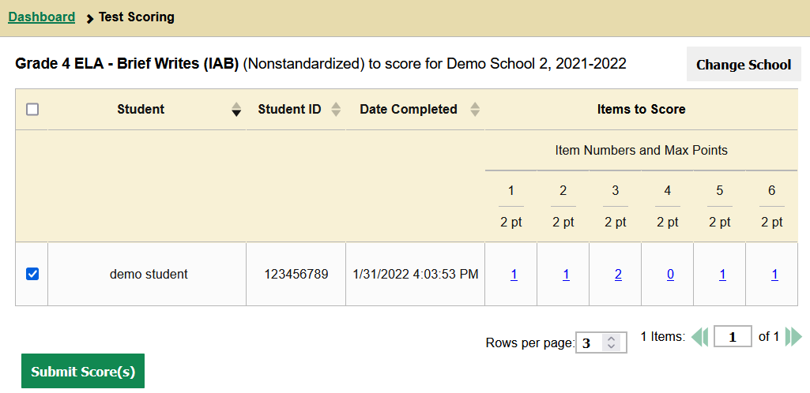
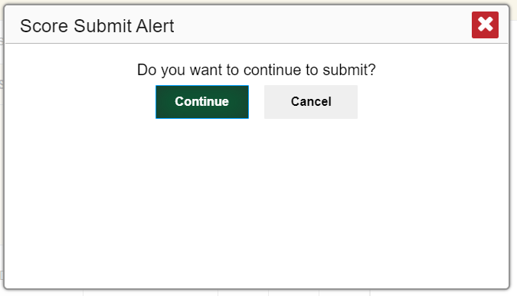
Submit the Scores
Grade 4 ELA—Brief Writes (IAB) to score for Demo School 2, 2022—2023
01/31/2023 8:59 AM
Notes:
When scoring for all items has been completed, the Test Scoring page will display the points assigned to each item.
Check the box to the left of the student's name and then click the Submit Scores button to send the scores to officially submit the scores.
The Score Submit Alert window will appear. Click Continue to confirm. The selected items will be submitted for processing and reporting and removed from the table.

Slide 14
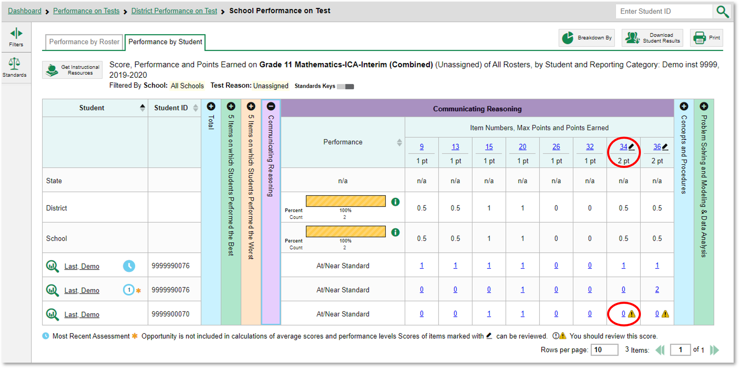
Modify Scores
Notes:
Users can modify scores for some items. Reports display a pencil icon in the column headers for each item with editable scores. If a machine-suggested score has a low-confidence level, a yellow warning triangle appears next to the score number. It is highly recommended that teachers review low-confidence scores.
Click the item score link in the student’s row of the report. The Item View window opens in the Item & Score tab.

Slide 15
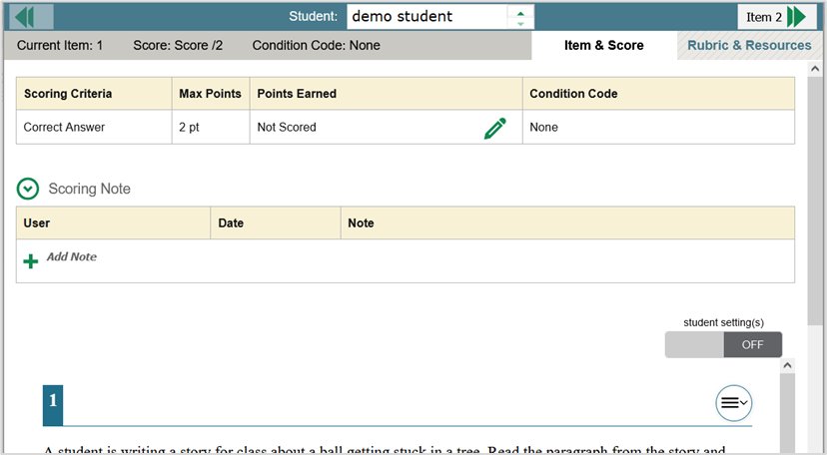
Modify Scores in Item & Score Tab
1
1
Notes:
Click the pencil icon in the Scoring Criteria table.
To enter a score for the response, select a numerical score from the Points Earned drop-down list. If the item consists of multiple scoring criteria, select a numerical score from the score drop-down list for all scoring criteria. To save the score, click Save.
Users can choose to assign a Condition Code in lieu of selecting the number of points earned.
When you close the item view window, any average scores or performance distributions on the assessment report will update automatically.

Slide 16
Condition Codes
Condition Code | Source of Code | Description
Insufficient Text (Duplicated Text) | Machine | The response contains a significant amount of repeated text.
Blank | Machine | The student did not enter a response.
Non-Specific* | Machine | This condition code is assigned to machine-scored responses when the Test Delivery System (TDS) identifies that the response requires a condition code but cannot determine which specific condition code it requires. Resolution is required.
Insufficient Text (Too Few Words) | Machine | The response contains too few words to be considered a valid attempt.
Non-Scorable Language (Uninterpretable Language)* | Machine | The response is in a language other than English or Spanish. Resolution is required.
Insufficient Text (Copied Text from the Prompt) | Machine | The response is largely composed of text copied from the prompt.
Off Topic or Off Purpose | Human | A writing sample will be judged off topic when the response is unrelated to the task or the sources or shows no evidence that the student has read the task or the sources (especially for informational/explanatory and opinion/argumentative).
Foreign Language | Human | The response is written in a language other than English.
Unreadable | Human | The response is unreadable. For example, an online response is unreadable if it contains only repeated/random keystrokes (e.g., “yyyyyyyyyyy”; “av:aeoiahvb;e”; “hhrrttuuvv”).
Blank | Human | The student did not enter a response.
Non-scorable Language | Human | The student inputs an answer that isn’t in English or Spanish.
Notes:
Here is a sample list of condition codes that you may see in your drop-down menus. As you can see from the table, some of the condition codes are assigned by machine and other condition codes are assigned by a human. When a condition code of Non-Specific or Uninterpretable Language has been assigned by machine, it is highly recommended that you review items.

Slide 17
How Can I Get More Information?
You can contact the Help Desk for assistance with any technical issues you encounter.
When contacting the Help Desk, please be ready to provide the following:
Any error messages that are appearing (including codes)
Your operating system and browser information
Your network configuration information
Your contact information for follow-up by phone or email
Any other relevant information, such as test names or content areas, student IDs, session IDs, and search criteria
For test administration or policy issues, please contact your District Test Coordinator.
You can find more announcements on your assessment portal.
Notes:
We hope this module has given you a solid understanding of interim tests and item-level data in the Reporting system. Watch for future announcements on your assessment portal page. A Reporting System User Guide is posted there. You can also call or email the Help Desk with your questions.

Slide 18
Thank You!
Further Information: Reporting System User Guide or Reporting Full Training Module
https://idaho.portal.cambiumast.com/
IDHelpDesk@cambiumassessment.com
Notes:
Thank you for taking the time to view this training module. For detailed information, consult your Reporting System User Guide for Summative and Interim Assessments, 2022-2023, located on your state portal, or contact your Help Desk.

