Slide 1
Student Interface Training Module
2022–2023
Published August 9, 2022
Copyright © 2022 Cambium Assessment, Inc. All rights reserved.
Notes:
Welcome to the Student Interface Training Module. This presentation is designed to help Test Coordinators and Test Administrators (TAs) understand the interface that students use to take online tests.

Slide 2
Objectives
After viewing this presentation, you should understand:
Please note: The navigation instructions that follow are from the viewpoint of a Windows PC user with a two-button mouse. Your steps may vary slightly depending upon the device and operating system you are using.
How students log in to the testing system and select a test
The layout of the test and functionality of test tools
How students navigate through the test
Notes:
After viewing this presentation, you should understand:
How students log in to the testing system and select a test
The layout of the test and functionality of test tools
How students navigate through the test
Please note, the navigation instructions that follow are from the viewpoint of a Windows PC user with a two-button mouse. Your steps may vary slightly depending on the device and operating system you are using.

Slide 3
The Secure Browser and Logging In
Notes:
Now let us take a look at the Secure Browser and how students log in to take a test.

Slide 4
What Is the Secure Browser?
The Secure Browser is designed to ensure test security by prohibiting students from accessing any other programs or websites during testing.
Secure Browser
If you have questions about installation of the Secure Browser, contact your Technology Coordinator.
Notes:
Students must use the Secure Browser to log in to the Student Interface. The Secure Browser is designed to ensure test security by prohibiting students from accessing any other programs or websites during testing.
Your school’s Technology Coordinator is responsible for ensuring that the Secure Browser has been correctly installed on all testing devices. If you have questions about installation of the Secure Browser, please contact your Technology Coordinator.

Slide 5
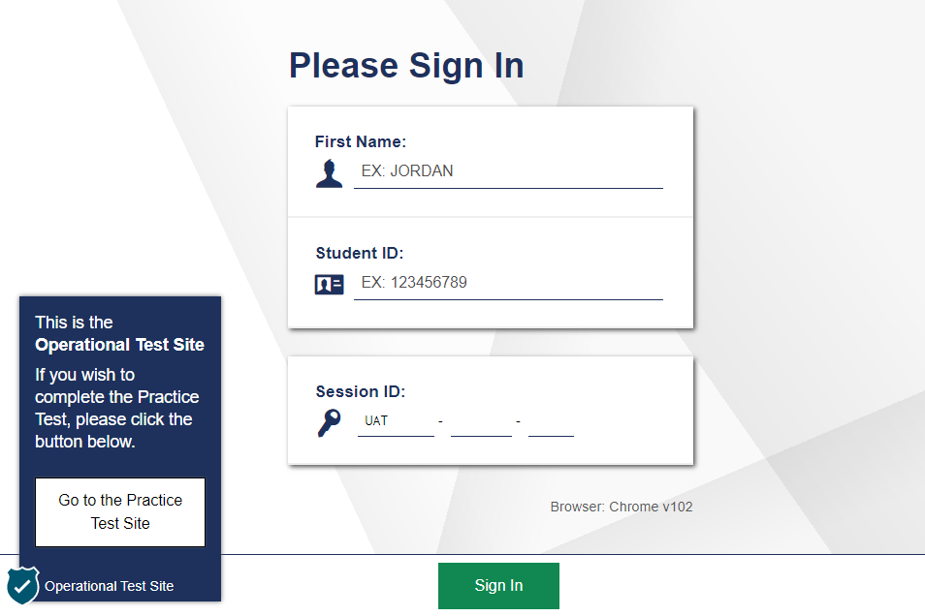
Secure Browser Login
Notes:
To log in to the online testing system, students must use the Secure Browser on a computer or device separate from the one used by the TA. Students must enter three pieces of identifying information: their first name, their state-assigned student identifier (SSID), and the current test session ID.
The test session ID is generated when the TA creates the test session. It needs to be given to students by the TA when it is time for them to log in to the test. Session IDs should not be generated more than 20 minutes before students are ready to log in.
When entries are complete, students will select the Sign In button to log in to the test. The TA may assist students with logging in, if necessary.

Slide 6
Student Login Errors
Issue | Error Message | What to Do
Student first name and SSID do not exactly match what is in the system. | Please check that your information is entered correctly. If you need help, ask your Test Administrator. | Verify that the student has entered the correct first name and exact SSID. You may need to use the Student Lookup Tool, which is located in the Test Administrator Interface, to verify that the student is in the system.
Student enters the session ID incorrectly. | The session is not available for testing. | Verify that the student has entered the correct session ID with no extra spaces or characters.
Student enters a session ID for an incorrect or expired session. | Session has expired. | Ensure that the student enters the correct session ID for the current session. If this does not work, verify that your session is open using the Test Administrator interface.
One person (either the TA or the student) is using the Operational Test Administration Site, and the other is using the Practice Site. | The session is not available for testing. | If taking a practice test, make sure that you and the student are both on the Practice Site. If taking an operational test, make sure that the student is using the Secure Browser and you are using the Operational Test Administration Site.
Notes:
If a student is having difficulty logging in, an error message and code will be displayed on the login screen. The most common errors occur when the student’s first name and SSID do not match what is in the system and when SSIDs are entered incorrectly. If the student receives an error message indicating that he or she has entered incorrect information in the first name or SSID fields, the TA should use the Student Lookup Tool in the TA Interface to verify the student’s information.
Another common error occurs when the student enters an incorrect session ID. If a student receives the message “The session is not available for testing,” verify that the session ID was entered correctly, with no extra spaces or characters. The session ID can be found in the TA Interface.
If a student receives the error message “Session has expired,” ensure that the student has entered the correct session ID for the current session. If the student has entered the session ID correctly, use the TA Interface to verify that your session is still open.
Finally, if administering a practice test, make sure that the TA and the student each use the appropriate practice and training test site. If administering an operational test, ensure that the TA is using the Operational Test Administration Site and the student is using the Secure Browser.

Slide 7
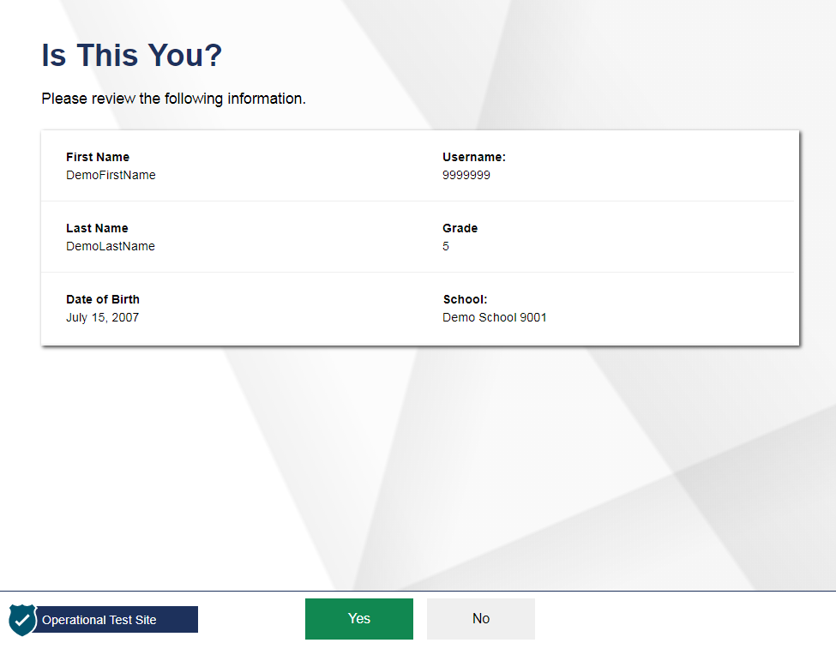
Student Verification
Notes:
After logging in, students need to complete a few more steps before they begin testing. Students will be asked to view and verify their personal information. If their information is correct, they should select Yes to proceed. If their information is incorrect, they should select No to return to the login page. You must then contact your School or District Test Coordinator to have the student’s information updated in the Test Information Distribution Engine (TIDE) before the student attempts to log in again.

Slide 8
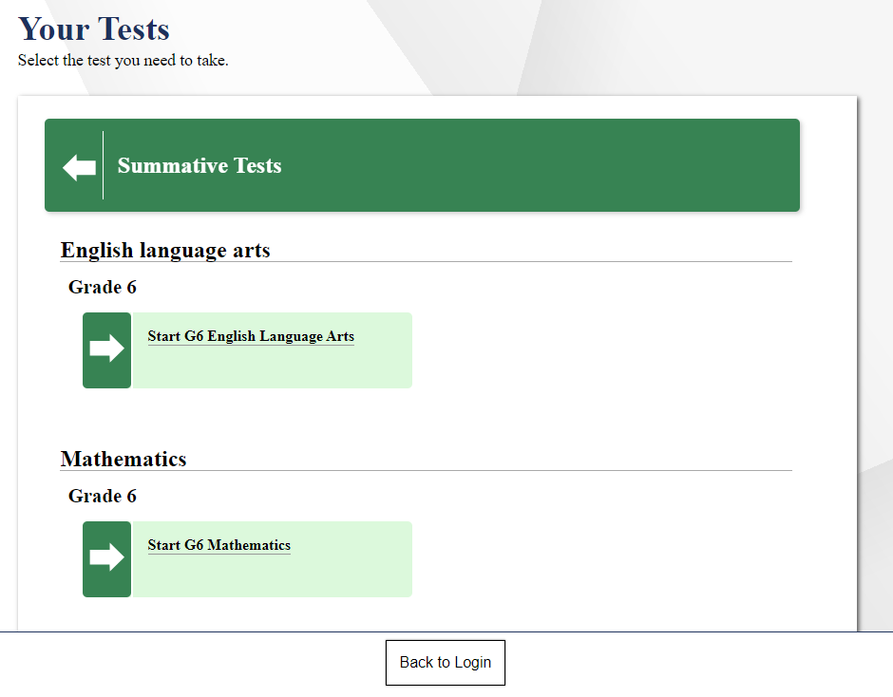
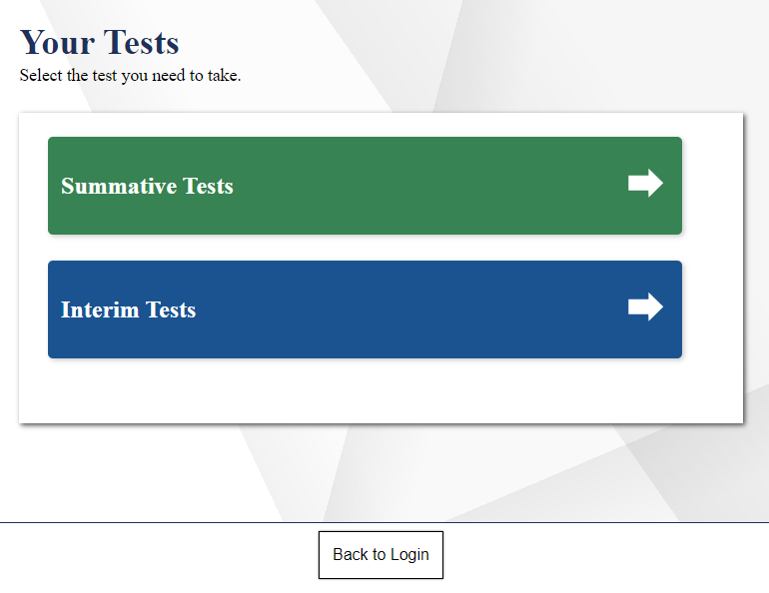
Student Test Selection
Notes:
On the Your Tests page, students will see a list of their assigned tests for this test session, color-coded by test category. Students may first need to select a category to see the tests available in that category as shown in the left image. The right image shows the tests available in the category selected.
If the tests displayed are incorrect, a test is inactive, or the expected test is not listed, students should select the Back to Login button to return to the login page and consult the TA to resolve the issue.
If there are no errors, students should select the correct test and wait for TA approval to proceed.

Slide 9
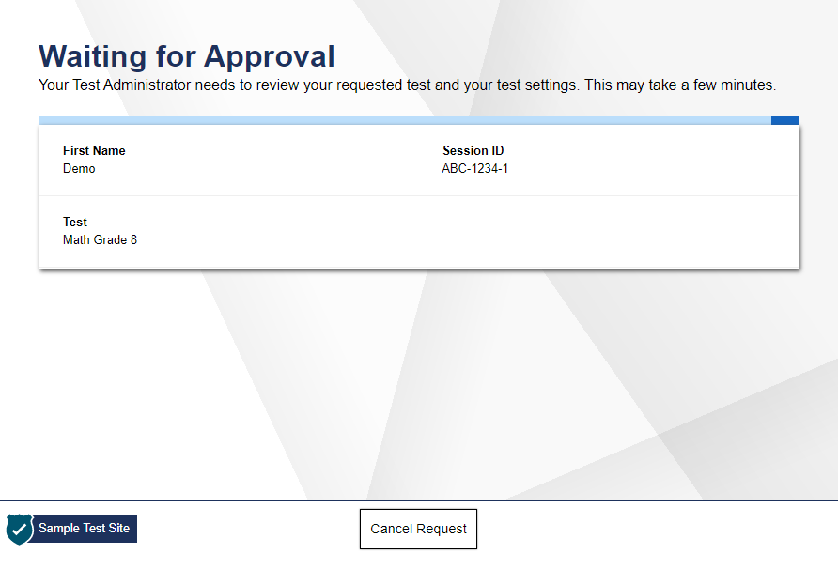
Waiting for Approval
Notes:
After selecting the test they need to take, students will see a “Waiting for Approval” screen. Once the TA approves a student’s request, the student will be able to proceed to the next screen.

Slide 10
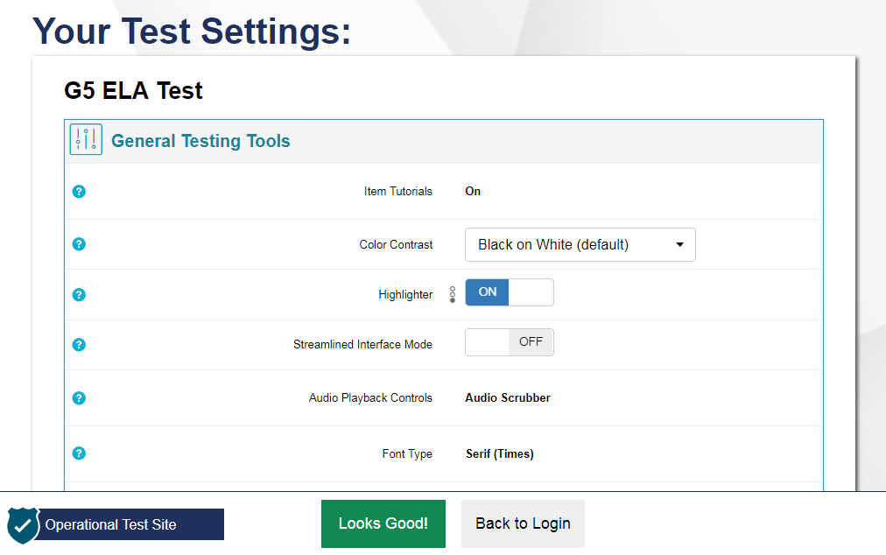
Verifying Test Setting Information
Notes:
After the TA has approved students for a test session, students will see a screen titled “Your Test Settings.” This screen displays the name of the test and any selected accessibility resources. If the information is correct, students should select Looks Good!. If any of the information is incorrect, they should select Back to Login and then wait to be advised by the TA. Note that the actual settings students see may vary from what is shown on this slide. Be sure to refer to the scripts located in the Test Administration Manual (TAM) to guide your students through the login and confirmation process.
After verifying their test, students will proceed through one or more functionality checks to make sure that their testing device is functioning properly. The functionality checks that appear will depend on the test that the student is taking.

Slide 11
Functionality Checks
Notes:
Now we will take a look at the various functionality checks students may see before beginning their test.

Slide 12
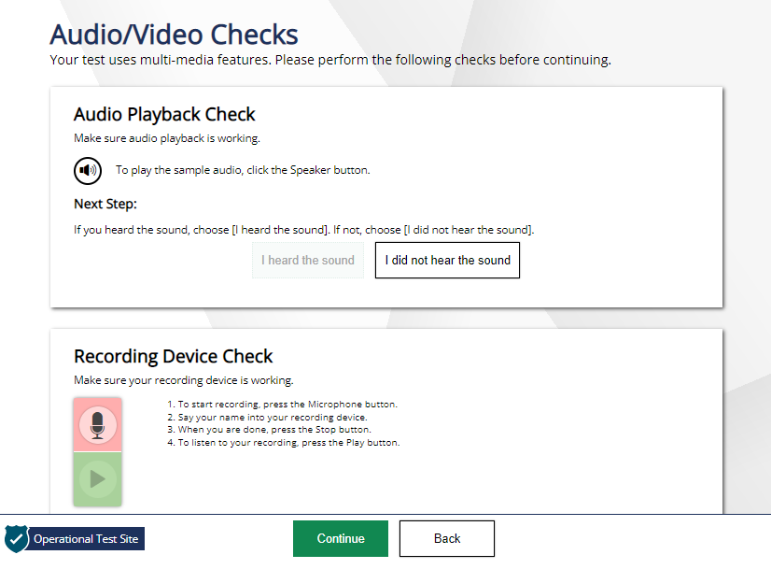
Audio/Video Checks
Notes:
If required by the test content or specified test settings, students will see an Audio/Video Checks page where they will need to perform functional checks to ensure their testing devices are working properly. Depending on the test students are taking, students may see one or more panels. We will walk through each of these audio/video checks in the next few slides. When students have finished all audio/video checks, they will need to select Continue to proceed.

Slide 13
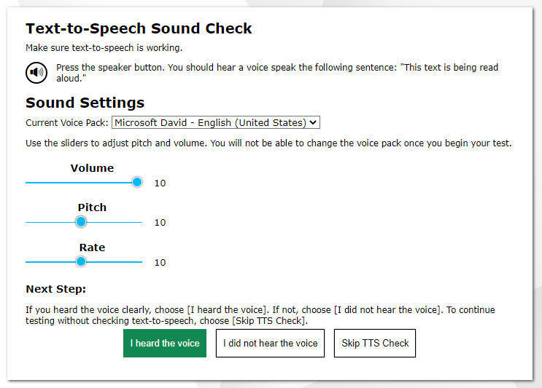
Text-to-Speech Check
Notes:
Students with text-to-speech (TTS) enabled will be presented with a TTS Sound Check panel on the Audio/Video Checks page that verifies that text is being spoken correctly on their device. Students should press the speaker button to hear sample text being read aloud. If the voice is audible, students should select I heard the voice to proceed. If not, students may adjust their TTS settings using the sliders on this page and try again. If they still cannot hear the voice, they should log out of the Secure Browser and ask their TA for assistance with their headset and/or audio settings.

Slide 14
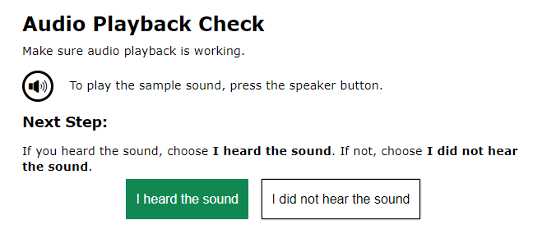
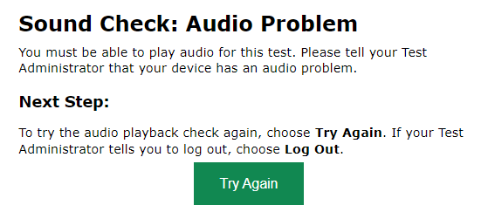
Audio Playback Check
Notes:
Be sure that all students taking English language arts (ELA) tests with listening items and students with text-to-speech have headphones. If students have selected a test requiring audio, students will see an “Audio Playback Check” panel on the Audio/Video Checks page. They will be prompted to select the sound icon and indicate whether the sound was audible by choosing either I heard the sound or I did not hear the sound.
If students select I heard the sound, they will proceed to the next audio/video check. If they select I did not hear the sound, they will receive a message advising them to tell the TA that they are having an audio problem. From there, they can select Try Again to listen to the sample audio again.

Slide 15
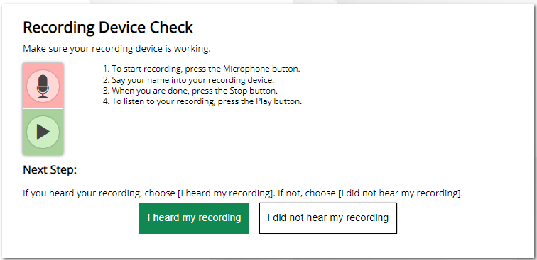
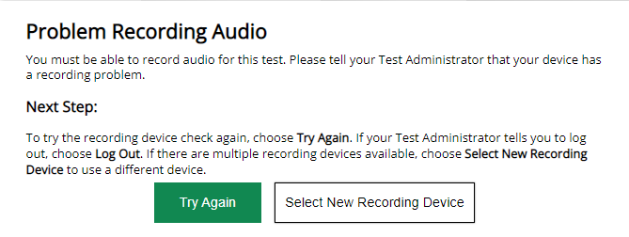
Recording Device Check
Notes:
If students have speech-to-text accommodation or they will be taking a test that has a speaking component, they will see a “Recording Device Check” panel. Be sure that these students are equipped with headphones and microphones. On this panel, students will verify that their recording devices are functioning properly.
First, they should select the microphone icon on this screen. After selecting the microphone icon, the microphone icon will be replaced with a stop button. Students should say their names into their microphones, and then select the stop button. Students should select the play button to hear their recording.
If students clearly hear their names, they should select the I heard my recording button. If the audio is not clear, students should select the I did not hear my recording button. The student will receive a message advising them to tell the TA about the recording device problem. From there, the student can select Try Again to record an audio sample again, choose Select New Recording Device to try recording using a different attached device, or log out of the test and work with the TA to adjust his or her recording device settings.

Slide 16
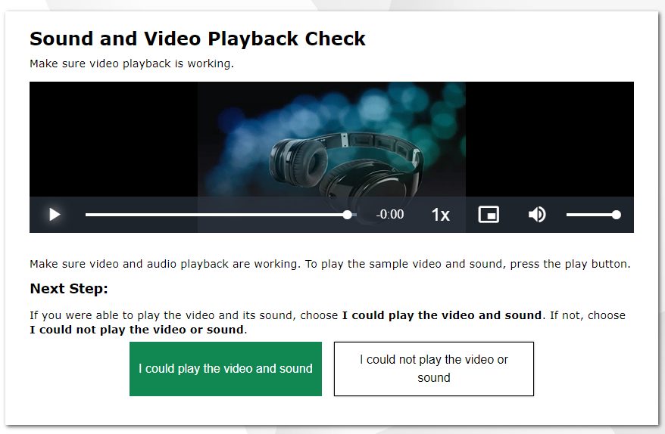
Sound and Video Playback Check
Notes:
Students taking tests with video content will be presented with a “Sound and Video Playback Check” panel. Students should select the play button to play the video and audio. If students can see the video and hear the audio, they should select I could play the video and sound to proceed. Otherwise, they should select I could not play the video or sound and ask their TA to help with troubleshooting the device and headphones. You may also move the student to another device with working audio and video.

Slide 17
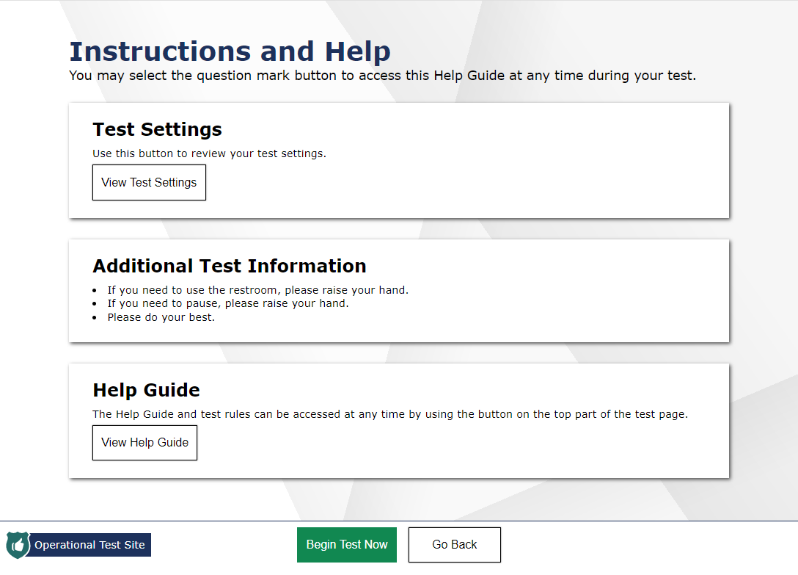
Instructions and Help
Notes:
Next, students have the opportunity to review detailed information about the tools and navigation features they will use during testing from the Instructions and Help screen.
The Test Settings section allows students to view their current test settings.
The Additional Test Information section lists any additional information that is necessary for students to know while in the testing session. This section can be customized to fit any test.
The Help Guide section contains an overview of the test site, test rules, and information on text-to-speech and print-on-request features.
When students select Begin Test Now, they will be presented with the first question of the test.

Slide 18
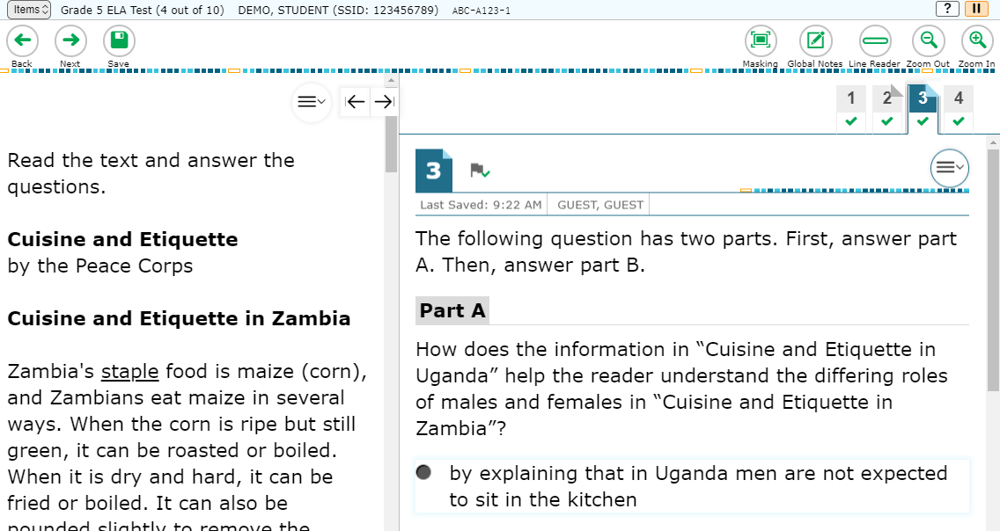
Test Interface
Notes:
After students log in, they will see the first item of the test. An example of the test interface is shown here. We will discuss more about the various features of the interface on the following slides.

Slide 19
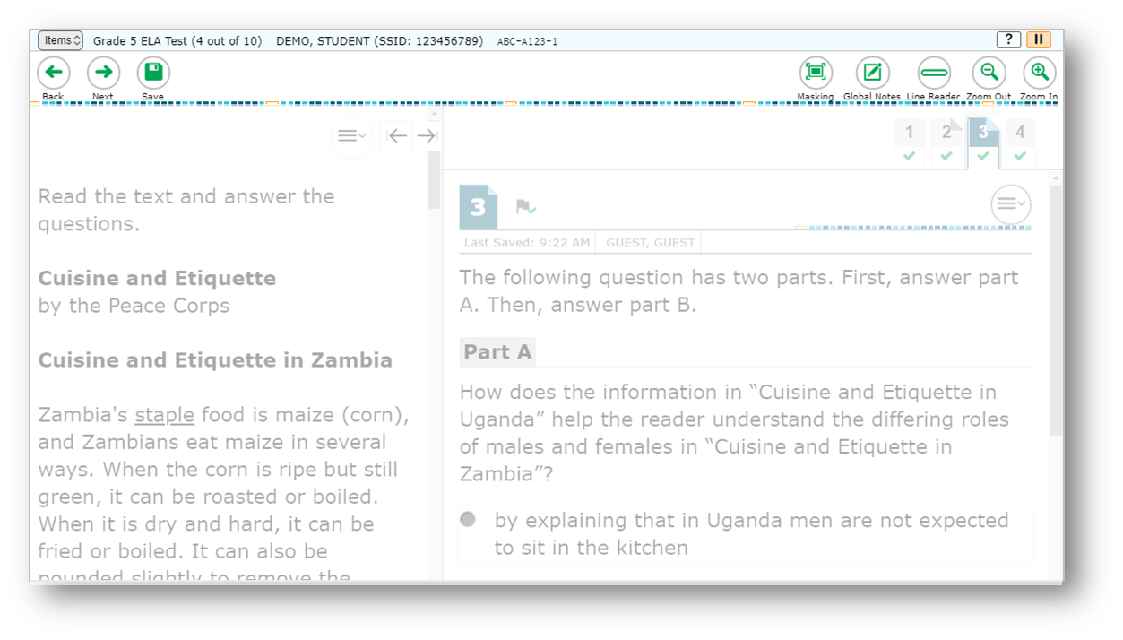
Global Menu
Navigation Buttons
Test Tools
Notes:
The global menu appears at the top of the Student Interface. The left side of the menu contains navigation buttons that students use to advance through the test.
All students can navigate between pages using the Back and Next arrow buttons. Students can also navigate between items using the Items drop-down menu located above the navigation buttons. We will discuss the items menu later in this module.
The Save button ensures that a response is committed to the system. However, the Save button is not required to save an item. Other actions, such as moving forward to the next question, will also save the response.
The right side of the menu contains test tools that students may use during testing. Some test tools, such as the Zoom In and Zoom Out buttons, are universal tools available to all students. The Pause button pauses a student’s test and logs the student out of the Student Interface. We will discuss more about pausing a test later in this presentation.
Other tools are designated supports or accommodations that must be set up in TIDE in order for students to use them.
The sample image on this slide is just one example of the test tools that may appear. For detailed information about individual accessibility resources, refer to the Usability, Accessibility, and Accommodations Guidelines on the Smarter Balanced website.

Slide 20
Items Drop-Down Menu
Notes:
In addition to using navigation buttons in the global menu, students can move through the test using the Items drop-down menu. The Items drop-down menu lists all items completed thus far and displays a blue flag for items that have been marked for review. If an item has been skipped, an orange triangle will appear next to the item number. Students can jump directly to an item at any time during the test by selecting the item number.
If the test contains a single cover page or multiple cover pages, the cover page icon is displayed in the position at which it occurs in the test. Students can select the page icon to navigate to that specific cover page.

Slide 21
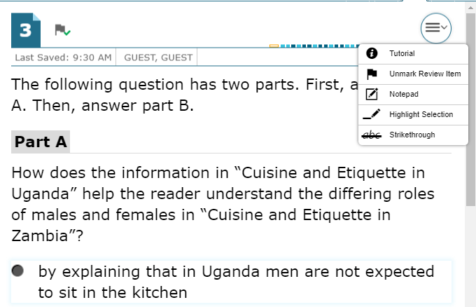
Context Menus
Context menus allow students to:
Mark items for review
View item tutorials
Send print requests to the TA (if available)
Access additional features depending on test settings and item types
Notes:
Test items and stimuli contain context menus. Students may use context menus to mark items for review, view item tutorials explaining how a particular item type works, send print requests to the TA (if test settings allow), and access additional test tools and features.

Slide 22
Accessibility Resources Overview
http://www.smarterbalanced.org/assessments/accessibility-and-accommodations/
Notes:
The online tests offer several accessibility resources to help students test successfully, including universal tools, designated supports, and accommodations. Authorized users can use TIDE to manage accessibility resources for students. The next few slides will give an overview of accessibility resources as they impact the student’s testing experience. For more information on managing accessibility resources in TIDE, refer to the TIDE User Guide. For detailed information about individual accessibility resources, refer to the Usability, Accessibility, and Accommodations Guidelines on the Smarter Balanced website at www.smarterbalanced.org.
The following slides will walk you through the various accessibility resources available to students while testing.

Slide 23
Universal Tools
Notes:
Universal tools and other features are available for all students to use during testing. These tools and features will be discussed in detail on the following slides.

Slide 24
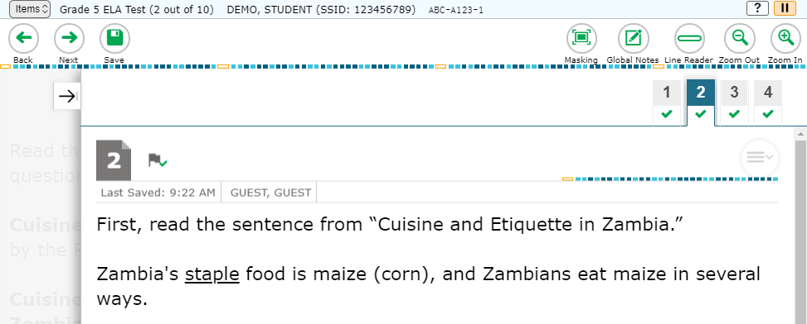
Universal Tools: Expandable Items
Passage
Notes:
Students can expand passages, stimuli, and test items so that they take up a larger area of the screen for easier reading. This can be done by selecting the double-arrow icon in the upper-right corner of the passage, stimulus, or item. This slide shows an expanded item in an ELA test. Note that the passage is hidden. To collapse the image and make the passage or stimulus viewable, students should select the arrow icon.

Slide 25
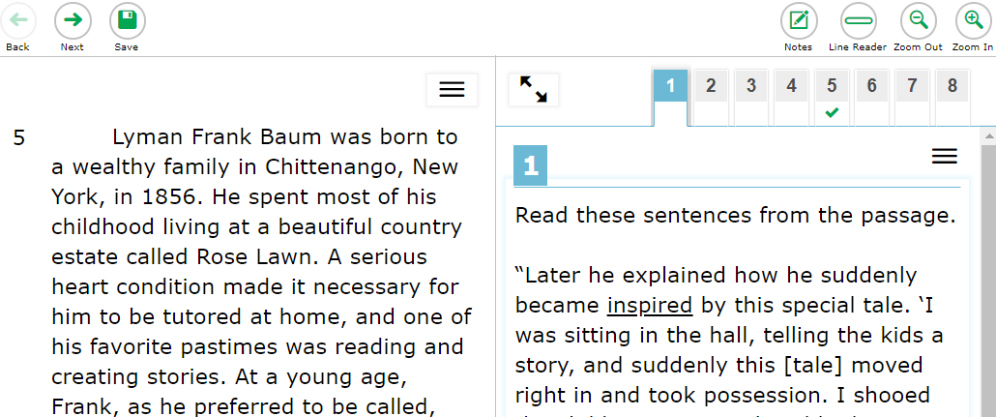
Universal Tools: Expandable Items continued
Notes:
Students can expand passages, stimuli, and test items so that they take up a larger area of the screen for easier reading. This can be done by selecting the double-arrow icon in the upper-right corner of the passage, stimulus, or item. This slide shows an expanded item in an ELA test. Note that the passage is hidden. To collapse the image and make the passage or stimulus viewable, students should select the double-arrow icon again.

Slide 26
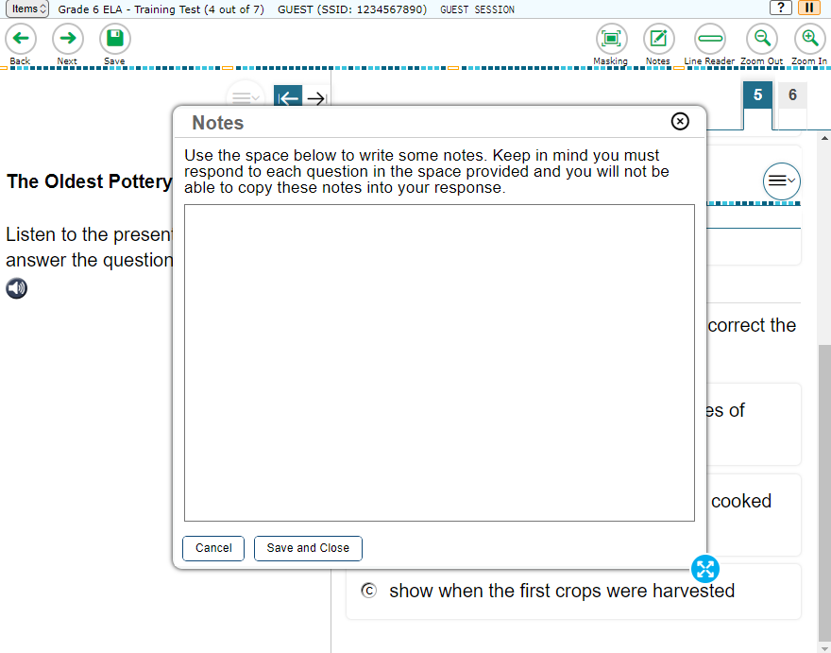
Universal Tools: Notes
resize
Notes:
Students can use the Notes tool to make notes that will persist throughout the entire test. These notes will be saved and continue to be accessible for later segments in a segmented test, even if the student is not able to go back to the first segment after completing it. The notes will also be retained if the student logs out of the test to resume later. Students can copy text from the notepad and paste it into the item response area, but this can only be done at the page level.
Depending on your state’s settings, advanced editing features, such as word and character count, spellcheck, and text formatting options, may also be available. In addition, the Notes window can be resized by dragging the blue dots on the outer edge.

Slide 27
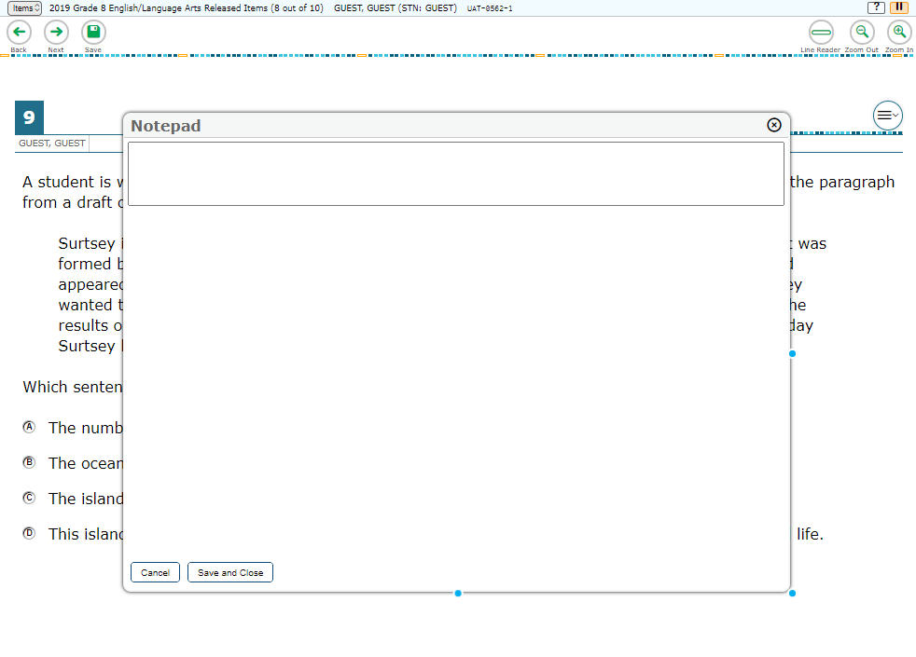
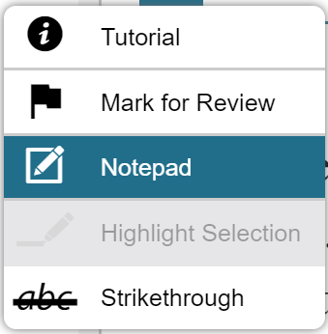
Universal Tools: Notepad
resize
Notes:
Students can use the Notepad located in the context menu to make notes about an item. The Notepad is item specific, so students can only access their notes for a question when they are on that question’s test page. Notes will continue to be saved when students move on to the next segment or if their tests are paused. Test items with notes will be displayed with a small notepad and pencil badge next to the item number.
Depending on your state’s settings, the Notepad may also include advanced editing features such as word and character count, spellcheck, and text formatting options. The Notepad window can also be resized by dragging one of the blue dots on the outer edges. If the copy/paste feature is enabled, the text entered in this tool can be copied and pasted into text response areas of items displayed on that page. For example, students cannot copy notes taken on item #1 and paste them to an item displayed on the next page.

Slide 28
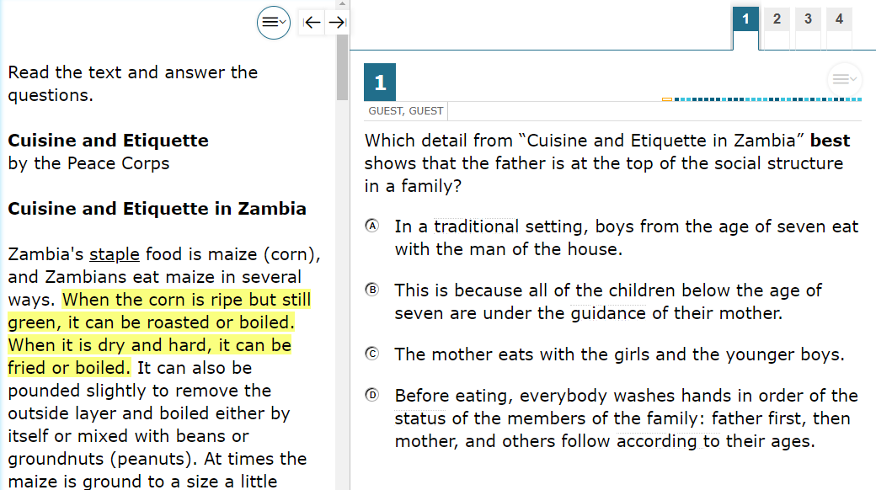
Universal Tools: Highlighter
Notes:
Students can use the Highlighter tool to mark text that they want to remember in reading passages, mathematics stimuli, and in text-based answer options, such as those that ask the student to select a section of text to choose an answer. To do this, students must select the desired text, right-click, and then select the Highlight Selection button that pops up. Students can select the color in which to highlight the text (if available in your state). To remove highlighting, students will right-click in the area of the highlighted text and select the Reset Highlighting button that pops up. If a student pauses the test, any highlighting made before pausing will be retained. The Highlighter tool can also be accessed from the context menu.

Slide 29
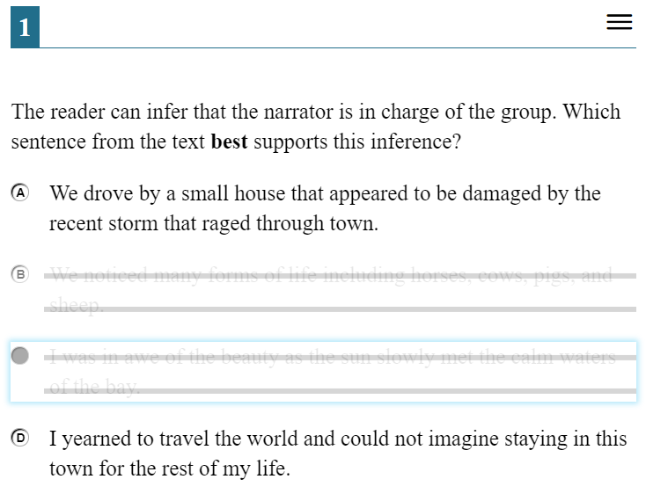
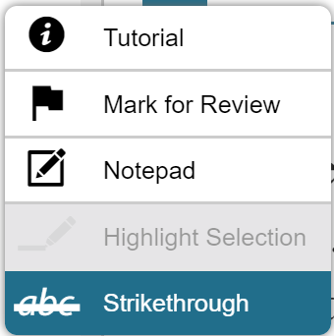
Universal Tools: Strikethrough
Notes:
For multiple-choice questions, students can use the Strikethrough tool to strike out the answer options they do not wish to choose.
To do this, students can right-click the answer option they want to strike out, and then select the Strikethrough button that pops up. The answer option will then be displayed with a line through it. If an answer option spans multiple lines, as shown in this image, and if the enhanced Strikethrough mode is enabled, the entire answer text will be displayed with lines through it. To remove the strikethrough, students must right-click and then select the Undo Strikethrough button that pops up. Alternatively, students can open the context menu and select Strikethrough to activate Strikethrough mode and then select each answer option they wish to strike out. To deactivate Strikethrough mode, they can press Esc or select outside the question’s response area.
It is important to note that striking through answers does not indicate a response to the question. Students must still select a response to answer each question. Also, striking out an answer option does not prevent the student from selecting that answer option as a response.

Slide 30
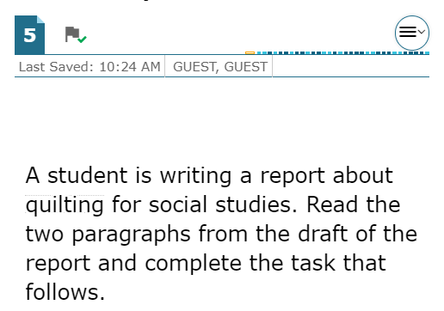
Universal Tools: Mark for Review
Notes:
Another element of the online test that helps students succeed is the Mark for Review feature. As they proceed through a summative test, students are required to answer each question on the screen before they can go on. If they are unsure of an answer, they should provide what they think is the best answer; there is no penalty for guessing. Students can then mark these items to review before completing the test segment. To mark an item for review, the student can open the context menu for an item and select Mark for Review. The item number will display a dog-eared corner and a small flag badge. For items with tabs, items marked for review will display a dog-eared tab.
At any time during a test segment, students can navigate back to marked items (within the segment) and review and change their answers as desired. This can be done either by selecting the Back button in the navigation toolbar until they reach the desired item or by using the Items drop-down menu, located in the upper-left corner of the page, to select a specific item. To unmark an item, students can open the context menu for the item and select Unmark Review Item. Note that once a student has completed a test segment in a test that prohibits navigation to previous segments, or if his or her test is paused for more than 20 minutes, returning to the items marked for review will not be allowed. However, the 20-minute rule does not apply to performance tasks.

Slide 31
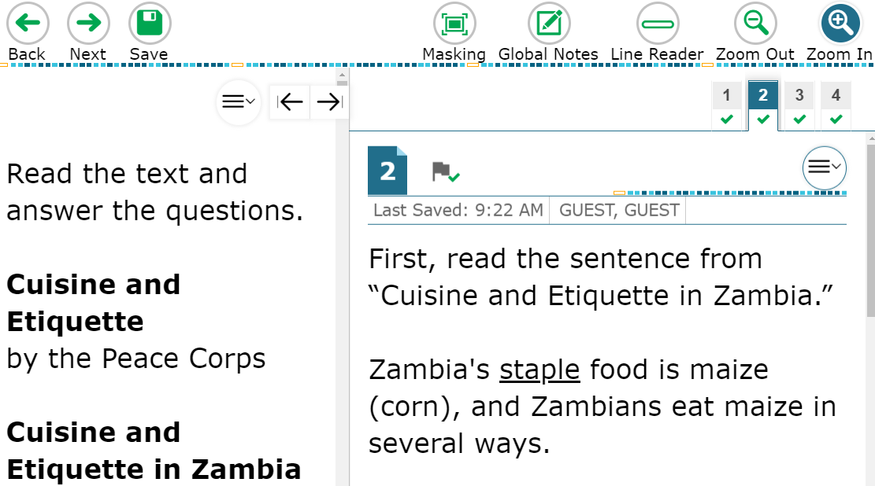
Universal Tools: Zoom
Notes:
During testing, students can use the Zoom feature to increase the size of text and graphics from 1.5 to 20 times their default size by using the Zoom In button. Text can be returned to a smaller size using the Zoom Out button. The default size for all tests is 14-point type. If desired, prior to testing, a Test Coordinator may increase the default print size for the entire test by setting the zoom level in TIDE, or the TA can change the text size setting in the TA Interface during the approval process.
Zoom levels beyond three times the default size will require streamlined mode to be enabled for the student. Please note that the Zoom tool is not the same as magnification, which students can access using their own assistive devices.

Slide 32
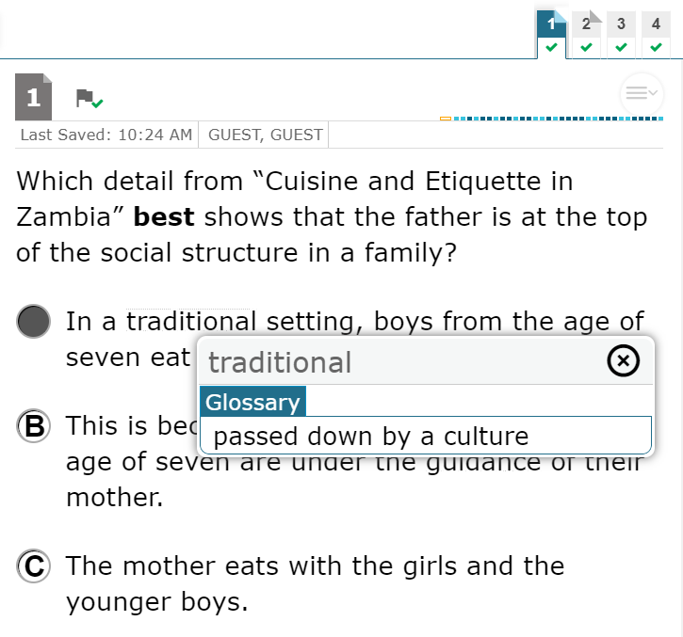
Universal Tools: English Glossary
Notes:
An English Glossary feature is available for students to use for some ELA and mathematics items during testing. The glossary is not available for ELA Reading items. The student can access the glossary by selecting any of the pre-selected terms, which are indicated on the screen by a gray dotted outline. When the student hovers the mouse over the term, it will be highlighted in blue. If the student selects a highlighted term, a pop-up box will appear with a definition of the term. Students can return to the item by selecting the X in the upper-right corner of the pop-up box to close it.
If the Text-to-Speech feature is enabled, students can select the TTS icon in the Glossary pop-up window to listen to the content. While the text is being read aloud, the TTS icon is replaced by the speaking icon.

Slide 33
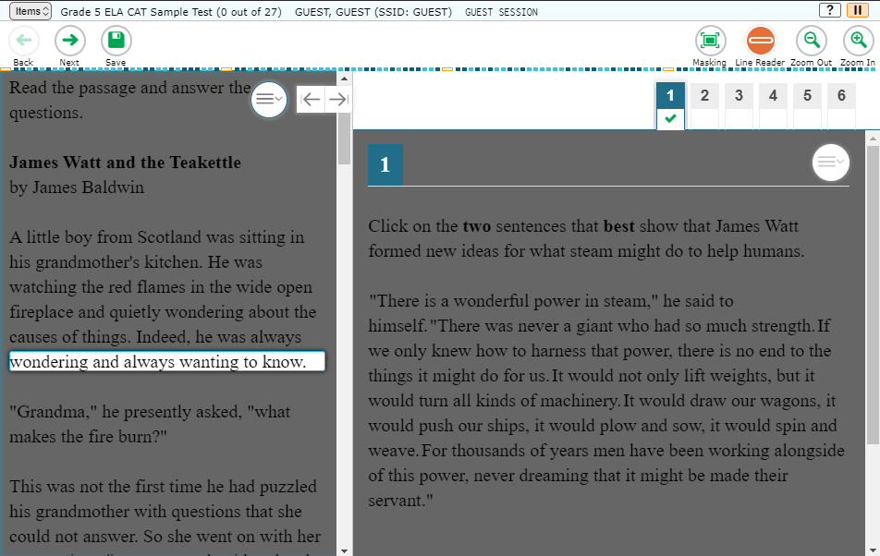
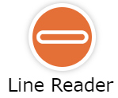
Universal Tools: Line Reader
Notes:
Students can highlight an individual line of text in a passage or question by selecting the Line Reader button in the global menu near the top of the window. If the enhanced line reader mode is enabled, as shown in this image, all content except for the line in focus is grayed out for greater emphasis. To turn off the line reader, students select the Line Reader button again.
Note that the Line Reader tool is not available when the Highlighter tool is in use.

Slide 34
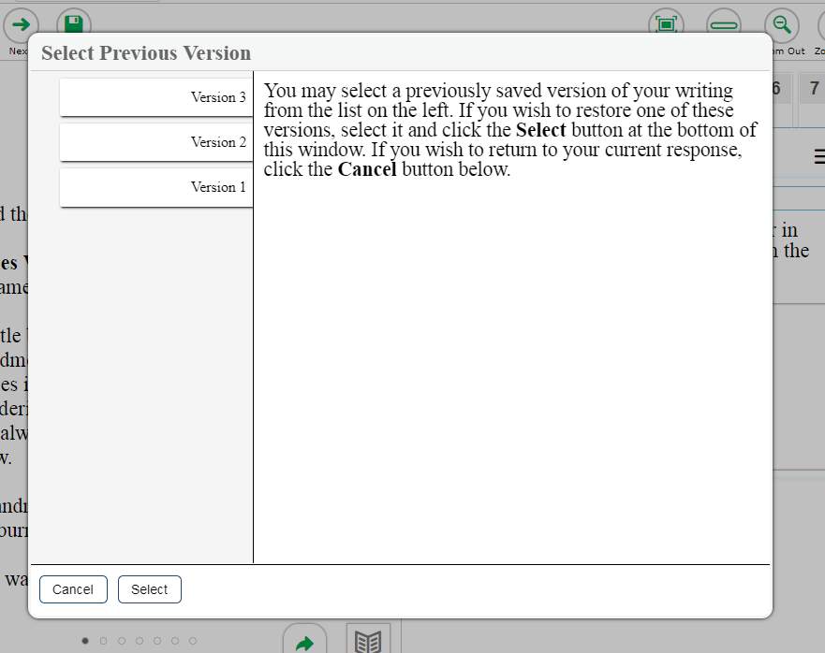
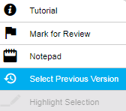
Universal Tools: Select Previous Version
Notes:
The Select Previous Version tool allows students to view and restore responses that they previously entered and saved for a Text Response item. To use this tool, students open the context menu for a Text Response item and choose Select Previous Version. A window will appear, listing any saved responses for the item and the text associated with each one. To view previous responses, students select a response version in the left panel and read the associated text in the right panel. To restore a selected response, students choose Select at the bottom of the window. The selected response will appear in the answer area for the item.
Please note that the Select Previous Version tool cannot restore responses that were entered before pausing a test.

Slide 35
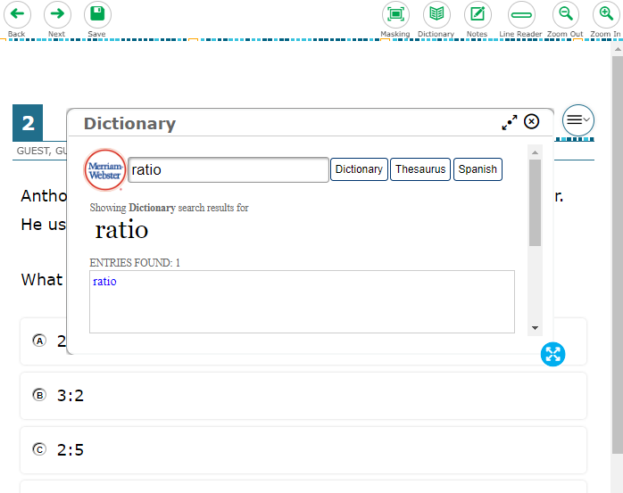
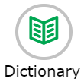
Universal Tools: Dictionary
Minimize/
Maximize
resize
Notes:
The dictionary tool allows students to look up definitions and synonyms in the Merriam-Webster Dictionary or Thesaurus. To launch the dictionary, students select the Dictionary button from the global menu near the top of the screen. Students will enter a word in the search box and select Dictionary or Thesaurus. If any entries are found, they will be shown in the text box.
The dictionary window can be resized by dragging the resizing handle on the outer edge of the calculator window. Students can also maximize or minimize the window by selecting the arrows in the top right-corner of the window. To remove the dictionary window, students will select the X button in the upper-right corner.

Slide 36
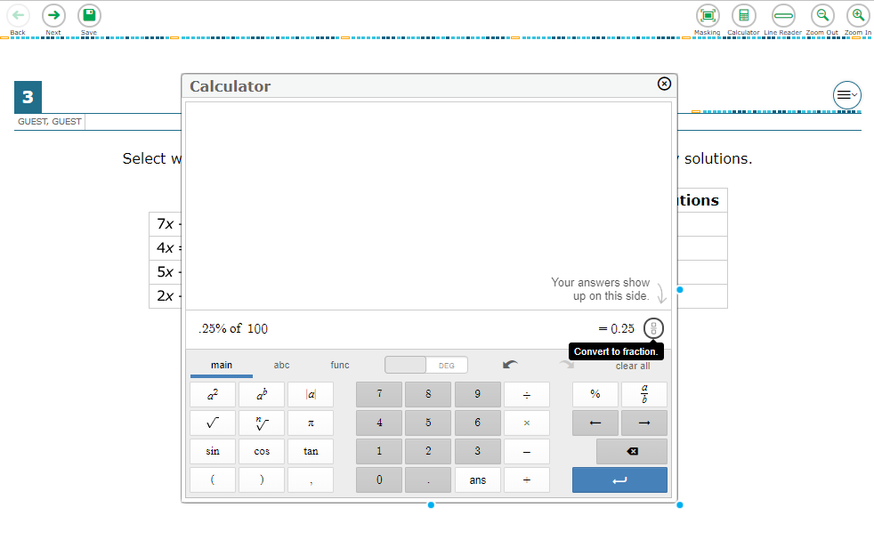
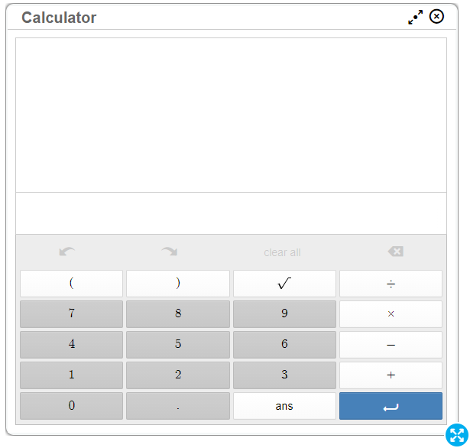
Universal Tools: Calculator
Minimize/
Maximize
resize
Notes:
For certain mathematics tests, students can use the on-screen calculator. To use the calculator, students need to select the Calculator button from the global menu near the top of the page. The calculator window can also be resized by dragging the resizing handle on the outer edge of the calculator window. Students can also maximize or minimize the window by selecting the arrows in the top-right corner of the window. To remove the calculator window, students will select the X button in the upper-right corner.

Slide 37
Accessibility Resources
Notes:
Now let’s take a look at the various accessibility resources available for students.
In addition to universal tools, which are available to all students, designated supports are available for use by any student for whom the need has been indicated by an educator. Accommodations are changes in procedures or materials that increase equitable access during the test. Accommodations are available for students with documentation of the need for the accommodations on an Individualized Education Program (IEP) or Section 504 accommodation plan.
For detailed information about designated supports and accommodations, please refer to the Usability, Accessibility, and Accommodations Guidelines on the Smarter Balanced website.

Slide 38
Accessibility Resources: Color Contrast
Black on White
White on Black
Red on White
White on Red
Black on Light Magenta
Black on Light Yellow
Black on Light Blue
Yellow on Blue
Notes:
Color Contrast is an accessibility resource that is available to eligible students. By default, tests are presented with black text on a white background. Students who require a different combination of font color and background color should be assigned the appropriate accommodation in TIDE. The color contrast selected will apply to all tests for that student. Color contrast options may include the following: Black on White; White on Black; Red on White; White on Red; Black on Light Magenta; Black on Light Yellow; Black on Light Blue; Yellow on Blue. Other options may be available in your state.

Slide 39
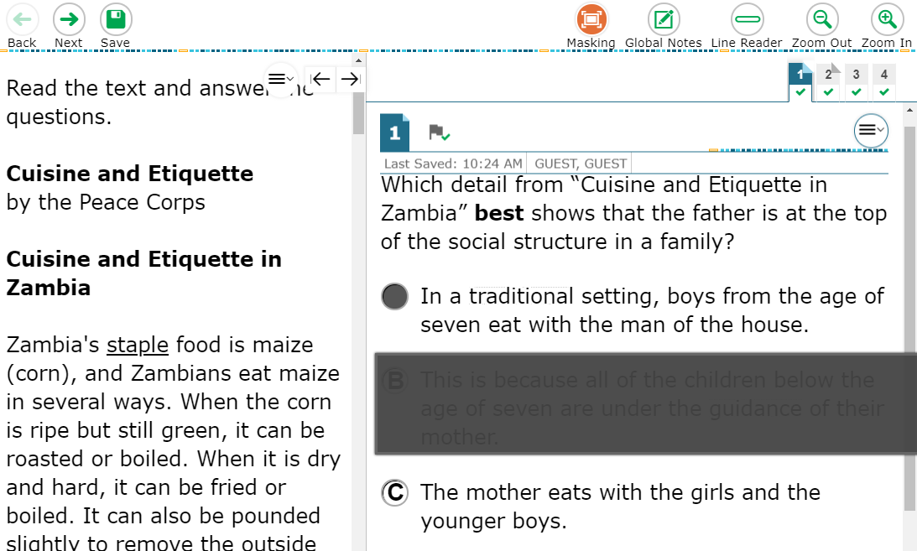
Accessibility Resources: Masking
Notes:
The Masking tool allows students to cover up a distracting area of the test page. To use this tool, students select the Masking button and then select and drag their mouse to select a rectangular area on the screen that they wish to mask. To deactivate masking mode, students must select the Masking button again. Masked areas remain on the screen even after masking mode is deactivated. To remove a masked area, students select the X button in the upper-right corner of the masked area.

Slide 40
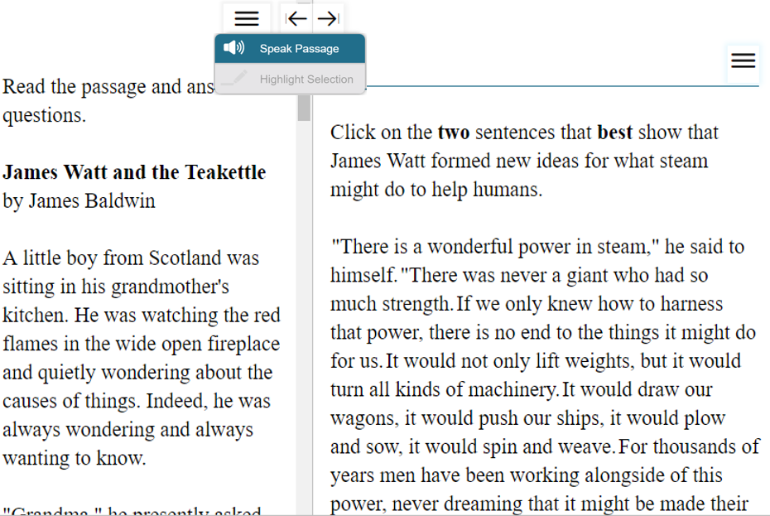
Accessibility Resources: Text-to-Speech
Notes:
Text-to-Speech (TTS) allows eligible students to listen to test content. TTS must be set up in TIDE before testing. It is available either as an embedded designated support or as an embedded accommodation for students with an identified need.
Please note that a test may include text that is not permissible to be read aloud. This text will be skipped when using TTS.
To use this tool, the student will select the desired Text-to-Speech option from the pop-up menu to hear the audio (for example: Speak Question or Speak Question and Options). We recommend that students who will be using this feature have the opportunity to try it by taking the practice test prior to testing. As mentioned earlier, you should ensure that all students requiring the Text-to-Speech feature have headphones and that they have completed the audio check successfully.
Some tests may also display ear icons by questions and answer options when TTS is enabled. The student can select these icons to listen to the content.
If a student’s test settings require the test page to be mandatorily read out in its entirety, TTS will automatically read the entire page and will prevent the student from performing any action until the content has been fully read.

Slide 41
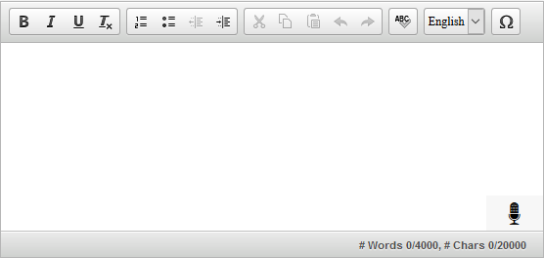
Accessibility Resources: Speech-to-Text
Notes:
Students with the Speech-to-Text (STT) accommodation may use the Speech-to-Text tool when responding to text response items. The STT tool allows a student to dictate responses to items that support the use of STT, and the student’s spoken words are then transcribed as text in the item response areas.
To begin dictating, the student selects the microphone button that appears in the item’s text response area. As the student speaks, words are transcribed into the text response area. Note that there may be a slight delay while text is being transcribed. While text is being transcribed, dots will appear in the text response to indicate that transcription is in progress. To stop the transcription, the student will select the stop button that appears after the microphone is selected. Students can dictate for five minutes at a time. Depending on your state’s configuration, students can also select whether to dictate text in English or Spanish from the language drop-down list in the formatting toolbar.
Depending on the tool settings, the text may be auto-punctuated. The student can also control some punctuation and grammar of the text through speech commands. For example, the student can say, “New Paragraph” to create a new paragraph. The student will need to ensure the accuracy of the speech transcription before continuing to the next item or submitting his or her test. Note that a student cannot navigate away from the test page while dictation is on.

Slide 42
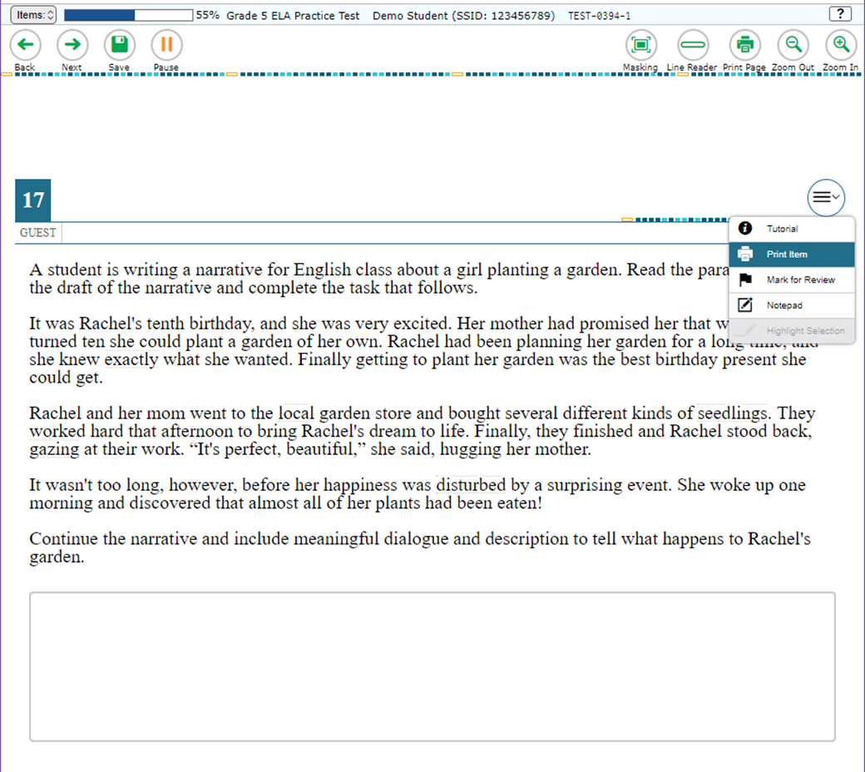
Accessibility Resources: Print-on-Demand
Notes:
The Print-on-Demand feature is available only for students who require it. It is a testing impropriety to apply this restricted resource for a student without documentation of actual need. This feature is not intended as a method for printing the test in order to administer it on paper. Depending on whether they are allowed to print items, passages, or both, students with this accommodation will see either a Print Page button at the top of the screen, a Print Item option in the context menu, or both. When a student selects either print option, the TA will receive a request for approval. The student will see a pop-up message that indicates that the request for approval has been sent. Before approving the request, the TA should ensure that the printer is monitored by staff who have been properly trained in test security.
Test items that students have requested to print will be displayed with a small printer badge next to the item number.

Slide 43
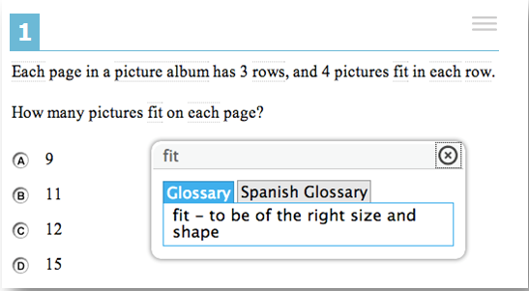
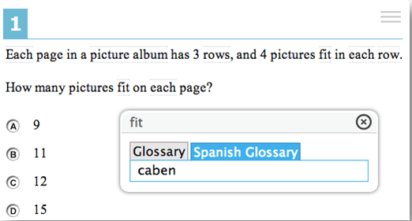
Accessibility Resources: Translation Glossaries
Notes:
Students who are English learners (ELs) may benefit from using a Translation Glossary for some tests. These students should have the Translation Glossary option selected in TIDE for the appropriate language. See the Translation Glossaries section in the Usability, Accessibility, and Accommodations Guidelines, available on the Smarter Balanced website, for information on how to determine if this support is appropriate for particular students. Available languages include Spanish, Arabic, Burmese, Cantonese, Filipino, Hmong, Korean, Mandarin, Punjabi, Russian, Ukrainian, and Vietnamese. A dual-language option is also available, which allows students to see both the English glossary and another language glossary at the same time.
When the Translation Glossary is enabled, some terms in mathematics items will appear with a gray dotted outline around them. When the student hovers the mouse over the term, it will be highlighted in blue. If the student selects a highlighted term, a pop-up box will appear with the translation of the term. Students can also select the audio icon next to the glossary term and listen to the audio recording of the glossary. Selecting the X in the upper-right corner of the pop-up box will close it. If the student has dual-language mode enabled, the glossary will appear with two tabs, one for each language.

Slide 44
Test Items
Notes:
Next, we will discuss some types of items that students may see.

Slide 45
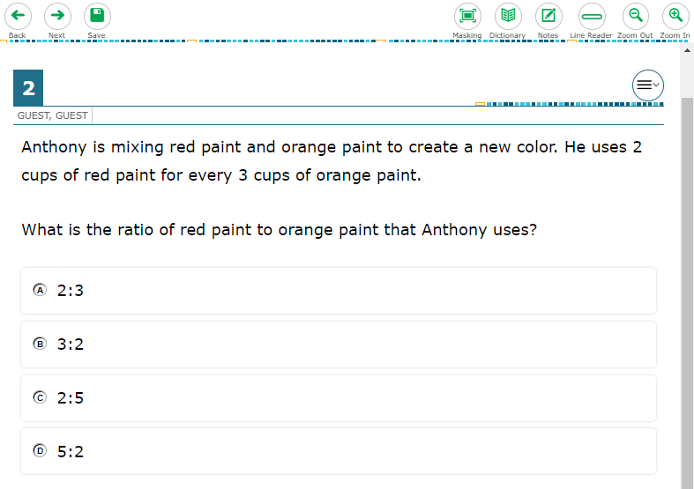
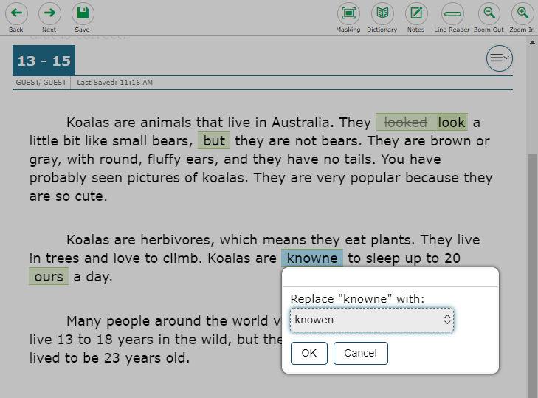
Test Items: Examples
Selected Response Item
Interactive Item
Notes:
Students will encounter several types of items during testing. They must answer each item before proceeding to the next one.
To answer selected-response items, students must select the desired answer option so that the letter A, B, C, or D becomes shaded.
For interactive items, students need to follow the instructions given to know how to indicate their answer. For example, students may be told to select an object to identify the appropriate answer, drag pictures or words in a table, or select a keypad.
If they wish, students may select the Save button while working on interactive items to save their work. Regardless of whether they select Save or not, their answers will be saved automatically when they navigate to the next part of the test.

Slide 46
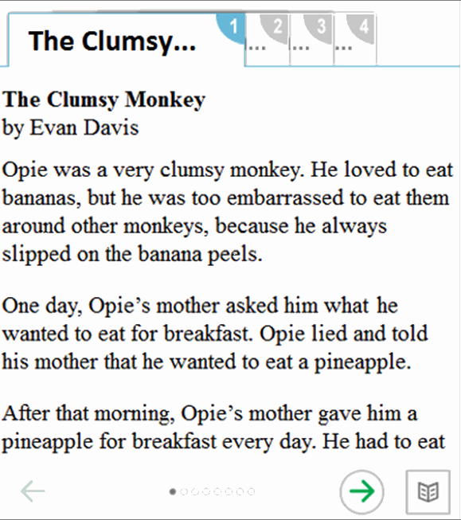
Reading Passages: Tabs
Notes:
Long reading passages are split up into separate pages. To move between the pages of a reading passage, students can use the round right arrow and left arrow buttons that appear below the passage.
Sometimes a stimulus may have multiple reading passages. In this case, students can select the numbered tabs at the top of the stimulus to switch between the available passages.

Slide 47
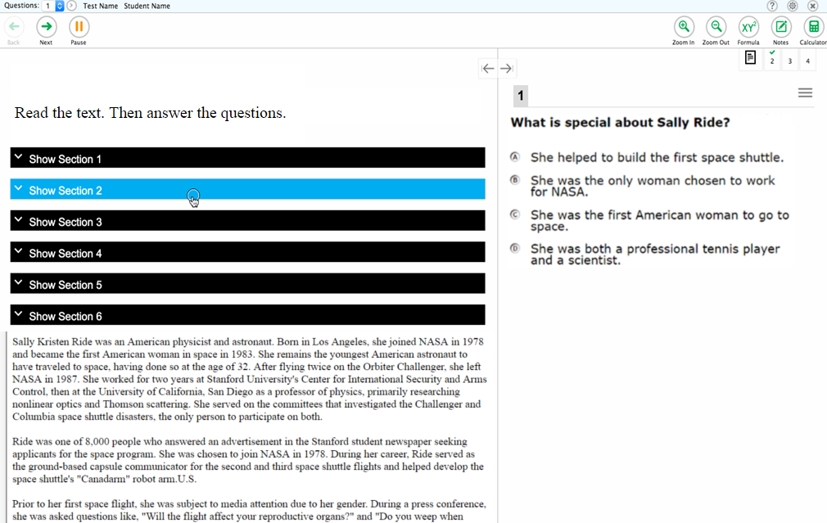
Reading Passages: Expandable Sections
Notes:
Some reading passages may contain sections of text that students can collapse to focus on other parts of the passage. Students can select Show Section to expand a collapsed section of text.

Slide 48
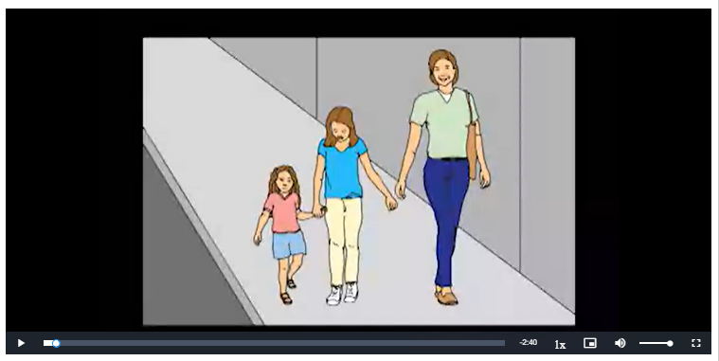
Test Items: Video Playback
Notes:
If a stimulus appears as a video, students can use the standard controls shown here to control the playback.
To play a video, select the play button in the lower-left corner of the player.
To jump to a different point in the video, drag the slider to the desired location.
To adjust the speed at which the video plays, select the 1x button, and then select the desired speed from the menu that will appear.
To expand the video to full-screen mode, select the full-screen icon in the far lower-right corner. To exit full-screen mode, select the full-screen icon again.
To mute or unmute the video, select the speaker icon in the lower-right corner.

Slide 49
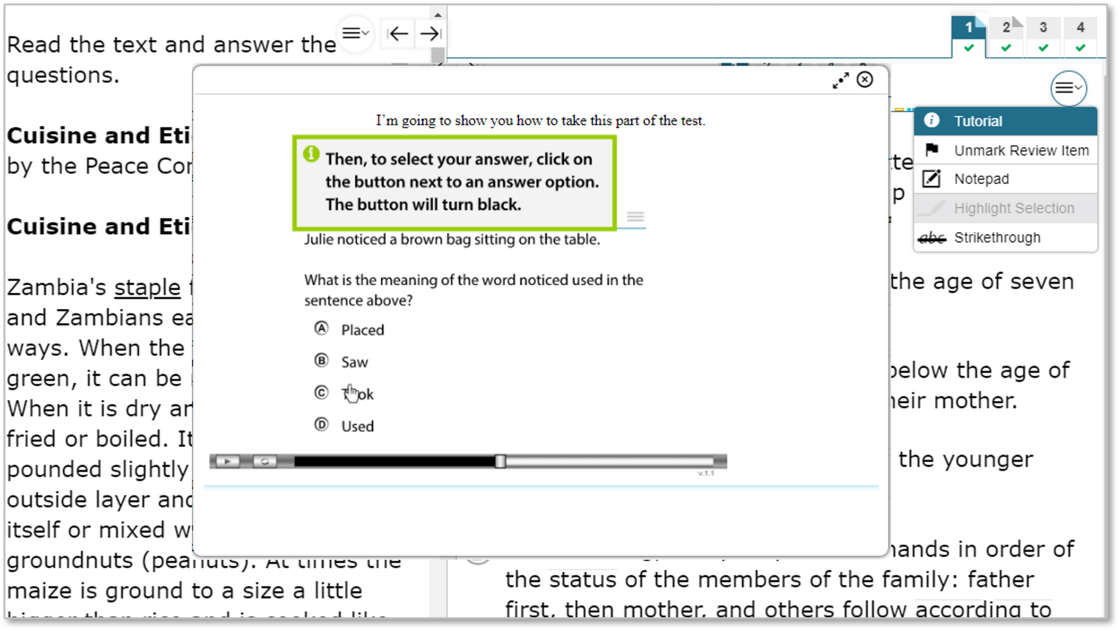
Item Tutorial
Notes:
Students can use the Item Tutorial tool to get more information about a particular item type. Selecting Tutorial from the context menu for a question opens a pop-up box that will show the student how that type of item works (for example, whether they should select an answer, drag-and-drop answers, or type a response in an answer space).
Students can also maximize or minimize the window by selecting the arrows in the top-right corner of the window. To remove the tutorial window, students will select the X button in the upper-right corner.

Slide 50
Ending a Test
Notes:
Finally, we will take a look at how students end a test.

Slide 51
Test Pause
Notes:
If your school plans to test over multiple days, you may wish to have students pause their tests at a certain point so that they can resume testing at another time. You may also allow a pause if students are taking a break from testing or if they need to leave the room for any reason. Whether they have been instructed to do so or not, students can pause their test at any time by selecting the Pause button in the upper-left corner of the screen. When they do so, a pop-up message will appear, asking them to confirm that they want to pause the test. Students should select Yes to confirm the pause or No to resume testing.

Slide 52
Test Pause Rules
For performance tasks and for computer adaptive tests (CATs) that have been paused for less than 20 minutes, students returning from a break in testing can revisit any items in the current test segment and change their answers if desired.
Students taking a computer adaptive test (CAT) who have paused their tests for longer than 20 minutes may only return to the most recently visited page containing unanswered test items in the current test segment. They may change any answers present on this page but may not access any items on previous pages or in previous segments of the test.
If all items on the most recently visited page were answered prior to pausing, the student will resume the test on the next page with unanswered items and will not be allowed to access previous pages or segments of the test.
Notes:
Some rules apply when students pause their tests, depending on the type of test and how long the pause lasts. For performance tasks and computer adaptive tests (CATs) that have been paused for less than 20 minutes, students returning from a break in testing can revisit any items in the current test segment and change their answers if desired.
Students taking a CAT who have paused their tests for longer than 20 minutes may only return to the most recently visited page containing unanswered test items in the current test segment. They may change any answers present on this page but may not access any items on previous pages. If all items on the most recently visited page were answered prior to pausing, the student will resume the test on the next page with unanswered items and will not be allowed to access previous pages or segments of the test.

Slide 53
Test Timeout
Test Timeout Due to Inactivity
As a security measure, after 20 minutes of test inactivity, students are logged out and their tests are paused automatically.
Inactivity is determined by whether the student is interacting with the test by selecting answers or using navigation tools. Selecting an empty space on the screen is not considered activity.
Students will receive a warning message before being logged out and must select OK on the pop-up message within 60 seconds to avoid automatic logout and pausing of their test.
If a student’s test is paused due to inactivity, the same rules apply as when the student intentionally pauses the test.
Notes:
As a security measure, after 20 minutes of test inactivity, students are logged out and their tests are paused automatically. Inactivity is determined by whether or not the student is interacting with the test by selecting answers or using navigation tools. Selecting an empty space on the screen is not considered activity. Students will receive a warning message before being logged out and must select OK on the pop-up message within 60 seconds to avoid automatic logout and pausing of their test. If a student’s test is paused due to inactivity, the same rules apply as when the student intentionally pauses the test. The student can log in to the test again and resume from the point that testing was interrupted, subject to the pause rule, if applicable.
Additionally, if a screen saver is activated during testing, the security breach feature will log the student out of the test. To avoid any such interruption, schools should either deactivate screen savers before students start testing or ensure that screen savers are set to more than the allocated testing time.

Slide 54
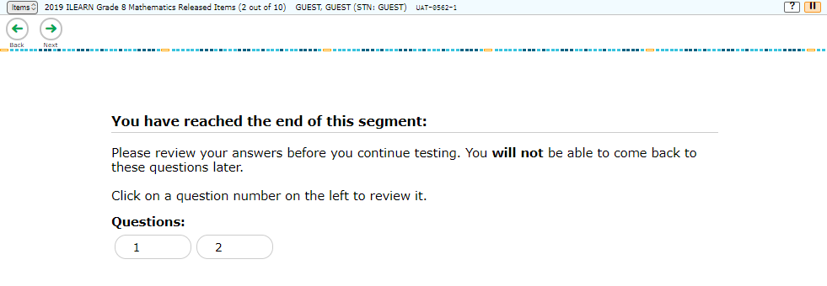
End of Segment
Notes:
Both the computer adaptive test and the performance tasks are presented in segments. When students reach the end of a test segment, they will see a message on the review screen advising that they cannot return to change their answers in the current segment once they have moved on. Once they confirm they want to end the segment, a warning will appear asking if they are sure they want to leave the current segment and move on to the next segment. Test Administrators should ensure that students understand the outcome of ending the test segment and encourage students to check their answers before moving on.
Students should select Yes to move to the next segment and No to return to the review screen.

Slide 55
End Test
Notes:
When students answer the final question on the test, the End Test button will appear in the upper-left section of the screen, along with a message advising them that the test has been completed and is ready to be submitted. The End Test button does not become visible until the student has selected at least one response to every question on the test. If students select the Next button at this point, they will see a pop-up message advising them to select the End Test button when they have finished reviewing their answers. They may also select the Back button to revisit previous items, subject to the pause rule if it has been applied during the test.
For the ELA performance full-write task, TAs should be sure that students have completed the entire full-write task before submitting their test. If students are taking a break during the full-write portion, they should pause their test rather than select the End Test button. The End Test button will appear on screen as soon as the student has begun answering the full-write task, but it should not be selected until the student is ready to finish and submit the test.

Slide 56
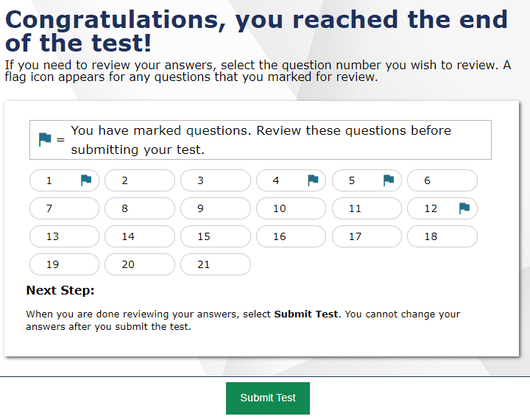
Test Submission
Notes:
When students are ready to end the test, they should select the End Test button. A pop-up message will appear allowing them to select Yes if they are ready to finish the test and No if they are not. If students select No, they will return to the last item of the test and can revisit previous items. If students select Yes, they will be taken to the review screen, where they have the choice to review their answers or submit the test. Their ability to review and change answers is subject to the pause rule, if applicable, for this test.
Students who are ready to submit their tests should select Submit Test to finish. They will receive a confirmation pop-up message asking if they are sure they want to submit. Selecting No will return them to the review screen. Selecting Yes will take them to the Test Completion page, which shows a message indicating that the test was successfully submitted and advises the student to log out.

Slide 57
Contact the Idaho Help Desk
If you have general questions or need further information visit the Idaho portal or consult the Idaho Help Desk for assistance.
Idaho Portal: https://idaho.portal.cambiumast.com/
Idaho Help Desk Contact Information:
Customer Support Email: IDHelpDesk@cambiumassessment.com
Customer Support Phone: 1-844-560-7365
Hours of Operation: Monday – Friday 8:00 am to 8:00 pm MT
When contacting the Idaho Help Desk, please be ready to provide the following information:
Any error messages that are appearing (including codes)
Your operating system and browser information
Your network configuration information
Your contact information for follow-up by phone or email
Any other relevant information, such as test names or content areas, student EDUIDs, session IDs, and search criteria
For questions about test administration or policy issues, please contact your District Test Coordinator.
Notes:
Thank you for viewing this training module. If you have general questions or need further information, please visit your state’s portal or consult your help desk for assistance.

