Slide 1
Authoring: the basics
Log In and Use Dashboard Quick Links & Content Tabs
2023–2024
Notes:
Welcome to this training module for the Authoring system. This module covers the basics of how to log in to the Authoring site and use the dashboard content tabs and quick links to find items, tests, and standards. For more detailed information on creating items and tests and performing actions on items and tests, please refer to the additional training modules in the series.
Please note that Idaho’s version of Authoring may differ slightly from the images shown in this presentation.

Slide 2
Objectives
Topics | Slides
1. How to Login to Authoring | 3–6
2. How to Use Quick Links to Start Common Tasks | 7–12
3. How to Use Content Tabs to View Items, Tests, and Standards | 13–18
4. More Information/More Modules | 19–20
Notes:
Here are the topics covered in this training module:
1. How to Login to Authoring,
2. How to Use Quick Links to Start Common Tasks,
3. How to Use Content Tabs to View Items, Tests, and Standards, and
4. More Information/More Modules.
Slide numbers are provided so you can quickly reference a specific section of this module.

Slide 3
How to Access Authoring
Notes:
This section covers how to access the Authoring system.

Slide 4
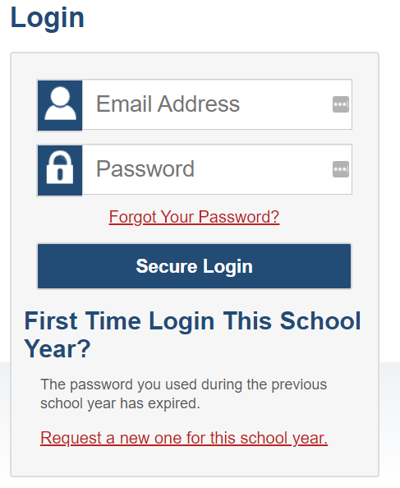
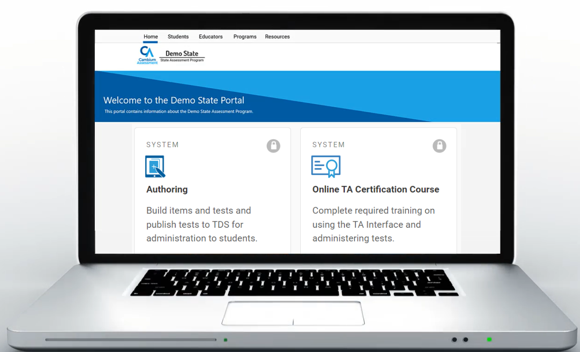
Log in to the Authoring System
idaho.portal.cambiumast.com
Notes:
To access Authoring, go to the Idaho Assessment Portal (idaho.portal.cambiumast.com) Select your user role. Select the Authoring system card. Enter your Email address and unique password and click Secure Login to continue.

Slide 5
Log in to Authoring (continued)
The system has an authentication process that triggers when you log in from a different device or browser, or after clearing your browser’s cache.
If you see this screen, an email containing the code will be in your inbox.
Enter the code and click Submit.
If you need the code re-sent, click Resend Code.
Notes:
When logging in with a new device or browser, or after clearing the cache on a previously used browser, you see an Enter Code page.
You need to enter the code on this page within fifteen minutes of receiving the email. If you do not receive a code or do not enter the code within the fifteen-minute time limit, click Resend Code. Click Submit after entering the authentication code to access the system.

Slide 6
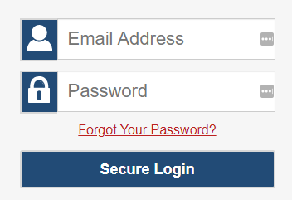
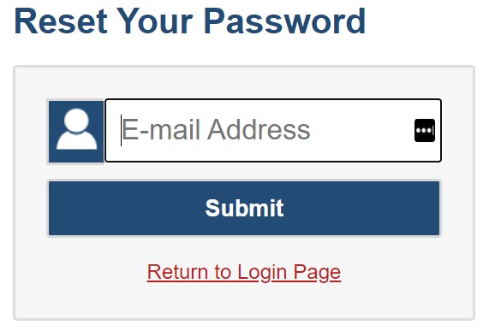
Reset Your Password
DoNotReply@cambiumassessment.com
Notes:
You will need to reset your password in the following situations:
You forget your password.
Your activation link expired.
Your account is locked because you exceeded the account login attempt limit.
It is a new school year.
To reset your password, click the Forgot Your Password link. You will be taken to the Reset Your Password page. Enter your email address and click Submit. You will receive an email from DoNotReply@cambiumassessment.com with instructions to reset your password.

Slide 7
How to Use Quick Links to Start Common Tasks
Notes:
This section covers how to use the quick links on the Authoring Dashboard to start common tasks.

Slide 8
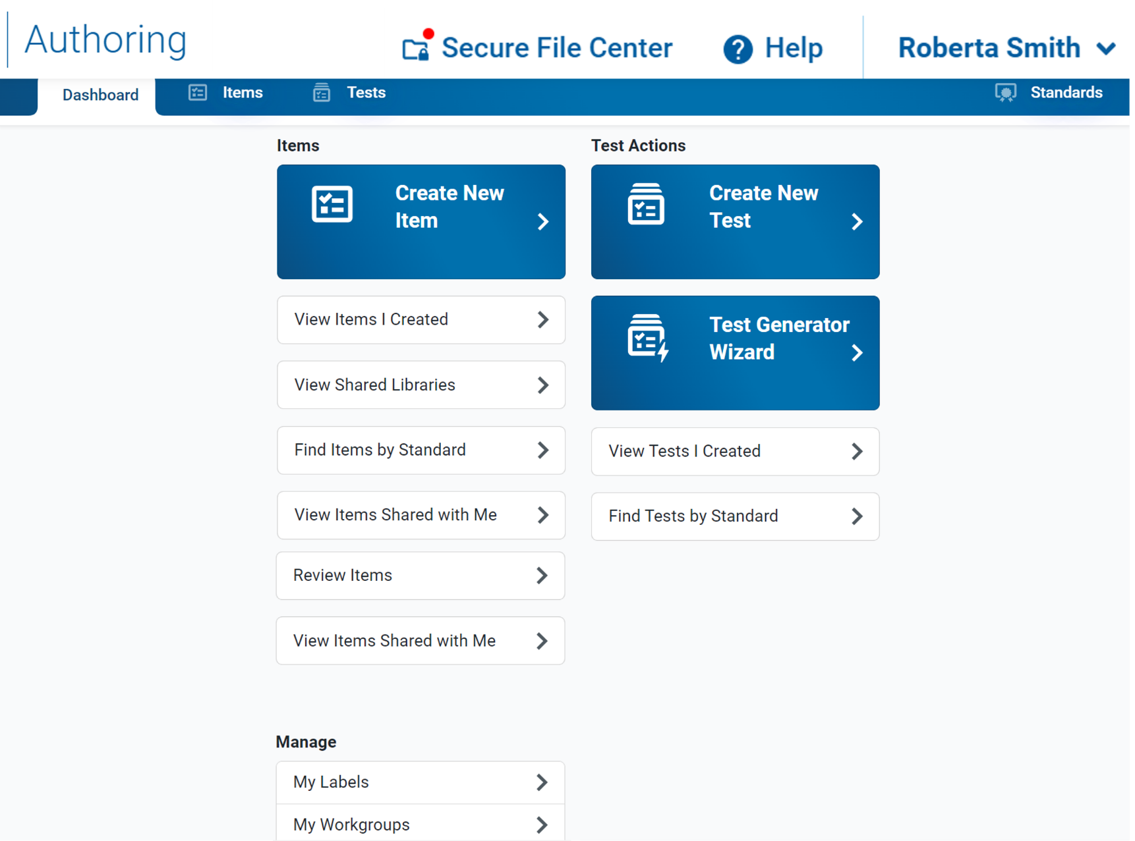
Dashboard Features
Content Tabs
Standards Panel
Quick Links
Management Links
Notes:
The Authoring site opens with a Dashboard that features links for common tasks, content tabs for working with Items and Tests, and a panel for viewing Standards. It also includes links for managing labels for items and tests as well as workgroups for sharing content.
The quick links are described on the next three slides.

Slide 9
Items Quick Links
Item Link | Description
Create New Item | Opens the item builder page where you can create a new item.
View Items I Created | Opens the Items tab, filtered to show you only your own items that were created or edited within the last 30 days.
Find Items by Standard | Opens the Items tab with the filter panel focused on the Standards search bar, so you can easily locate items aligned to a specific standard. You need to enter a standard name or key and click Apply in order to display the items.
View Items Shared With Me | Opens the Items tab, filtered to show you only the items that other Authoring users created and shared with you within the last 30 days.
Notes:
On this slide you can read a quick description of what will open when you click on the various item links on the Dashboard.

Slide 10
Tests Quick Links
Test Link | Description
Create New Test | Opens the test builder page where you can create a new test manually.
Test Generator Wizard | Opens the test generator wizard, which allows you to automatically generate a new test based on the standards you want it to assess.
View Tests I Created | Opens the Tests tab, filtered to show you only your own tests that were created or edited within the last 30 days.
Find Tests by Standard | Opens the Tests tab with the filter panel focused on the Standards search bar, so you can locate tests with items aligned to a specific standard. You will need to enter a standard key and click Apply in order to display the tests.
Notes:
On this slide you can read a quick description of what will open when you click on the Tests quick links on the dashboard.

Slide 11
General Management Links
Link | Description
My Labels | You can create and manage labels you can use to organize your items and test.
My Workgroups | You can create and manage workgroups which are groups of users who regularly share items and tests with each other.
Notes:
On this slide you can read a quick description of what will open when you click on the various general management links on the Dashboard.

Slide 12
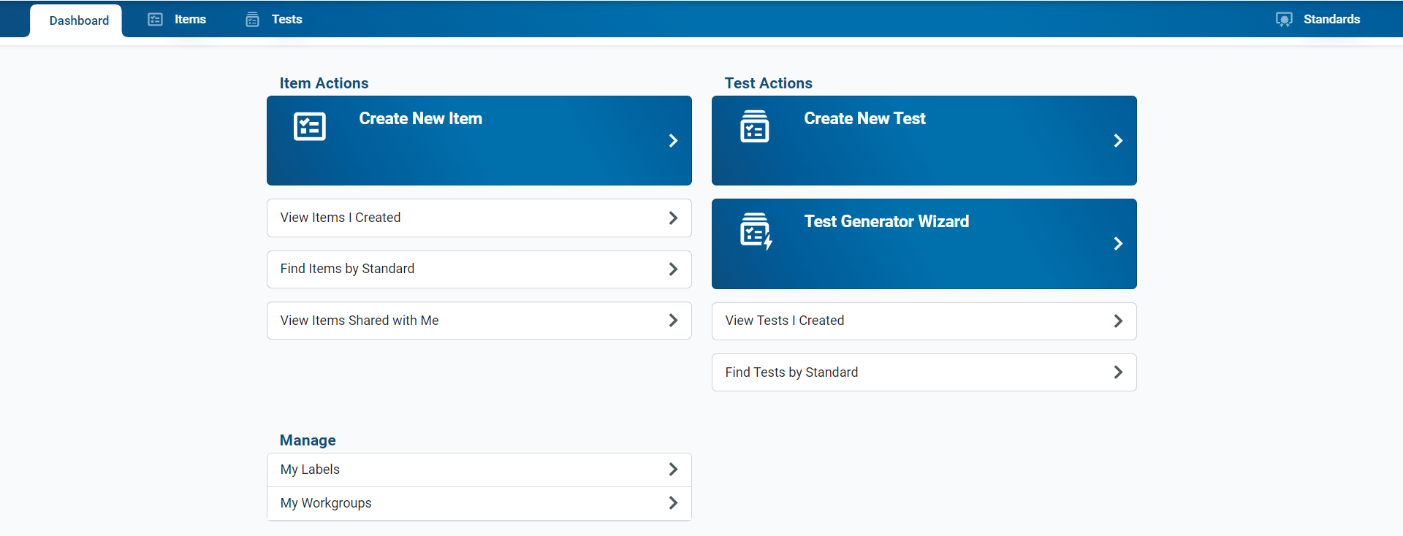
General Management Links
Notes:
On this slide is a screenshot of the dashboard upon logging into the Authoring system. It displays the location of the links on the previous three slides.

Slide 13
How to Use the Content Tabs to View Items, Tests, and Standards
Notes:
This section covers how to use the content tabs on the dashboard to view items, tests, and standards.

Slide 14
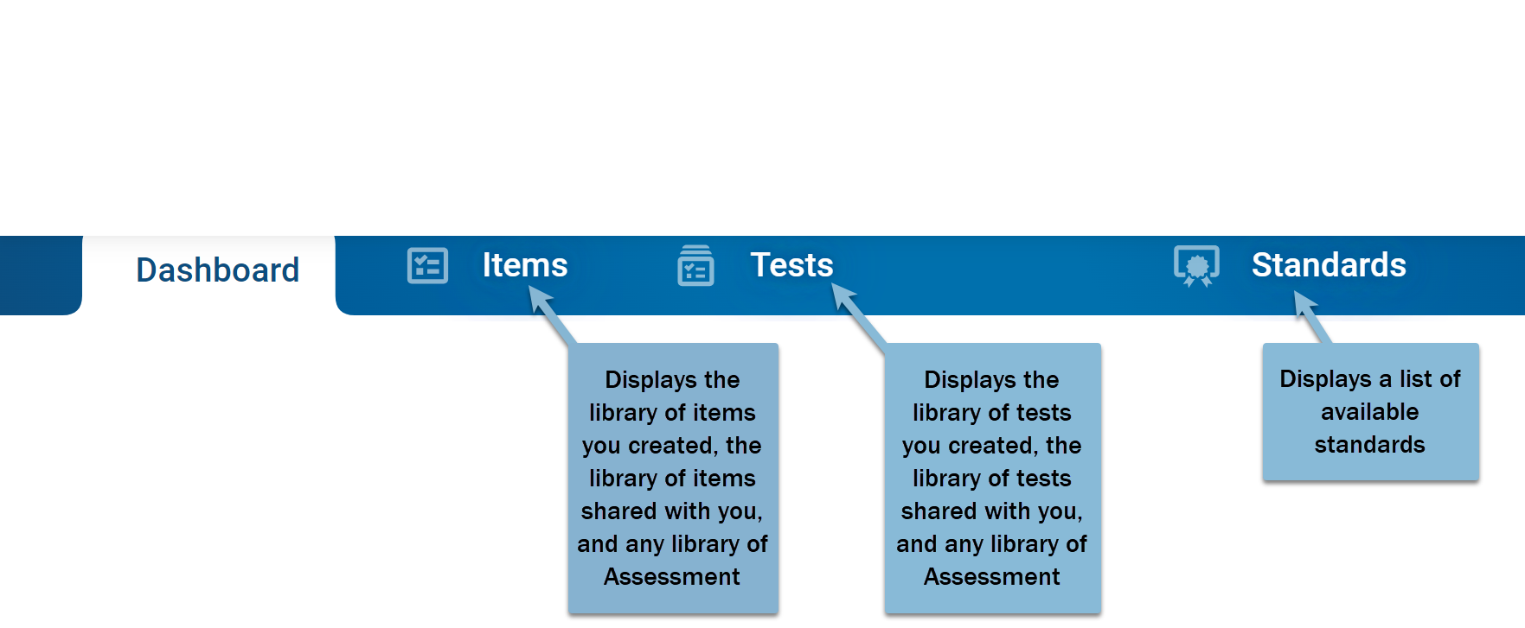
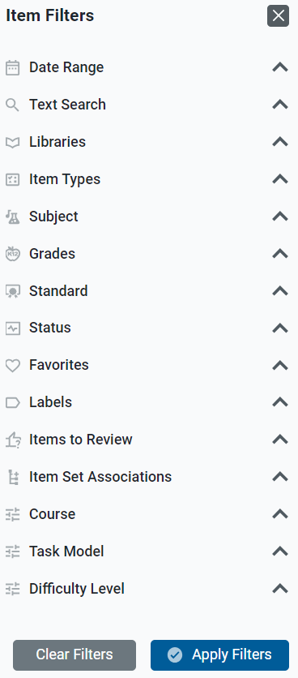
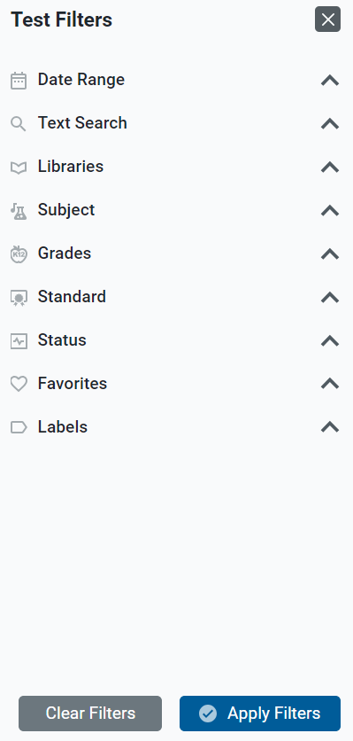
Content Tabs
Notes:
The Dashboard includes content tabs at the top to help you access your items, tests, and standards. A table of results will display from the library of items or tests you created, the library of items or tests shared with you, and any library of Assessment Program items or tests. The Standards tab displays a list of available standards publications and is useful for locating items and tests that are aligned to a particular standard.
It is helpful to use the filter options that display when you click a content tab. Here you can see the item filter options and the test filter options under the Dashboard banner. The message on the page reminds you to choose your filter options and select Apply to view the results table.

Slide 15
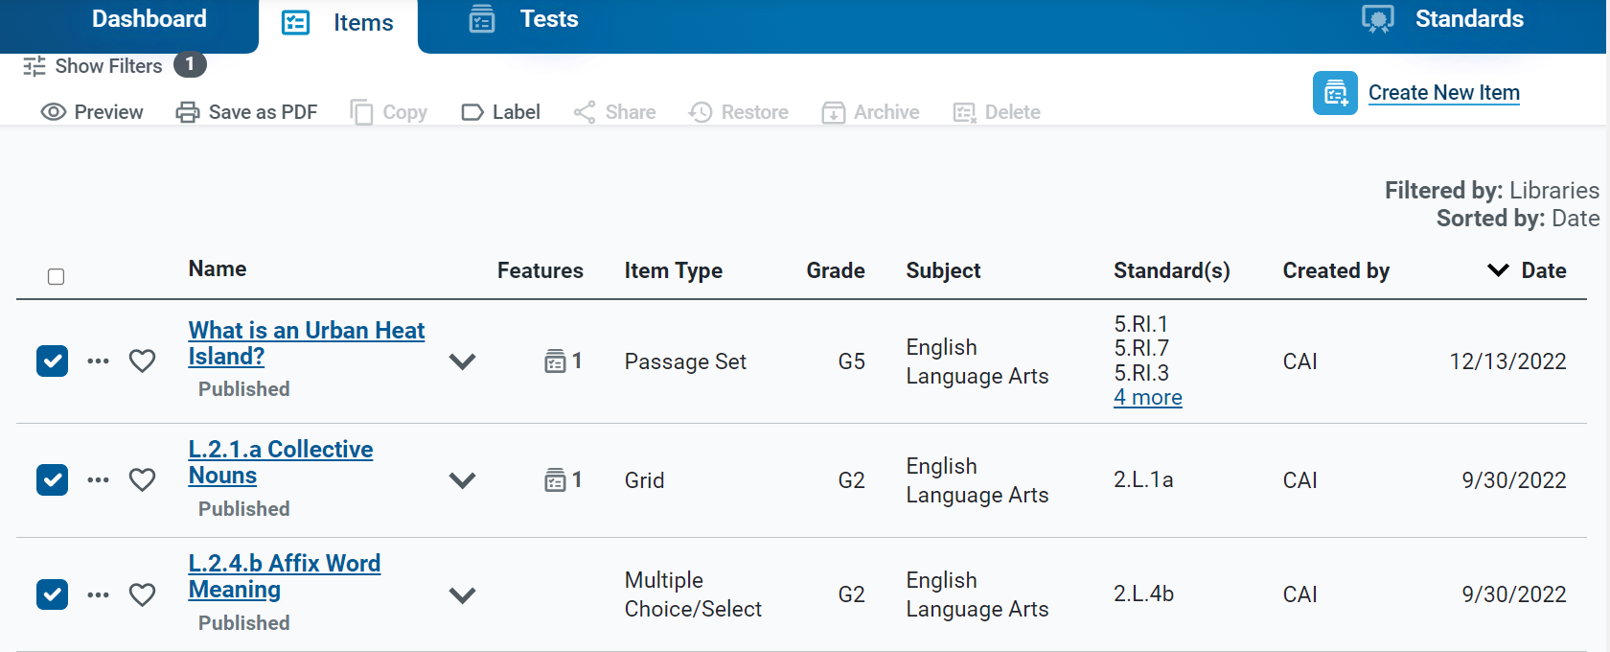
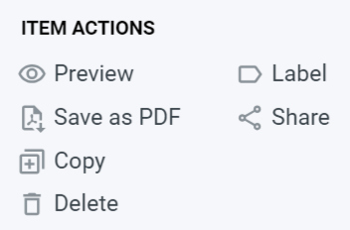
Items Content Table
Items Toolbar
Notes:
Here is an example of an items content table, filtered by Assessment Program library. The table provides details about the content available to you based on its subject, grade level, standards, and other properties. You can use the toolbar above each table to perform actions on your items. Click the expansion arrow to display a description of the item, it’s standard alignment and other information. Click on the dotted icon to display a list of item actions, such as Preview, Save as PDF, Copy, Label, and Share.

Slide 16
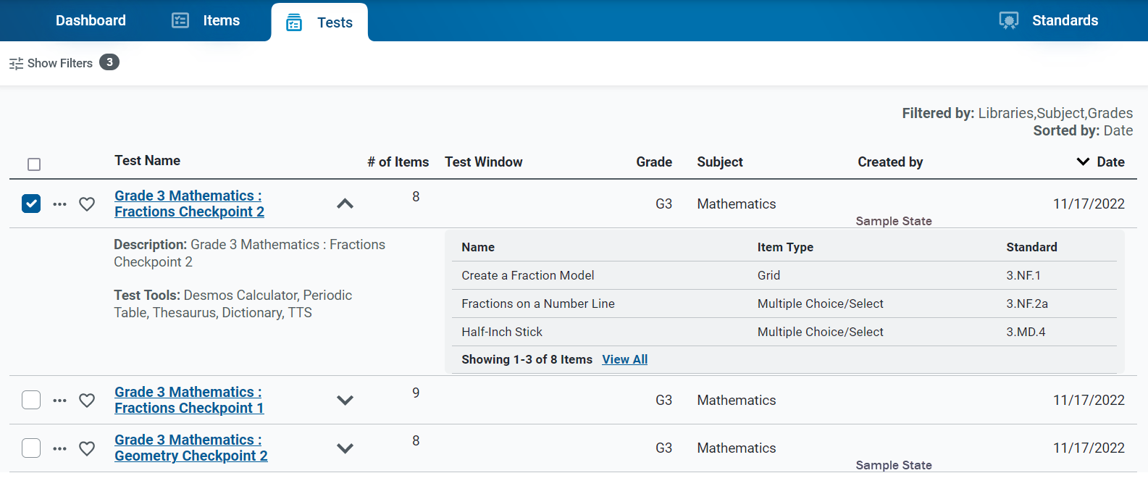
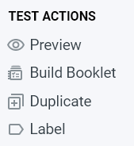
Tests Content Table
Notes:
Here is an example of a tests content table, filtered by libraries, subject, and grade. The details under the expansion arrow include a description of the test, the test tools assigned to it, and a list of the items included on the test. Click on the dotted icon to display a list of test actions, such as Preview, Build Booklet, Duplicate, and Label.

Slide 17
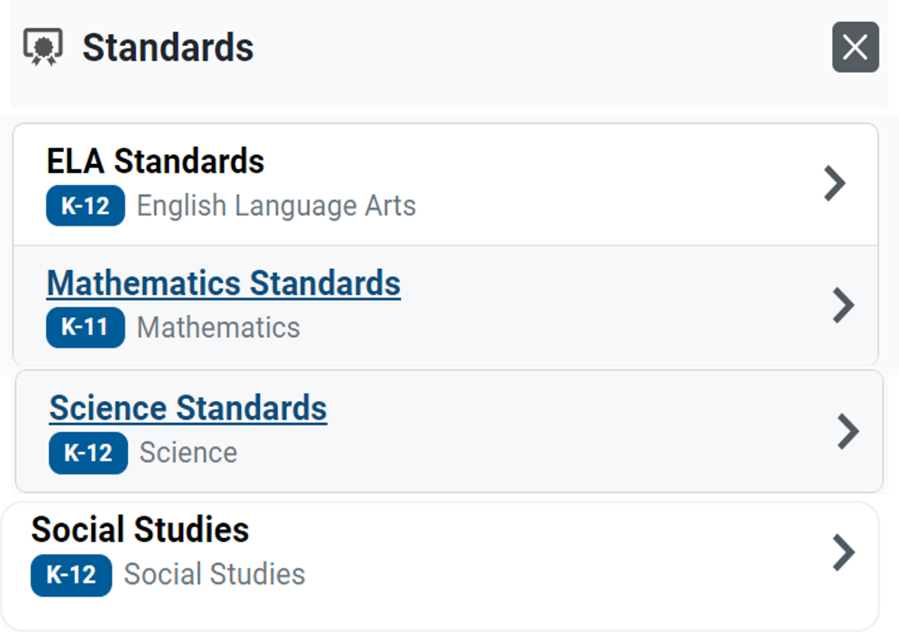
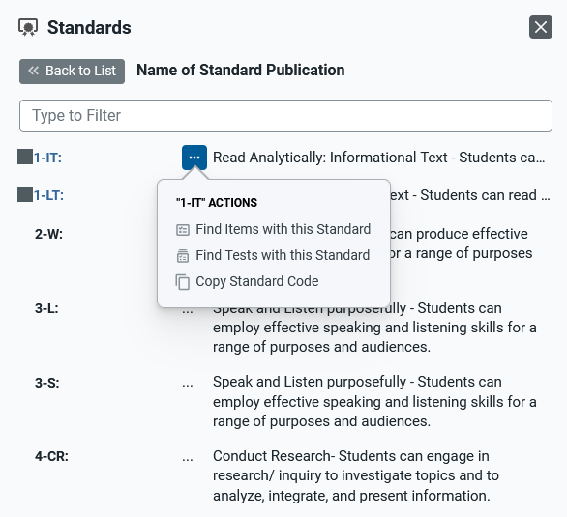
Standards Panel
Notes:
Here is an example of the Standards panel showing the standards tree for ELA, Mathematics, Science, and Social Studies. Expand the standard categories until you locate the standard you are looking for. You can also search for the standard at the top of this panel in the Type to Filter field. To use the actions options, click the dotted menu to the left of a specific standard. Options include Find Items with this Standard, Find Tests with this Standard, and Copy Standard Code.
Standards identify the specific skills or areas of knowledge that an item measures. Aligned standards will appear in the reports for Authoring tests, helping you pinpoint the specific areas in which a student may be excelling or may need additional support.

Slide 18
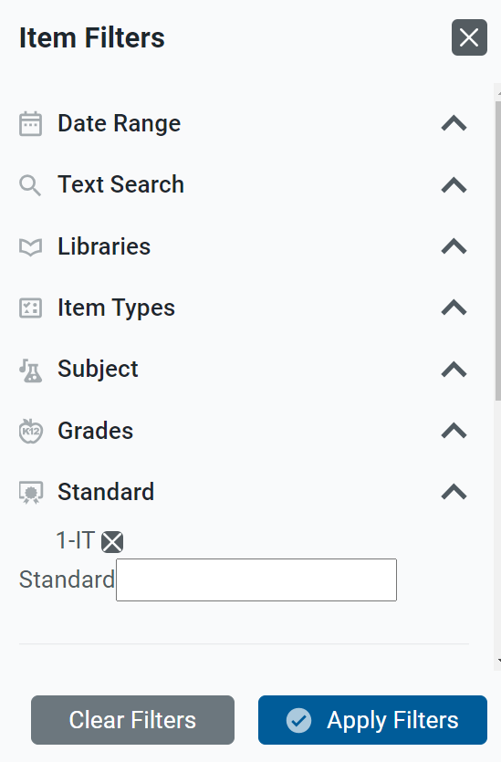
Find Items and Tests Aligned to a Standard
Notes:
As stated on the previous content slide, two actions listed under the dotted menu on the Standards page are used to find items and tests aligned to the standard displaying in the standard tree. When you elect to find items or tests aligned with a specific standard, the standard code appears in the Standard menu option of the Filters menu. The table of results displays the items or tests aligned to the standard you selected.

Slide 19
For More Help
You can contact the Helpdesk for assistance with any technical issues you encounter. When contacting the Helpdesk, please be ready to provide:
Any error messages that are appearing (including codes)
Your operating system and browser information
Your network configuration information
Your contact information for follow-up by phone or email
Any other relevant information, such as test names or content areas, student IDs, session IDs, and search criteria
For test administration or policy issues, please contact your district test coordinator.
Further Information
Id.portal.cambiumast.com
Idaho Help Desk
Toll-Free Phone Support: 1-844-560-7365
Email Support: IDHelpDesk@cambiumassessment.com
Thank you!
Notes:
You can find additional Authoring resources on your state or district assessment portal. However, if you still require assistance with troubleshooting a technical issue, you may also contact your Helpdesk. When contacting your Helpdesk, please be ready to provide the following information:
Any error messages that are appearing (including codes)
Your operating system and browser information
Your network configuration information
Your contact information for follow-up by phone or email
Any other relevant information, such as test names or content areas, student IDs, session IDs, and search criteria
For questions about test administration or policy issues, please contact your district test coordinator.
Thank you for taking the time to view this training module. For detailed information, consult your Authoring Guide located on the Idaho State Portal or contact your Help Desk.

Slide 20
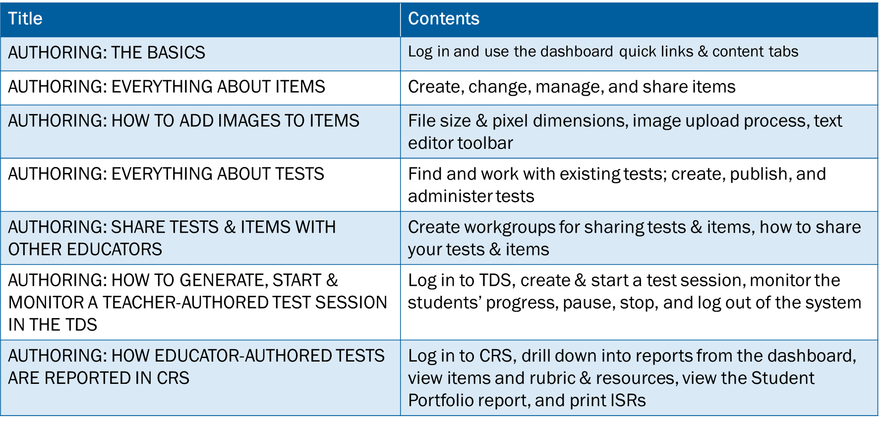
Training Modules in the Series
Notes:
Here are the modules that make up the Authoring system training series. They may be posted on Idaho State assessment portal.

