Slide 1
Authoring: everything about items
— Create, Change, Manage, and Share Items
2023–2024
Notes:
Welcome to this training module for the Authoring system. This training module covers how to create, change, manage, and share items you will use on tests.
Please note that Idaho’s version of Authoring may differ slightly from the images shown in this presentation.

Slide 2
Objectives
Topics | Slides
1. How to Navigate the Dashboard, the Standards Panel, and the Quick Links | 3–6
2. How to Use the Create New Items Button | 7–10
3. How to Create Items Using Different Templates | 11–25
— Passage Set | 12
— Multiple Choice/Multiple Select | 13
— Hot Text | 14
— Hot Spot | 15
— Edit Text Inline Choice | 16
— Edit Task | 17
— Simple Text Entry | 18
— Embedded Text Entry | 19
Topics | Slides
— Text Drag and Drop | 20
— Image Drag and Drop | 21
— Table Match | 22
— Equation Response | 23
— Multi-Part | 24–25
4. How to Add Images to Items | 26–36
5. How to Use the Item Properties Panel to Set Up Properties & Align Items to Standards | 37–39
6. How to Work with Items Available to You | 40–52
7. How to Create Workgroups for Sharing Items | 53–55
8. More Information/More Modules | 56–57
Notes:
Here are the topics covered in this training module. You can jump to the section slides if you need information on a single topic. The topics are:
1. How to Navigate the Dashboard & the Standards Panel
2. How to Use the Create New Items Button
3. How to Create Items Using Different Templates;
– Passage Set
– Multiple Choice/Multiple Select
– Creating Hot Text Items
– Creating Hot Spot Items
– Creating Edit Text Inline Choice Items
– Creating Edit Task Items
– Creating Simple Text Entry Items
– Creating Embedded Text Entry Items
– Creating Text Drag and Drop Items
– Creating Image Drag and Drop Items
– Creating Table Match Items
– Creating Equation Response Items
– Creating Multi-Part Items that Combine Item Types
4. How to Add Images to Items
5. How to Use the Item Properties Panel to Set Up Properties & Align Items to Standards
6. How to Work with Items Available to You
7. How to Create Workgroups for Sharing Items
8. How to Submit Items for Review, and
9. More Information/More Modules

Slide 3
How to Navigate the Dashboard, the Standards Panel, & the Quick Links
Notes:
First, we cover how to navigate the Authoring Dashboard, the Standards Panel, and the Quick Links.

Slide 4
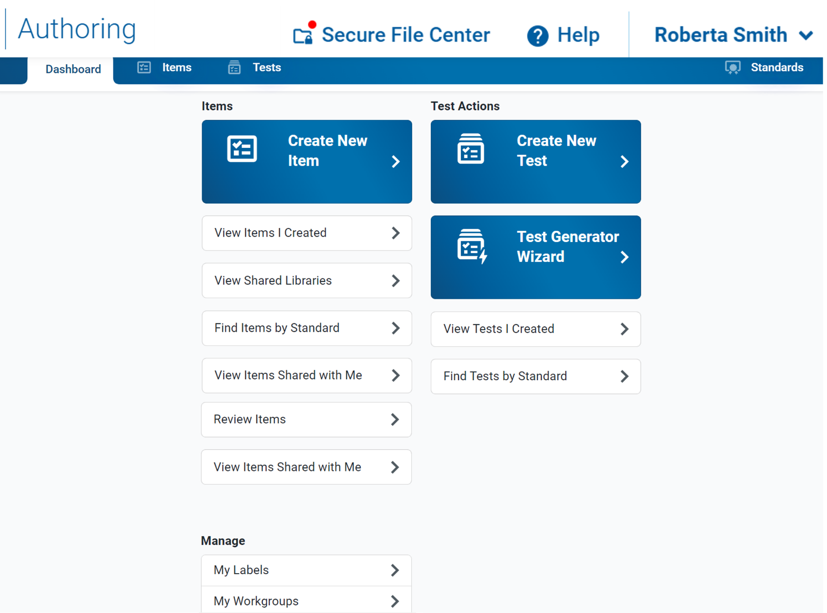
Dashboard Features
Content Tabs
Standards Panel
Quick Links
Management links
Notes:
The Authoring site opens to a dashboard where you can quickly jump to links for common tasks, content tabs for working with Items, and a panel for viewing standards. It also includes links for managing labels for items and workgroups for sharing content.
To find pre-existing items, use the Items content tab or one of the quick links. The quick links are explained on the next slide.

Slide 5
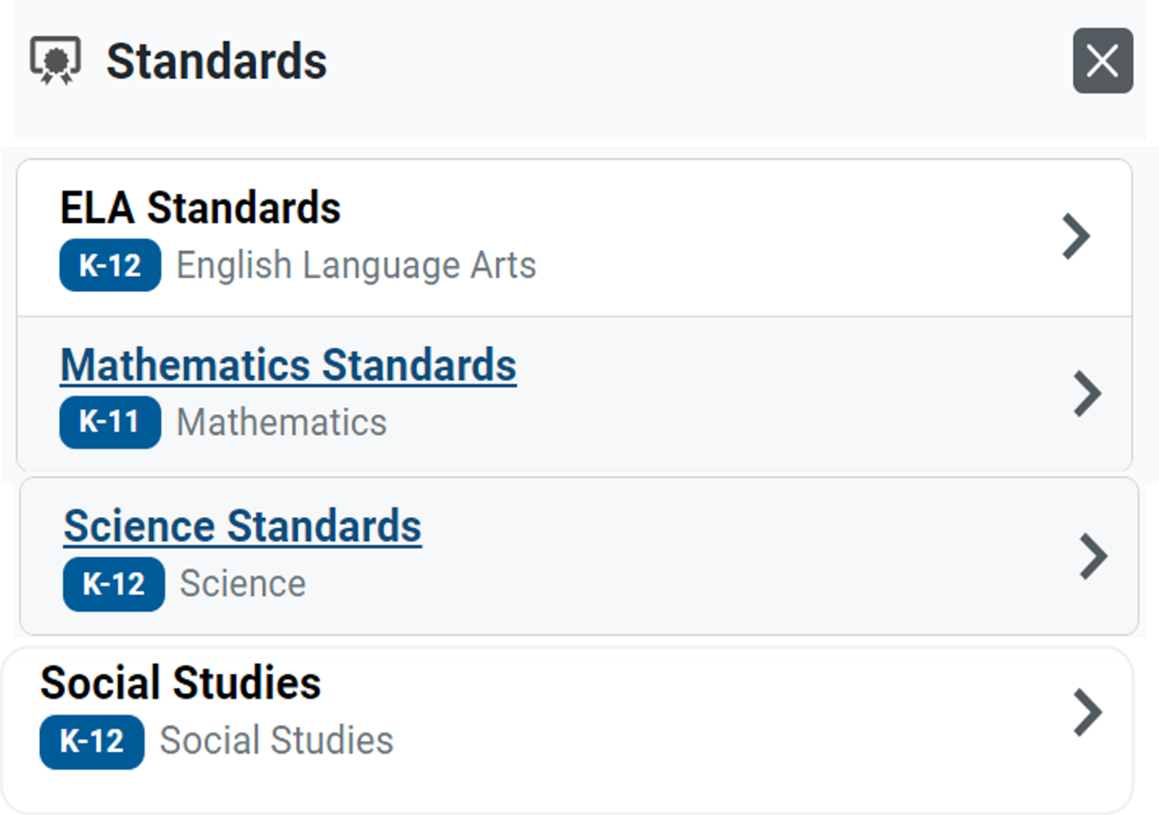
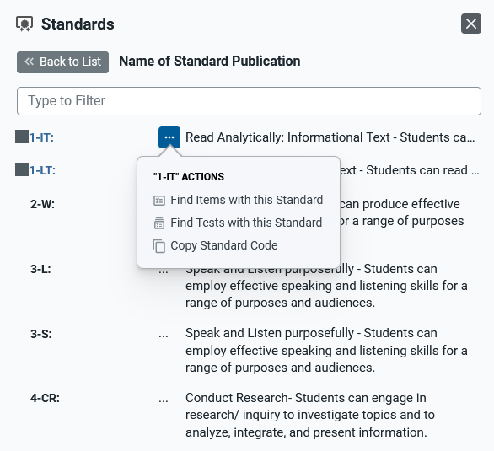
Standards Panel
Notes:
You can use the Standards panel to view the assessment standards published by your assessment program. You can also use this feature to find items aligned to a specific standard. Click the panel button in the Dashboard banner.
Here is an example of the Standards panel showing the standard trees for ELA, mathematics, science, and social studies. Expand the standards categories until you locate the standard you are looking for. You can also search for the standard at the top of this panel in the Type to Filter field. To use the actions options, click the dotted menu to the left of a specific standard. Options include Find Items with this Standard, Find Tests with this Standard, and Copy Standard Code.
Standards identify the specific skills or areas of knowledge that an item measures. Aligned standards will appear in the reports for Authoring tests, helping you pinpoint the specific areas in which a student may be excelling or may need additional support.

Slide 6
Items Quick Links
Test Link | Description
Create New Item | Opens the item builder page where you can create a new item.
View Items I Created | Opens the Items tab, filtered to show you only your own items that were created or edited within the last 30 days.
View Shared Libraries | Opens the Items tab with the Filters panel open and the Libraries, Grade, and Subject filters expanded so that you can easily locate the items in a shared library.
Find Items by Standard | Opens the Items tab with the filter panel focused on the Standards search bar, so you can locate items with items aligned to a specific standard. You will need to enter a standard key and click Apply in order to display the tests.
View Items Shared With Me | Opens the Items tab, filtered to show you only the items that other Authoring users created and shared with you within the last 30 days.
Notes:
On this slide, you can read a description of what will open when you select the quick links listed under Item Actions on the dashboard.

Slide 7
How to Use the Create New Item Button
Notes:
This section covers how to use the Create New Item button and introduces the three main steps used in item creation.

Slide 8
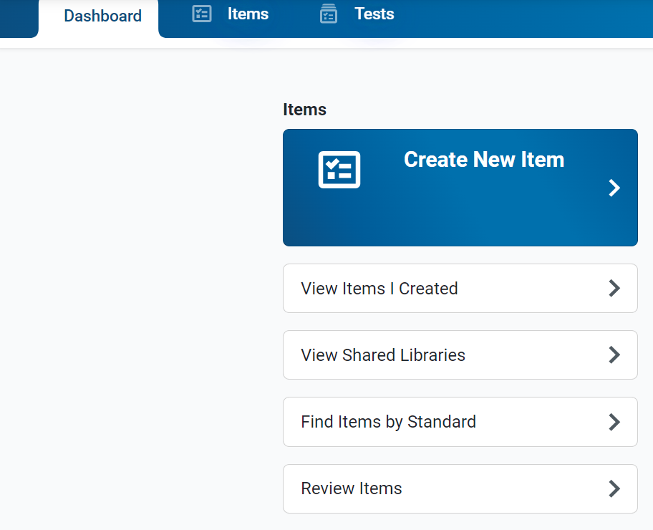
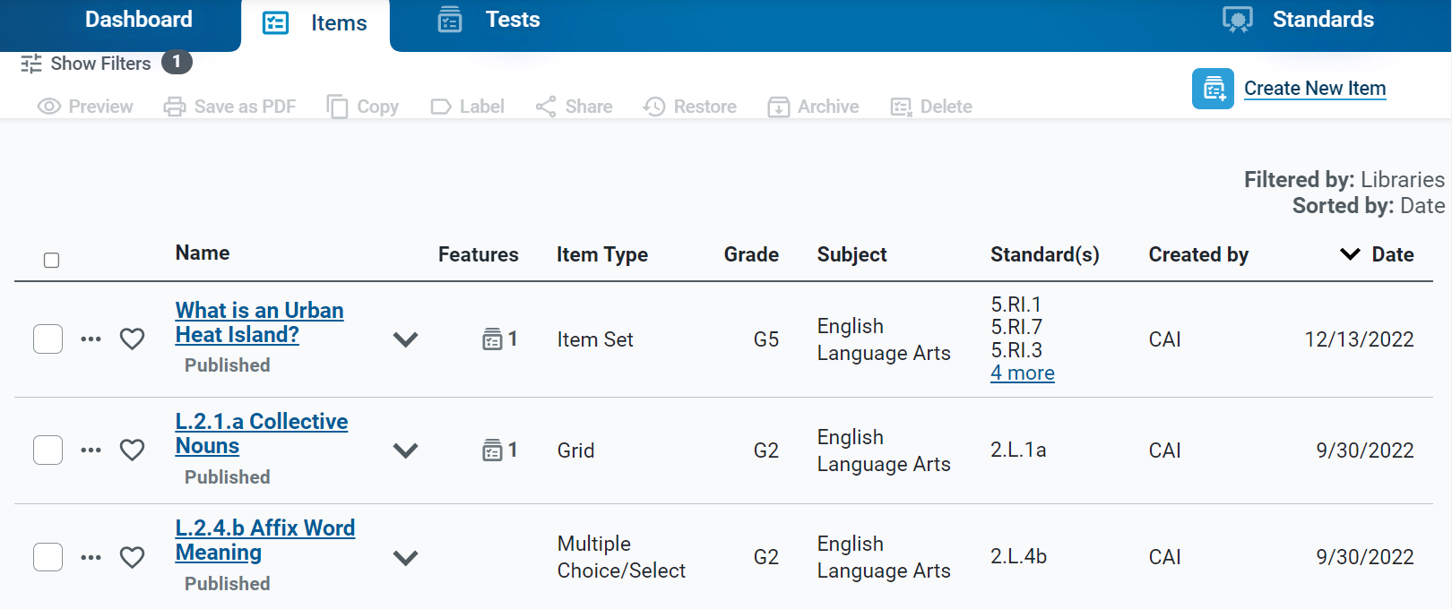
Create New Items
Click the Create New Item link
Click the Create New Item button.
Notes:
To create a new item, click on the Create New Item link on the Dashboard; or open the Items content tab and click the Create New Item button.

Slide 9
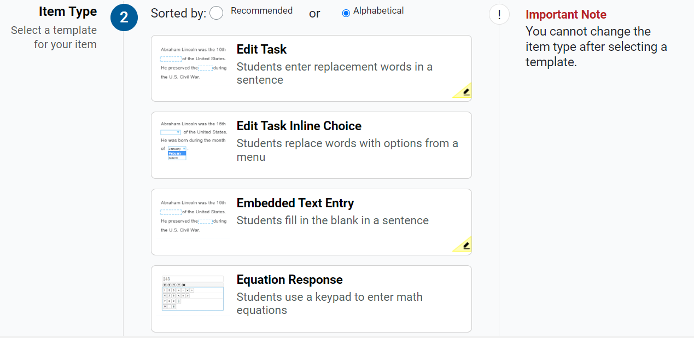
Item Builder—Template Options
Notes:
There are many different item types available. The item templates, in alphabetical order, are: Edit Task, Edit Task Inline Choice, Embedded Text Entry, Equation Response, Hot Spot, Hot Text, Image Drag and Drop, Multi-Part, Multiple Choice/Select, Passage, Simple Text Entry, Table Match, and Text Drag and Drop. Select an item type to create an item based on that template. Templates with a pencil icon in the corner will need to be scored by a user in the Reporting system.

Slide 10
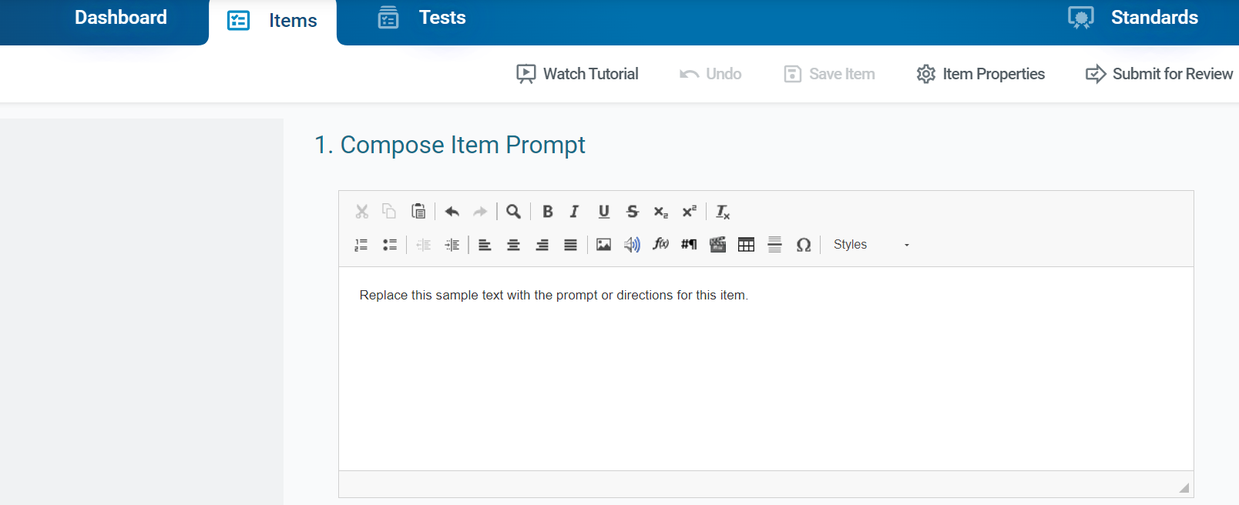
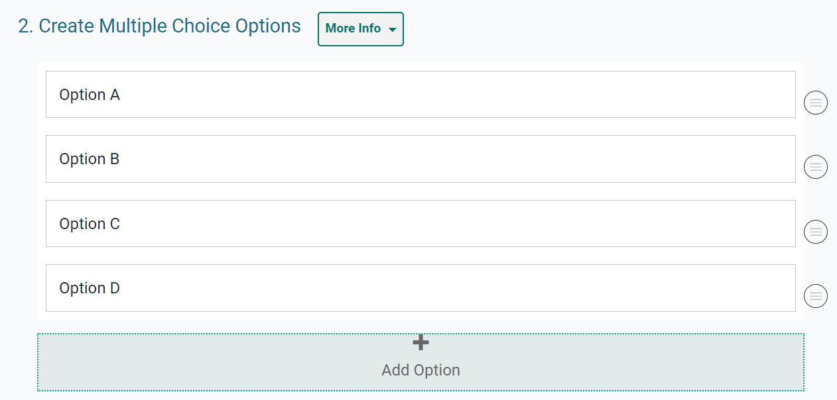
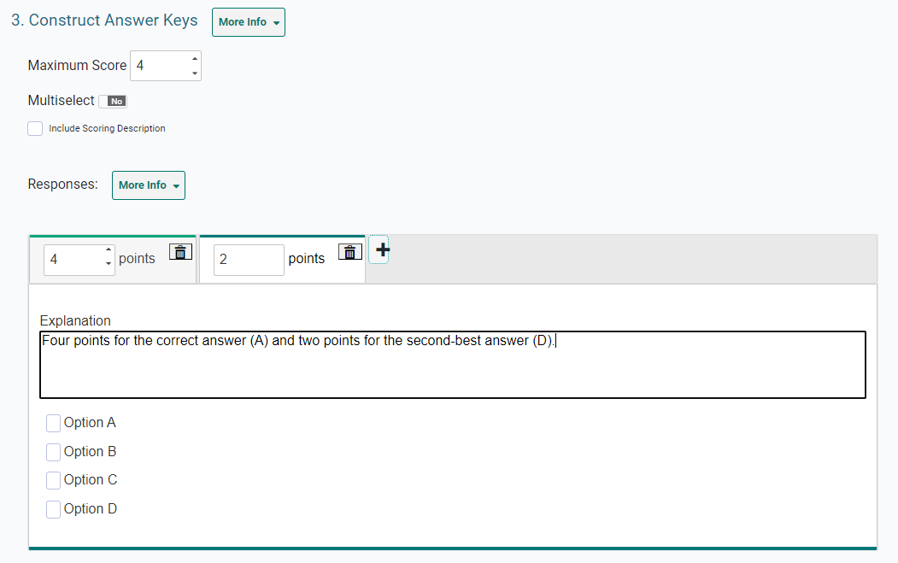
Item Builder—3 Main Steps
Notes:
Here, you see the three steps on the item builder page.
Step 1 is to compose the item prompt. The prompt is the question or the directions that students respond to in an item. Enter the prompt in a text box at the top of the template. You can use the text box toolbar to format the text and insert media elements, such as images, videos, and tables. You should not add video or audio to any items you plan to administer in paper test booklets.
Step 2 is to create the response area. The response area is the part of the item that students interact with in order to answer the question. Here, you see a multiple-choice item response area. The steps for creating the response area are different for each type of item template. We will explain each type later in this module.
Step 3 is to construct the answer key. The answer key determines how many points an item is worth and how a student’s response will be scored. Students do not see this information, but it is used by the Authoring system (for machine-scored items) and educators (for handscored items). The steps for constructing the answer key are slightly different for different types of item templates. We give instructions for each type later in this module.
Please note that each item template features a Watch Tutorial button in the banner.
Next, we explain how to create items using the different templates.

Slide 11
How to Create Items Using Different Templates
Passage Set
Multiple Choice/Select
Hot Text
Hot Spot
Edit Text Inline Choice
Edit Task
Simple Text Entry
Embedded Text Entry
Text Drag and Drop
Image Drag and Drop
Table Match
Equation Response
Multi-Part
Notes:
In this section, the different item templates are explained, in this order.

Slide 12
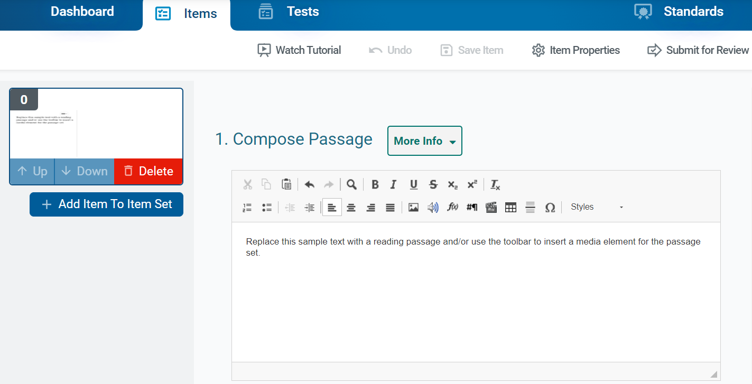
Passage Set — Groups Items Together
Notes:
The Passage Set template allows you to create a reading passage or other type of media, such as an image or video, that students will view in order to answer additional items that are linked to the set. For example, you can create a reading passage about a historical event and link it with items that will evaluate the students’ understanding of that event.
You can group multiple items in a passage set on a single test page. The passage or media element in a passage set does not include a response area or an answer key, but the items you link with it do.
To fill out the template, enter the content for the passage or other media type in the provided text box. You can use the toolbar in this box to format the text and insert media elements.
In the item toolbar above the template, click Save Item.
To create items to link with the stimulus, click the Add Item to Item Set button, which looks like a plus sign, to the left of the template. Then select an item type to proceed with adding the item. Note that you cannot link a stimulus with another stimulus. You can enter the content for the linked item by following the instructions for the appropriate item type, as presented later in this module. You can add more items as necessary. Note that you cannot link a stimulus to an original item that already exists in your libraries.

Slide 13
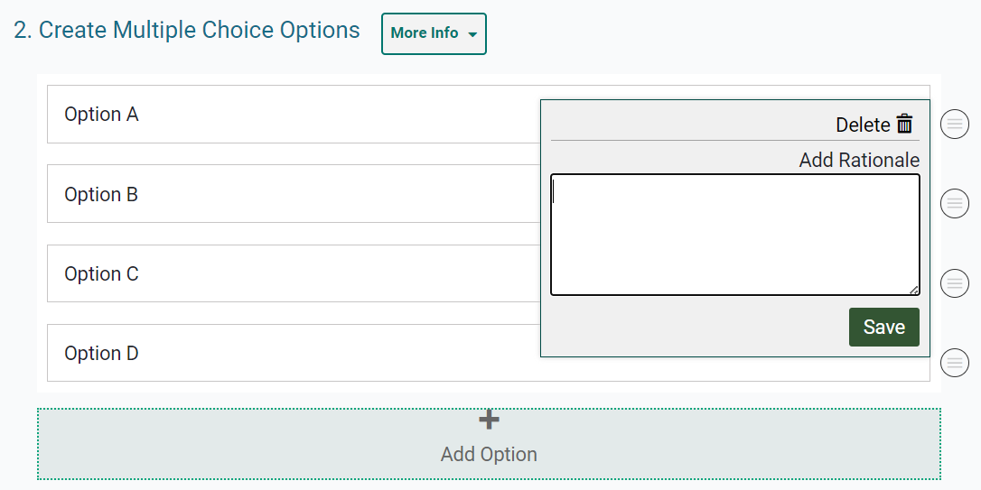
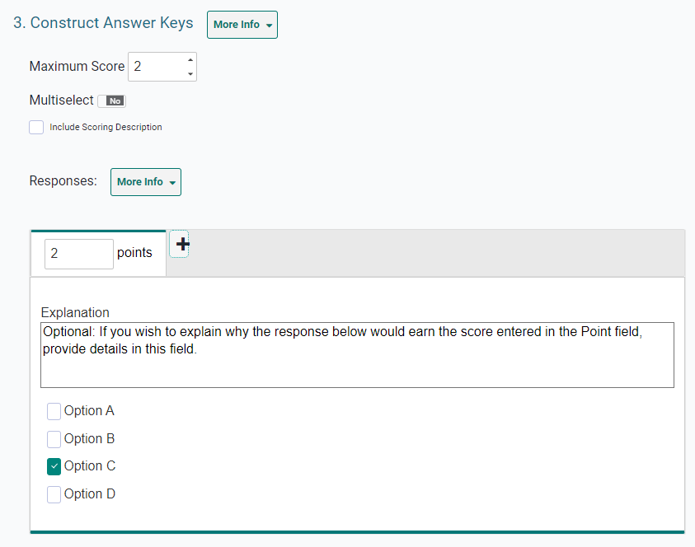
Multiple Choice and Multiple Select Items
Notes:
Multiple Choice/Multiple Select items require students to select a single option or multiple options from a list of possible answer options.
To fill out the template, in the Compose Item Prompt section, replace the sample text with the item’s question or directions. In the Create Multiple Choice Options section, sample response options are already provided. You can click each option to replace the sample text with the desired text for that response option.
If you want to add additional response options to the item, click Add Option and then enter the content for the new option that appears. To remove an option, click the menu button beside it and then click Delete. If you want to enter the rationale for why a response option is correct or incorrect, click the menu button beside it, then enter a description in the Add Rationale field and click Save.
In the Construct Answer Keys section, enter the item’s highest possible score in the Maximum Score field. If you want to allow students to select more than one response option, set the Multiselect toggle to Yes. Then specify the maximum number of options they can select in the Maximum Selections field. To create answer keys for the item, do the following: In the Points field, enter the score for a correct or partially correct response. Note that if a sample response is already entered, you may need to clear its checkbox first. Then, in the provided response area, select the response options that students would need to select in order to earn the score you entered in the Points field. You can add an explanation for the correct answers in the Explanation field above the answer options.

Slide 14
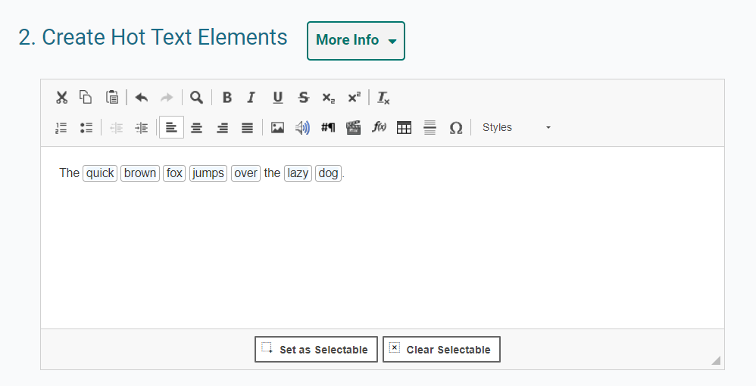
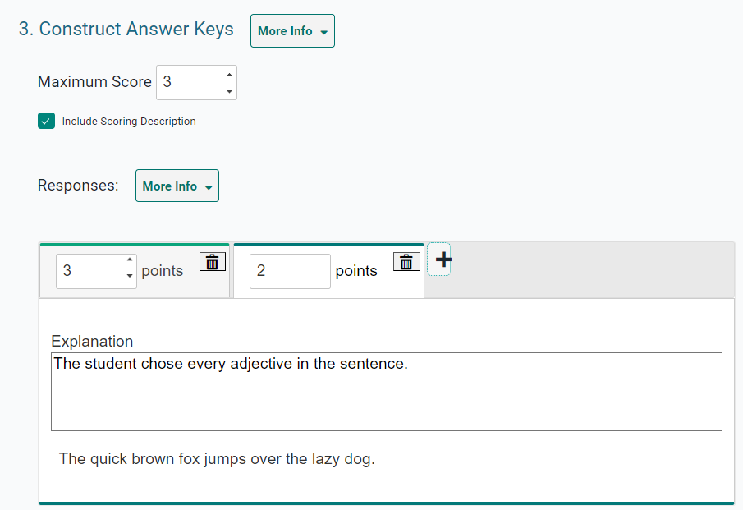
Hot Text Items
Notes:
Hot Text items require students to select words or phrases in a section of text. The words and phrases appear shaded when students select them. For example, a Hot Text item might provide a sentence and ask students to select all the adjectives in it.
In the Compose Item Prompt section, replace the sample text with the item’s question or directions. The Create Hot Text Elements section displays sample text, including a selectable word. Delete this sample text and enter new text containing the words or phrases students will select.
To tag a word or phrase that will be selectable to students, do the following. First, click and drag the cursor across a word or phrase to highlight it. Next, click Set as Selectable below the text box. A border appears around the selected word. If you need to remove a word you marked as selectable, click that word and then click Clear Selectable.
In the Construct Answer Keys section, enter the highest possible score in the Maximum Score field. To create answer keys for the item, do the following. In the Points field, enter the score for a correct or partially correct response. Then, in the provided response area, click the words or phrases that students would need to select in order to earn the score you entered in the Points field.

Slide 15
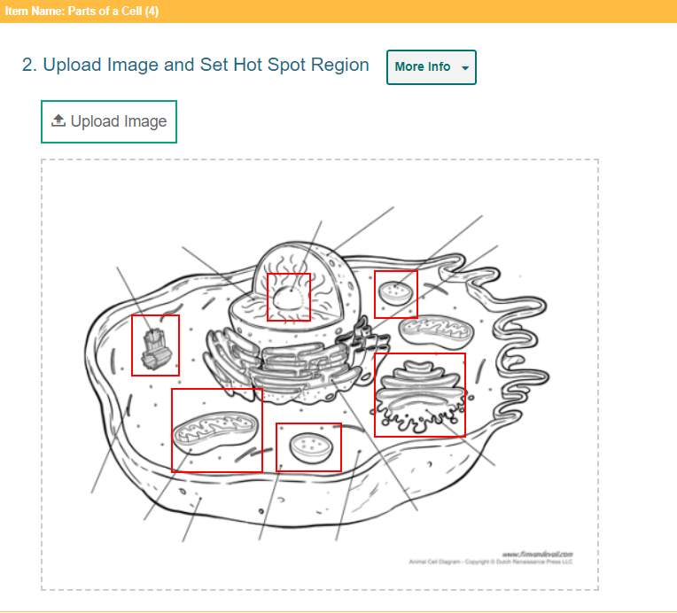
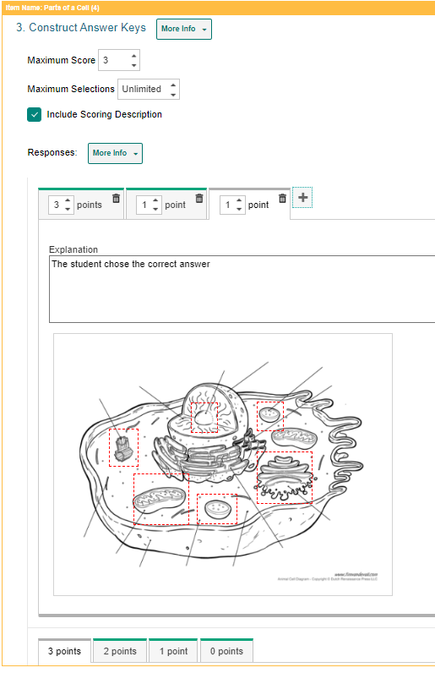
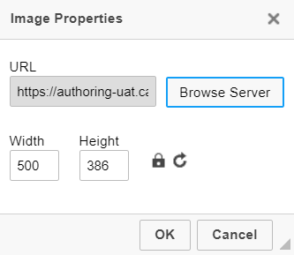
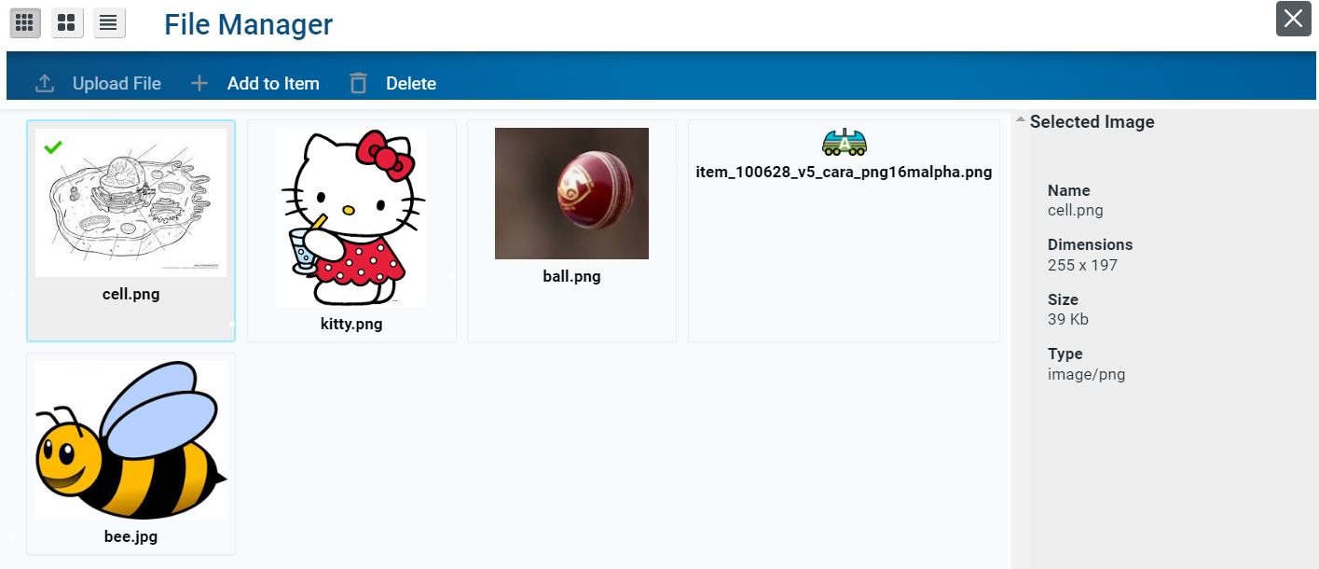
Hot Spot Items
More Information on how to add images to items is located on slides 26–36.
Notes:
Hot Spot items require students to select one or more clickable regions on an image. A rectangular border appears around each region the students select. For example, a Hot Spot item can show a diagram of an animal cell and ask students to identify the parts of the cell.
First, in the Compose Item Prompt section, replace the sample text with the item’s question or directions. Next, in the Upload Image and Set Hot Spot Region section, upload an image for the item. To do so, click Upload Image. In the Image Properties window, click Browse Server. If the image you want to use for the item is already available in the File Manager window, select it and click Add to Item. You can use the search bar in the corner to search for an image by its file name. If the image you want to use is not available in the File Manager window, click Upload File and select an image file from your computer. Then select the image and click Add to Item. The image must be 600×600 pixels or smaller and under 1.5 MB. In the Image Properties window, click OK.
Next, to create the selectable regions on the image, do the following. Click the image once to set the first corner of the selectable rectangle, then click one more time where you want to set its opposite corner (do not click and drag). A red box appears, but this will not be visible to students. To move a selectable region, click that region and drag it to the desired location. You can copy or delete a selectable region by selecting that region's box and then clicking Copy or Delete.
In the Construct Answer Keys section, enter the highest possible score in the Maximum Score field. Optionally, to limit the number of hot spot regions students can select at a time, enter a value in the Maximum Selections field. To create answer keys for the item, do the following: in the Points field, enter the score for a correct or partially correct response. If a sample response is already entered, you may need to unselect that hot spot first. In the provided response area, click the image regions that students will need to select in order to earn the score you entered in the Points field.
More information on how to add images to items can be found on slides 26–36.

Slide 16
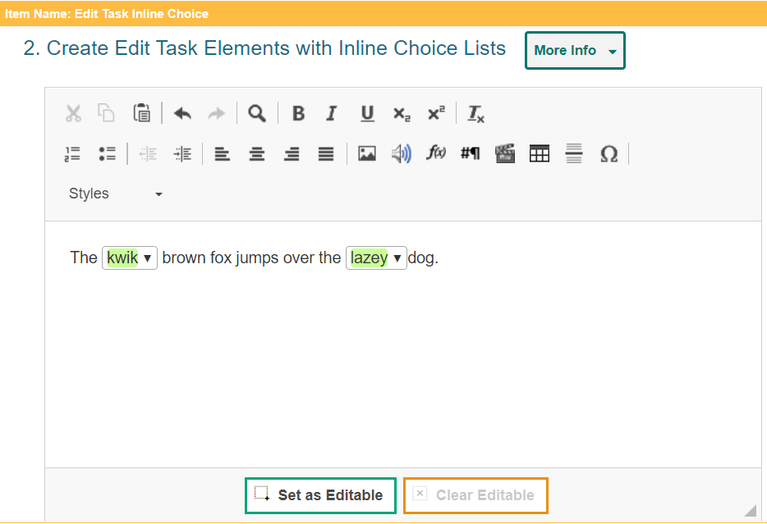
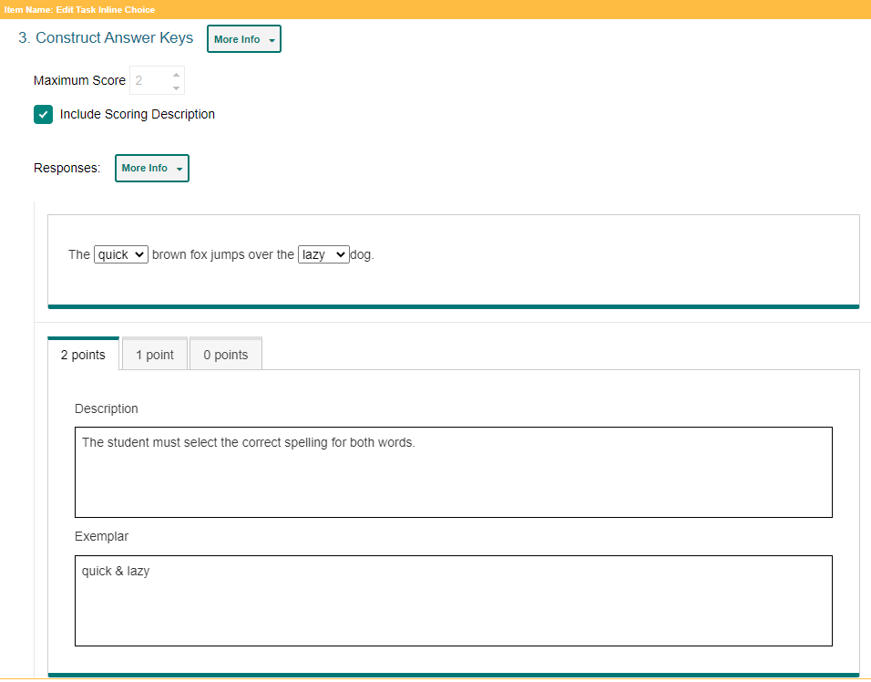
Edit Task Inline Choice Items
Notes:
Edit Task Inline Choice items provide a section of text in which one or more words appear as drop-down menus. Students select answer options from the drop-downs to replace the original words in the text. For example, an Edit Task Inline Choice item can provide a sentence with a misspelled word and ask students to select the correct spelling from the drop-down menu.
In the Compose Item Prompt section, replace the sample text with the item’s question or directions.
The Create Edit Task Elements with Inline Choice Lists section displays sample text content, including an editable word. Delete this sample text and enter new text content containing the words that students will replace.
To tag a word or phrase that students will be able to replace, do the following. Click and drag the cursor across the desired word or phrase to highlight it. Click Set as Editable below the text box. A border appears around the selected word and the Inline Choice window appears. In the Inline Choice window, enter a replacement option for the tagged word in the blank text box. To add additional replacement options, click Add Option and enter the replacement option in the new text box that appears.
In the Construct Answer Keys section, the maximum score is automatically set based on the number of editable elements you created. You cannot customize this score. To create the item’s answer key, click the editable words in the sample response area and replace each one with the correct answer option. The item will automatically assign students the appropriate number of points for their response based on the number of correct selections they made.

Slide 17
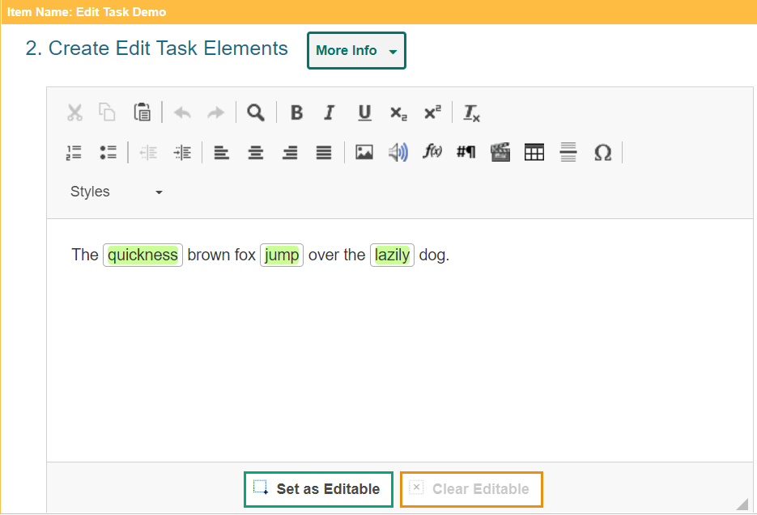
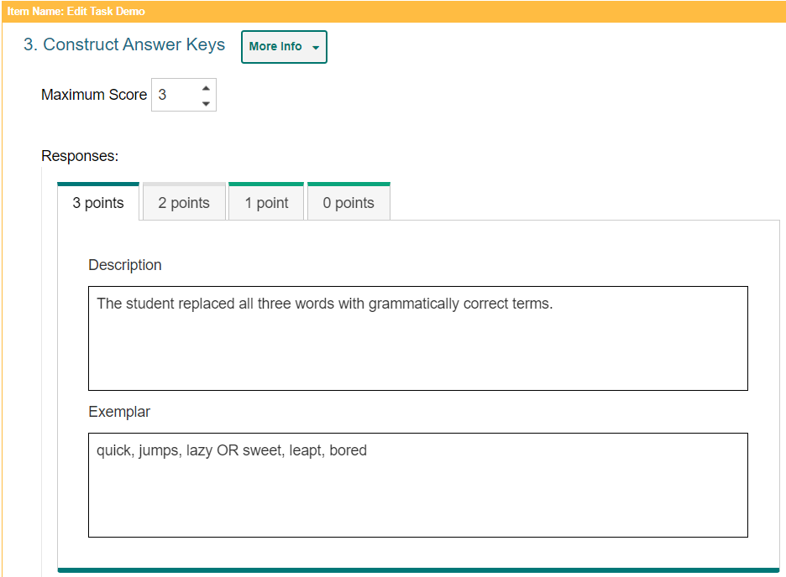
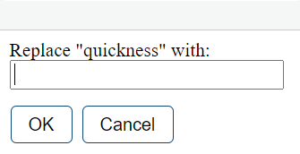
Edit Task Items
Notes:
Edit Task items require students to make edits to a specified word or phrase in a sentence or paragraph. Students can click each of these words or phrases to open a text box where they type a replacement for the original text. These items must be scored by an authorized user in the Reporting system. For example, an Edit Task item can provide a sentence with a misspelled word and ask students to enter the correct spelling for it in a popup text box.
In the Compose Item Prompt section, replace the sample text with the item’s question or directions.
The Create Edit Task Elements section displays sample text content, including an editable word. Delete this sample text and enter new text content containing the words that students will replace. To tag a word or phrase that students will be able to replace, do the following. Click and drag the cursor across a word or phrase to highlight it. Then click Set as Editable below the text box. A border appears for the selected word.
In the Construct Answer Keys section, enter the item’s highest possible score in the Maximum Score field. Fill out the rubric for the correct, full-credit response for the item. In the Description field, describe how a student must respond to the item in order to earn full credit. In the Exemplar field, enter an example of a response that would earn full credit. Note that the template automatically creates a rubric tab for each possible score a student can earn, based on the maximum score. To fill out any additional rubrics for the item, click the tab for that rubric and enter a description and exemplar for the rubric’s score.

Slide 18
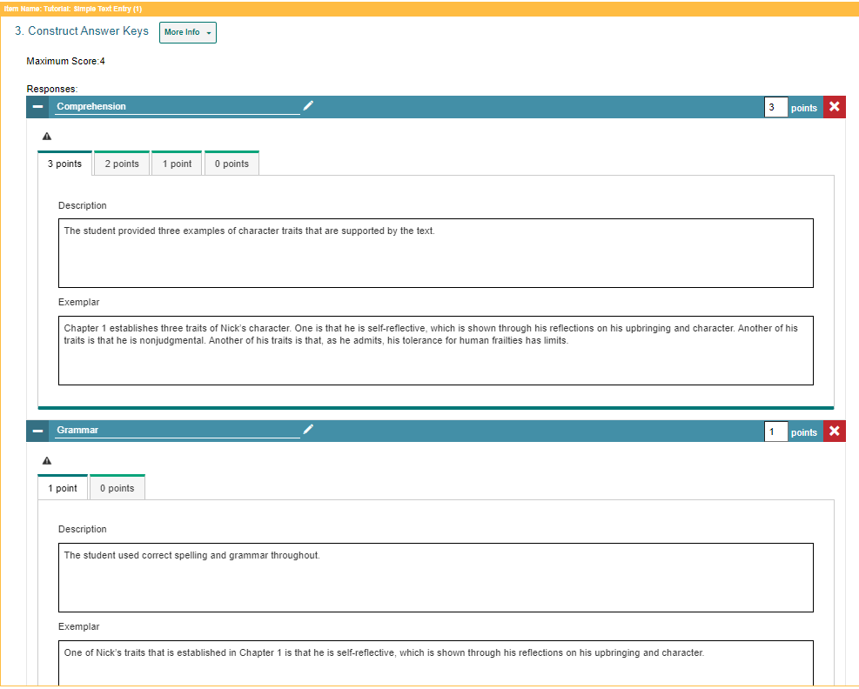
Simple Text Entry Items
Notes:
Simple Text Entry items require students to type a written response in a provided text box. You can choose what kind of toolbar to include in the text box. For example, a Simple Text Entry item might ask students to write a short essay about their favorite historical figure. Note that these items must be scored by a user in the Reporting system.
In the Compose Item Prompt section, replace the sample text with the item’s question or directions. You can use the toolbar to format the text and insert media elements. To specify the height of the students' text box, enter a value in the Number of Rows in Text Box field. To specify the type of toolbar that will be available to students, select an option from the Text Editor to Show Student menu. You can choose to use no toolbar, or you can use a toolbar with buttons for spell check, formatting text, and/or adding bulleted lists or numbered lists.
To fill out the rubric for the item’s full-credit response, enter the maximum score in the Points field. In the Description field, describe how students must respond in order to earn full credit. In the Exemplar field, enter an example of a response that would earn full credit. Note that the template automatically creates a rubric tab for each possible score a student can earn based on the maximum score. To fill out any additional rubrics, click the tab for that rubric and enter a description and exemplar for the rubric’s score.
If multiple scoring criteria should be used to evaluate the student’s response, you can click Add More at the bottom of the page to create a separate rubric for each criterion. For example, you could create separate rubrics for spelling, syntax, comprehension, and so on.

Slide 19
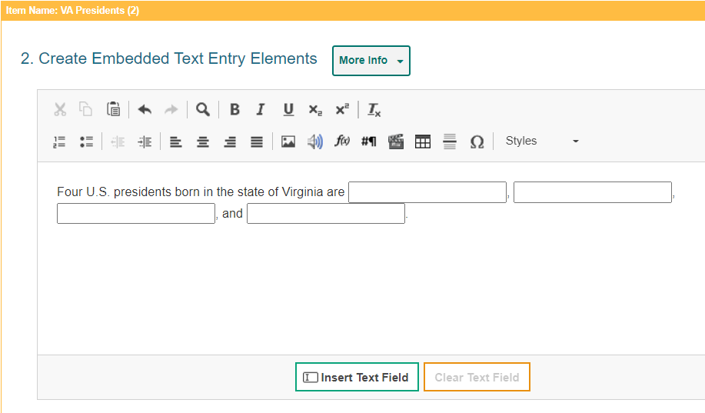
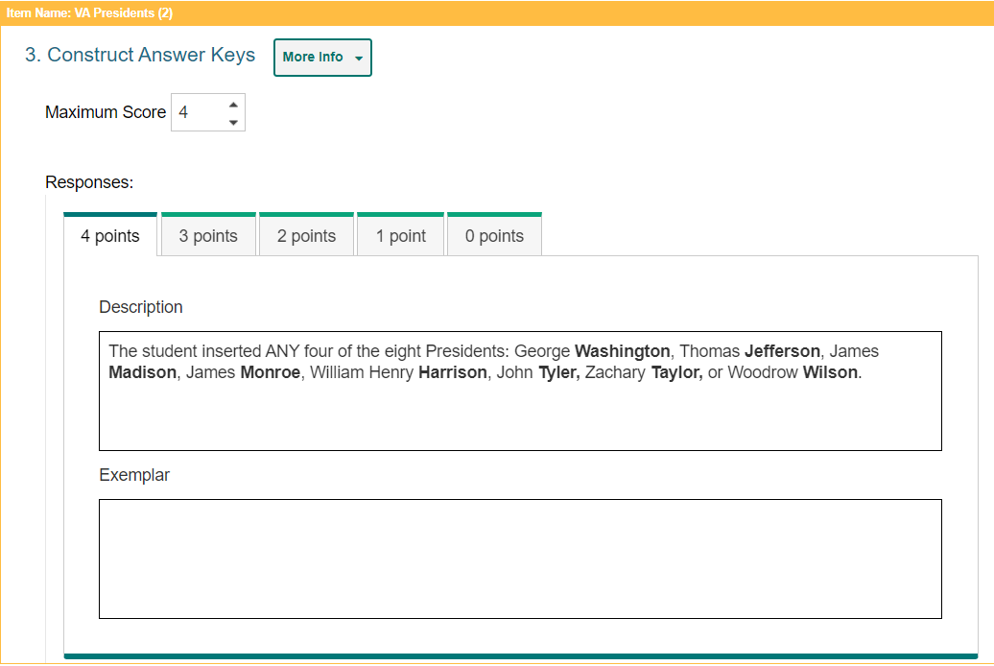
Embedded Text Entry Items
Notes:
Embedded Text Entry items require students to fill in one or more blank text boxes in a sentence by typing a response in the provided boxes. For example, an Embedded Text Entry item can provide a sentence with a missing word and ask students to fill in the blank with the appropriate vocabulary word that they learned in English class. These items must be scored by a user in the Reporting system.
In the Compose Item Prompt section, replace the sample text with the item’s question or directions. You can use the toolbar to format the text and insert media elements.
The Create Embedded Text Entry Elements section displays sample text with a blank text box. Replace this sample content with the new text content and text boxes for your item.
To insert a blank text box in the response area, click the cursor where you want to place the text box, and then click Insert Text Field. You can insert multiple text boxes, if necessary. In the Enter Text Field Properties window, specify the length of the blank text box. If you need to remove a blank text box from the response area, click the box and then click Clear Text Field.
In the Construct Answer Keys section, enter the item’s highest possible score in the Maximum Score field. Fill out the rubric for the correct, full-credit response for the item. In the Description field, describe how a student must respond to the item in order to earn full credit. In the Exemplar field, enter an example of a response that would earn full credit. Note that the template automatically creates a rubric tab for each possible score a student can earn, based on the maximum score. To fill out any additional rubrics for the item, click the tab for that rubric and enter a description and exemplar for the rubric’s score.

Slide 20
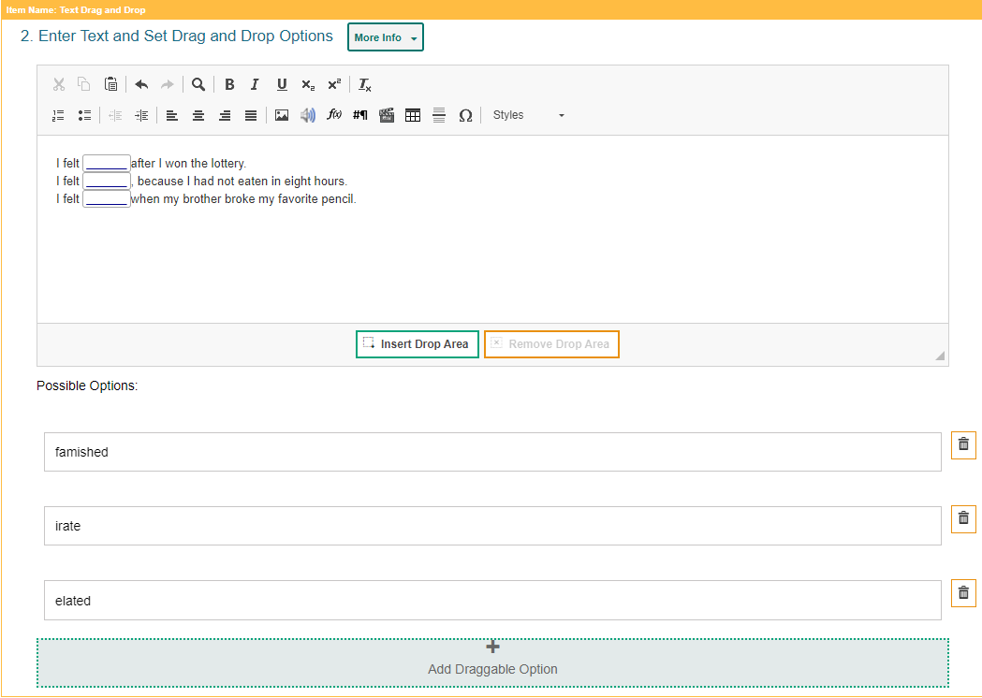
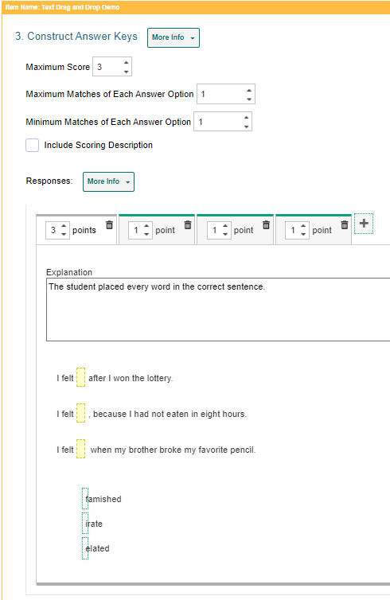
Text Drag and Drop Items
Notes:
Text Drag and Drop items require students to fill in one or more blank "drop" boxes in a sentence or paragraph by dragging response options into those boxes from a word bank. For example, a Text Drag and Drop item can provide a sentence with a missing word and ask students to fill in the blank with a vocabulary word from the provided word bank.
In the Compose Item Prompt section, replace the sample text with the item’s question or directions.
The Enter Text and Set Drag and Drop Options section displays sample text content, including a blank drop box. Replace this sample content with the new text content and the blank text boxes for your item.
To insert a blank drop box in the response area, click where you want to place the drop box, then click Insert Drop Area. You can insert multiple drop boxes, if necessary. If you need to remove a blank drop box from the response area, select the box and click Clear Drop Area.
The template displays sample word bank options below the text box. You can click these answer options to replace the sample text with the text that students will drag into the drop boxes. To create additional answer options, click Add Draggable Option and enter the content for that answer option in the box that appears.
In the Construct Answer Keys section, enter the item’s highest possible score in the Maximum Score field. Optionally, you can set the maximum number of times students can drag each answer option into a drop box by entering the value in the Maximum Matches of Each Answer Option field. If you enter a number greater than 1, students will be able to reuse each word bank option in multiple drop boxes. Also optionally, you can require students to use each answer option a certain number of times. To do so, enter the required value in the Minimum Matches of Each Answer Option field. Students will not be able to complete the item until they have used each answer option the specified number of times.
To create answer keys for the item, do the following. In the Points field, enter the score for a correct or partially correct response. If a sample response is already entered, you may need to drag it out of the response area first. In the provided response area, drag the answer options into the drop boxes required in order to earn the score you entered in the Points field.

Slide 21
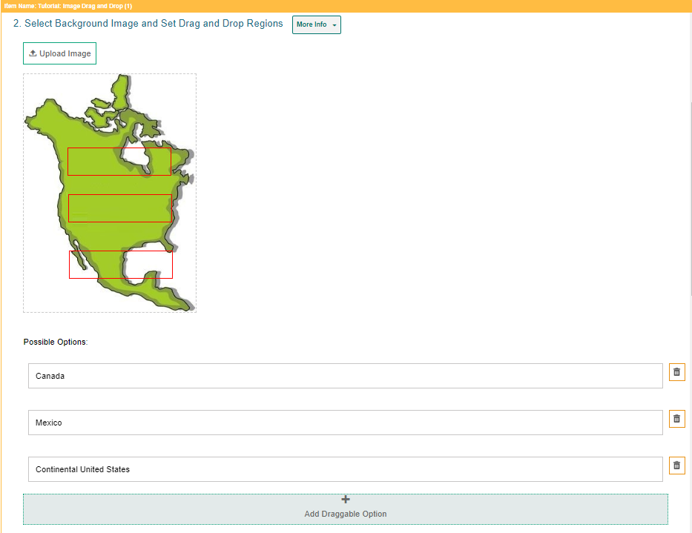
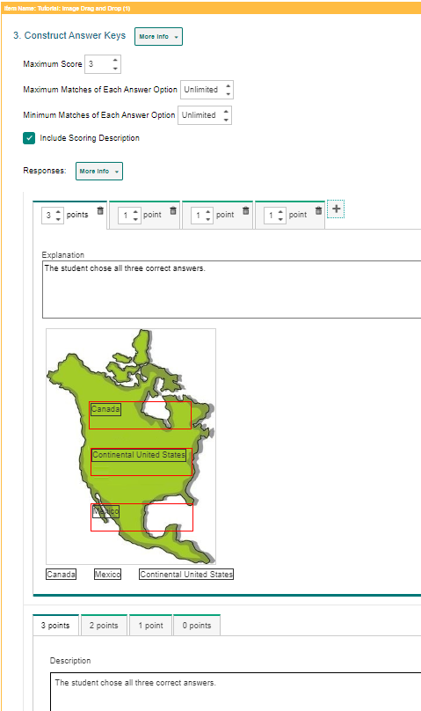
Image Drag and Drop Items
More Information on how to add images to items is located on slides 27–37.
Notes:
Image Drag and Drop items require students to fill in the blank "drop" boxes on an image by dragging response options from a word bank into these boxes. You can specify the size and location of the drop boxes where students drag their answers. For example, an Image Drag and Drop item can provide a map of the Northern Hemisphere and ask students to place country names on the map using a provided word bank.
First, in the Compose Item Prompt section, replace the sample text with the item’s question or directions. You can use the toolbar to format the text and insert media elements. In the Select Background Image and Set Drag and Drop Regions section, click Upload Image. In the Image Properties window, click Browse Server. If the image you want to use for the item is already available in the File Manager window, select it and click Add to Item. You can use the search bar in the corner to search for an image by its file name. If the image you want to use is not available in the File Manager window, click Upload File and select an image file from your computer. Then select the image and click Add to Item. The image must be 600×600 pixels or smaller and under 1.5 MB. The file may take a moment to upload.
To add the drop box areas to the image, do the following. Click the image once to set the first corner of the selectable rectangle, then click one more time where you want to set its opposite corner (do not click and drag). A red box appears, but this will not be visible to students. To move a drop box region, click that box and drag it to the desired location on the image. You can copy or delete a drop box region by selecting the box and then clicking Copy or Delete.
The item template displays sample answer options below the background image. You can click these answer options to replace the sample text with the new text or image that students will be able to drag into the drop boxes. If you want to create additional answer options, click Add Draggable Option and enter the content for that answer option in the box that appears. In the Construct Answer Keys section, enter the item’s highest possible score in the Maximum Score field.
If you want to limit how many times students can use each answer option in the word bank, enter the desired limit in the Maximum Matches of Each Answer Option field. If you enter a number greater than 1, students will be able to reuse each option in multiple drop boxes. If you want to require students to use each answer option a certain number of times, enter a value in the Minimum Matches of Each Answer Option field. Students will not be able to finish the item until they have used each response option the specifies number of times.
To create answer keys for the item, do the following. In the Points field, enter the score for a correct or partially correct response. Note that if a sample response is already entered, you may need to drag it out of the response area first. Then, in the provided response area, drag the response options into the drop boxes required to earn the score you entered in the Points field.
More information on how to add images to items is located on slides 26–36.

Slide 22
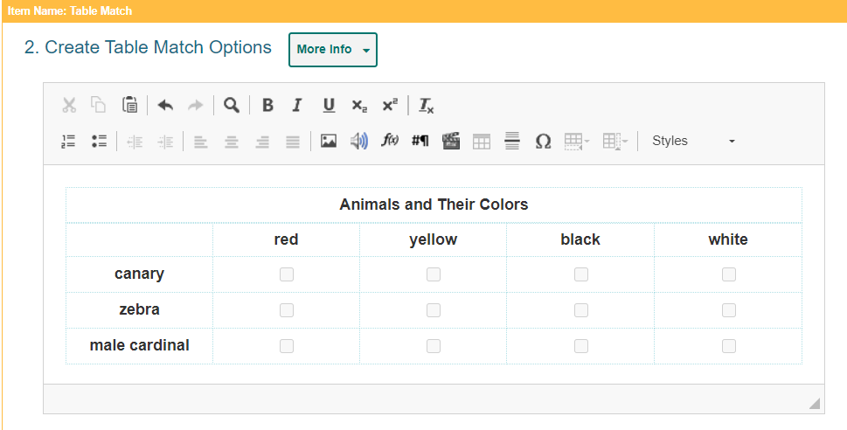
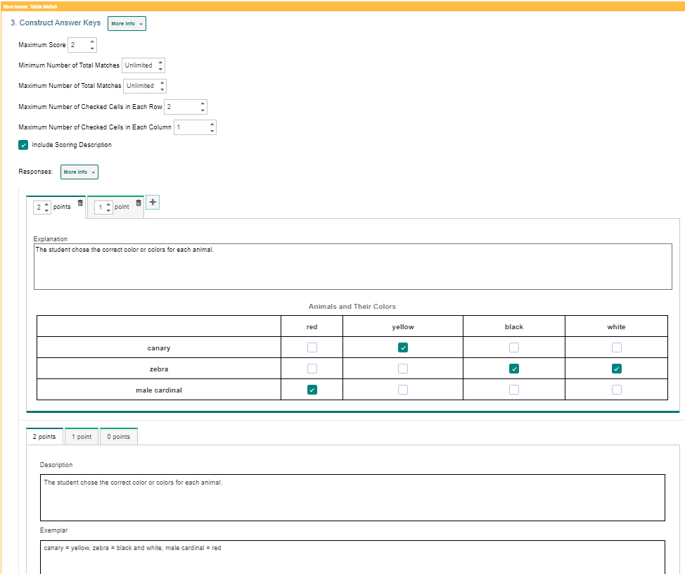
Table Match Items
Notes:
Table Match interactions provide two sets of match options in a table, with one set listed in columns and the other set listed in rows. Students match options in the columns to options in the rows by marking checkboxes in the cells where they intersect. In the example shown, the Table Match item lists a set of numbers in the rows and a set of properties in the columns (such as odd, even, positive, and negative), and students must select the properties that apply to each number.
To fill out the template, in the Compose Item Prompt section, replace the sample text with the item’s question or directions. You can use the toolbar to format the text and insert media elements.
The Create Table Match Options section displays a sample table. You can modify the match options that appear in each column header and row header. You can also modify the number of rows and columns that appear in the table.
To enter a caption for this table, click the text box above the table and type the caption. To enter match options in the table, click inside the row headers and column headers, and then replace the sample text with the content for the match options.
To modify the number of rows in the table, click the table rows button in the toolbar and select an option from the menu that appears. You can also right-click a row and select a menu option.
To modify the number of columns in the table, click the table columns button in the toolbar and select an option from the menu that appears. You can also right-click a column and select a menu option.
In the Construct Answer Keys section, enter the item’s highest possible score in the Maximum Score field. To set restrictions on the matches a student can make, do the following. In the Minimum Number of Total Matches field, enter the minimum number of checkboxes students must mark in the entire table. In the Maximum Number of Total Matches field, enter the maximum number of checkboxes students can mark in the entire table. In the Maximum Number of Checked Cells in Each Row field, enter the maximum number of checkboxes students can mark in any row. In the Maximum Number of Checked Cells in Each Column field, enter the maximum number of checkboxes students can mark in any column.
To create answer keys for the item, do the following. First, in the Points field, enter the score for a correct or partially correct response. Note that if a sample response is already entered, you may need to clear the checkboxes first. Then, in the provided response area, mark the checkboxes in the table cells that students will need to select in order to earn the score you entered in the Points field.

Slide 23
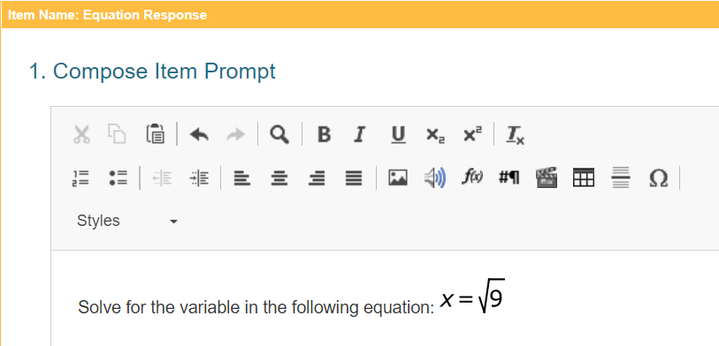
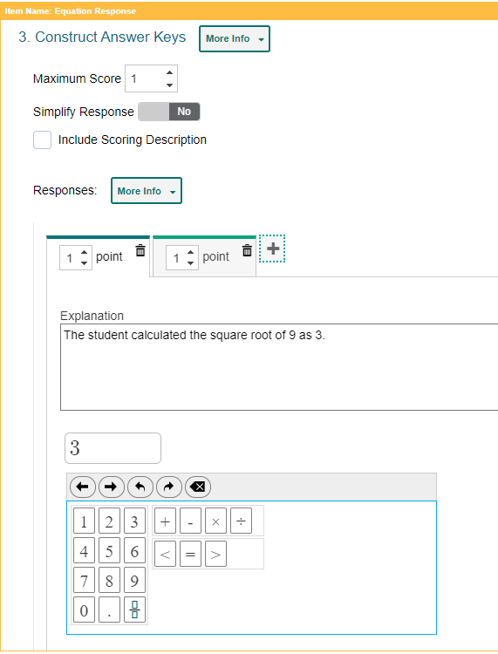
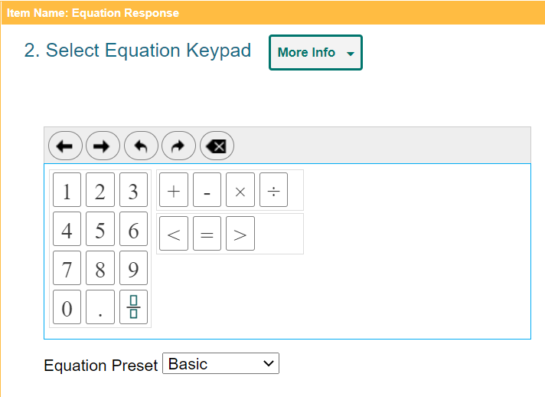
Equation Response Items
Notes:
Equation Response items require students to use an on-screen keypad or their physical keyboard to enter a mathematical expression or equation in the response area. For example, an Equation item can provide an algebraic equation and ask students to solve for x.
In the Compose Item Prompt section, replace the sample text with the item’s question or directions. You can use the Add Math Equation button in the toolbar to insert a formula.
In the Select Equation Keypad section, select an option from the Equation Preset dropdown menu to determine which buttons will be available on the student’s keypad.
The keypad in this section displays the buttons associated with the selected Equation Preset type. All keypads include Back, Next, Undo, Redo, and Delete buttons at the top.
In the Construct Answer Keys section, enter the item’s highest possible score in the Maximum Score field.
Optionally, to set the item to automatically simplify the student’s entered response, set the Simplify Response toggle to Yes.
To create answer keys for the item, do the following. First, in the Points field, enter the score for a correct or partially correct response. If a sample response is already entered, you may need to clear the response area first. In the provided response area, use the keypad to enter the mathematical expression that students will input in order to earn the score you entered in the Points field. After entering a fraction, exponent, or root, you may need to click the right arrow button in order to enter additional characters.

Slide 24
Multi-Part Items That Combine Item Types
Here are some factors associated with the Multi-Part item:
You can combine two to four item types into a single item.
You can choose how the Multi-Part item is scored, how many parts it includes, and which item type is used for which part.
If any item is handscored, or the Multi-Part item combines more than two parts, the Multi-Part item must be handscored.
Create a separate prompt and response area for each part of the Multi-Part item, but only one answer key.
Notes:
Here is a list of some factors associated with the Multi-Part item. The template allows you to combine two to four item types into a single item. When creating a Multi-Part item, you can choose how it is scored, how many parts it includes, and which item type is used for each part. For example, a Multi-Part item with a Multiple Choice/Select part and an Edit Task part can ask students whether a statement is true or false, and then ask them to correct the part of the statement that is false.
If a Multi-Part item includes only two parts and both item types are machine-scored, then the Multi-Part item itself can be machine-scored. If a Multi-Part item includes more than two parts, or if any of the included item types are handscored, then the Multi-Part item must be scored by hand.
The templates for Multi-Part items require you to create a separate prompt and response area for each part of the item, but only one answer key is needed for the whole item. Some of the settings and fields that usually appear in the section for constructing answer keys will appear in the section for constructing response areas in Multi-Part item templates.

Slide 25
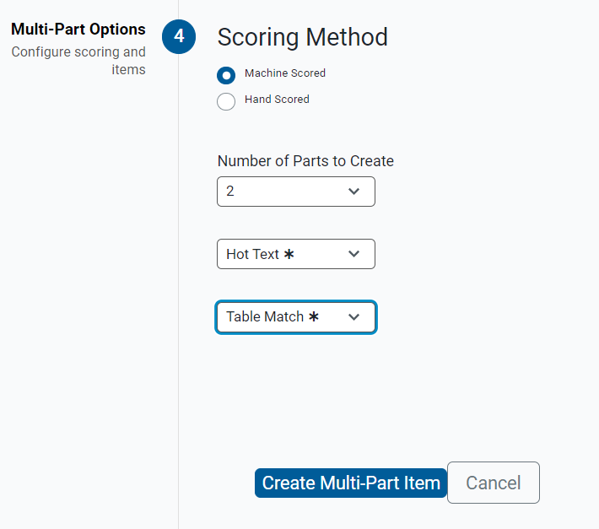
Multi-Part Item Options
Notes:
The Multi-Part item template initiates with a page where you will select options under Scoring Method, Number of Parts to Create, parts of the Multi-Part item, and a button, “Create Multi-Part Item.” After you click that button, the actual steps involved depend on which item type you selected for the first part of the item. For more information, you can consult the instructions for each item type in the Filling Out Item Templates section of the Authoring User Guide.

Slide 26
How to Add Images to Items
Notes:
This section covers how to add images to items in Authoring.

Slide 27
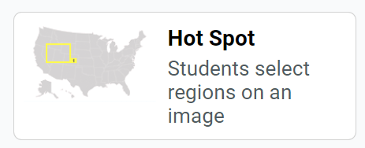
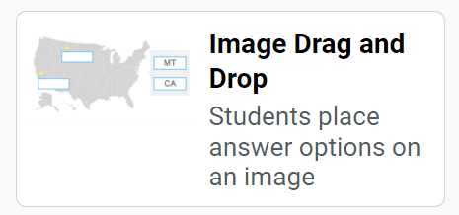
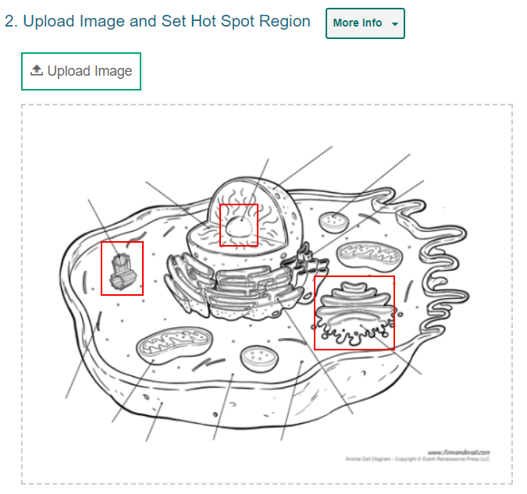
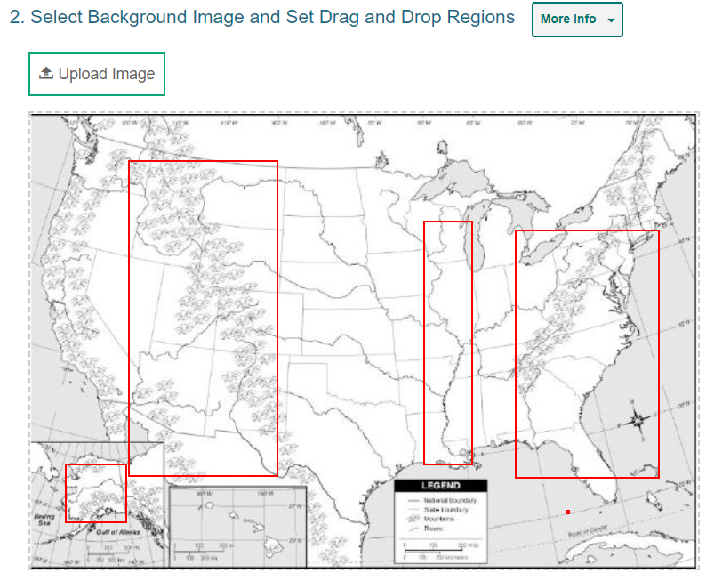
Images in Response Section
Notes:
Two of the item types in Authoring require you to upload images in the response section. In Hot Spot items, students select one or more clickable regions on an image or a diagram to respond to a question. In the Image Drag and Drop item, students drag answers into “drop boxes” in an image or diagram.
You can insert JPG, PNG, or GIF files. They must be smaller than 600 x 600 pixels and under 1.5 MB in size. Keep this in mind as you search online or in a district system for images to use. Be sure to verify the copyright status of any online image so you comply with legal permissions.

Slide 28
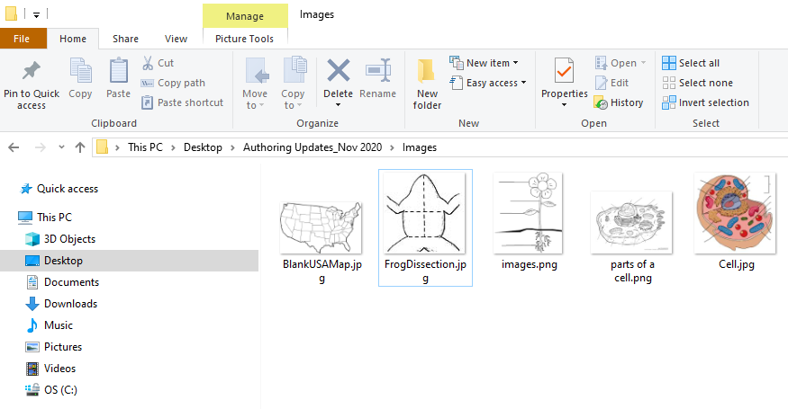
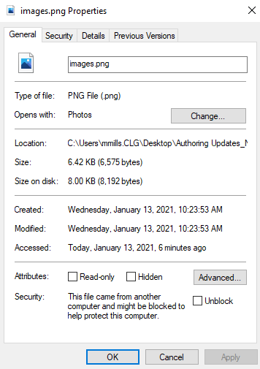
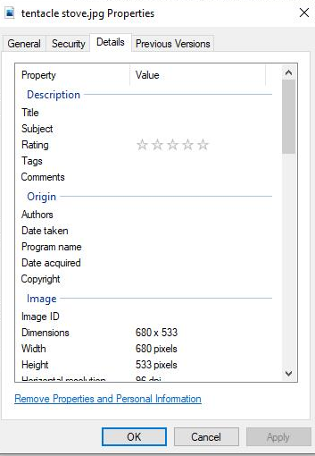
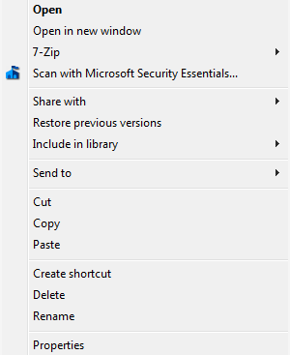
Easy Way to Check Dimensions and Size in Windows
3. The file size is here.
4. Click on the Details button above for the pixel dimensions.
1. Right-click on an image you have saved.
2. Click on Properties
Notes:
You can check the size and dimensions of the images you have saved on your computer before you upload them to Authoring.
1. In a File Explorer folder, right-click an image file you want to check.
2. Then click on Properties at the bottom of the menu.
3. The file size displays on that page under size.
4. To check the pixel dimensions, click the Details button at the top of the page. The width and height display on that page.

Slide 29
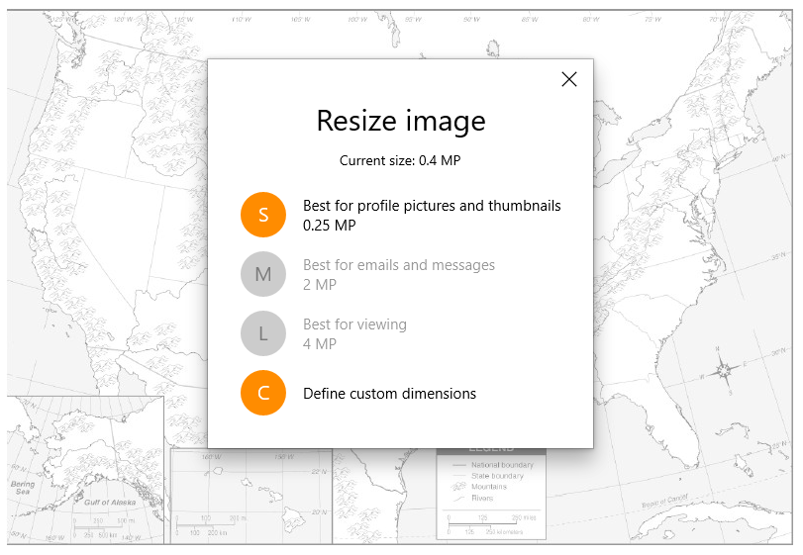
Resize a Saved Image
Notes:
If you need to resize an image you have saved, Windows has a setting for that in the Photo Manager. First open the image file in Photo Manager. Then select Resize and set the Custom Dimensions to something under 600 x 600 pixels.

Slide 30
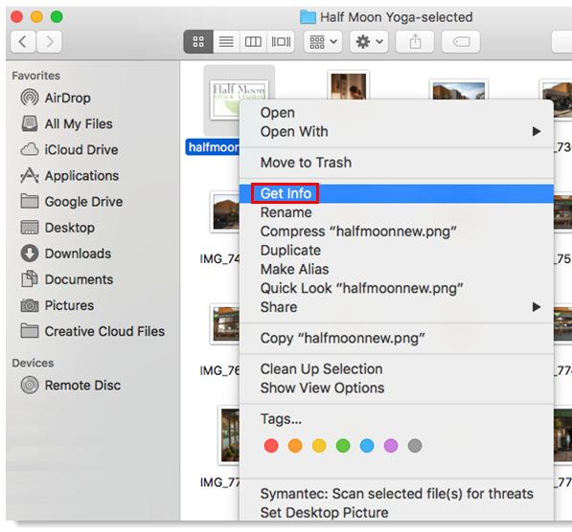
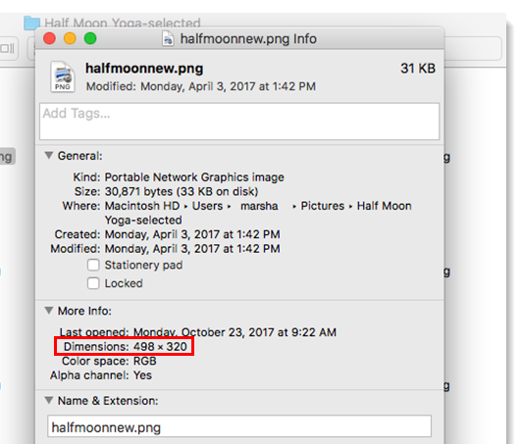
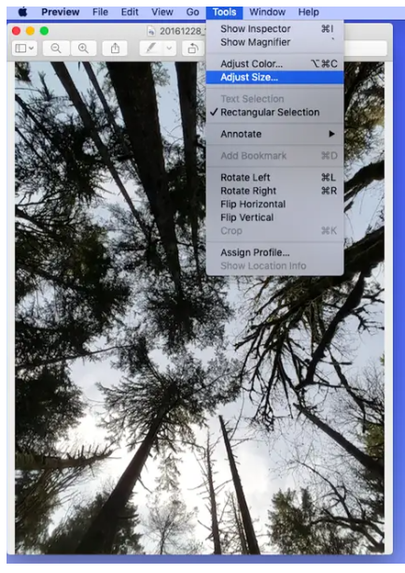
Easy Way to Check Size and Dimensions in Mac
Notes:
To check the size of an image in a folder on an Apple computer, click Control+Click on the image file in a folder. Click Get Info in the window that appears. Expand the General section to see the file size and the More Info section to see the dimensions. There is also a setting under Tools that allows you to Adjust Size.

Slide 31
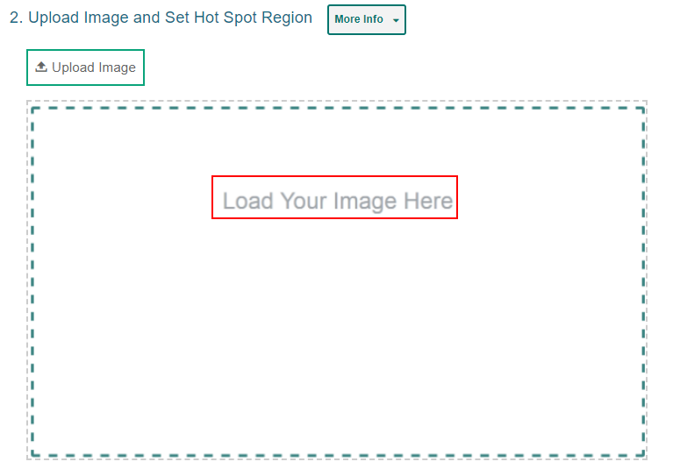
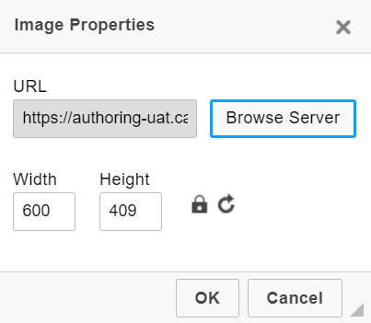
Upload an Image
1
2
3
Notes:
The image import process is the same for Hot Spot items and Image Drag and Drop items. First, create the item type using the content tab or the quick link from the Dashboard or search for an item in Draft mode that you want to edit.
In Section 2 of the item template, click Upload Image. In the Image Properties window, click Browse Server. If the image you want to use for the item is already available in the File Manager window, select it and click Add to Item. You can use the search bar in the corner to search for an image by its file name. If the image you want to use is not available in the File Manager window, click Upload File and select an image file from your computer.

Slide 32
Upload an Image (continued)
4
5
6
Notes:
Select the image and click Add to Item. In the image properties window, click OK.

Slide 33
Upload an Image (Error Message)
Notes:
If there is an issue with the file, an error message appears when you try to upload it.

Slide 34
Add Regions
Notes:
Now you are ready to add your hot spot regions or drag and drop boxes to the image.

Slide 35
Insert Images With the Text Editor
Notes:
You can also add JPG, PNG, or GIF images to your instructions in Section 1 of an item template: Compose Item Prompt. The same size and dimension requirements apply. Click on the image button in the toolbar and upload a file to the Media Upload page using the same import process. You have some additional options in the Image Properties window. You can create alternative text for screen readers. You can select an alignment preference. And you can change the image dimensions using the Width and Height fields. Click the open lock icon to lock the width-to-height ratio. To reset the image dimensions, click the arrow button. You can add a caption to the image by checking the Captioned Image box.

Slide 36
Item Prompt with Image
Notes:
Here is what the captioned diagram looks like under the Compose Item Prompt section.

Slide 37
How to Use the Item Properties Panel to Set Up Properties and Align Items to Standards
Notes:
In this section, we cover how to set up properties for items and align them to standards, using the Item Properties Panel.

Slide 38
Item Properties Panel
Notes:
You can use the Item Properties panel in the toolbar to enter other helpful details, such as the subject and grade levels an item belongs to. Some fields may be required by your assessment program. The properties you set up for items make it easier to filter items when adding them to tests or locating them on the Items tab.
Make your selections from the drop-down menus and fields and click Close.

Slide 39
Align Item to Standards
Notes:
Standards identify the specific skills or areas of knowledge that an item measures. Aligned standards will appear in the reports for Authoring tests, helping you pinpoint the specific areas in which a student may be excelling or may need additional support.
You can align your items to a primary standard and a secondary standard. If you know the ID for the standard you want to align to the item, click the Quick Key tab, then enter the key in the search field. You can copy a standard’s ID from the Standards panel.
If you don’t know the ID for the standard you want to align to the item, select the appropriate standard categories from the drop-down choices provided on the Guided tab.
If a standard is already aligned to the item, you can click Change Standard to align a different standard, if necessary.
Item properties can be entered at any point while an item has a Draft status. However, once an item is added to a test and the test is published, the item status changes to Published and its properties will be locked, along with its content.

Slide 40
How to Work with Items Available to You
Find Items
Perform Actions on Items
Edit Items
Preview Items
Duplicate Items
Label Items
Share an Item
Archive or Delete an Item
Translate an Item
Notes:
In this section, we cover how to perform various actions on items available to you. The actions you can perform may depend on the item’s status and library.

Slide 41
Find Items Available to You
Notes:
Pre-existing items available for your use are organized into libraries that are located on the Item Filters panel. Click the Show Filters button on the Dashboard to open it and expand the arrow next to the Libraries option. The libraries you see are determined by your state’s assessment program. Make your selections from those listed and click Apply Filters to display a table of results.
You can select other options, such as subject, grade, and standard, from the Item Filter panel to further refine your search. A sample panel is shown here on the right.

Slide 42
Find Items by Standard (Quick Link)
Notes:
To search for items aligned to a certain standard, you can use the quick link, “Find Items by Standard.” In the Standard field of the Item Filters panel, type in a few letters of the standard key, such as a number or a letter. A list of possible matches displays in a drop-down list. Select one or several standards and the standards you selected display above the search box. Click Apply Filters. The results table will display the items aligned to the selected standards.

Slide 43
Perform Actions on Items
Items Toolbar
Edit button
Dotted Menu
Notes:
Here is a table of results generated with four filters: the Items I Created library, the Checkpoint Math Items library, the subject of Mathematics, and Grade 3. You can use the toolbar and table menus to perform various actions on items.
You can see that many of the action features are displayed in both the toolbar and the dotted menu. To perform the same action on multiple items, mark the checkbox next to the dotted menu and use the action button in the toolbar. To perform an action on an individual item, open the dotted menu and select the option from the list.
The next slide describes the actions you may perform.

Slide 44
Possible Actions for Items
Edit your items that haven’t been published yet.
Preview an item to see how it will appear to students in the Test Delivery System.
Duplicate items that you want to modify without affecting the original version.
Label items so it is easier to organize and locate on your content tab tables.
Save an item as a PDF so you can print it out.
Share items that you want other educators to co-author or use for themselves.
Archive or delete items that you don’t need to use anymore.
Translate items into another language.
Notes:
Here is a list of the actions you can take on items. The actions you can perform may depend on the item’s status and library. The buttons shown here are displayed in the toolbar above the results table or in the table menu.
This section covers these actions in the order that they appear in this list.

Slide 45
Edit Items
Notes:
You can make changes to any items you created that have a Draft status. You cannot edit Published items. When another educator shares an item with you, you may only edit its content if you were given editing permission by the original author. If you cannot edit an item, you may create a copy of it and make changes to the copy.
To make changes to your items, open the content tab and click the Edit button under the name of the item. The corresponding builder page will appear. When editing items, you may also need to click the Edit button, which looks like a pencil, in the item toolbar.

Slide 46
Preview Items
Notes:
You can preview your items and tests to see how they will appear to students in the Test Delivery System. Open the Items tab and filter to find the item you wish to edit. Select Preview from the dotted menu or use the Preview button in the banner. The properties for each item are found by expanding the Item Details section on the left.
Optional: You can enter responses for machine-scored items and click Item Score to verify the item is being scored accurately. A window pops up, indicating which answer key matches the entered response.

Slide 47
Duplicate Items
Notes:
You can create duplicates of items that you wish to modify without affecting the original version. For example, if you want to edit a Published item or a shared item that you don’t have permission to edit, you can copy that item and make edits to the duplicate version.
You may not have permission to duplicate items in some libraries. Editing the items on a test duplicate will affect the items on the original test, and vice versa.
Open the Items tab and filter to find the item or items you wish to duplicate. Select Duplicate from the dotted menu or use the Duplicate button in the banner.

Slide 48
Label Items
Notes:
You can create labels and add them to items that you want to organize on the content tab. Open the Items tab and mark the checkbox for each item you wish to label, or to label an individual item, use the dotted menu option. Click the Label button in the toolbar. The Apply Label window appears. You can search for a label, or you can select a sub-label from a drop-down menu and click the Apply button.
After adding labels to your items, you can use the Labels menu in the filter panel on the left of the Items tab to easily view the items with the selected label. You can create labels for any content in your libraries, but these labels appear on your screen only. They are unique to your account and do not display for anyone else the content is shared with.
Optional: To modify a label, select the My Labels quick link from the Dashboard. Click Edit next to the label's name. Make the necessary changes and then click Done.

Slide 49
Save an Item as a PDF
Notes:
If you want to create a printable version of an item, you can save it as a PDF file. When saving items as a PDF, you can choose to include the item’s scoring guidelines in the printout. PDF files display items with paper-friendly formatting (if available) and also display an item’s properties.
To save an item as a PDF, open the Items tab and mark the checkbox for each item you wish to save as a PDF, then click Save as PDF above the table (you may need to apply filters first). If you select multiple items, they will be saved as a single PDF file. You may not be able to save a PDF for a large selection of items (the number of items at which issues can arise depends on the items’ content).
Click Generate PDF. The file will be added to the Secure File Center where you can download it for 30 days.

Slide 50
Share Items with Others
1
3
2
4
Notes:
You can share any items in your personal libraries. Open the Items tab and apply the appropriate filters. Then use the banner button or the dotted menu option to share items. The Item Sharing window appears.
1. Search for an educator’s name or email address, or the name of a workgroup or institution. Select the recipients you want to share your content with.
2. In the Search Results, click + for each educator you wish to add as a recipient.
3. Select the specific permissions you’d like to give to each recipient. All recipients will be able to create copies of your shared content by default.
To allow a recipient to view the content, mark the View checkbox.
To allow a recipient to make edits to the shared content, mark the Edit checkbox.
To allow a recipient to publish tests containing the Draft item, mark the Pub checkbox.
4. Click Save. The shared content will now appear in the items table for the selected recipients

Slide 51
Archive and Delete Items
Content Type | Archive and Delete Permissions
Draft Items | Draft items can be deleted if they are not linked to any tests. Draft items cannot be deleted while they are linked to a test. Draft items cannot be archived.
Published Items | Published items cannot be deleted. Published items cannot be archived if they are linked to a published test. Published items can be archived only if every test they are linked to is also archived.
Notes:
You can archive and delete items that you do not wish to use any more. This will remove the items from your content tab tables. Archived and deleted items cannot be shared, added to tests, or associated with other content. Your ability to archive and delete items depends on the item’s status and other conditions explained in this table.
Mark the checkbox for the items you want to archive or delete and select the appropriate button in the banner. A pop-up window displays along with a pre-populated command related to the items selected. Click Okay.
If you wish to restore an archived item, set the Status filter to Archived, then mark the checkbox for the item or items you wish to use again and click Restore in the banner.

Slide 52
Translating Items
Notes:
While an item is in Draft status, you can create translations for it in additional languages. Expand the details section to see the language or languages that the item’s content is currently available in. A plus symbol appears in the icon for any available language translation. Click the plus sign to display the Add Language page. The item’s original content displays on the right and the translated content on the left.
Review the translations that Authoring automatically generated and revise as necessary. You can save the item, reset the translation, and preview it in the translated language or in English.
For more information, see the Guide for Translating Authoring Item Types in the Authoring User Guide.

Slide 53
How to Create Workgroups for Sharing Items
Notes:
This section covers how to create custom workgroups so that you can share your items with other educators on a regular basis.

Slide 54
How to Create Workgroups for Sharing Content
1
2
Notes:
To make it easy to share your items with the same group of educators on a regular basis, you can create a workgroup. You can also join other workgroups you get invited to and manage the membership of your existing workgroups.
1. Select the My Workgroups link on the dashboard.
2. Click Create New Workgroup on the Manage Workgroups page.

Slide 55
How to Create Workgroups for Sharing Content (continued)
3
4
5
6
Notes:
3. In the Workgroup Name field, enter a unique name for your group and select an institution.
4. In the Search to Add to Workgroup field, enter the name or email address for the user you want to add to the group. Select the name when it appears in the drop-down menu.
5. The educator’s name will appear in the Members section.
6. Educators become active in a workgroup once you click Save. You can share tests with them.
Optional: If you ever need to modify the workgroup, select Manage Workgroups on the Dashboard and then click the edit button by the name of the workgroup you wish to modify. You can also click X to delete a workgroup.

Slide 56
For More Help
You can contact the Helpdesk for assistance with any technical issues you encounter. When contacting the Helpdesk, please be ready to provide:
Any error messages that are appearing (including codes)
Your operating system and browser information
Your network configuration information
Your contact information for follow-up by phone or email
Any other relevant information, such as test names or content areas, student IDs, session IDs, and search criteria
For test administration or policy issues, please contact your district test coordinator.
Further Information
Id.portal.cambiumast.com
Idaho Help Desk
Toll-Free Phone Support: 1-844-560-7365
Email Support: IDHelpDesk@cambiumassessment.com
Thank you!
Notes:
You can find additional Authoring resources on Idaho State Assessment portal. However, if you still require assistance with troubleshooting a technical issue, you may also contact the Helpdesk. When contacting the Helpdesk, please be ready to provide the following information:
* Any error messages that are appearing (including codes)
* Your operating system and browser information
* Your network configuration information
* Your contact information for follow-up by phone or email
* Any other relevant information, such as test names or content areas, student IDs, session IDs, and search criteria
For questions about test administration or policy issues, please contact your district test coordinator.
Thank you for taking the time to view this training module. For detailed information, consult your Authoring Guide located on the Idaho State Portal or contact the Help Desk.

Slide 57
Training Modules in the Series
Title | Contents
AUTHORING: THE BASICS | Log in and use the dashboard quick links & content tabs
AUTHORING: EVERYTHING ABOUT ITEMS | Create, change, manage, and share items
AUTHORING: HOW TO ADD IMAGES TO ITEMS | File size & pixel dimensions, image upload process, text editor toolbar
AUTHORING: EVERYTHING ABOUT TESTS | Find and work with existing tests; create, publish, and administer tests
AUTHORING: SHARE TESTS & ITEMS WITH OTHER EDUCATORS | Create workgroups for sharing tests & items, how to share your tests & items
AUTHORING: HOW TO GENERATE, START & MONITOR A TEACHER-AUTHORED TEST SESSION IN THE TDS | Log in to TDS, create & start a test session, monitor the students’ progress, pause, stop, and log out of the system
AUTHORING: HOW EDUCATOR-AUTHORED TESTS ARE REPORTED IN CRS | Log in to CRS, drill down into reports from the dashboard, view items and rubric & resources, view the Student Portfolio report, and print ISRs
Notes:
Here are the modules that make up the Authoring system training series. They may be posted on the Idaho assessment portal.

