Slide 1
Authoring: How to add images to items
2023–2024
Notes:
Welcome to this training module on the Authoring system. This module covers how to add images to items. There are two ways to use images and diagrams in the items you create: in the item response areas and the item prompts. This module explains the process of uploading images and provides tips on size and dimension requirements.
Please note that Idaho’s version of Authoring may differ slightly from the images shown in this presentation.

Slide 2
Objectives
Topic | Slides
1. File Size and Pixel Dimensions—Requirements in Windows and Mac | 3–6
2. Image Upload Process | 7–10
3. Add Images to an Item Prompt with the Text Editor | 11–12
4. More Information/More Modules | 13–14
Notes:
There are four topics covered in this training module. You can jump to the section slides if you information on a single topic. The topics are:
#1. File Size and Pixel Dimensions—Requirements in Windows and Mac
#2. Image Upload Process
#3. Add Images to an Item Prompt with the Text Editor
#4. More Information and More Modules

Slide 3
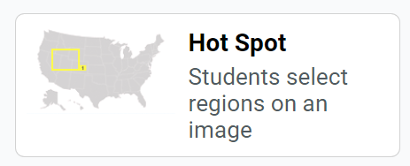
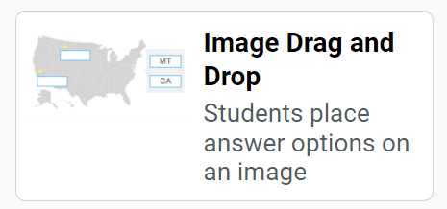
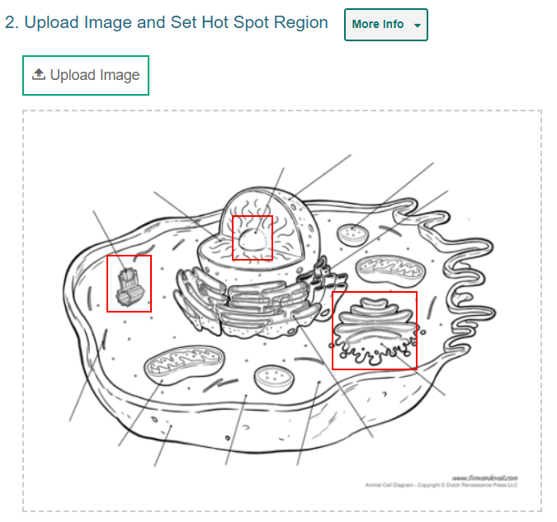
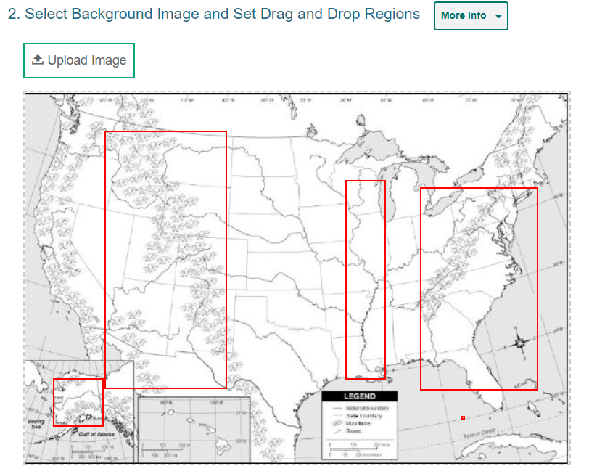
Images in Response Section
Notes:
Two of the item types in Authoring require you to upload images in the response section. In Hot Spot items, students select one or more clickable regions on an image or a diagram to respond to a question. In the Image Drag and Drop item students drag answers into “drop boxes” in an image or diagram.
You can insert JPG, PNG, or GIF files. They must be smaller than 600 x 600 pixels and must be under 1.5 MB. Keep this in mind as you search online or in a district system for images to use. Be sure to verify the copyright status of any online image so you comply with legal permissions.

Slide 4
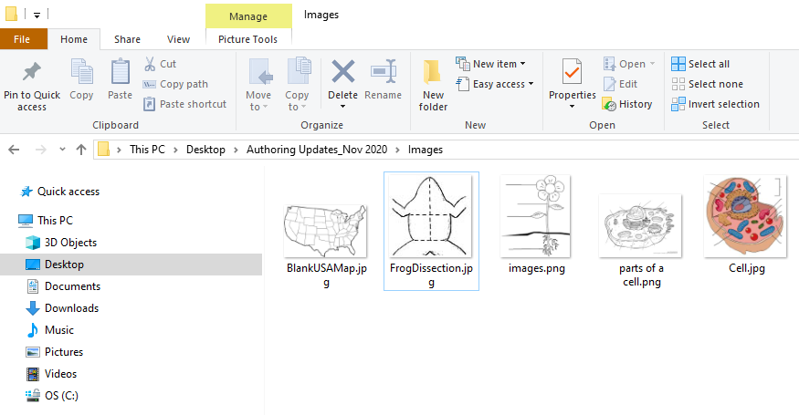
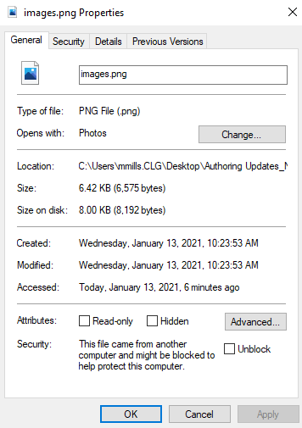
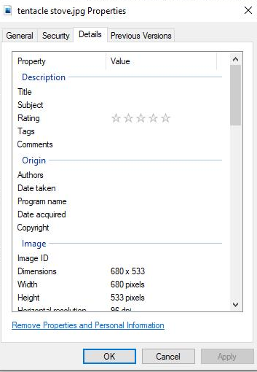
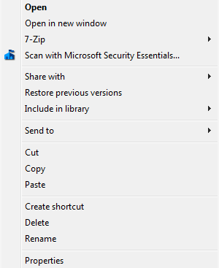
Easy Way to Check Dimensions and Size in Windows
3. The file size is here.
4. Click on the Details button above for the pixel dimensions.
1. Right-click on an image you have saved.
2. Click on Properties
Notes:
You can check the size and dimensions of the images you have saved on your Windows computer before you upload them to Authoring.
1. In a File Explorer folder, right-click an image file you want to check.
2. Then click on Properties at the bottom of the menu.
3. The file size displays on that page under size.
4. To check the pixel dimensions, click the Details button at the top of the page. The width and height display on that page.

Slide 5
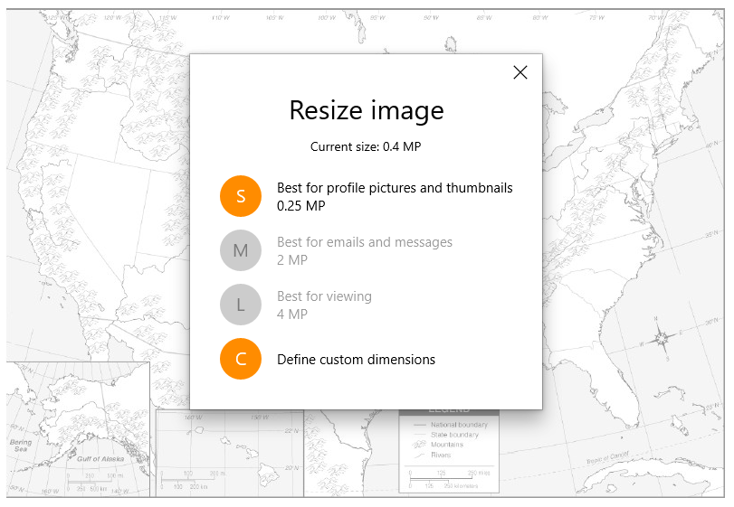
Resize a Saved Image
Notes:
If you need to resize an image you have saved, Windows has a setting for that in the Photo Manager. First open the image file in Photo Manager. Then select Resize and set the Custom Dimensions to something under 600 x 600 pixels.

Slide 6
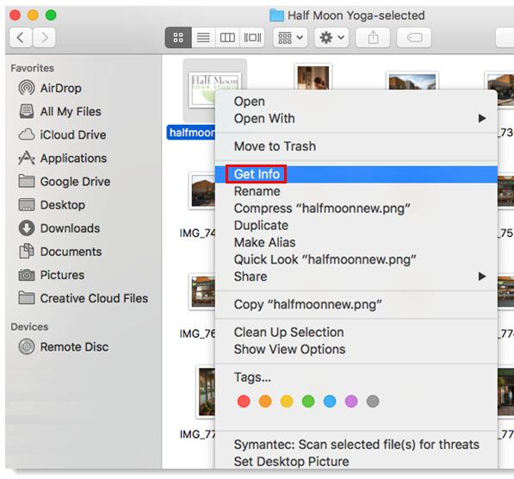
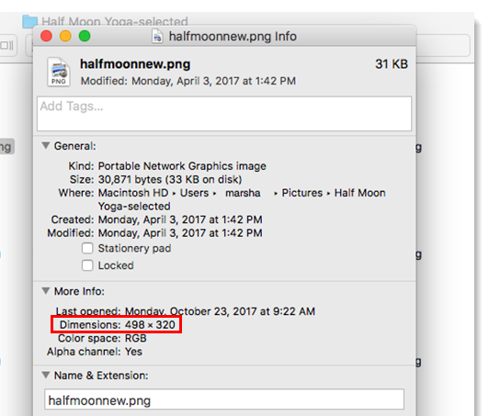
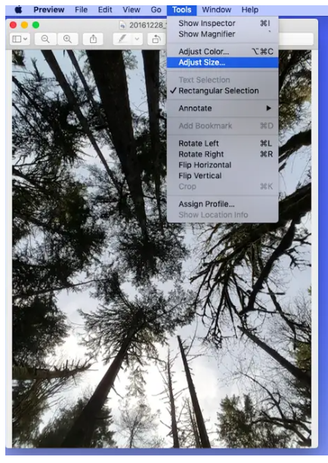
Easy Way to Check Size and Dimensions in Mac
Notes:
To check the size of an image in a folder on an Apple computer, click Control+Click on the image file in a folder. Click Get Info in the window that appears. Expand the General section to see the file size and the More Info section to see the dimensions. There is also a setting under Tools that allows you to Adjust Size.

Slide 7
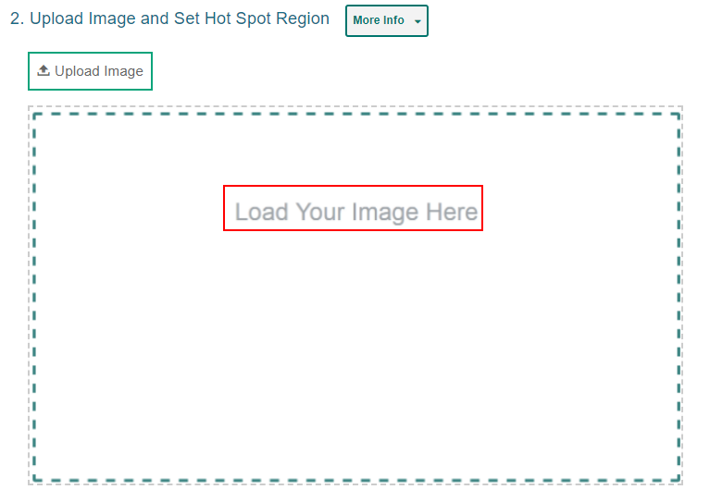
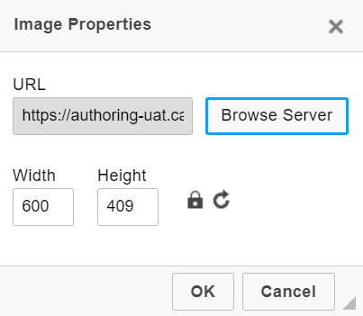
Upload an Image
1
2
3
Notes:
The image import process is the same for Hot Spot items and Image Drag and Drop items. First create the item type using the content tab or the quick link from the Dashboard or search for an item in Draft mode that you want to edit.
In Section 2 of the item template, click Upload Image. In the Image Properties window click Browse Server. If the image you want to use for the item is already available in the File Manager window, select it and click Add to Item. You can use the search bar in the corner to search for an image by its file name. If the image you want to use is not available in the File Manager window, click Upload File and select an image file from your computer.

Slide 8
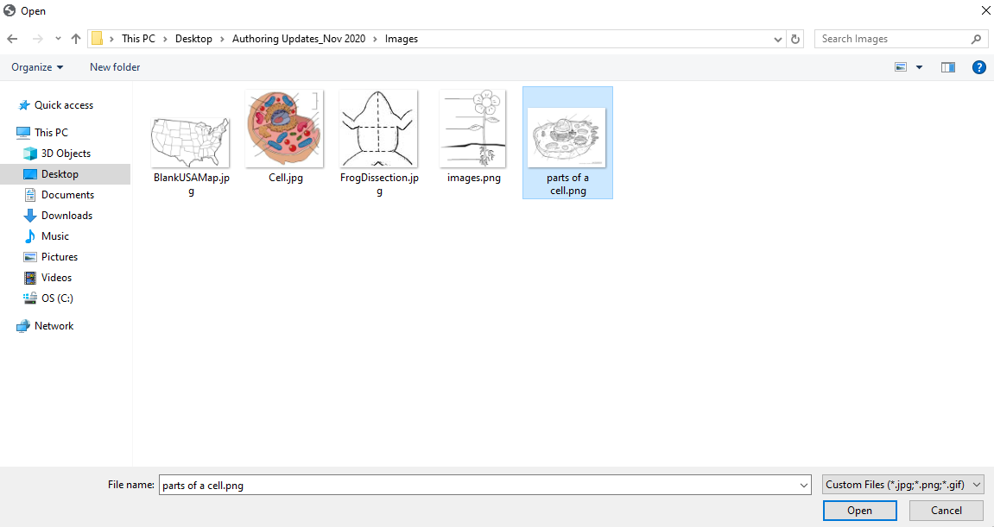
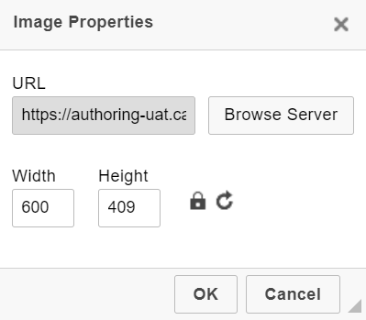
Upload an Image (continued)
4
5
6
Notes:
Select the image and click Add to Item. In the image properties window, click OK.

Slide 9
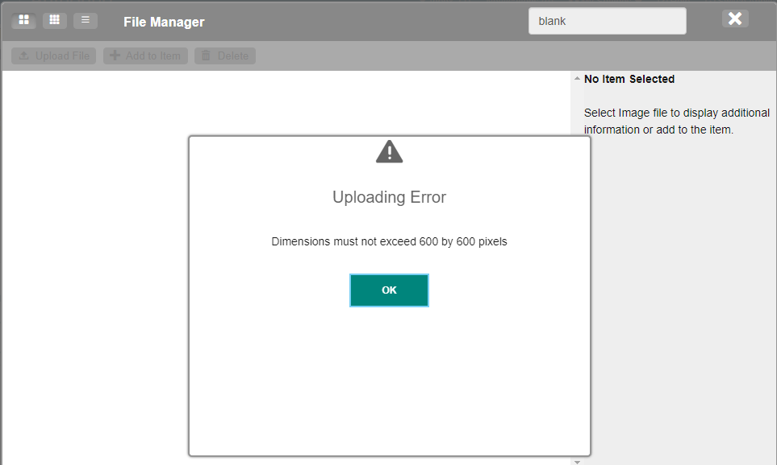
Upload an Image (Error Message)
Notes:
If there is an issue with the file, an error message appears when you try to upload it.

Slide 10
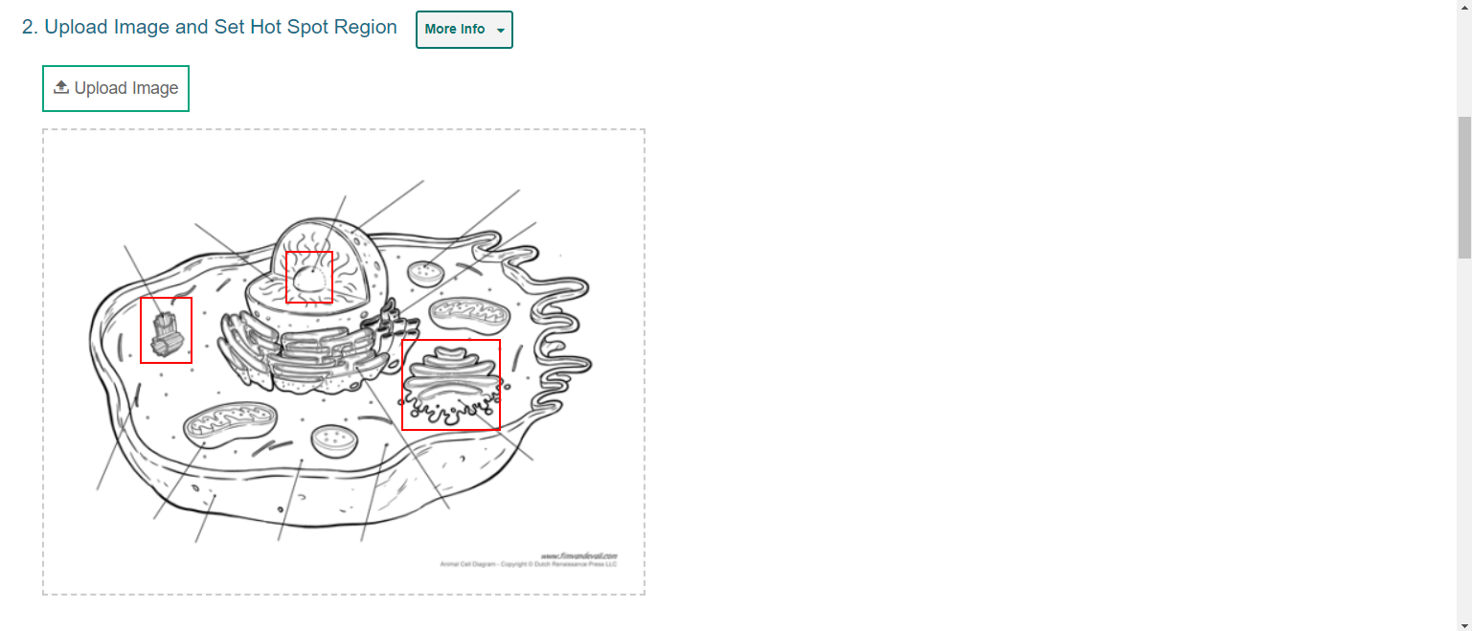
Add Regions
Notes:
Now you are ready to add your hot spot regions or drag and drop boxes to the image.

Slide 11
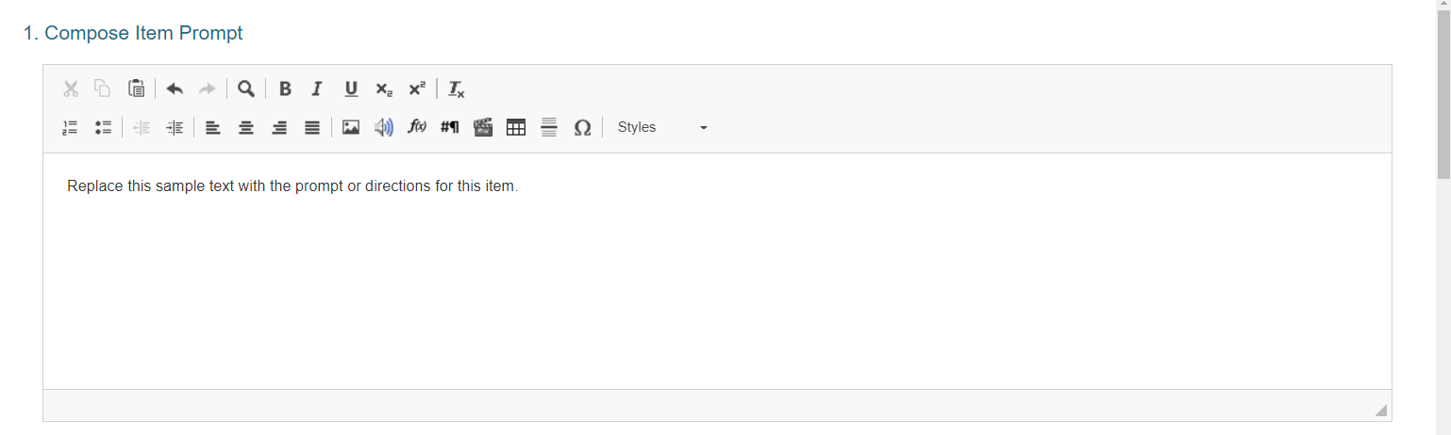
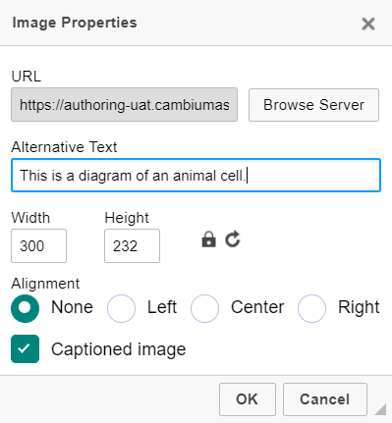
Insert Images with the Text Editor
Notes:
You can also add JPG, PNG or GIF images to your instructions in Section 1 of an item template: Compose Item Prompt. The same size and dimension requirements apply. Click on the image button in the toolbar and upload a file to the Media Upload page using the same import process. You have some additional options in the Image Properties window. You can create alternative text for screen readers. You can select an alignment preference. And you can change the image dimensions using the Width and Height fields. Click the open lock icon to lock the width-to-height ratio. To reset the image dimensions, click the arrow button. You can add a caption to the image by checking the Captioned Image box.

Slide 12
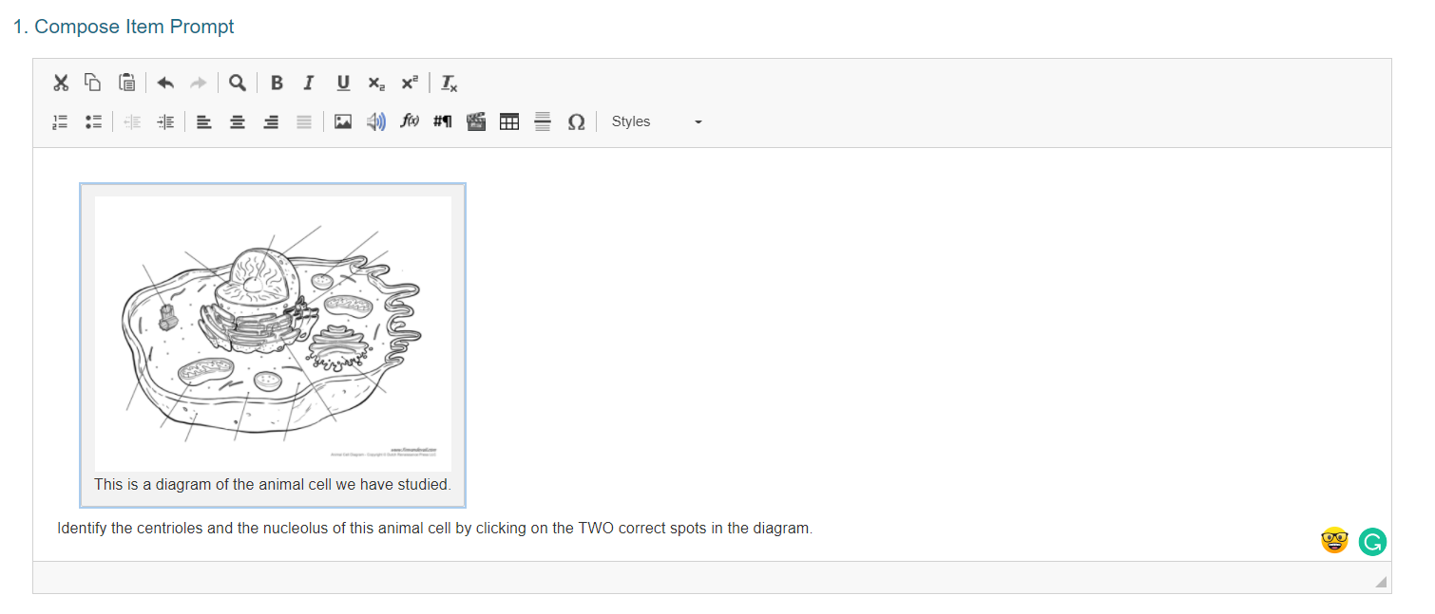
Item Prompt with Image
Notes:
Here is what the captioned diagram looks like under the Compose Item Prompt section.

Slide 13
For More Help
You can contact the Helpdesk for assistance with any technical issues you encounter. When contacting the Helpdesk, please be ready to provide:
Any error messages that are appearing (including codes)
Your operating system and browser information
Your network configuration information
Your contact information for follow-up by phone or email
Any other relevant information, such as test names or content areas, student IDs, session IDs, and search criteria
For test administration or policy issues, please contact your district test coordinator.
Further Information
Id.portal.cambiumast.com
Idaho Help Desk
Toll-Free Phone Support: 1-844-560-7365
Email Support: IDHelpDesk@cambiumassessment.com
Thank you!
Notes:
You can find additional Authoring resources on the Idaho State Portal. However, if you still require assistance with troubleshooting a technical issue, you may also contact the Helpdesk. When contacting the Helpdesk, please be ready to provide the following information:
Any error messages that are appearing (including codes)
Your operating system and browser information
Your network configuration information
Your contact information for follow-up by phone or email
Any other relevant information, such as test names or content areas, student IDs, session IDs, and search criteria
For questions about test administration or policy issues, please contact your district test coordinator.
Thank you for taking the time to view this training module. For detailed information, consult your Authoring Guide located on Idaho State Portal or contact the Help Desk.

Slide 14
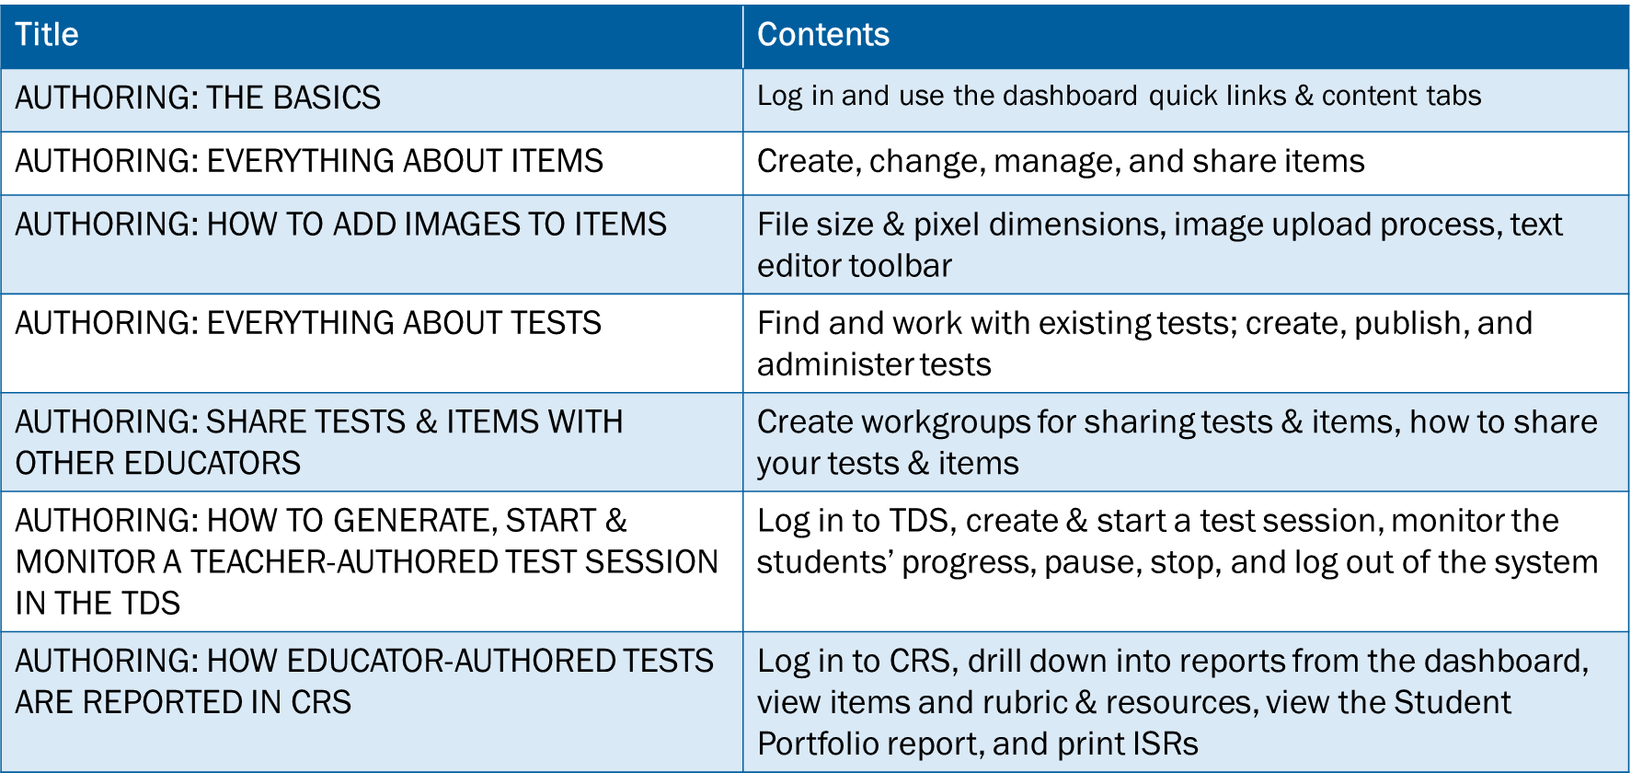
Training Modules in the Series
Notes:
Here are the modules that make up the Authoring system training series. They may be posted on the Idaho State Assessment portal.

