Slide 1
Authoring: everything about tests
— Find and Work with Existing Tests
— Create, Publish, and Administer Tests
2023–2024
Notes:
Welcome to this training module for the Authoring system. This training module covers how to find and work with existing tests, and how to create, publish, and administer tests.
Please note that your Idaho’s version of the Authoring system may slightly differ from the images shown in this presentation.

Slide 2
Objectives
Topics | Slides
1. How to Find Tests Using Quick Links, Content Tab, and the Standards Panel | 3–11
2. How to Perform Common Tasks on Tests | 12–25
— Preview a Test | 14
— Copy/Duplicate a Test | 15
— Edit a Test with Draft Status | 16
— Add a Label | 17–18
— Share Tests with Other Educators | 19–21
— Build a Test Booklet for Printing | 22–24
— Archive, Delete, or Restore a Test | 25
Topics | Slides
3. How to Automatically Create a Test | 26–32
4. How to Manually Create a Test | 33–37
5. How to Publish a Test and Change Administration Dates | 38–40
6. How to Create Workgroups for Sharing Tests with Other Educators | 41–43
7. More Information and More Modules | 44–45
Notes:
Here are the topics covered in this training module:
1. How to Find Tests Using Quick Links, Content Tab, and the Standards Panel
2. How to Perform Common Tasks on Tests, such as:
— Preview a Test
— Copy/Duplicate a Test
— Edit a Test with Draft Status
— Add a Label
— Share Tests with Other Educators
— Build a Test Booklet for Printing
— Archive, Delete, or Restore a Test
3. How to Automatically Create a Test
4. How to Manually Create a Test
5. How to Publish a Test and Change Administration Dates
6. How to Create Workgroups for Sharing Tests with Other Educators
7. More Information and More Modules
Slide numbers are provided so you can quickly reference a specific section of this module.

Slide 3
How to Find Tests Using Quick Links, the Tests Content Tab, and the Standards Panel
Notes:
First, we cover how to find tests using the quick links, the tests content tab, or the standards panel. Then, we explain the common tasks and actions you can perform on the tests.

Slide 4
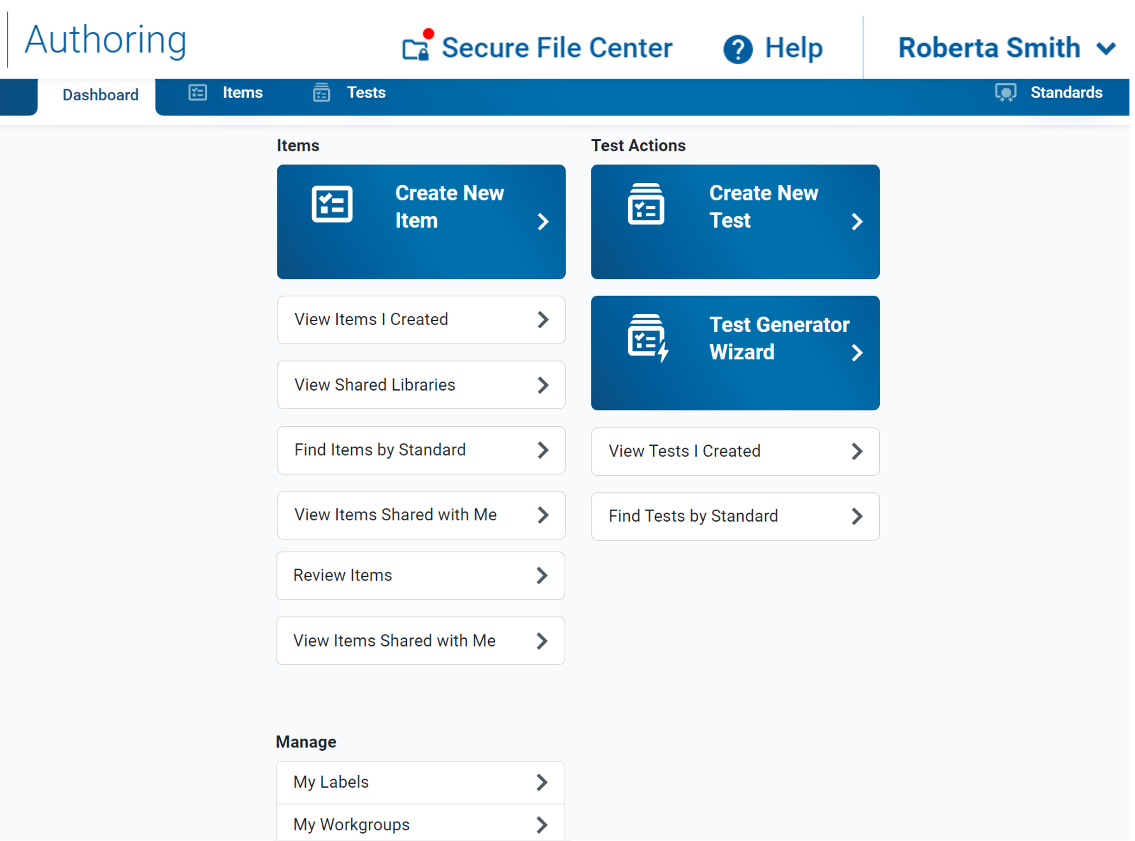
Dashboard Features Related to Tests
Tests Content Tab
Standards Panel
Quick Links Used to Start Common Tasks
Notes:
The Authoring site opens with a dashboard featuring quick links where you can quickly jump to common tasks related to testing, as well as a content tab for working with tests and a panel for viewing standards. These features help you find tests and perform actions on the tests that you need to administer. They also allow you to manually create new tests or create tests with the Test Generator Wizard.
The quick links listed under Test Actions are described on the next slide.

Slide 5
Tests Quick Links
Test Link | Description
Create New Test | Opens the test builder page where you can manually create a new test
Test Generator Wizard | Opens the Test Generator Wizard, which allows you to automatically generate a new test based on the standards you want it to assess
View Tests I Created | Opens the Tests tab, filtered to show you only your own tests that were created or edited within the last 30 days
Find Tests by Standard | Opens the Tests tab with the filter panel focused on the Standards search bar so that you can locate tests with items aligned to a specific standard; you will need to enter a standard key and click Apply in order to display the tests
Notes:
On this slide you can read a description of what will open when you select the quick links listed under Test Actions on the dashboard.

Slide 6
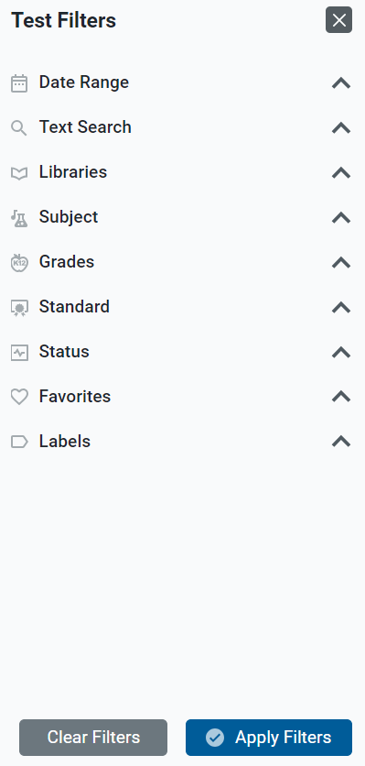
Tests Content Tab
Notes:
The Tests Content tab displays in the banner of all Authoring pages. When the tab is first opened, a message appears prompting you to select options from the Test Filters panel, shown here. Filter options include Date Range, Text Search, Libraries, Subject, Grades, Standard, Status, Favorites, and Labels. Your Authoring site may display more or fewer options depending on your state’s configuration. Filter options are addressed throughout this training module.
Make the necessary selections in the drop-down menu and click Apply Filters. You can clear the filters at any time while working in the Authoring site by selecting the Show Filters button under the Dashboard banner and selecting the Clear Filters button.

Slide 7
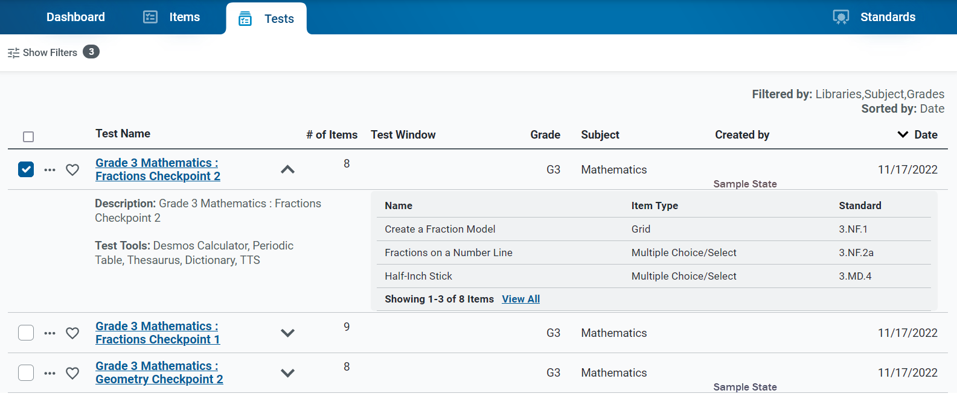
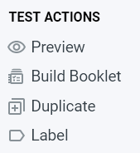
Tests Content Table (continued)
Notes:
Here is an example of a tests content table, filtered by libraries, subject, and grade. The details under the expansion arrow include a description of the test, the test tools assigned to it, and a list of the items included on the test. Click the dotted menu to display a list of test actions you can take, such as Preview, Build Booklet, Duplicate, and Label. These actions are addressed in this training module.

Slide 8
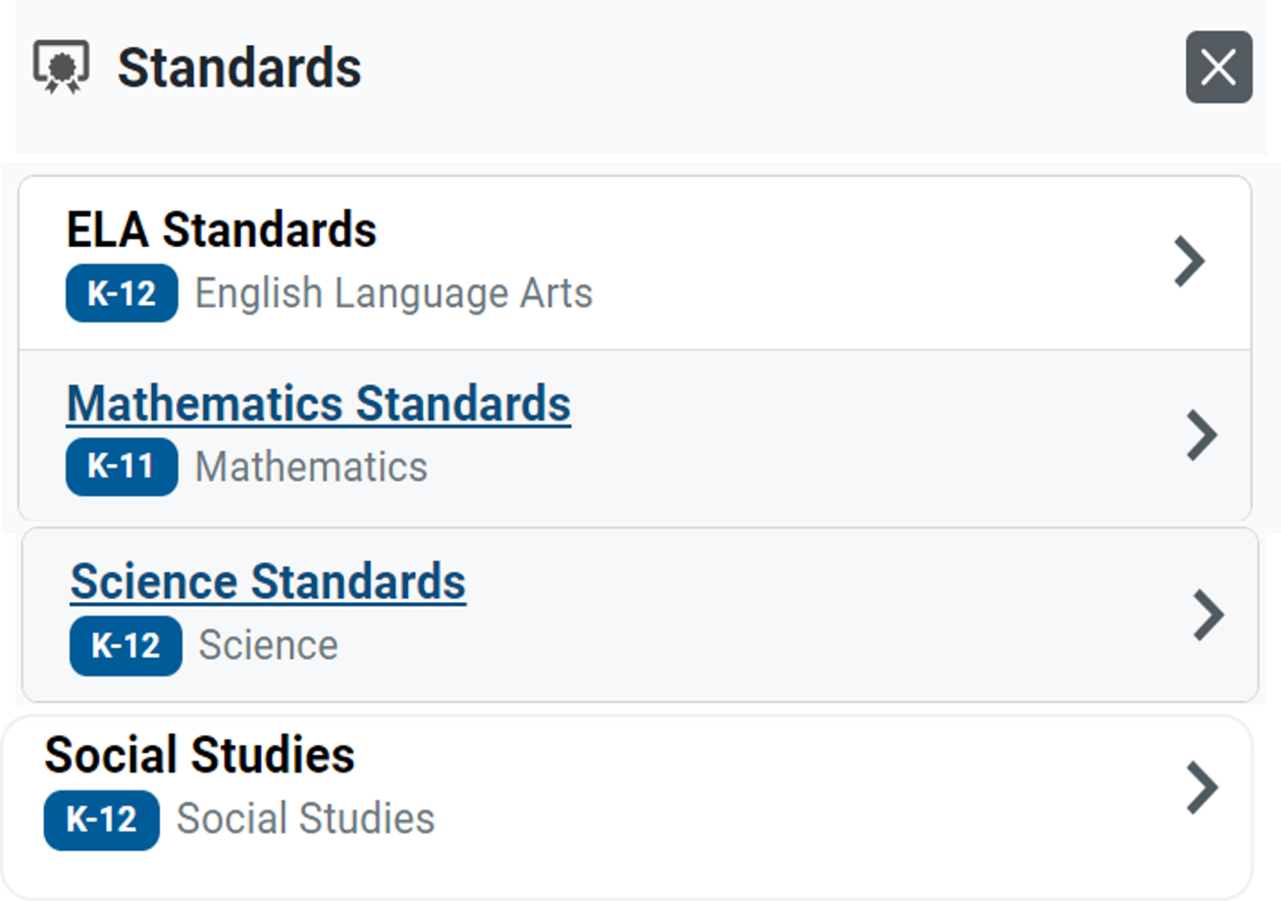
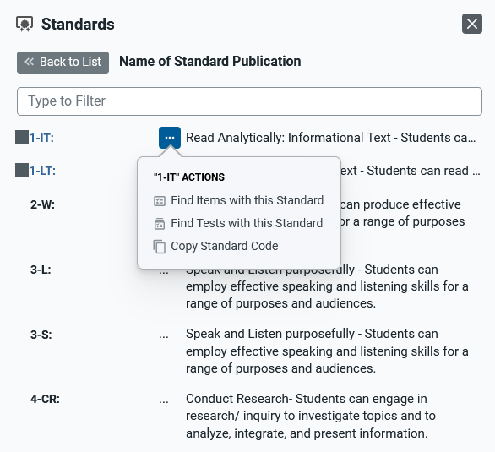
Standards Panel
Notes:
You can use the Standards panel in the Dashboard banner to view the assessment standards published by your assessment program. You can also use this feature to find tests aligned to a specific standard.
Here is an example of the Standards panel showing the standard trees for ELA, mathematics, science, and social studies. Expand the standard categories until you locate the standard you are looking for. You can also search for the standard at the top of this panel in the Type to Filter field. To use the actions options, click the dotted menu to the left of a specific standard. Options include Find Items with this Standard, Find Tests with this Standard, and Copy Standard Code.
Standards identify the specific skills or areas of knowledge that an item measures. Aligned standards will appear in the reports for Authoring tests, helping you pinpoint the specific areas in which a student may be excelling or may need additional support.

Slide 9
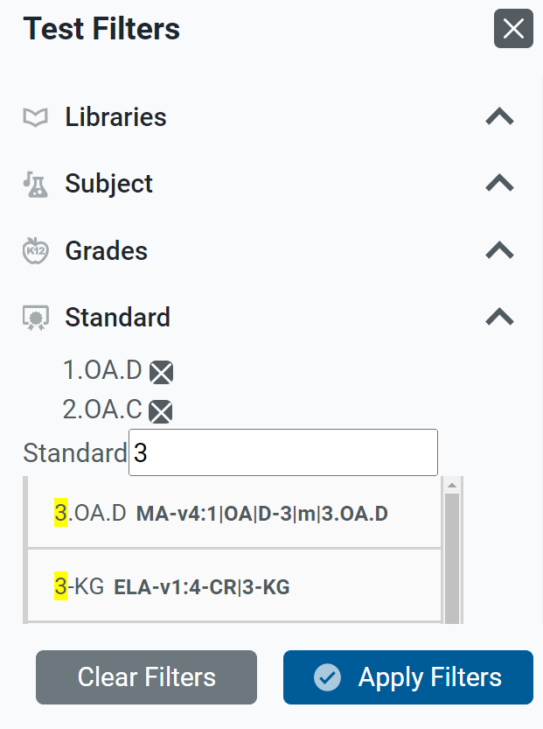
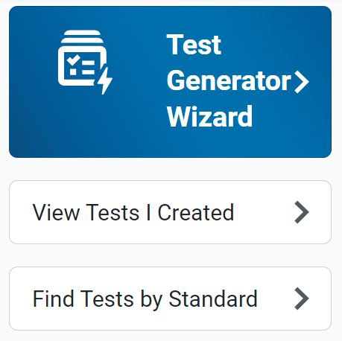
Find Tests by Standard (Quick Link)
Notes:
To search for tests aligned to a certain standard, you can use the quick link “Find Tests by Standard.” In the Standard field of the Test Filters panel, type in a few letters of the standard key, such as a number or a letter. A list of possible matches displays in a drop-down list. Select one or several standards; the standards you select are displayed above the search box. Click Apply Filters.
The next slide shows a table of results aligned to your selected standards.

Slide 10
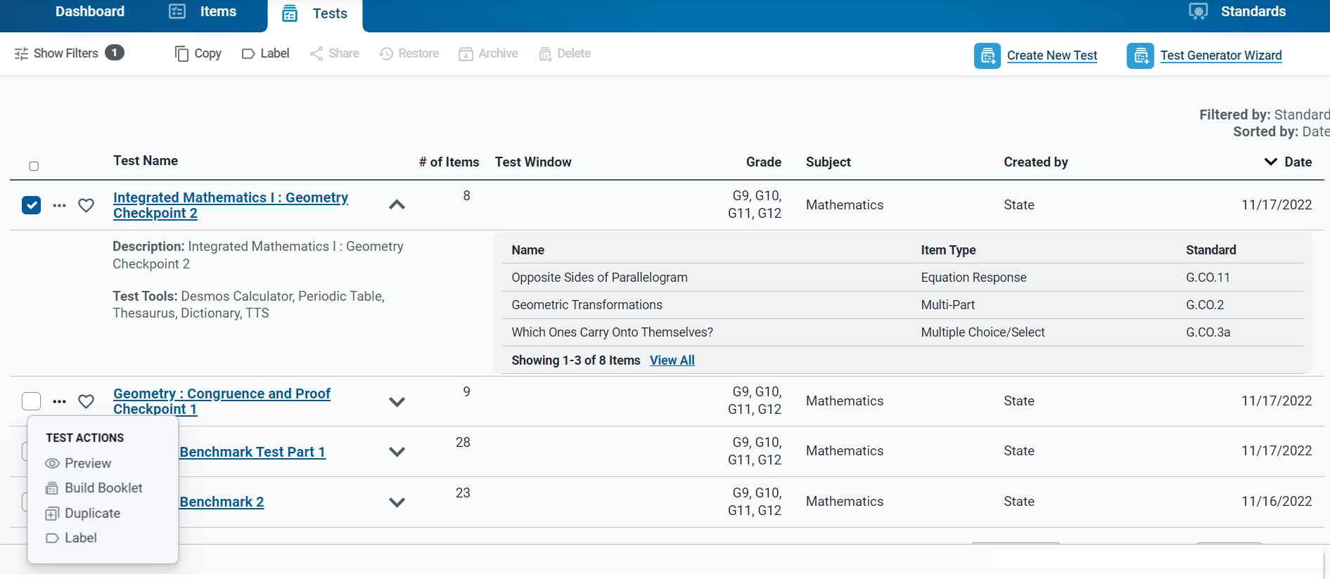
Tests Table Filtered by Standard
Toolbar
Notes:
The table of results displays all tests aligned with the selected standards and the standards are noted in the test details section. You have options in the toolbar above the table and in the dotted menu that opens the Test Actions drop-down menu. From the toolbar you can copy or label the test. Under test actions, you can preview the test, build a test booklet for printing, duplicate the test, and label the test.
Note that the Copy function in the toolbar is the same as the Duplicate function in the Test Actions menu. The Label function is in both places, as well.

Slide 11
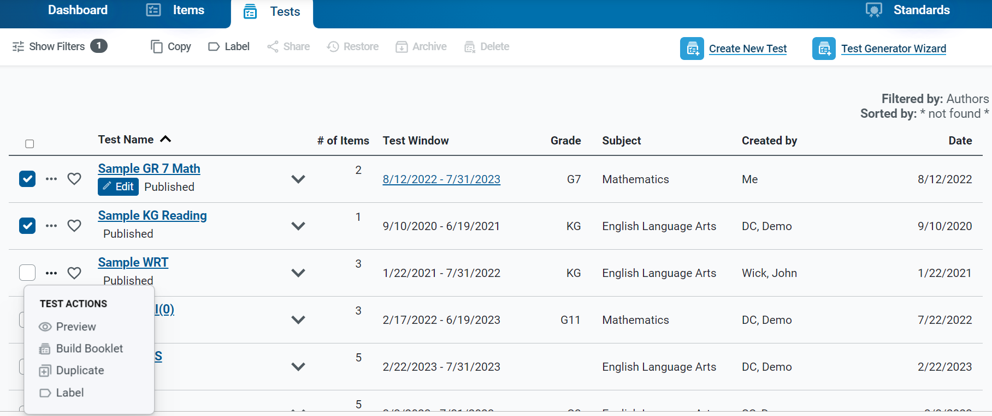
Two Ways to Perform Actions on Tests
Toolbar
Notes:
We have shown you how to find tests using the quick links, content tab, and standards panel. When working with the tests, you will find there are two ways to perform actions; you can perform an action on a single test or perform an action on a group of tests.
To perform an action on a single test, select the action using the dotted menu to the left of the Test Name.
To perform an action on multiple tests at once, mark the checkboxes for each test you want to affect and then use the buttons in the toolbar to apply the action to all of them.
The next section goes into detail on the actions you can perform on tests.

Slide 12
How to Perform Common Tasks on Tests
Notes:
This section covers the common tasks or actions you can perform on tests.

Slide 13
Actions Available on Tests
Icon/Action | Description
 | Preview tests to see how they will appear to students in the Test Administration Site.
 | Copy tests you want to modify without affecting the original version.
 | Label tests so it is easier to organize and locate on your content tab tables.
 | Share tests with other educators so they can co-author them with you or use the tests for themselves.
 | Build a test booklet that can be administered to students on paper (not available for Alternate Assessment items).
 | Archive tests that you do not use anymore. Delete a Draft test. Restore an archived test.
Notes:
Here is a list of the actions you can take on tests. The actions you can perform may depend on the test’s status and library. The buttons shown here display in the toolbar above the results table or in the dotted menu.
This section covers these actions in the order that they appear in this table.

Slide 14
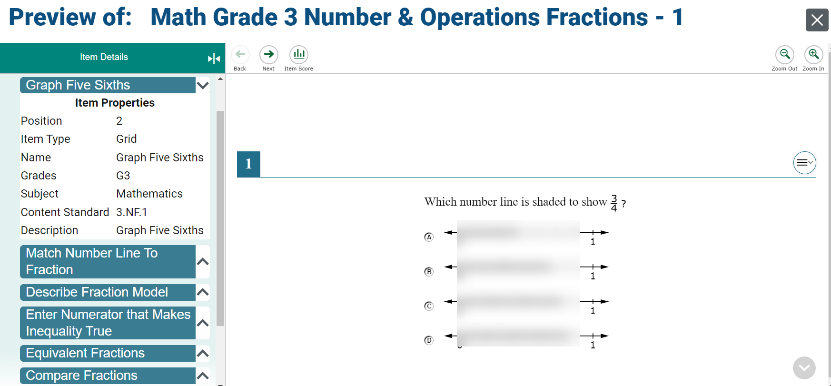
Previewing Tests
Notes:
To preview a published test, click the Preview button on the dotted menu to the left of the Test Name on the results table. The test displays the items under the Item Details panel on the left. You can expand each separate item to view the properties assigned to it. You can use the Item Score button to check the answer key options. Use the Next and Back buttons to move through the items included in the test.

Slide 15
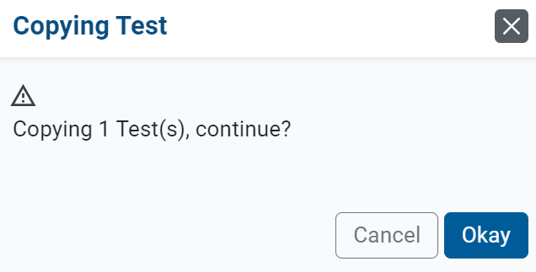
Copy/Duplicate a Test
Copied tests can be edited.
Notes:
You can create copies of any test that you wish to modify without affecting the original version. To do so, open the Tests tab and mark the checkbox for each test you wish to copy. Click the Copy button in the toolbar or the Duplicate button in the Test Actions dotted menu. Click OK in the message that displays. The copied test is added to the results table. You can now click the name of the copied test to edit the content. As shown here, you may be able to share and delete copied tests.

Slide 16
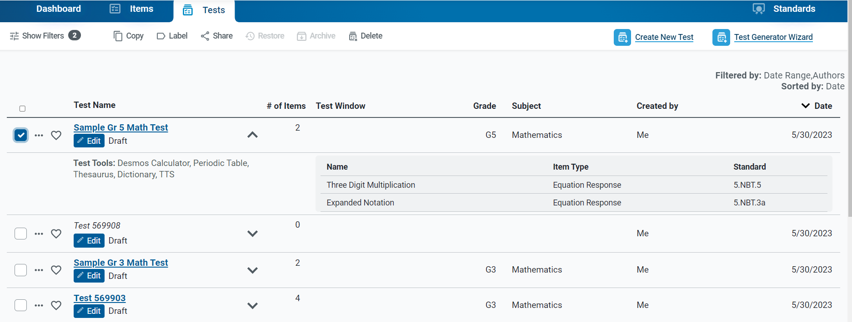
Making Changes to Your Tests
Notes:
You can modify the content of any test you have created if it has a Draft status. After you publish a test, you cannot edit that test’s items or properties.
When another educator shares a test with you, you may only edit the test’s content if you were given editing permissions by the original author. You can also make copies of shared tests and edit the copies.
To make changes to your tests, open the Tests tab and click the Edit button under the name of the test you want to edit (you may need to apply filters first). The corresponding test builder page will appear.

Slide 17
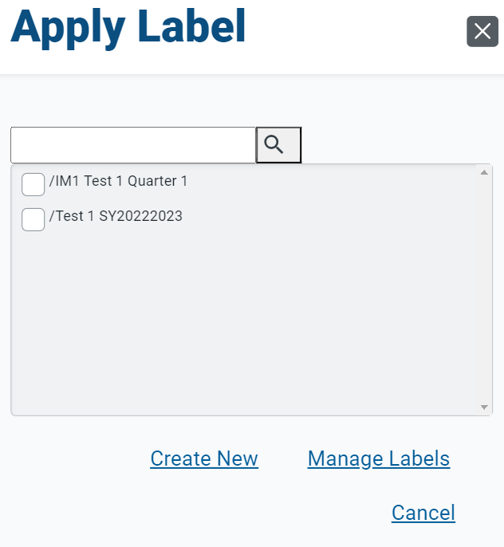
Apply a Label
Notes:
You can create labels and add them to tests that you want to organize in the content tab. Open the Tests tab and mark the checkbox for each test you wish to label; to label an individual test, use the dotted menu option. Click the Label button in the toolbar; the Apply Label window will appear. You can search for a label, or you can select a sub-label from a drop-down menu and click the Apply button.
After adding labels to your tests, you can use the Labels menu in the filter panel on the left of the Tests tab to easily view the tests with the selected label. You can create labels for any content in your libraries, but these labels appear on your screen only. They are unique to your account and do not display for anyone else the content is shared with.

Slide 18
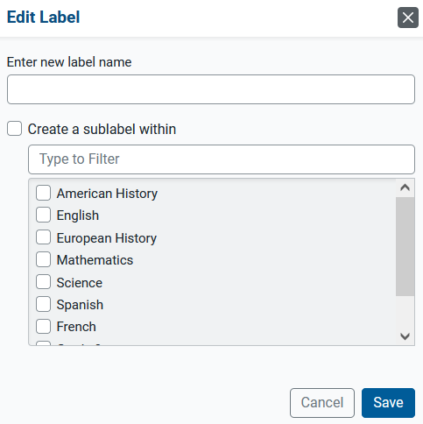
Create a New Label
Notes:
To create a new label, click the Create New button to display the Edit Label pop-up window where you can enter a new label name. You can add a sub-label within the label by making selections from the drop-down menu. When you have created your label, click Save.

Slide 19
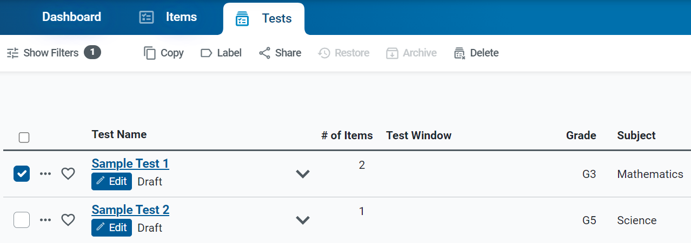
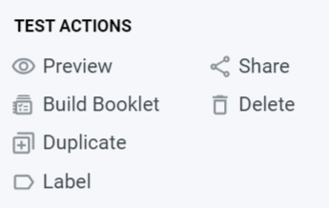
How to Share Your Tests with Others for Administration
1
Notes:
When sharing tests with other educators, you can choose to share the test in Authoring for collaboration purposes or in the Test Administration Site, where they can administer it to students. Begin by filtering the Tests content tab for the tests you want to share. To share an individual test, click the dotted menu to the left of the test and select Share.
1. To share multiple tests, mark the checkboxes of the tests you want to share and click the Share button in the toolbar.

Slide 20
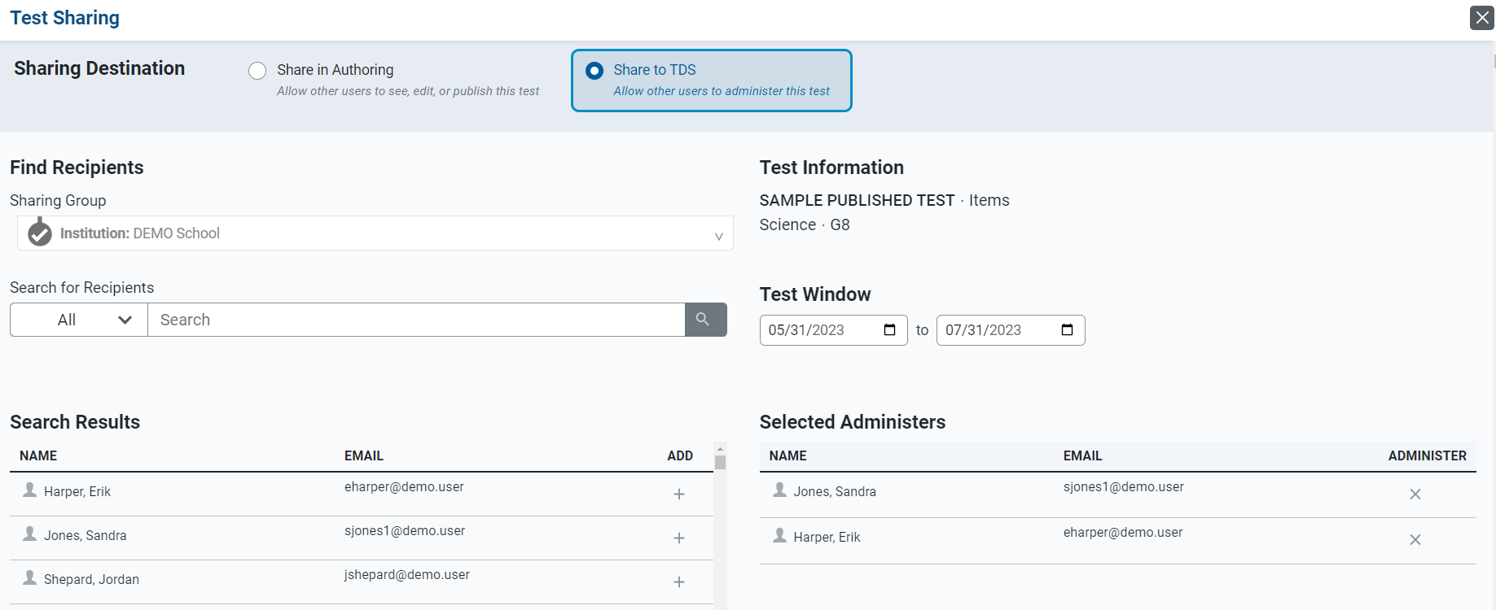
How to Share Your Tests with Others for Administration (continued)
2
3
5
4
6
Notes:
2. The Test Sharing window appears; to share the test so it can be administered by other educators, mark the Share to TDS radio button.
3. Search for an educator’s name or email address, or the name of a workgroup or institution. Select the recipients you want to share your content with.
4. In the Search Results, click + for each educator you wish to add as a recipient.
5. Enter or change the dates in the Administration Period fields.
6. Click Save. The tests will now appear in the Select Tests tab of the TDS for the selected recipients.

Slide 21
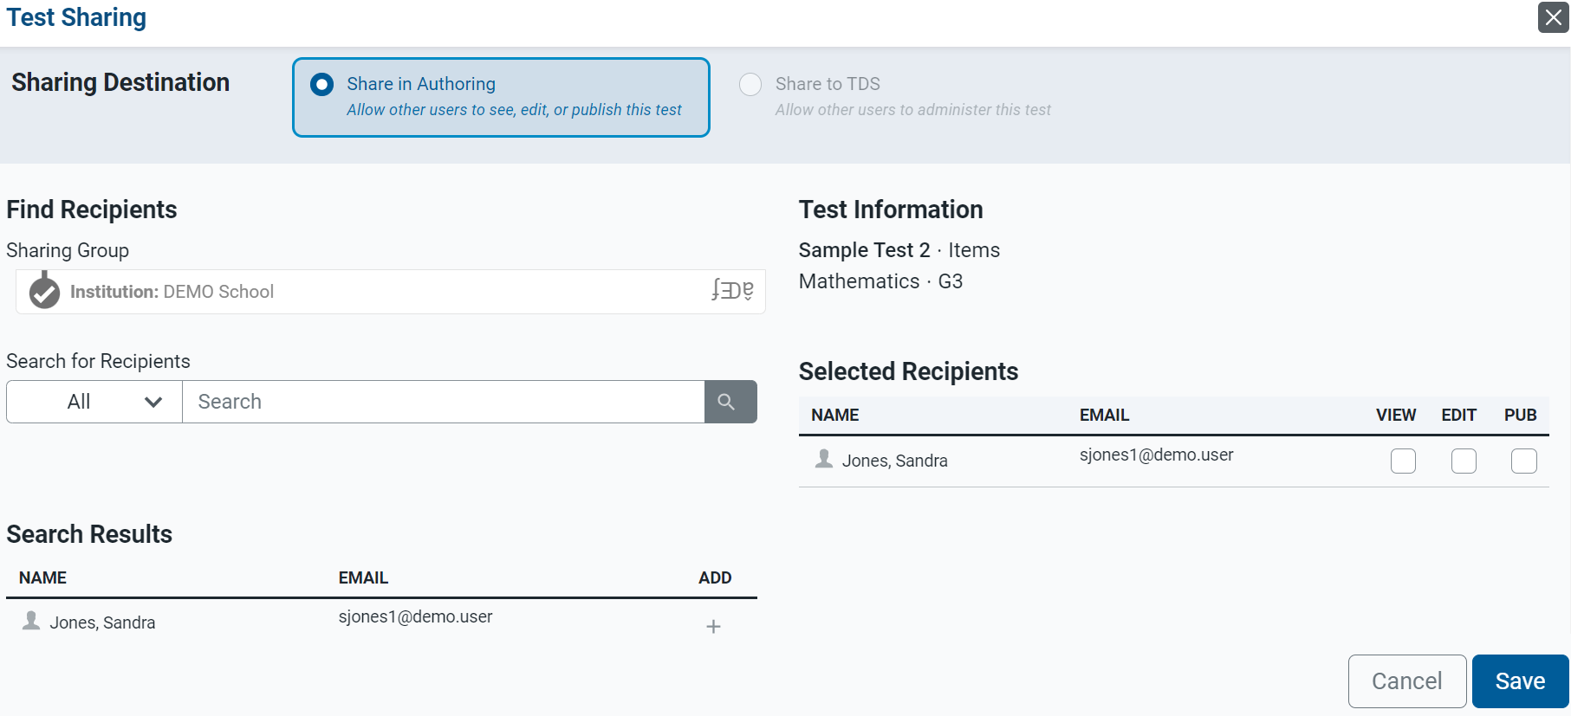
How to Share Your Tests with Others for Collaboration
1
2
4
3
Notes:
When sharing tests with other educators for collaboration purposes;
select the Share in Authoring radio button at the top of the Test Sharing page;
find recipients by using the Sharing Group field and the Search for Recipients menu;
use the Search Results column to Add recipients; and
select the specific permissions you would like to give to each recipient. All recipients will be able to create copies of your shared content by default.
To allow a recipient to view the tests, mark the View checkbox.
To allow a recipient to make edits to the shared tests, mark the Edit checkbox.
To allow a recipient to publish the tests, mark the Publish checkbox.

Slide 22
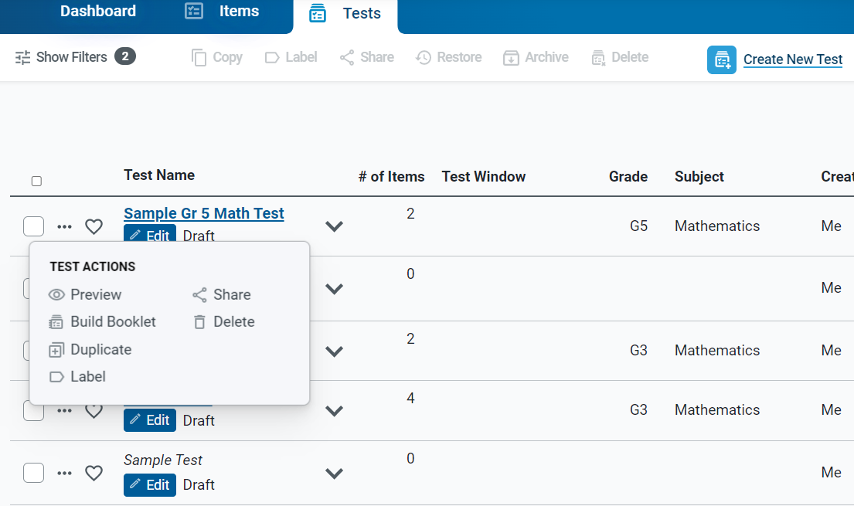
Build a Test Booklet
Notes:
If you plan to administer a test to students on paper, you can generate a test booklet with paper-friendly versions of the test items. When building a test booklet, you can customize the cover page, test instructions, resources, and end test page. You can also choose whether to create a student edition or a teacher edition (the teacher edition includes the scoring information).
Open the dotted menu and click the Build Booklet button under Test Actions.

Slide 23
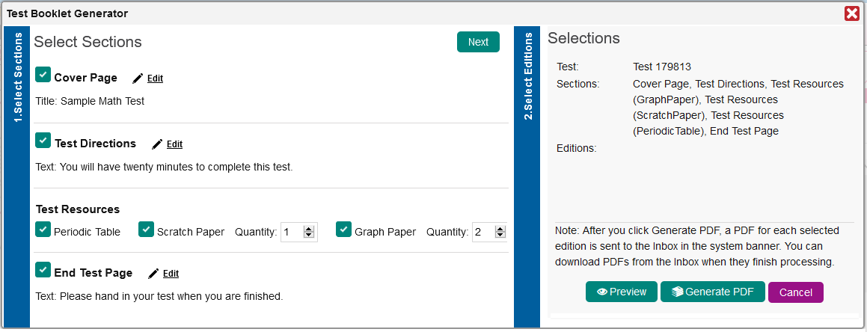
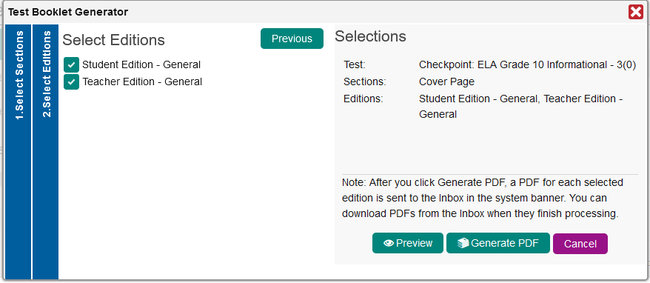
Test Booklet Generator
Notes:
The Test Booklet Generator window opens, displaying the Select Sections panel. Use this panel to customize the booklet with a cover page, test directions, test resources, and an end test page. After customizing the test booklet sections, click Next. The Select Editions panel appears. Mark the checkbox for each edition of the booklet that you wish to generate. It is important to preview the booklet to ensure that it does not include any items with multimedia or items from a shared library that do not have paper-friendly formatting.

Slide 24
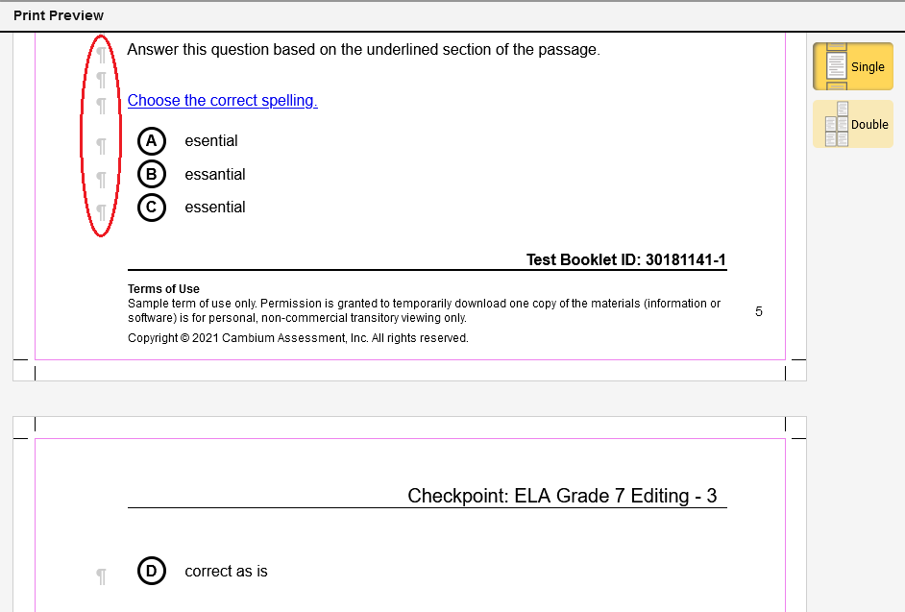
Preview the Booklet
Notes:
Here is a sample Print Preview page. You can view the booklet one page at a time or two side-by-side pages. You can click the paragraph icons to insert page breaks in the booklet.
Return to the Test Booklet Generator page and click Generate PDF. A PDF file for each selected edition type will be added to the Secure File Center once the task finishes processing.

Slide 25
Archiving and Deleting Tests You No Longer Need
Content Type | Archive and Delete Permissions
Draft Tests | Draft tests can be deleted. Draft tests cannot be archived.
Published Tests | Published tests cannot be deleted. Published tests can be archived.
Notes:
You can archive and delete content that you no longer with to use. This will remove it from your content tab tables. Archived and deleted content cannot be shared, administered, or associated with other content. Your ability to archive and delete content depends on its status and other conditions explained in this table. For example, you cannot archive or delete any tests in a shared library.
Open the appropriate content tab and mark the checkbox of the test you wish to delete or archive. Click the appropriate button in the toolbar. A pop-up window displays along with a pre-populated command related to the items on the test. Click OK.
If you wish to restore an archived test, set the Status filter to Archived, then mark the checkbox for the content you wish to use again and click Restore above the table.

Slide 26
Create a Test with the Test Generator Wizard
Notes:
This section covers how to create a test automatically using the Test Generator Wizard.

Slide 27
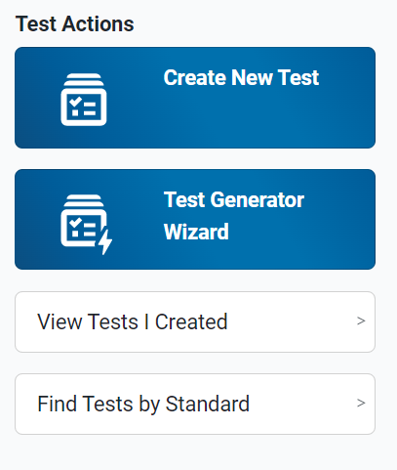
Access the Test Generator Wizard
Notes:
To access the Test Generator Wizard, click the quick link on the dashboard under Test Actions. Or, if you have the Tests content tab open, click the Test Generator Wizard tab in the Tests toolbar.

Slide 28
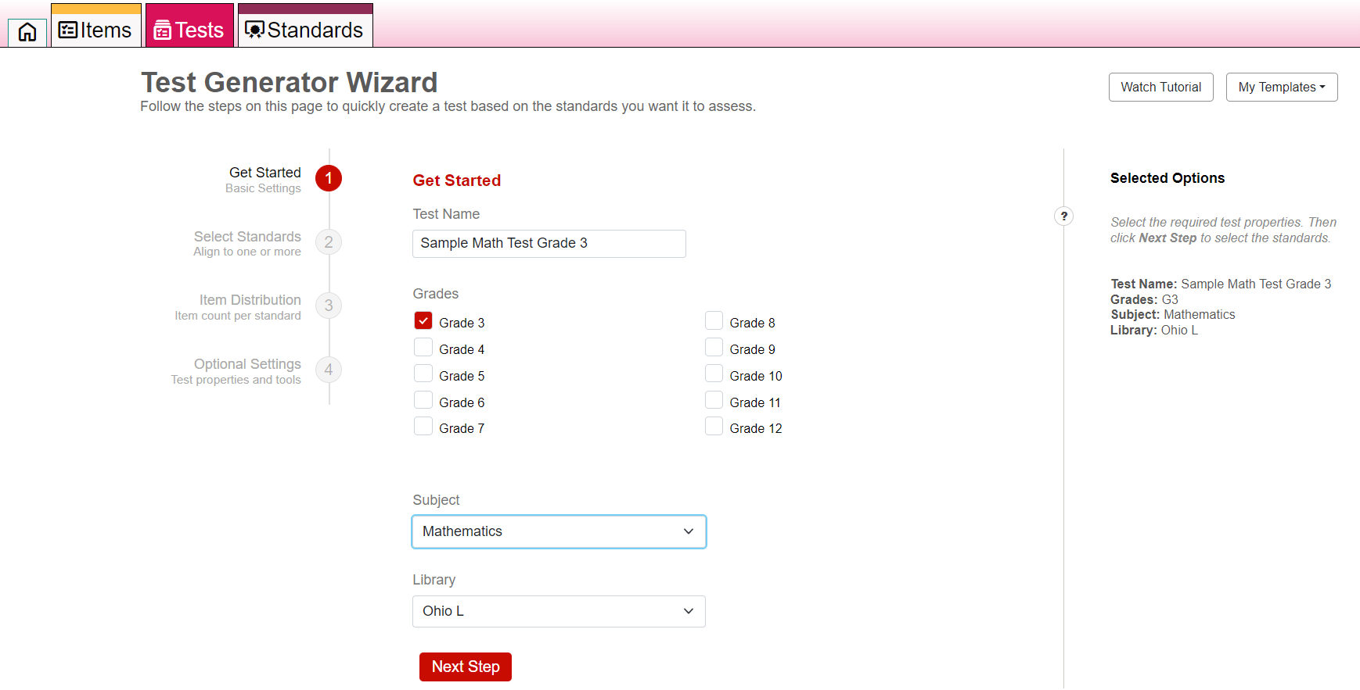
Steps in the Process: Step 1—Get Started
Notes:
There are three required steps in the process of generating a test with the Test Generator Wizard. They are: Step 1: Get Started, where you will enter a name for your test and select a grade and subject from the drop-down lists, Step 2: Select Standards, where you will align the test to one or more standards, and Step 3: Item Distribution, where you will assign an item count to each standard. Then, you can use the Optional Settings to assign test properties and tools.
The Wizard will automatically build the test based on your chosen parameters.
You can also generate a test based on an existing template, in which the properties, standards, and item counts are pre-selected. To do this, use the My Templates button at the upper-right corner of the page.
As you make your selections, they populate under Selected Options in the right side of the page. Click the red Next Step button to progress.

Slide 29
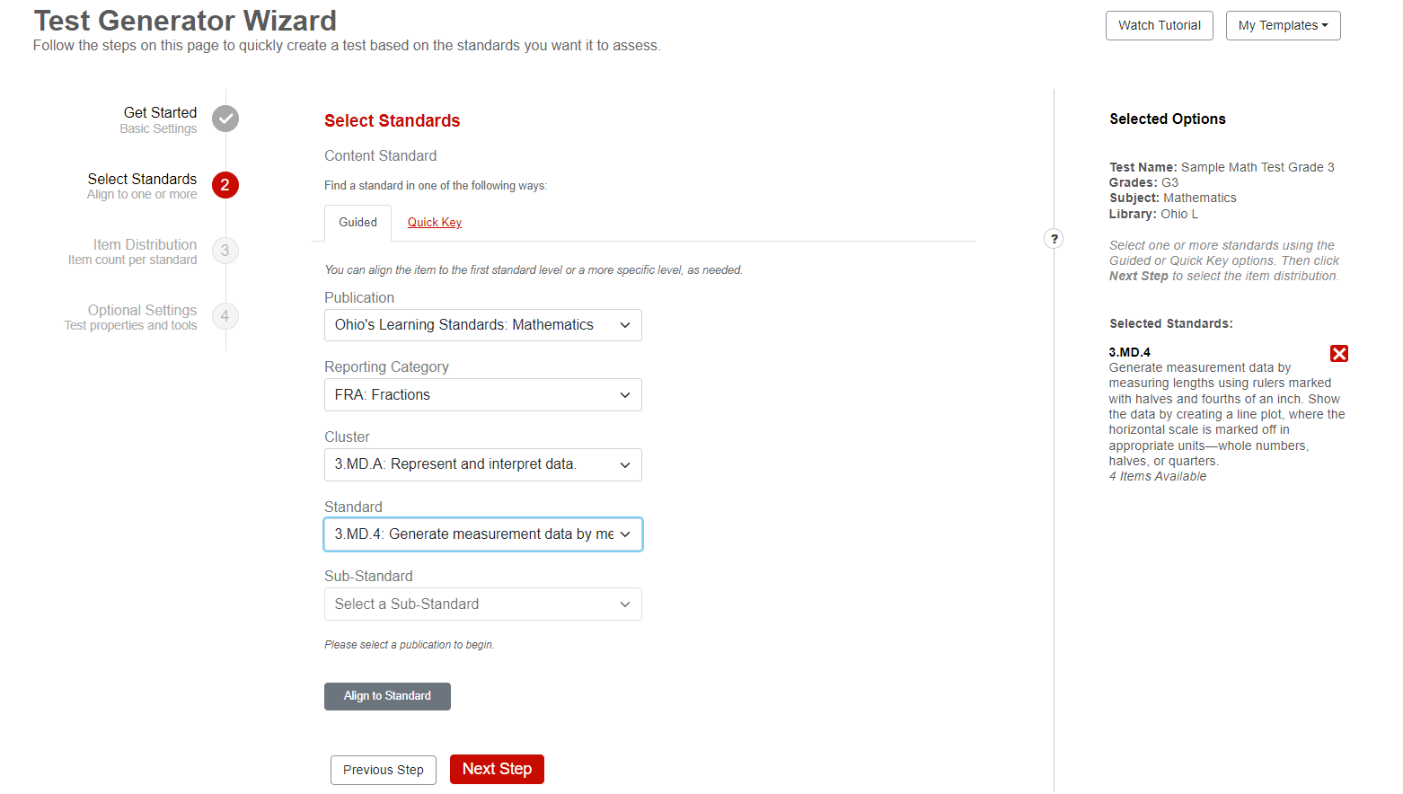
Step 2—Select Standards
Notes:
In the Select Standards panel, use the Guided and Quick Key options to select which standards the test should assess. When you click the Align button, the standards appear in the Selected Options panel on the right. Repeat this step until you have added every standard you want to include in the test. Then, click Next Step.

Slide 30
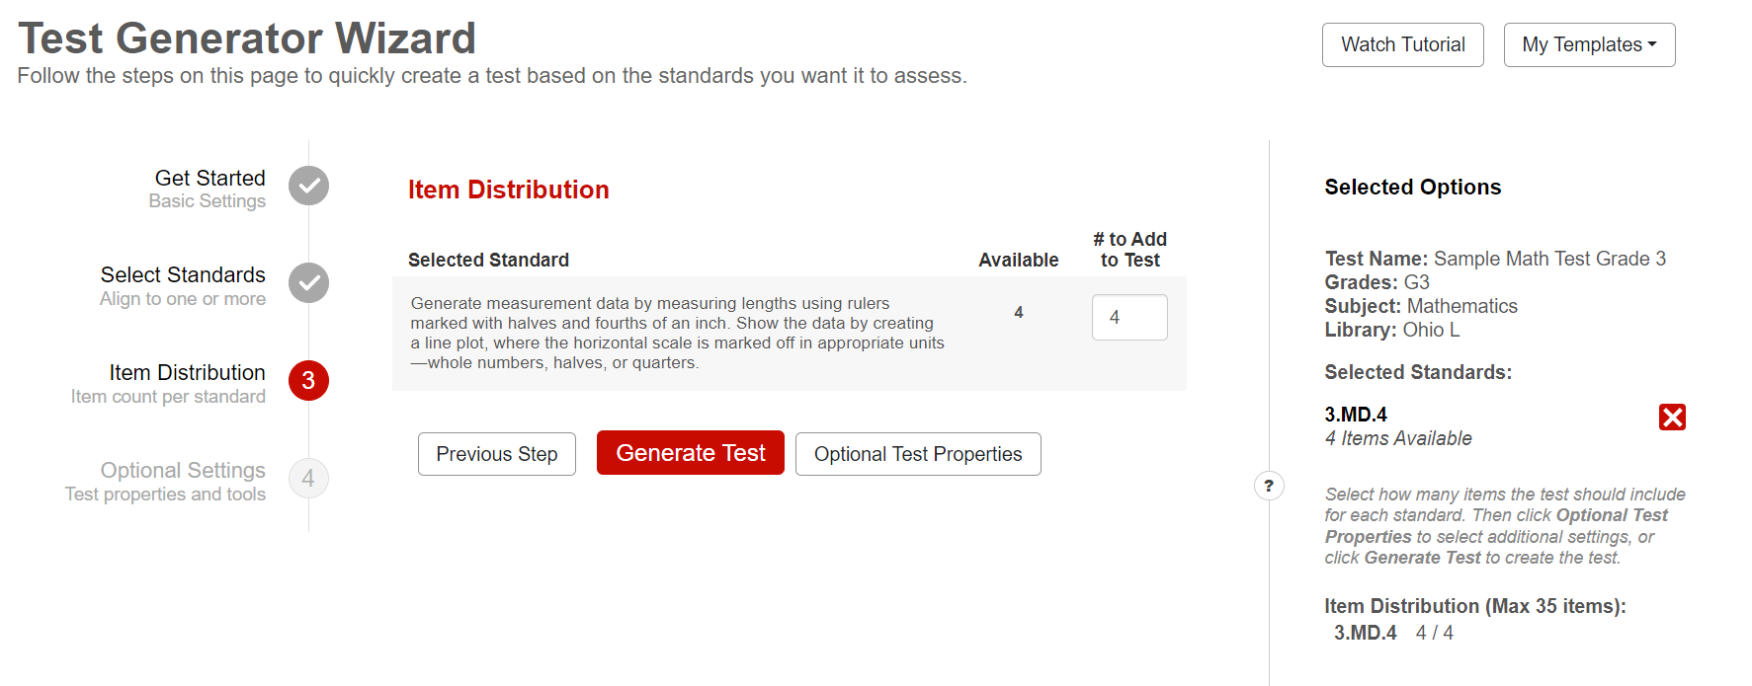
Step 3—Item Distribution
Notes:
The Item Distribution panel appears, displaying the number of items available for each standard you selected. Enter a number in the # to Add to Test field or use the arrow buttons to select a number in each field. The item count updates in the Selected Options panel.
You have the following two options at this point:
You can generate the test by clicking the Generate Test button.
You can customize the tools and other available test properties by clicking the Optional Test Properties button.
Test properties include various options, such as the description, keywords, security rules, and test tools.

Slide 31
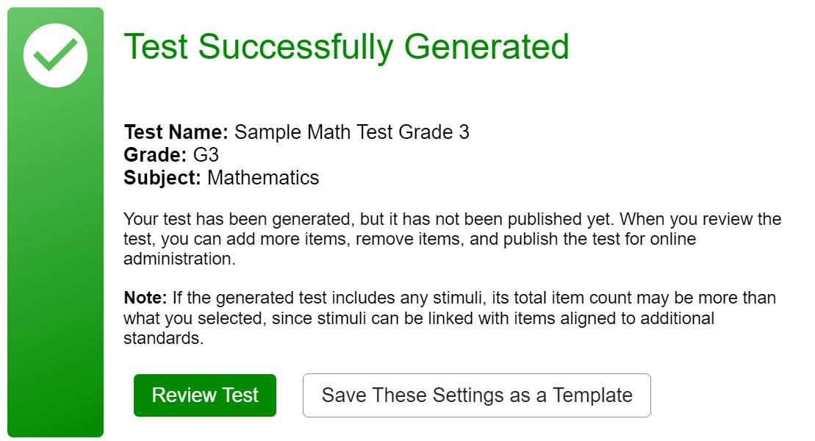
Confirmation Message
Notes:
When you click Generate Test, the confirmation screen confirms that the test has been generated and it reminds you that, by clicking the Review Test button, you can use the test builder to add and remove items just like you would for a manually built test.
Optional: If you want to re-use the selected standards and item counts as a template for generating future tests, click Save These Settings as a Template. Tests generated from a template use the same properties, standards, and item counts as the original test, but the actual items may differ. Refer to the Assessment Authoring User Guide for detailed instructions on using a template.

Slide 32
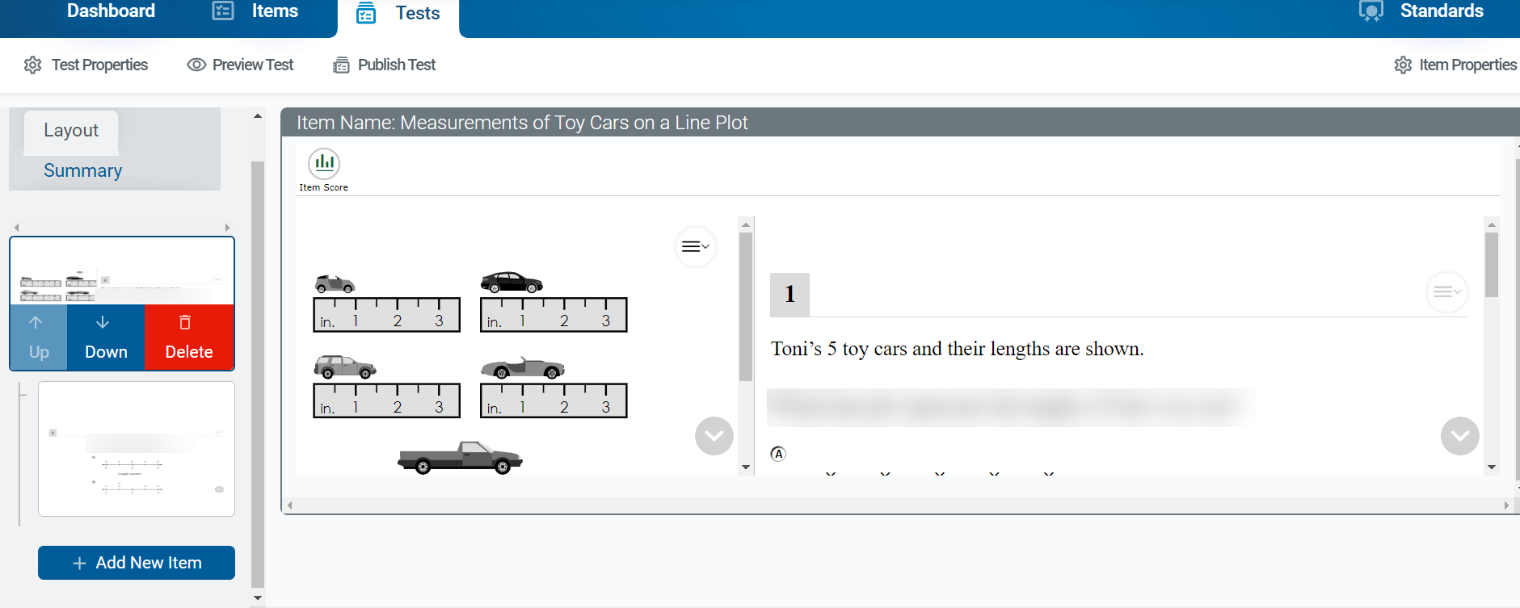
Review the Test Using the Test Builder
Notes:
Here is the test builder page for the Sample Test. Selected items in the Layout panel on the left side of the page are displayed in the Preview portion of the page. You can delete or add items by using the trash can button or the plus signs displayed as you scroll down the Layout panel. This process is explained in the next section, Manually Create a Test.

Slide 33
Manually Create a Test
Notes:
This section covers how to manually create a test.

Slide 34
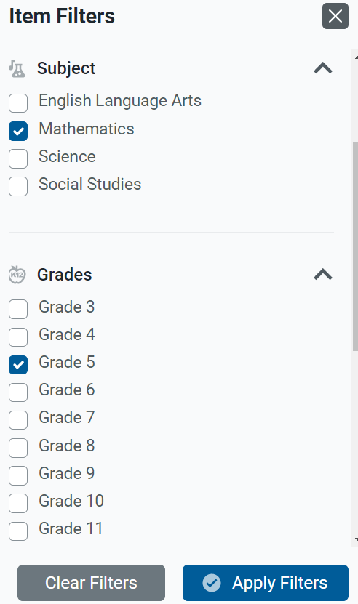
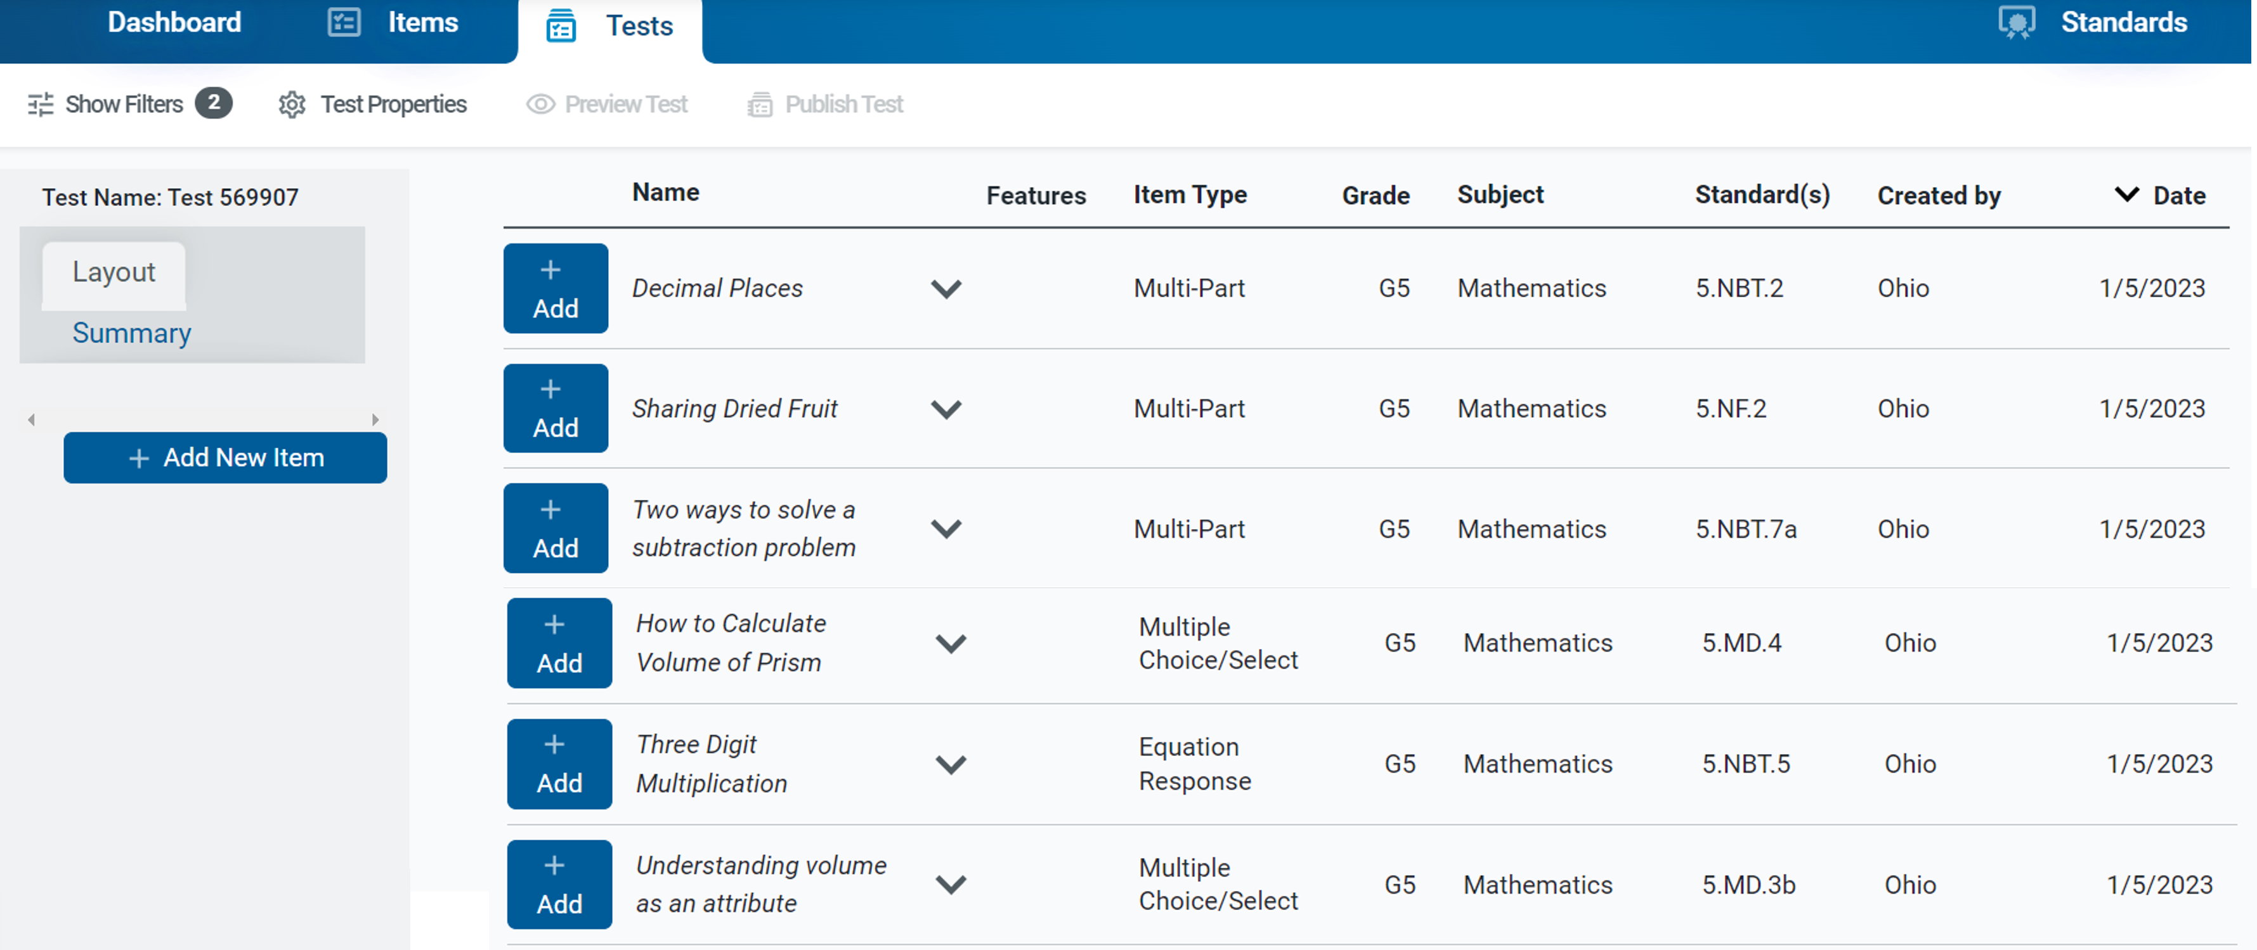
Add an Item from a Library
See Mini Module 2
Notes:
When adding an item from a library, you may need to apply at least one filter from the Item Filters panel in order to display the available items. You can also search for specific items by their item properties (such as their name, keywords, and aligned standards). Select the library item you wish to add.

Slide 35
Add an Item from a Library (continued)
Notes:
The Item Preview window displays the option to Add Item to Test.

Slide 36
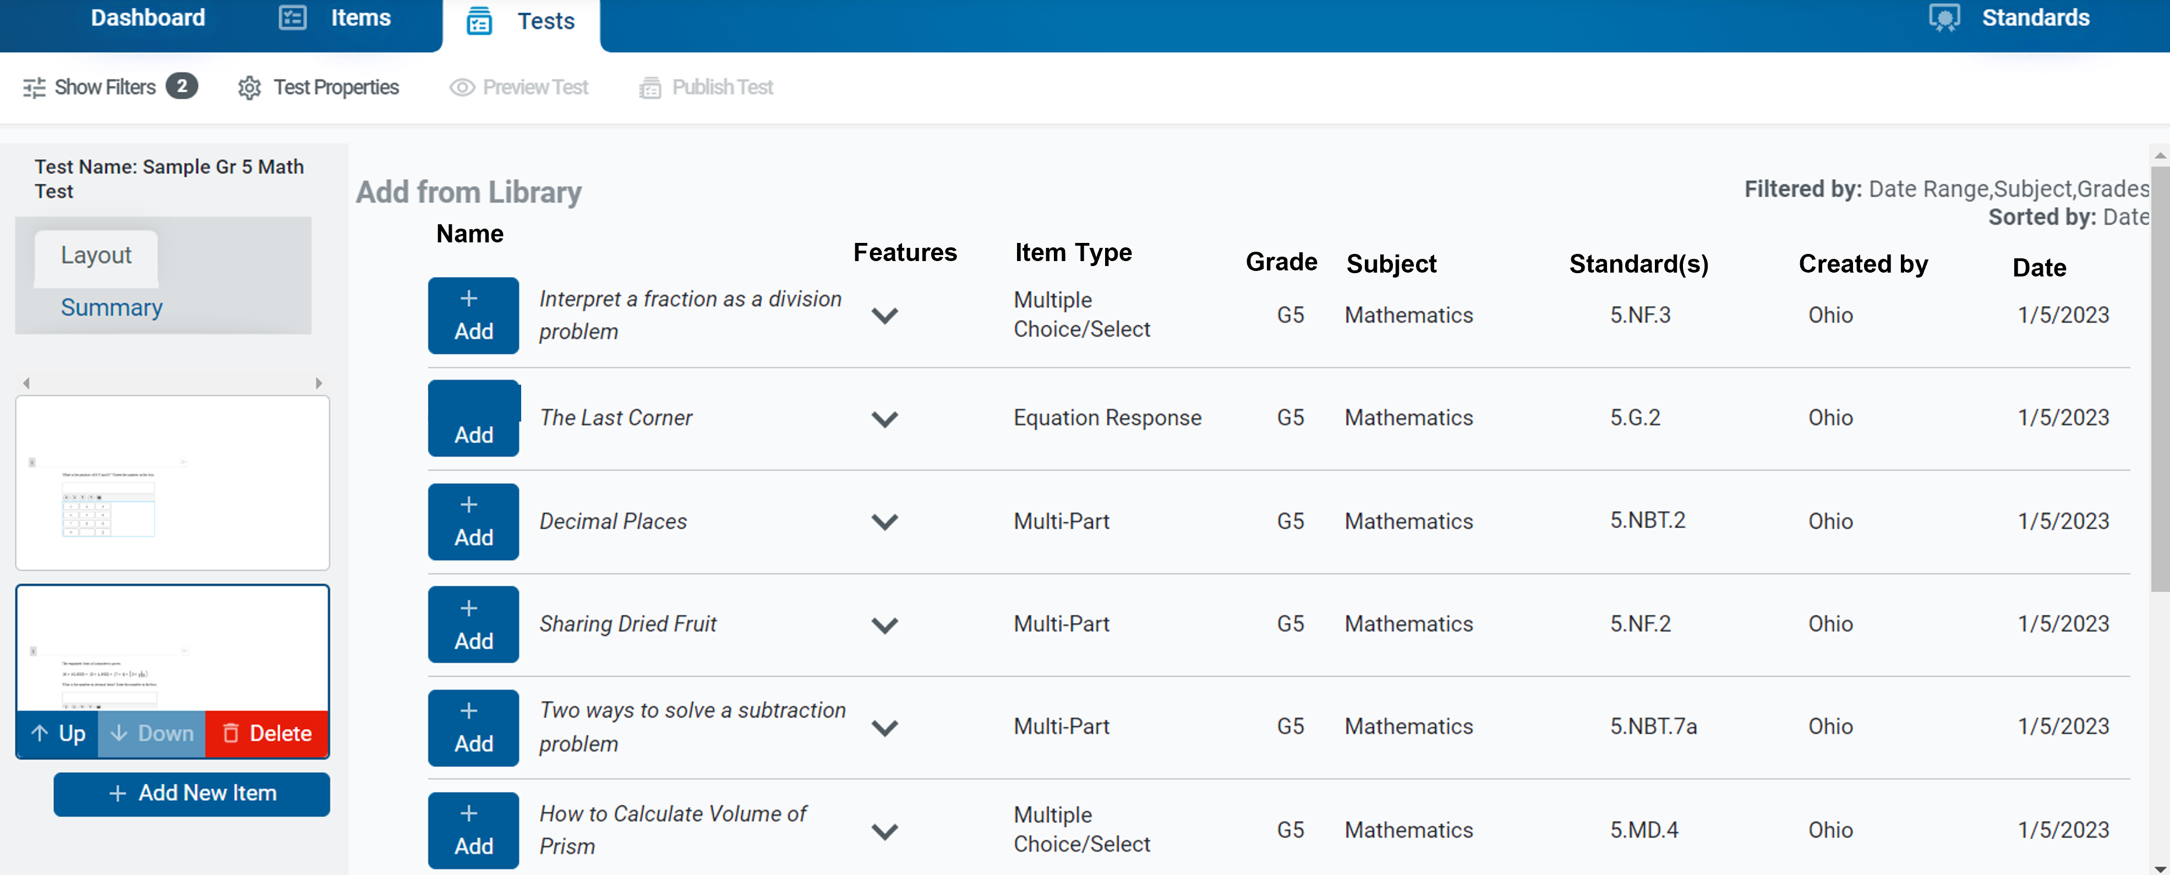
Editing Item Content when Creating a Test
Notes:
Continue to add items from the results table or click the Add New Item button to return to the Item Filters panel. A new thumbnail appears in the Layout panel for each item you add.
You can re-arrange the items in your tests by clicking their thumbnails and then clicking the Up and Down arrow icons that appear to the left of the trash can button.

Slide 37
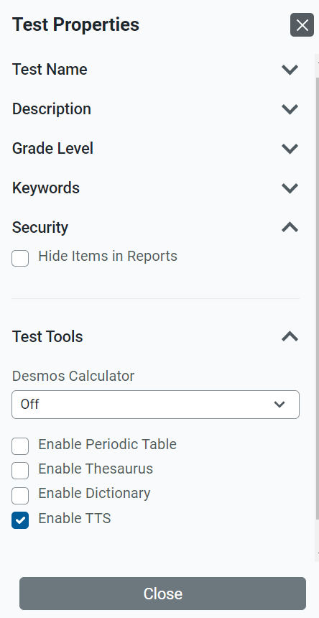
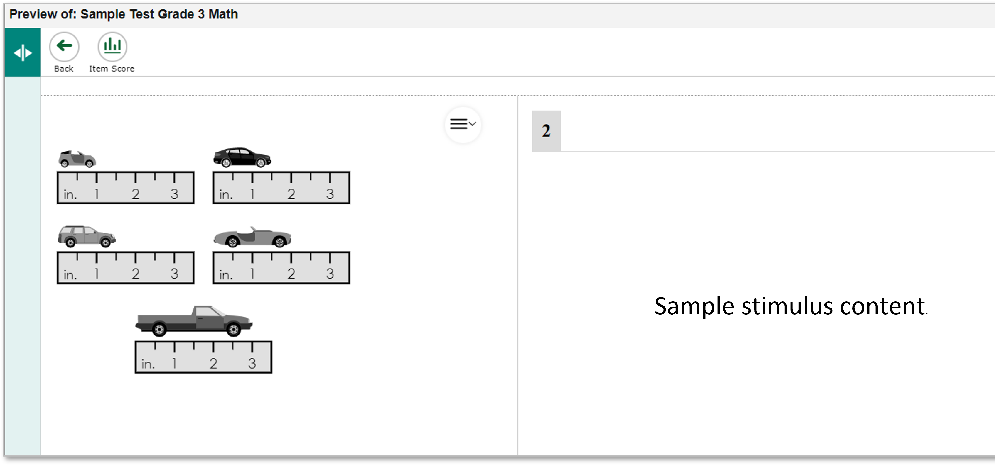
Test Properties Menu/Preview Item
Notes:
You can enter details at any point in creating your test, such as the test name, description, grade, keywords, security, and test tools (for example, calculator, periodic table, thesaurus, dictionary). Use the Test Properties button in the test toolbar, make your selections, and click Close. Please note that the periodic table, thesaurus, and dictionary tools are available to use in teacher-authored tests, but will not be available in the summative tests.
To see what your test will look like to students, click Preview Test in the test toolbar. You can enter sample responses to items and click Item Score to make sure the items are being scored correctly.

Slide 38
How to Publish a Test for Online Administration and Change the Administration Dates
Notes:
If you plan to administer your test to students online, you must publish it to the Test Administration Site. You can administer any test you publish, and you can share the test with other Assessment Authoring users to let them administer the test as well. Every test gets published from the test builder, whether you automatically generated the test or manually built it. You can also change the administration dates.

Slide 39
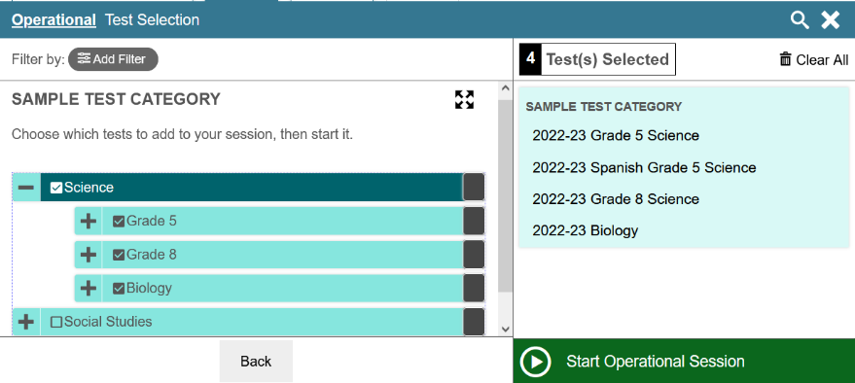
Publish a Test
Test Administration System:
Test Selection Window
Notes:
To publish the test, click the Publish Test button in the Tests toolbar. If this button is not clickable, make sure that the test does not include any blank pages and that you have saved changes to each item on the test. Published tests automatically appear in TDS for the user who created the test. Administration dates are automatically set in the system.
After publishing a test, you can add it to your test sessions by selecting it from the Test Selection window in the Test Administration System. You can administer your own tests, shared tests, and tests from a shared test library. For more information about administering tests, refer to the Test Administration User Guide.

Slide 40
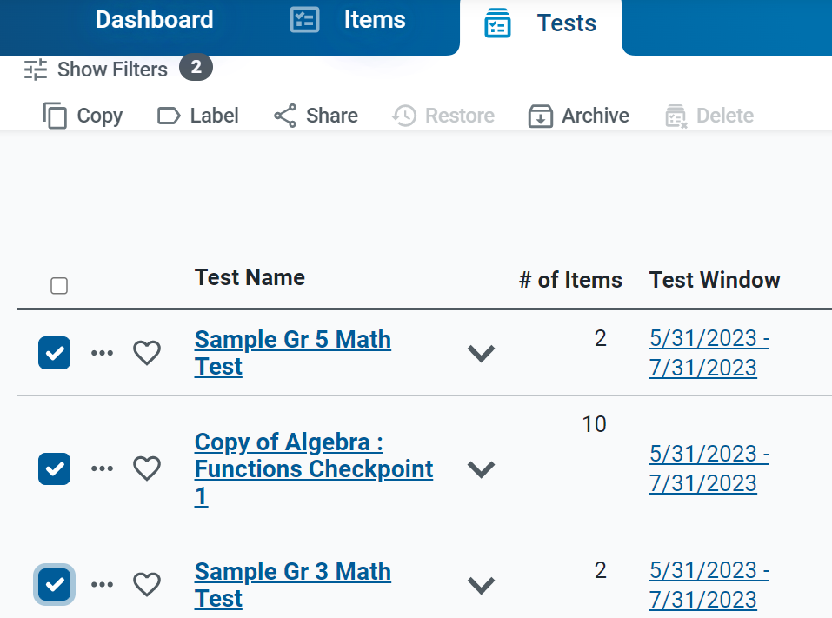
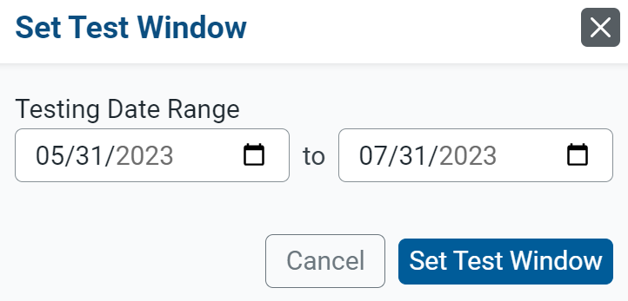
Change Test Administration Dates
Notes:
Depending on your user role, you can change the test administration dates. Click the date range link in the Test Window column. Then, use the fields in the Set Test Window to assign a testing window.

Slide 41
How to Create Workgroups for Sharing Tests and Items
Notes:
First, we will explain how to create custom workgroups so that you can share tests and items with other educators on a regular basis.

Slide 42
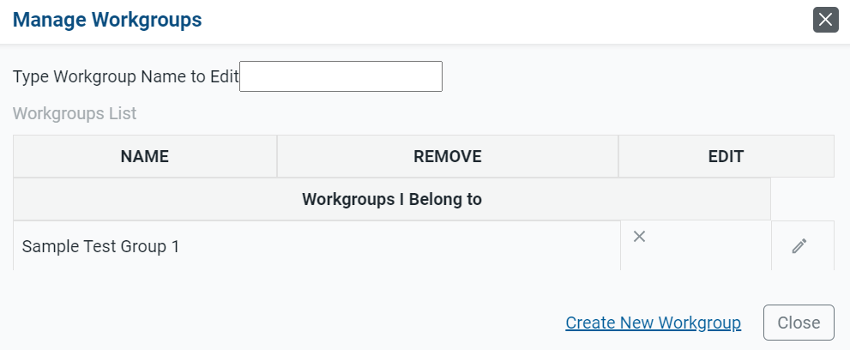
How to Create Workgroups for Sharing Content
1
2
Notes:
Authoring lets you share your original tests with other educators who can co-author the test, use the test for themselves, or administer your original tests to their students. Tests may be shared with individual educators, custom groups of educators (known as “workgroups”), or an entire school or district. You can choose exactly how recipients will be able to use your shared tests. When sharing a test, you can choose to let recipients view, edit, publish, and/or administer the test in the Test Administration Site.
You can create a workgroup to make it easy to share your tests with the same group of educators on a regular basis. You can also join other workgroups you get invited to and manage the membership of your existing workgroups.
1. Select the My Workgroups link on the dashboard.
2. Click Create New Workgroup on the Manage Workgroups page.

Slide 43
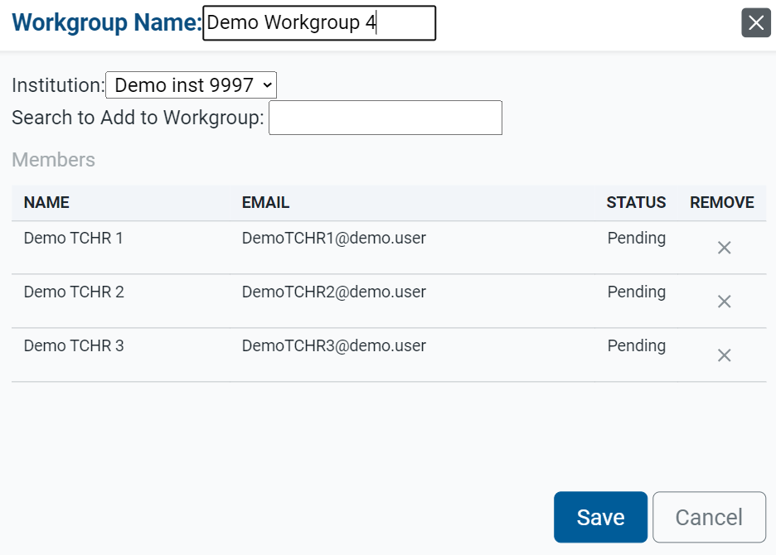
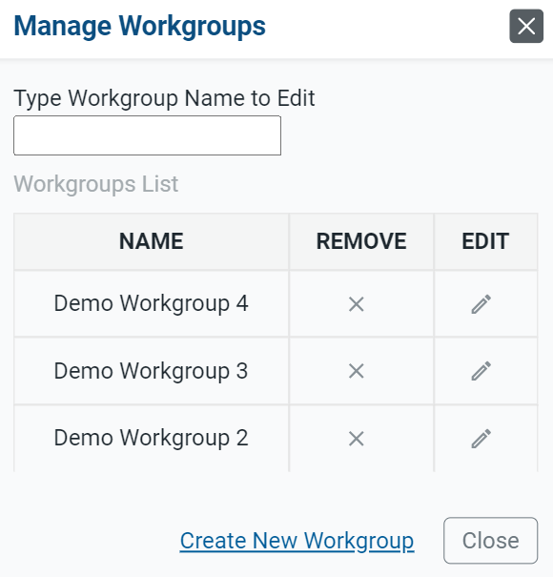
How to Create Workgroups for Sharing Content (continued)
3
4
5
6
Notes:
3. In the Workgroup Name field, enter a unique name for your group and select an institution.
4. In the Search to Add to Workgroup field, enter the name or email address for the user you want to add to the group. Select the name when it appears in the dropdown.
5. The educator’s name will appear in the Members section.
6. Educators become active in a workgroup once you click Save. You can share tests with them.
Optional: If you ever need to modify the workgroup, select Manage Workgroups on the Dashboard and then click the edit button by the name of the workgroup you wish to modify. You can also click X to delete a workgroup.

Slide 44
For More Help
You can contact the Helpdesk for assistance with any technical issues you encounter. When contacting the Helpdesk, please be ready to provide
any error messages that are appearing (including codes);
your operating system and browser information;
your network configuration information;
your contact information for follow-up by phone or email; and
any other relevant information, such as test names or content areas, student IDs, session IDs, and search criteria.
For test administration or policy issues, please contact your district test coordinator.
Further Information
Id.portal.cambiumast.com
Idaho Help Desk
Toll-Free Phone Support: 1-844-560-7365
Email Support: IDHelpDesk@cambiumassessment.com
Thank you!
Notes:
You can find additional Authoring resources on your state or district assessment portal. However, if you still require assistance with troubleshooting a technical issue, you may also contact the Helpdesk. When contacting the Helpdesk, please be ready to provide:
any error messages that are appearing (including codes);
your operating system and browser information;
your network configuration information;
your contact information for follow-up by phone or email; and
any other relevant information, such as test names or content areas, student IDs, session IDs, and search criteria.
For questions about test administration or policy issues, please contact your district test coordinator.
Thank you for taking the time to view this training module. For detailed information, consult your Authoring Guide located on Idaho State Portal state portal or contact the Helpdesk.

Slide 45
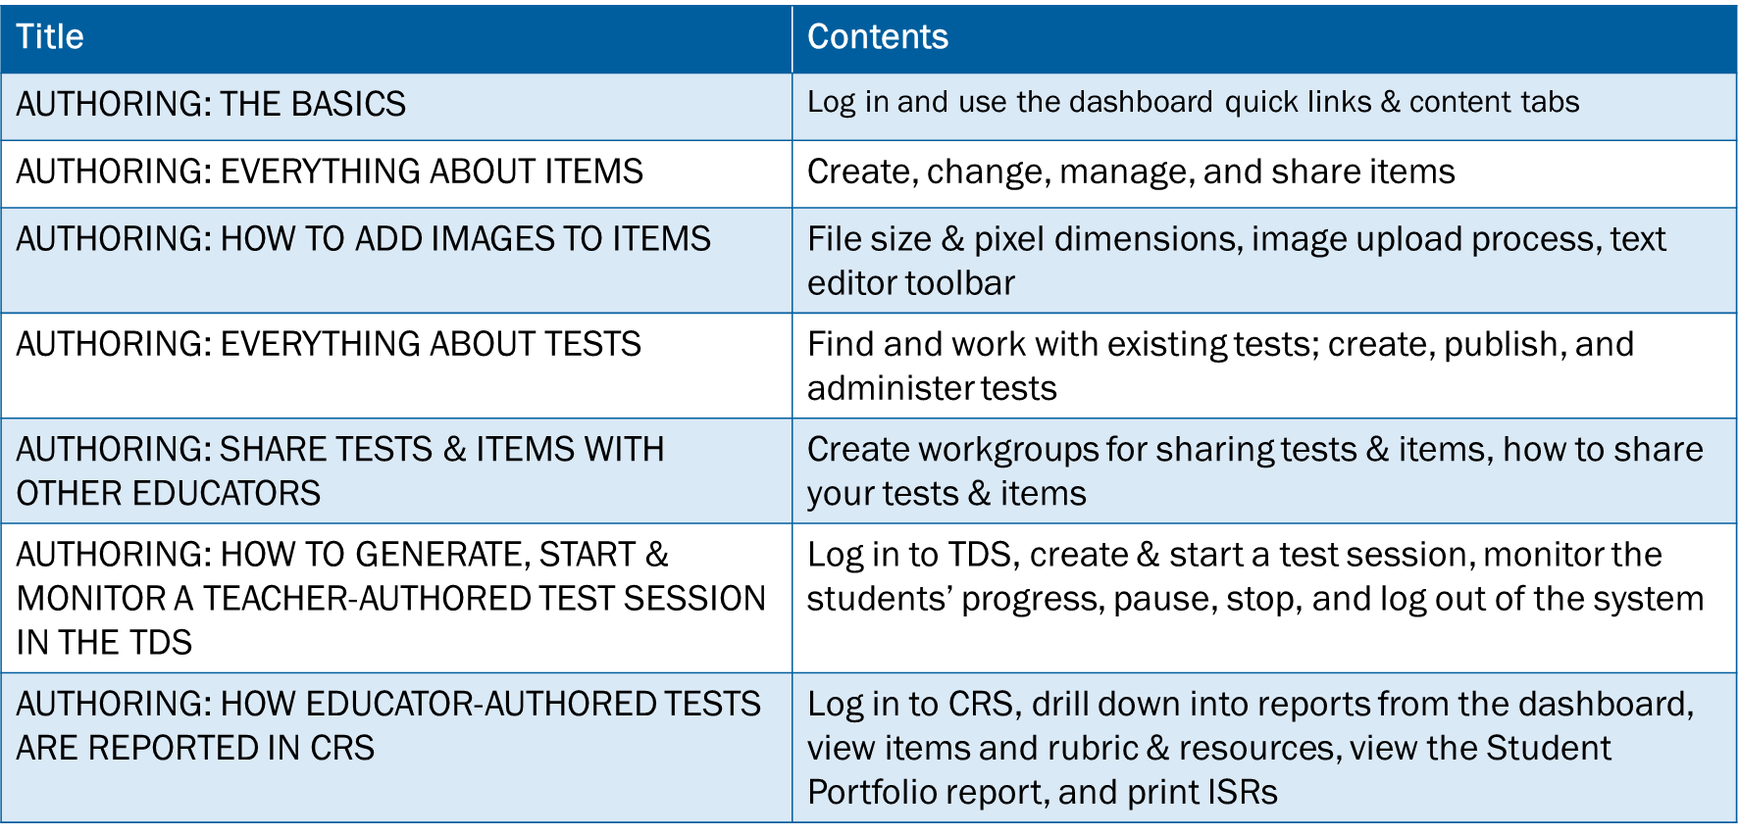
Training Modules in the Series
Notes:
Here are the modules that make up the Authoring system training series. They may be posted on the Idaho State Assessment portal.

