Slide 1
Authoring: share tests & items with other educators
2023–2024
Notes:
Welcome to this training module for the Authoring system. This module covers the basics of sharing your created tests and items with other educators for collaboration and administration. For more detailed information on performing actions on items and tests, please refer to the more specific training modules in the series.
Please note that Idaho’s version of Authoring may differ slightly from the images shown in this presentation.

Slide 2
Objectives
Topics | Slides
1. How to Create Workgroups for Sharing Tests & Items | 3-4
How to Share Your Tests | 6–9
How to Share Items | 10–12
5. More Information/More Modules | 13–14
Notes:
Here are the topics covered in this training module:
1. How to Create Workgroups for Sharing Content
2. How to Share Your Tests
3. How to Share Your Items
4. More Information and More Modules
Slide numbers are provided so you can quickly reference a specific section of this module.

Slide 3
How to Create Workgroups for Sharing Tests & Items
Notes:
First, we will explain how to create custom workgroups so that you can share tests and items with other educators on a regular basis.

Slide 4
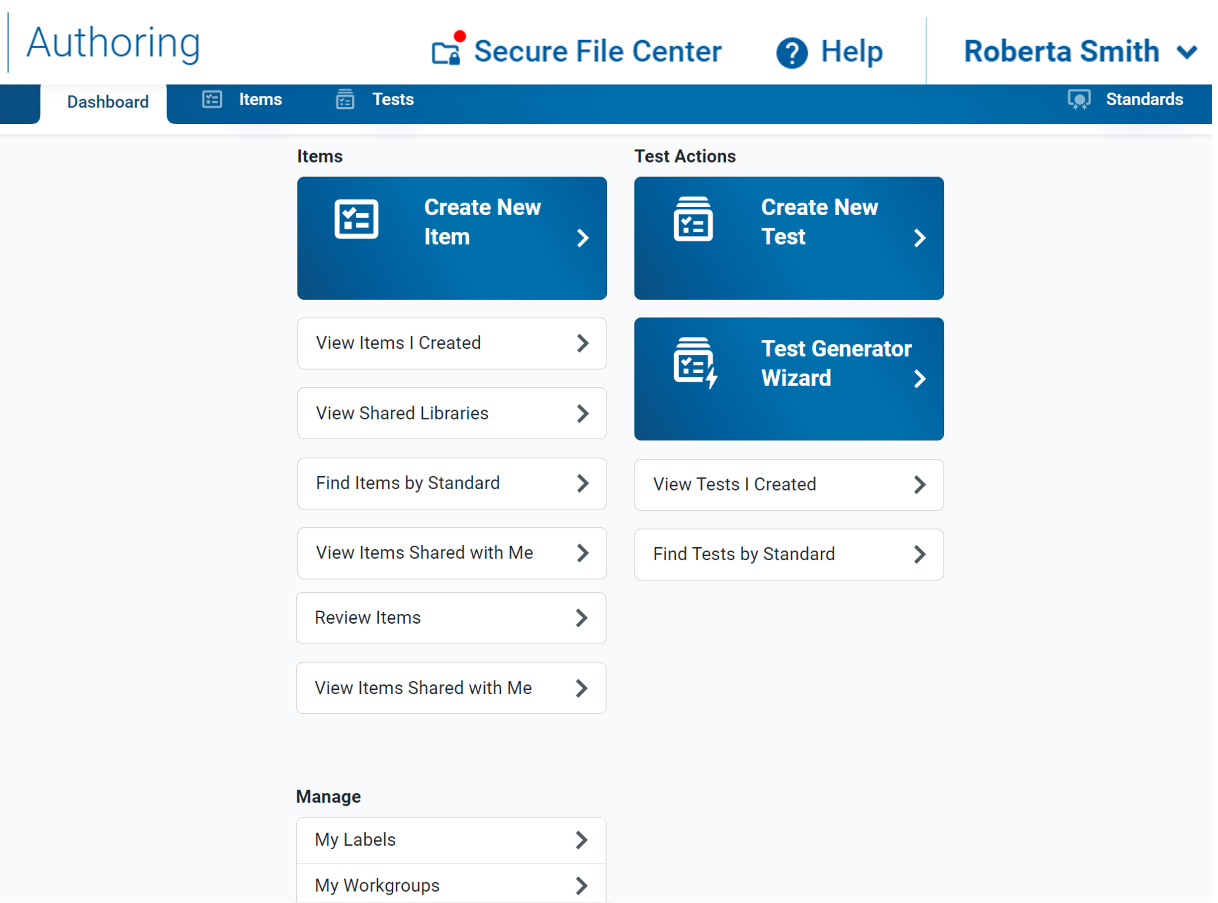
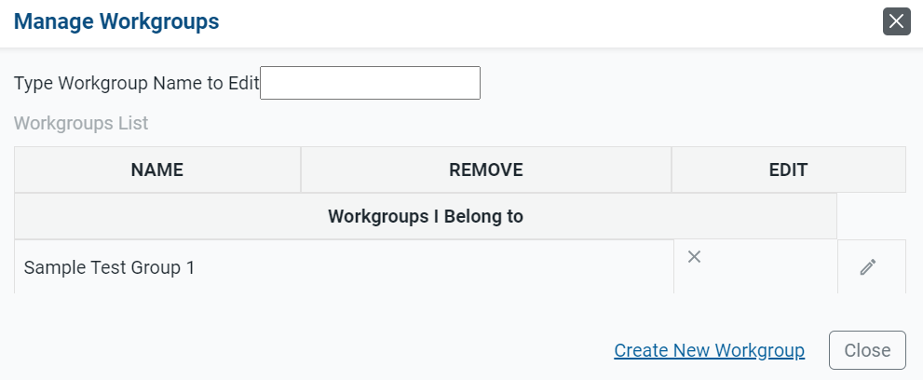
Create New Workgroup
1
2
Notes:
Authoring lets you share your original tests with other educators who you want to co-author the test, use the test for themselves, or administer your original tests to their students. Tests may be shared with individual educators, custom groups of educators (known as “workgroups”), or an entire school or district. You can choose exactly how recipients will be able to use your shared tests. When sharing a test, you can choose to let recipients view it, edit it, publish it, and/or administer it in the Test Administration Site.
To make it easy to share your tests with the same group of educators on a regular basis, you can create a workgroup for them. You can also join other workgroups you get invited to and manage the membership of your existing workgroups.
1. Select the My Workgroups link on the dashboard.
2. Click Create New Workgroup on the Manage Workgroups page.

Slide 5
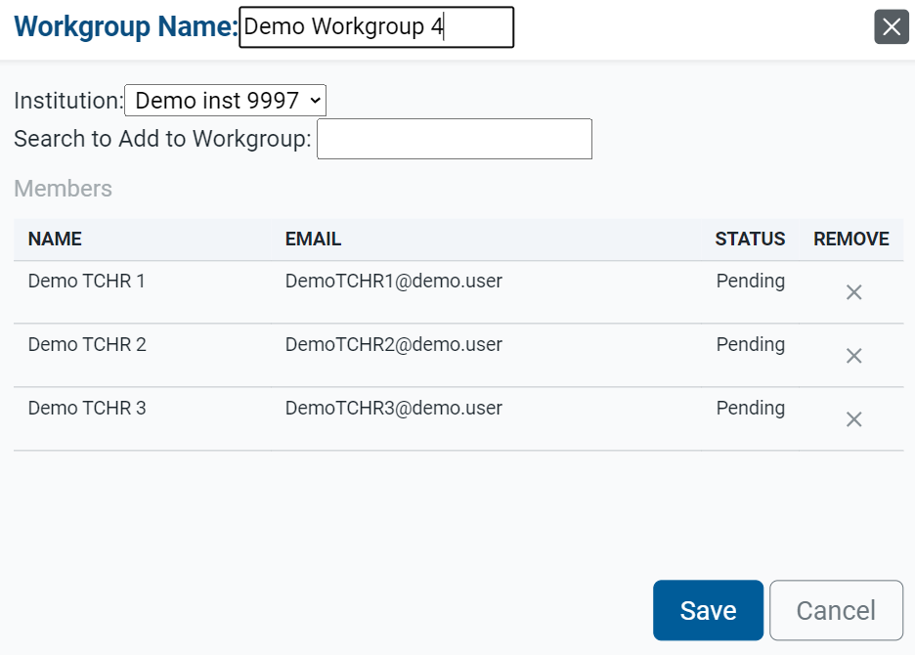
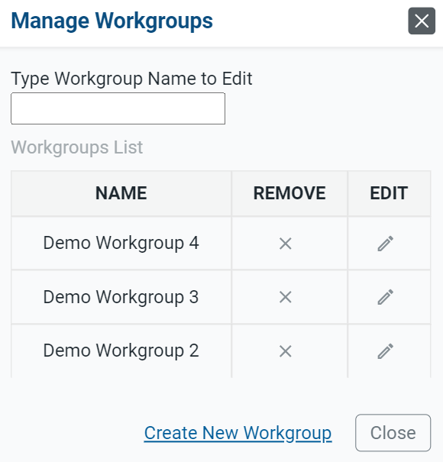
Build & Manage Workgroups
3
4
5
6
Notes:
3. In the Workgroup Name field, enter a unique name for your group and select an institution.
4. In the Search to Add to Workgroup field, enter the name or email address for the user you want to add to the group. Select the name when it appears in the dropdown.
5. The educator’s name will appear in the Members section.
6. Educators become active in a workgroup once you click Save. You can share tests with them.
Optional: If you ever need to modify the workgroup, select Manage Workgroups on the Dashboard and then click the edit button by the name of the workgroup you wish to modify. You can also click X to delete a workgroup.

Slide 6
How to Share Your Tests with Others
— For Administration
— For Collaboration
Notes:
This section covers how to share your tests with other educators. When sharing tests with other educators, you can choose to share the test with them in Authoring for administration in the Test Delivery System, where they can administer it to students, or for collaboration purposes.

Slide 7
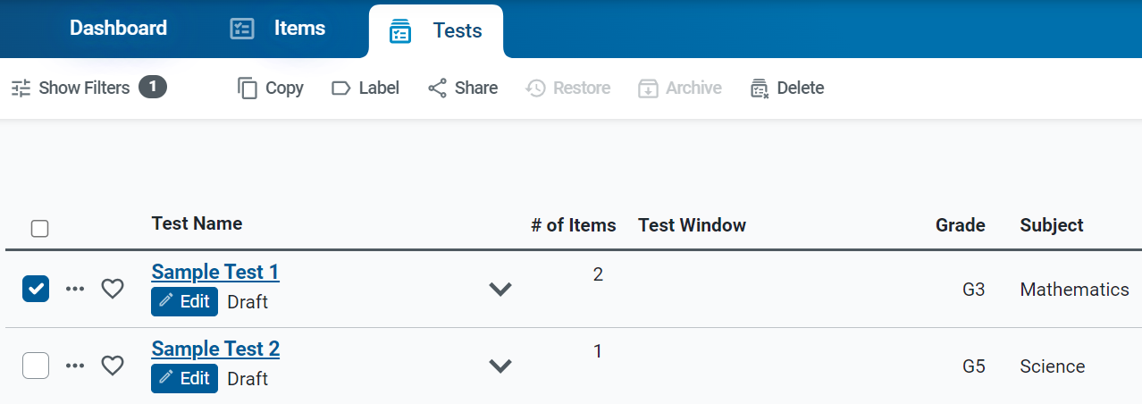
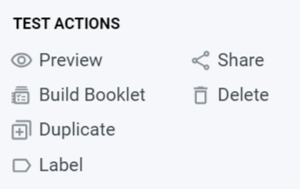
Share Tests Buttons
1
Notes:
Begin by filtering the Tests content tab for the tests you want to share. To share an individual test, click the dotted menu to the left of the test and select Share.
1. To share multiple tests, mark the checkboxes of the tests you want to share and click the Share button in the toolbar.

Slide 8
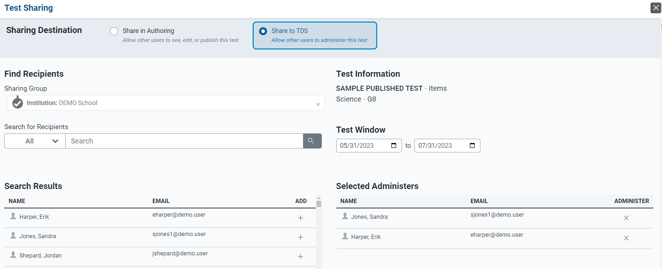
Share to TDS
2
3
5
4
6
Notes:
2. The Test Sharing window appears. To share the test so it can be administered by other educators, mark the Share to TDS radio button.
3. Search for an educator’s name or email address, or the name of a workgroup or institution. Select the recipients you want to share your content with.
4. In the Search Results, click + for each educator you wish to add as a recipient.
5. Enter or change the dates in the Administration Period fields.
6. Click Save. The tests will now appear in the Select Tests tab of TDS for the selected recipients.

Slide 9
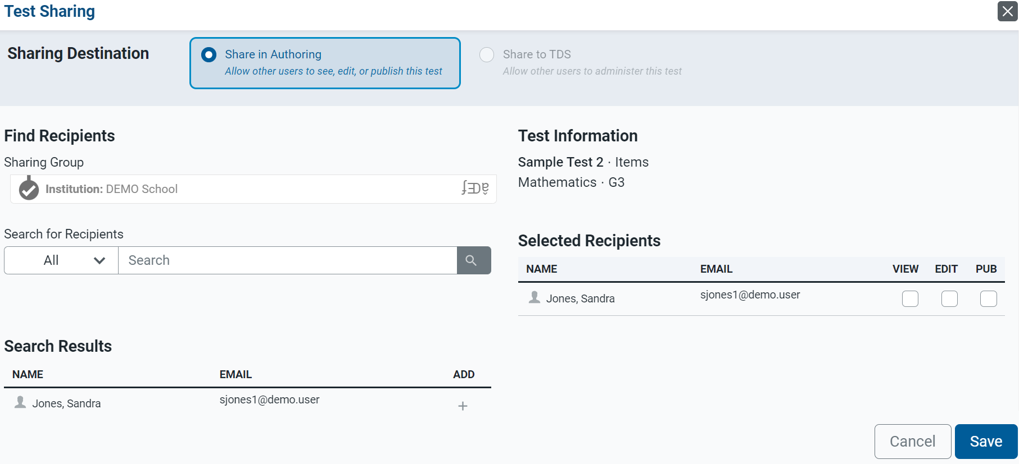
Share in Authoring
1
2
4
3
Notes:
When sharing tests with other educators for collaboration purposes:
Select the Share in Authoring radio button at the top of the Test Sharing page.
Find recipients by using the Sharing Group field and the Search for Recipients menu.
Use the Search Results column to Add recipients.
Select the specific permissions you’d like to give to each recipient. All recipients will be able to create copies of your shared content by default.
To allow a recipient to view the tests, mark the View checkbox.
To allow a recipient to make edits to the shared tests, mark the Edit checkbox.
To allow a recipient to publish the tests, mark the Publish checkbox.

Slide 10
How to Share Your Items with Others
Notes:
This section covers how to share your items with other educators.

Slide 11
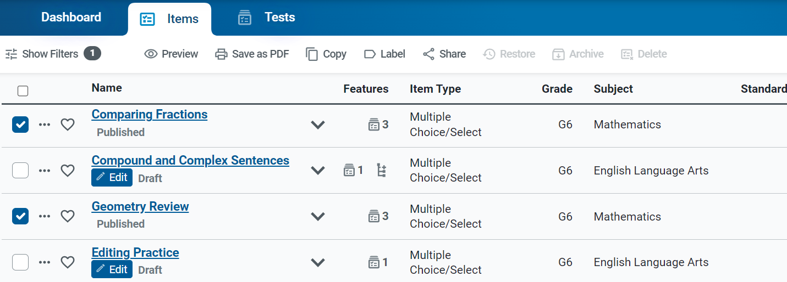
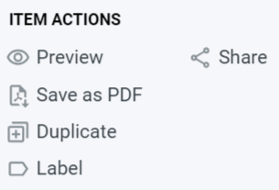
Share Items Buttons
2
1
Notes:
To share items with other educators from your personal library, open the items tab and apply the appropriate filters.
1. To share an individual item, click the dotted menu to the left of the item and select Share.
2. To share multiple items, mark the checkbox or checkboxes for the items you wish to share. Click the share button above the table.

Slide 12
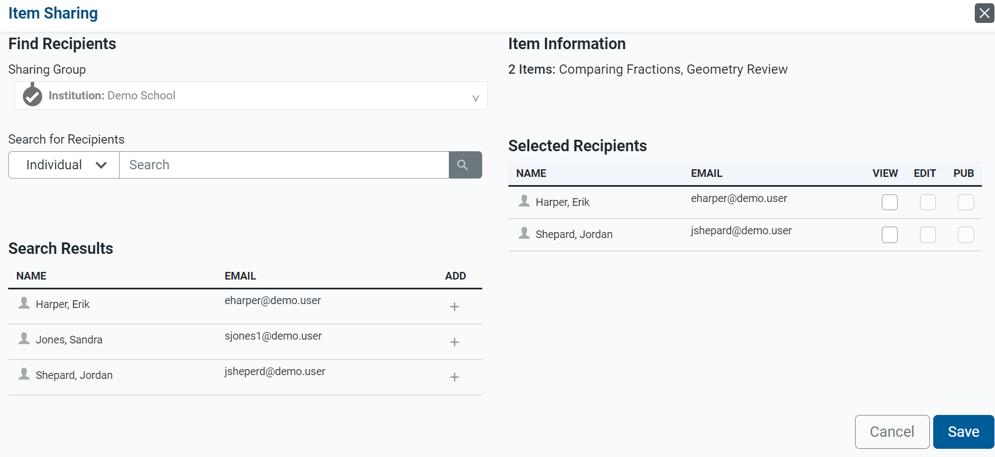
Item Sharing Page
1
3
2
4
Notes:
The Item Sharing window appears. Use this window to share the selected items with other Authoring users.
1. Search for an educator’s name or email address, or the name of a workgroup or institution. Select the recipients you want to share your content with.
2. In the Search Results, click + for each educator you wish to add as a recipient.
3. Select the specific permissions you’d like to give to each recipient. All recipients will be able to create copies of your shared content by default.
To allow a recipient to view the content, mark the View checkbox.
To allow a recipient to make edits to the shared content, mark the Edit checkbox.
To allow a recipient to publish tests containing the Draft item, mark the Publish checkbox.
4. Click Save. The shared content will now appear in the items table for the selected recipients

Slide 13
For More Help
You can contact the Helpdesk for assistance with any technical issues you encounter. When contacting the Helpdesk, please be ready to provide:
Any error messages that are appearing (including codes)
Your operating system and browser information
Your network configuration information
Your contact information for follow-up by phone or email
Any other relevant information, such as test names or content areas, student IDs, session IDs, and search criteria
For test administration or policy issues, please contact your district test coordinator.
Further Information
Id.portal.cambiumast.com
Idaho Help Desk
Toll-Free Phone Support: 1-844-560-7365
Email Support: IDHelpDesk@cambiumassessment.com
Thank you!
Notes:
You can find additional Authoring resources on Idaho State Assessment portal. However, if you still require assistance with troubleshooting a technical issue, you may also contact the Helpdesk. When contacting then Helpdesk, please be ready to provide the following information:
Any error messages that are appearing (including codes)
Your operating system and browser information
Your network configuration information
Your contact information for follow-up by phone or email
Any other relevant information, such as test names or content areas, student IDs, session IDs, and search criteria
For questions about test administration or policy issues, please contact your district test coordinator.
Thank you for taking the time to view this training module. For detailed information, consult your Authoring Guide located on the Idaho State Portal or contact the Help Desk.

Slide 14
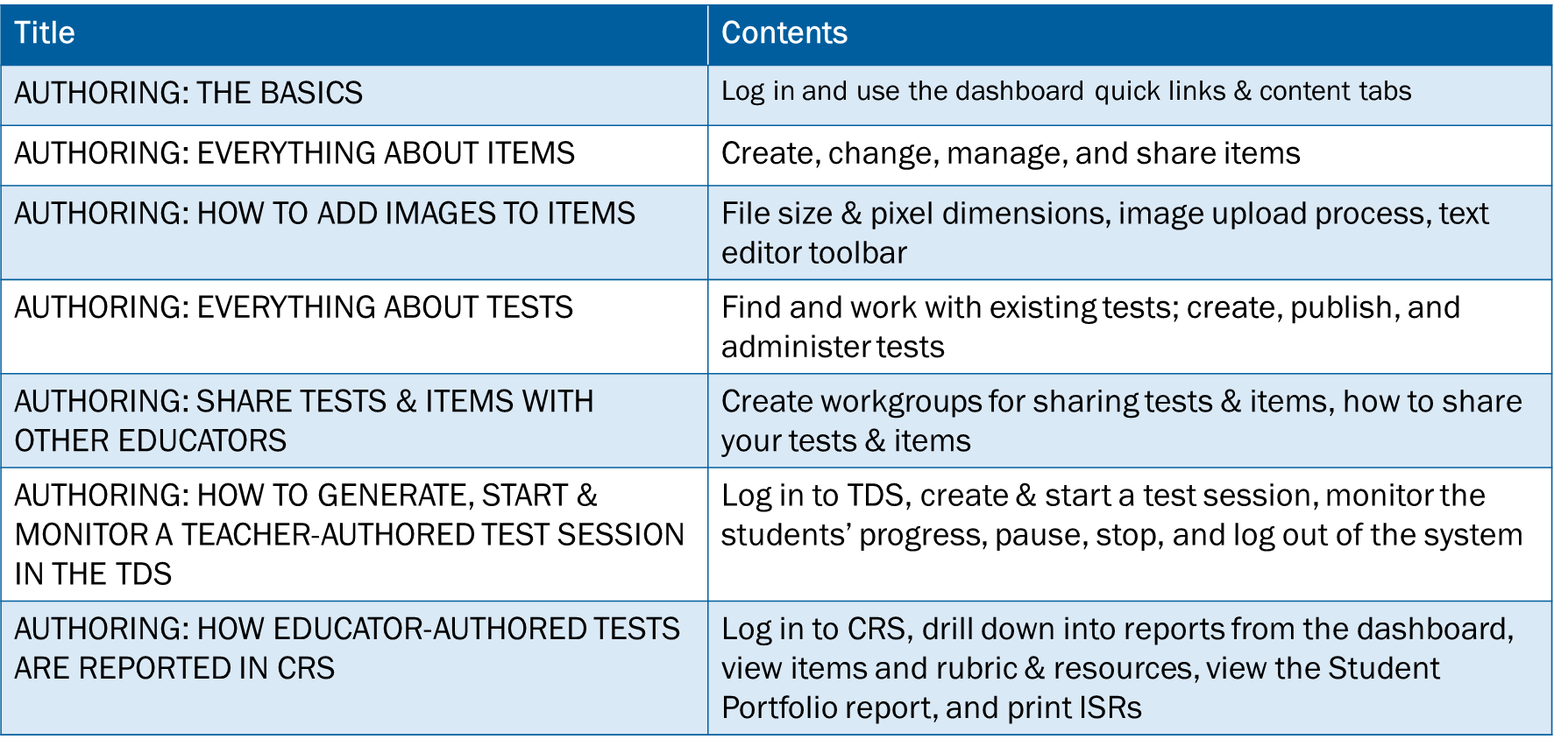
Training Modules in the Series
Notes:
Here are the modules that make up the Authoring system training series. They may be posted on the Idaho assessment portal.

