Slide 1
Authoring: how to generate, start, and monitor a teacher-authored test session in the test delivery system (TDS)
2023-2024
Copyright © 2023 Cambium Assessment, Inc. All rights reserved.
Notes:
Welcome to this training module for the Authoring system. This module covers how to generate, start, and monitor a test session in the Test Delivery System, or TDS. For additional information, reference the Test Delivery System Test Administrator User Guide located on the test portal. You can also refer to the additional training modules in the Authoring series.
Please note that your Idaho’s version of Authoring may differ slightly from the images shown in this presentation.

Slide 2
Objectives
Topics | Slides
1. How to Access the TA Interface of TDS | 3–5
2. How to Create & Start a Teacher-Authored Test Session using the Test Administration (TA) Interface | 6–12
3. How to Monitor Student Test Progress | 13–14
4. How to Pause and Stop a Test Session | 15–16
5. How to Log Out of the TA Interface | 17–18
6. More Information/More Modules | 19–20
Notes:
There are six topics covered in this training module. You can jump to the section slides if you need information on a single topic. The topics are:
1. How to Access the TA Interface of TDS,
2. How to Start a Teacher-Authored Test Session using the Test Administration (TA) Interface,
3. How to Monitor Student Test Progress,
4. How to Pause and Stop a Test Session,
5. How to Log Out of the TA Interface, and
6. More Information and More Modules

Slide 3
How to Access the TA Interface of TDS
Notes:
This section covers how to access the Test Administration interface of the Test Delivery System.

Slide 4
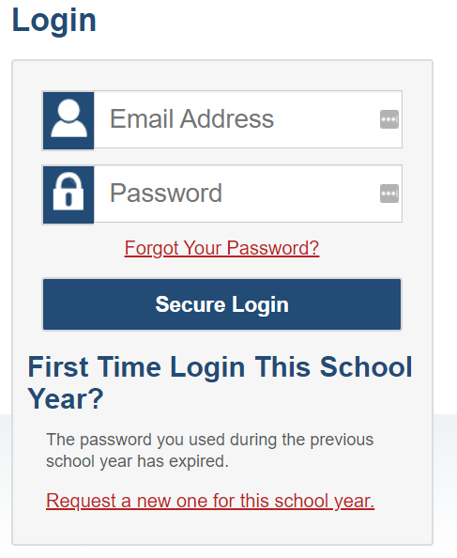
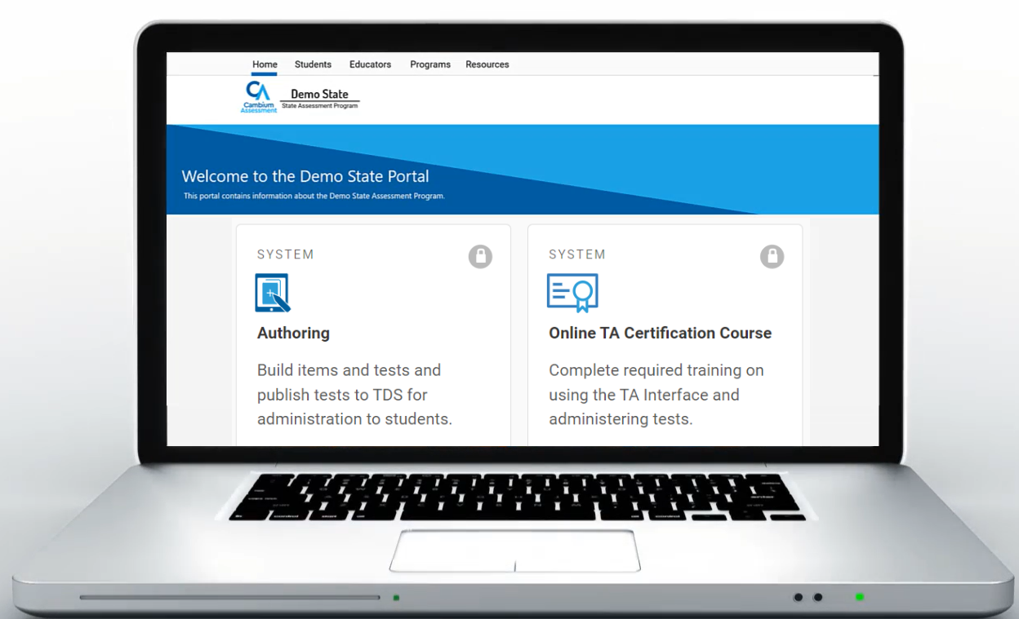
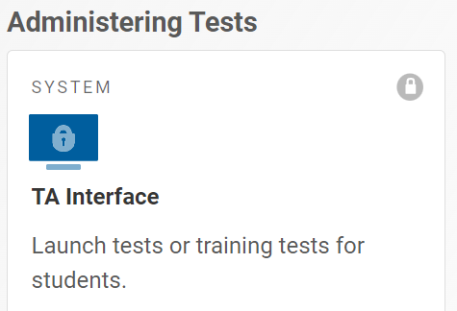
Log in to the TA Interface of TDS
id.portal.cambiumast.com
Notes:
The TA Interface is used to create and manage test sessions that students join to complete online tests. We will begin with detailed instructions on how to log in to the interface followed by a detailed review of each feature.
To log in to the TA Interface, go to the Idaho State Assessment Portal. Select the appropriate user role tab or card. Next, select the TA Interface card under Administering Tests. Enter the email address associated with your Test Information Distribution Engine (TIDE) account and your password. Then select Secure Login.

Slide 5
Log in to Authoring (continued)
The system has an authentication process that triggers when you log in from a different device or browser, or after clearing your browser’s cache.
If you see this screen, an email containing the code will be in your inbox.
Enter the code and click Submit.
If you need the code re-sent, click Resend Code.
Notes:
When logging in with a new device or browser, or after clearing the cache on a previously used browser, you see an Enter Code page.
You will need to enter the code on this page within fifteen minutes of receiving the email. If you do not receive a code or do not enter the code within the fifteen-minute time limit, click Resend Code. Click Submit after entering the authentication code to access the system.

Slide 6
How to Create & Start a Test Session Using the TA Interface
Notes:
This section covers how to create and start a test session in the Test Administration (TA) interface of the Test Delivery System.

Slide 7
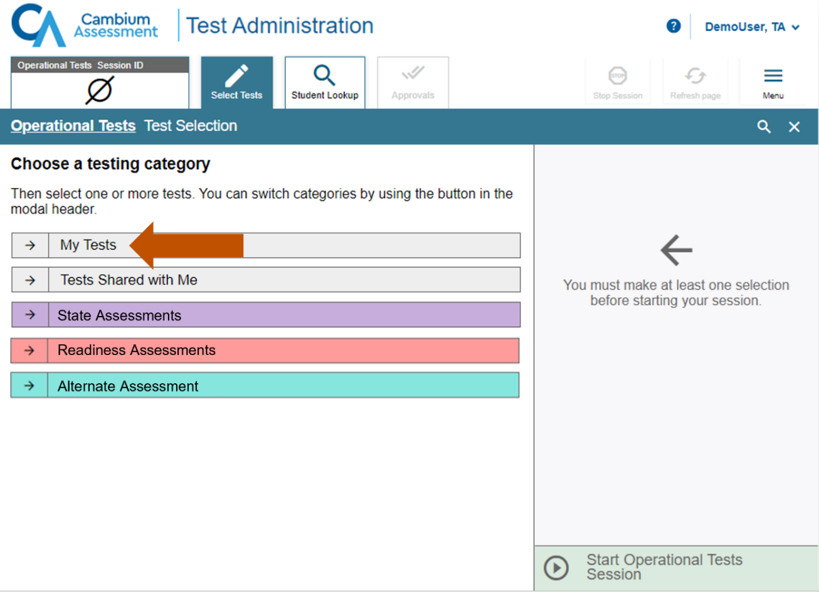
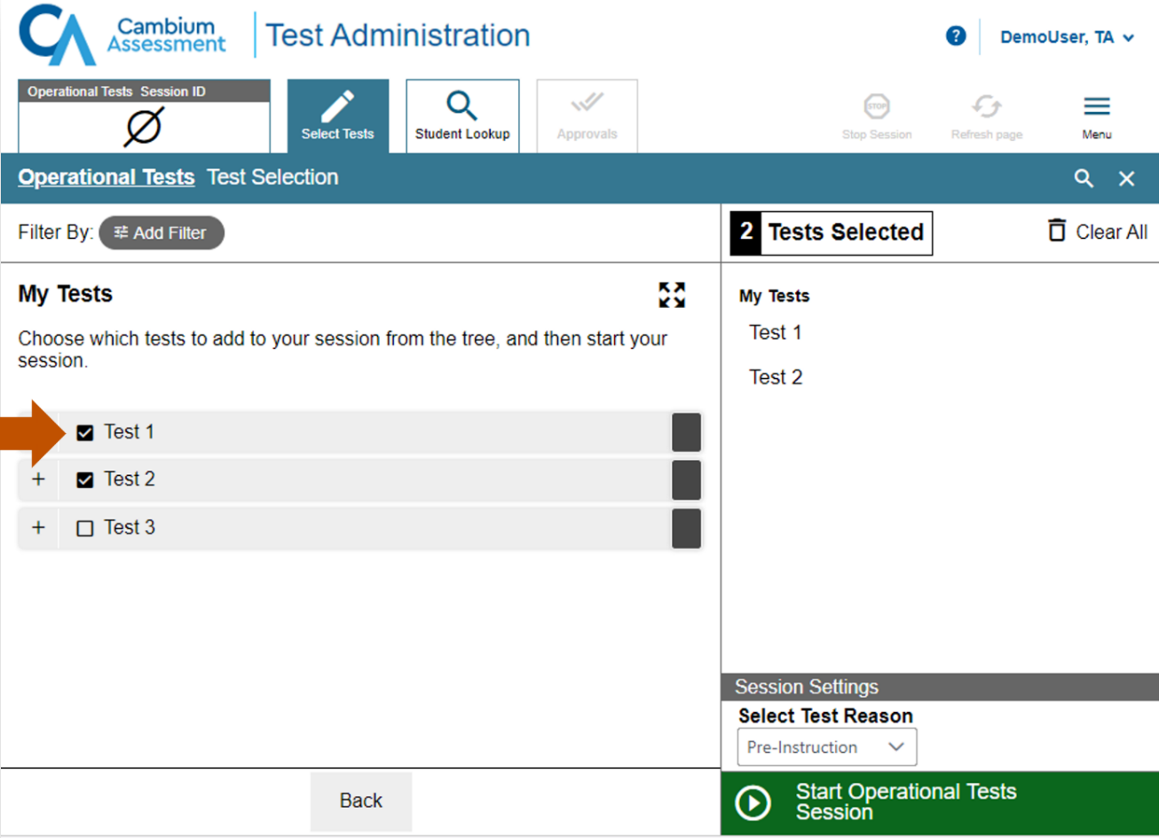
Create a Test Session: Test Categories
Notes:
Teacher-authored tests created and published in the Authoring system are administered through the Test Delivery System (TDS). The steps to create a test session for a teacher-authored test are the same steps you would use to create a test session for a formative or summative assessment. This includes the administration of Alternate Assessments, as well.
The first step in administering a teacher-authored test is to create a test session. After logging in to the TA Interface, you will see a list of test categories. Tests created in Authoring that have been published to the Test Administration System will appear in a separate category or categories. On this screen, the published tests created in Authoring can be found under the My Tests category and/or the Tests Shared with Me category.
Click the arrow next to the My Tests category or the Tests Shared with Me category to see all available teacher-authored tests. Mark the checkbox next to the test(s) you want to add to the test session. The tests you select will appear in the Tests Selected column. To unselect a test, uncheck the box next to the test name you want to remove.

Slide 8
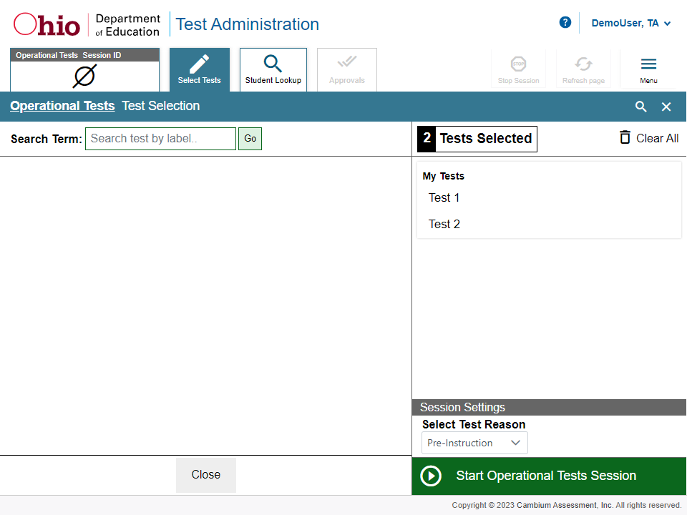
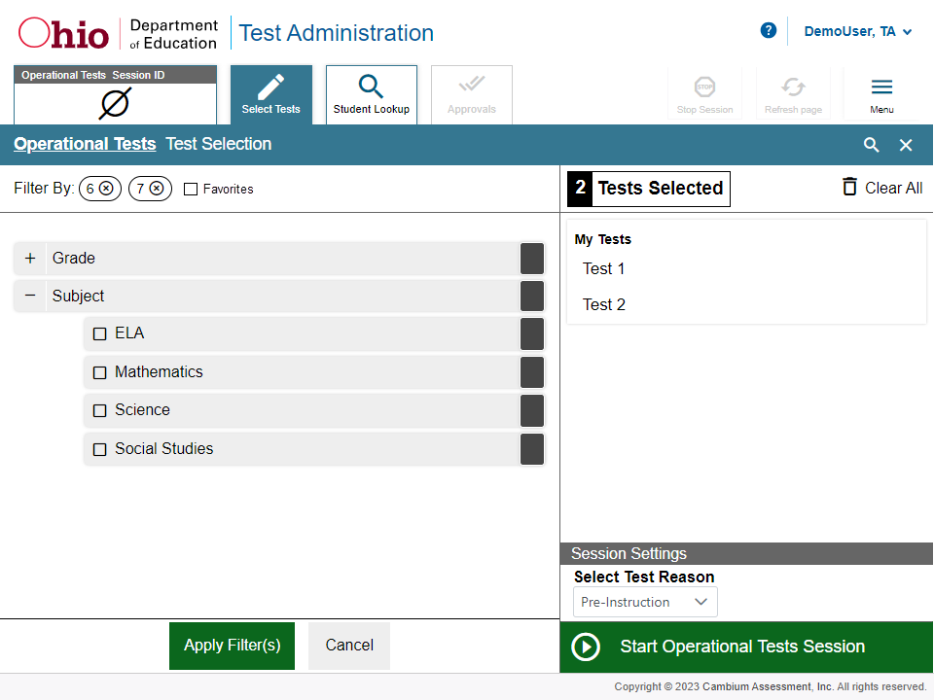
Filters and Search
Notes:
You can filter a list of tests by grade and subject, in order to focus on specific types of assessments. Published tests created in Authoring can also be filtered by custom label, standards, and by favorite items. The filter function is especially useful when many tests exist.
To filter a list of tests, first click on the Add Filter button and the filters panel will appear. If needed, expand the filter categories by selecting the + sign. Then, mark the checkbox next to the filters you want to apply. Your selected filters will appear at the top of the window. To remove a filter, select the “x” button next to the filter you want to remove. Once you are finished selecting filters, click Apply Filter(s).
To filter tests by items favorited in Authoring, check the box next to Favorites.
You can also search for specific tests to add by using the global search feature. To search for tests, select the magnifying glass in the upper right corner of the window. Enter the key search term(s) you want to search for and click Go. Tests matching your search criteria will appear.

Slide 9
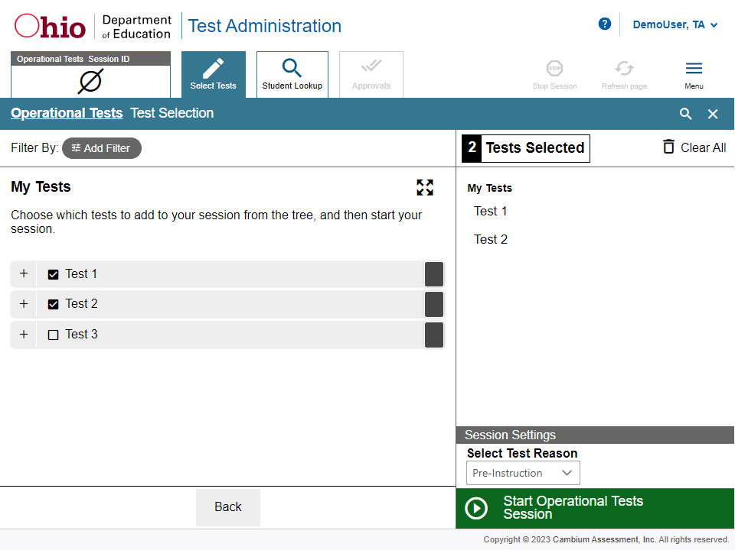
Create a Test Session: Start Session
See Mini Module 4
Notes:
Once you are finished selecting tests to add to your session, select a test reason (a timeframe or season in which tests were taken), if available, and click the Start Operational Tests Session button.

Slide 10
Session ID
DM – 1234 -5
DM – 1234 -5
Notes:
Once you start a teacher-authored session, the system will automatically generate a session ID. The session ID will appear in a tab at the top left corner of the TA Interface. This ID must be provided to students for them to log in.
When students start signing into the test session, the Approvals tab will also become active and display the number of students waiting for approval. Once you approve students for testing, you will see the test session table that displays students’ testing progress. We will discuss more about this in later slides.

Slide 11
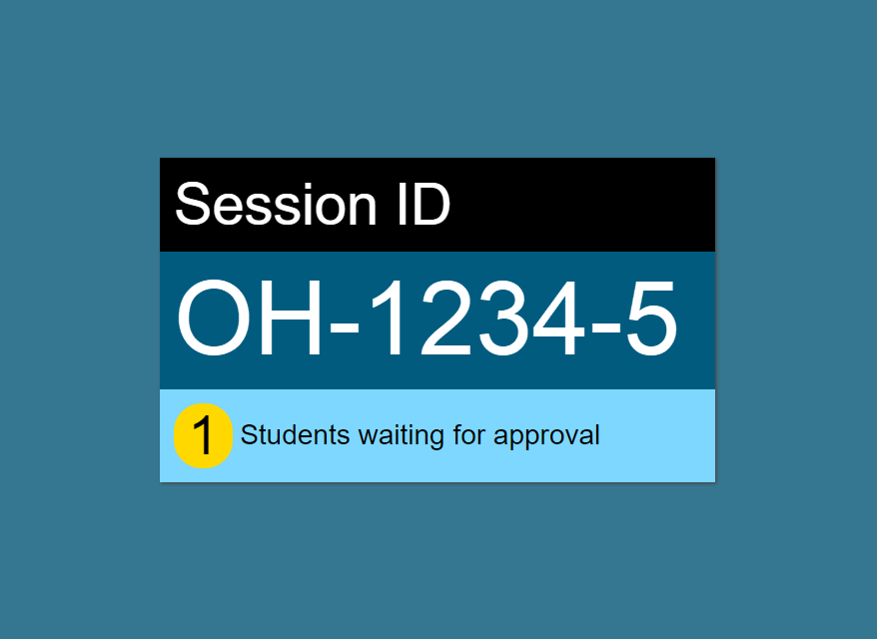
Screensaver
DM – 1234 -5
DM-1234-5
Notes:
Since the student test progress tables in the TA Interface often contain sensitive student information, such as student IDs, the TA Interface contains a screensaver function to hide the data from view. The screensaver will automatically show if you are not active in the TA Interface for 5 minutes.
To access the screensaver at any time, select the Menu dropdown in the top right corner of the window, and then click Toggle Screensaver. The screensaver displays the Session ID and the timer, if applicable. It also displays notifications if students are awaiting approval, if there are pending print requests, or if students require other interventions.
The screensaver will automatically turn off if any mouse or keyboard activity is detected. It will also turn off automatically if the test session times out due to TA or student inactivity.

Slide 12
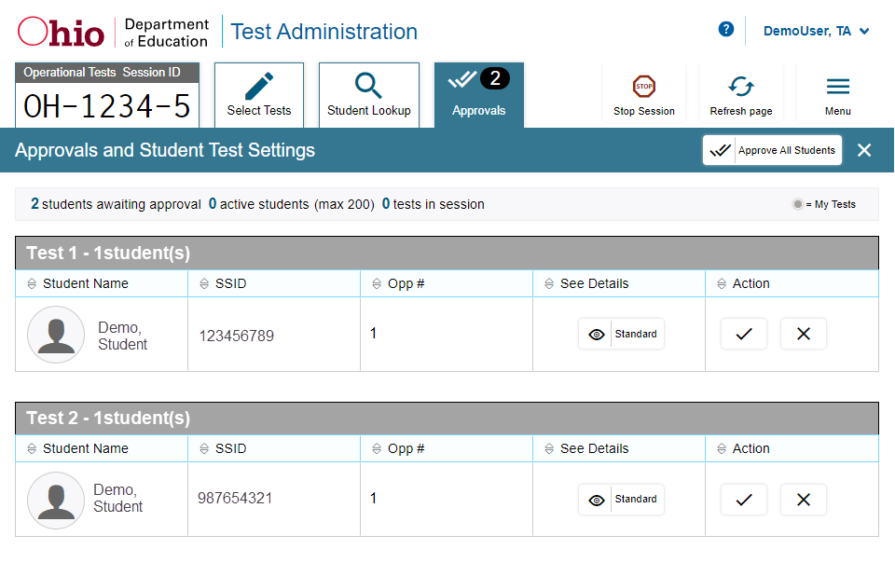
Approving Student Entry
DM – 1234-5
Notes:
Once you start the test session and students log in, you must approve their test settings before they can access their tests. It is important that you pay close attention to the test name prior to approval to be sure that students have selected the appropriate test. To approve students for testing, click the Approvals tab. A list of students will display, organized by test name. You should review the list to make sure that all students chose the correct content area and test. To ensure that a student’s test settings are correct, select the icon in the See Details column.
To approve a single student, click the checkmark button in the Action column. To deny a student entry to the test session, click the X button. Denying the student entry into the test session will not prevent other approved students from beginning their tests.
If no changes are needed, select Approve All Students to admit all students to the session.

Slide 13
How to Monitor Student Test Progress
Notes:
This section covers how to monitor student test progress.

Slide 14
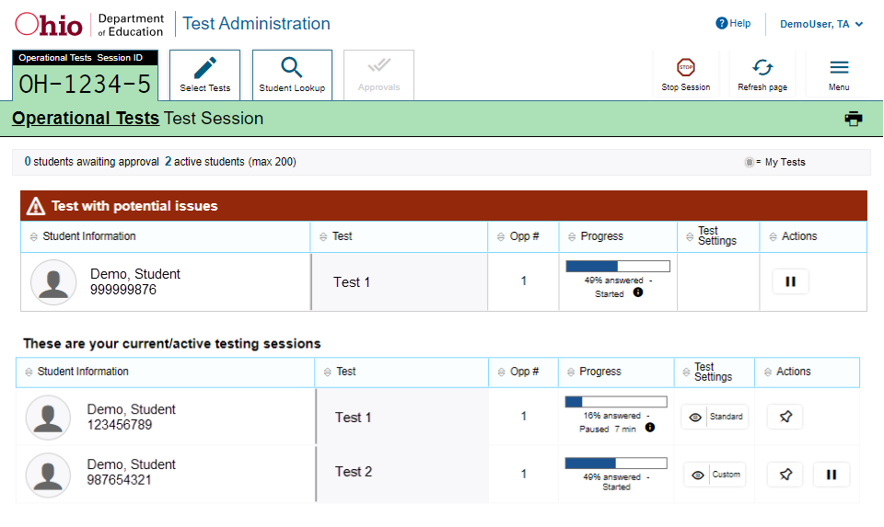
Test with Potential Issues Table
ABC – 1234-5
Notes:
Once students log in and are approved for testing, you can monitor their status from the table(s) displayed on the TA Interface that consist of the following columns - Student Information, Test Name, Opportunity Number, Progress, Status, Test Settings, and Actions.
The Progress column displays the student’s progress through the items in the test. It may display a progress bar to indicate the student’s progress through the test or display the total number of items completed thus far and the total number of items in the test.
The Test Settings column displays either Standard or Custom. This column displays Custom when a student’s test settings are different from the default settings for that test. Click the Eye button to view a student’s test settings
The Actions column includes a Pause button that allows you to pause a student’s test. If a student requests a printout, a printer icon will appear in this column.
If the TDS detects that a student may be having technical issues or requires assistance, a “Tests with potential issues” table will appear. A “more info” icon will appear in the Test Status column. Hovering over this icon will display more information about the issue.

Slide 15
How to Pause & Stop a Test Session
Notes:
This section covers how to pause and stop a test session.

Slide 16
Pausing and Stopping Sessions
DM – 1234-5
Notes:
You have two options within the TA Interface to pause or stop testing once it has begun. You can pause an individual student’s test or stop the entire session. To pause an individual student’s test, click the Pause button in the Actions column for that student. When prompted, click OK to confirm that you want to pause the test.
If you stop the session, all in-progress tests will be paused. If a session stops, it cannot be resumed. You will have to create a new test session and give the new session ID to students so that they can resume testing. To stop the entire test session for all students, do the following:
• Click the Stop sign button. A pop-up message will appear requesting verification to end the session and log students out.
• When prompted, click OK to continue.
If you forget to log out before leaving the testing area, the session will close automatically after 20 minutes of inactivity on both the TA and student computers. You would then need to create a new session and provide the new session ID to students in order to resume testing.

Slide 17
How to Log Out of the TA Interface
Notes:
This section covers how to log out of the TA Interface.

Slide 18
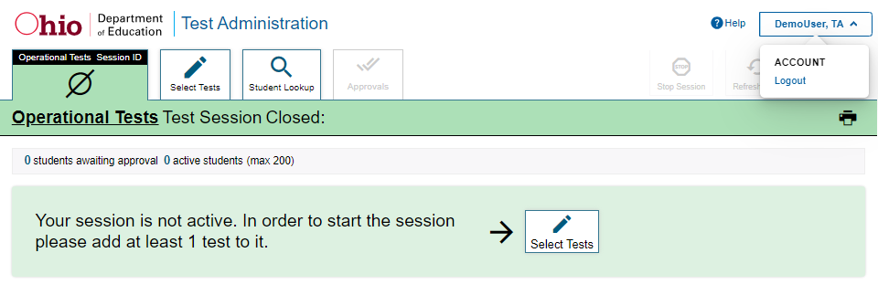
Log Out of the TA Interface
Notes:
To log out of the TA Interface, click your username located in the upper right corner and select Logout.
It is preferable for you to log out only after stopping your active test session, as logging out will cause all in-progress tests to be paused. A confirmation message will appear, asking you to confirm that you want to exit the website and pause all students’ in-progress tests. This scenario also occurs when you navigate to another website from the TA Interface. However, regardless of when or how you log out or navigate away from the TA Interface, student data will NOT be lost. If you need to access another application, we encourage you to open it in a separate browser window.

Slide 19
For More Help
You can contact the Helpdesk for assistance with any technical issues you encounter. When contacting the Helpdesk, please be ready to provide:
Any error messages that are appearing (including codes)
Your operating system and browser information
Your network configuration information
Your contact information for follow-up by phone or email
Any other relevant information, such as test names or content areas, student IDs, session IDs, and search criteria
For test administration or policy issues, please contact your district test coordinator.
Further Information
Id.portal.cambiumast.com
Idaho Help Desk
Toll-Free Phone Support: 1-844-560-7365
Email Support: IDHelpDesk@cambiumassessment.com
Thank you!
Notes:
You can find additional Authoring resources on the Idaho assessment portal. However, if you still require assistance with troubleshooting a technical issue, you may also contact your Helpdesk. When contacting your Helpdesk, please be ready to provide the following information:
Any error messages that are appearing (including codes)
Your operating system and browser information
Your network configuration information
Your contact information for follow-up by phone or email
Any other relevant information, such as test names or content areas, student IDs, session IDs, and search criteria
For questions about test administration or policy issues, please contact your district test coordinator.
Thank you for taking the time to view this training module. For detailed information, consult your Authoring Guide located on your Idaho or contact your Help Desk.

Slide 20
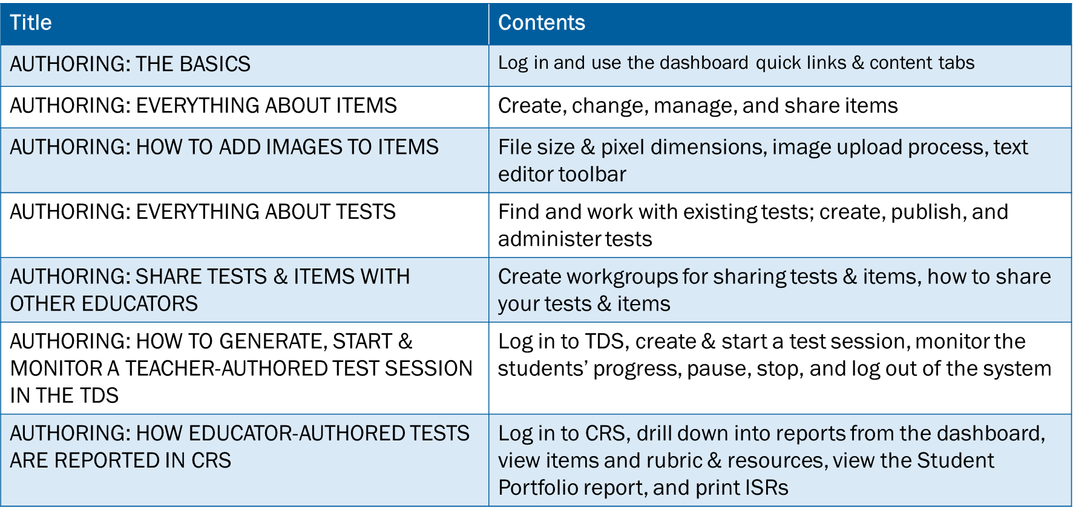
Training Modules in the Series
Notes:
Here are the modules that make up the Authoring system training series. They may be posted on the Idaho assessment portal.

