Slide 1
AUTHORING: How Educator-Authored Tests Are Reported in the Centralized Reporting System
2023–2024
Copyright © 2023 Cambium Assessment, Inc. All rights reserved.
Notes:
Welcome to the How Educator-Authored Tests Are Reported in the Centralized Reporting System training module. This module is part of a series of training modules on the Authoring System. This module explains how educator-authored tests are reported in the Centralized Reporting System (CRS).
Please consult the Idaho portal and the Centralized Reporting System User Guide for additional information about specific features of your state’s Centralized Reporting System. You can also refer to the Authoring System User Guide for more detailed information on features in the Authoring System.

Slide 2
Objectives
Topics | Slides
1. Log in to the Centralized Reporting System | 3–5
2. Drill Down into Reports from the Dashboard | 6–9
3. View Items and Rubric & Resources | 10–14
4. View the Student Portfolio Report | 15–16
5. Download and Print Individual Student Reports (ISRs) | 17–18
6. More Information/More Modules | 19–20
Notes:
There are six topics covered in this training module. You can jump to the section slides if you need information on a single topic. The topics are:
1. Log in to the Centralized Reporting System (CRS)
2. Drill Down into Reports from the Dashboard
3. View items and Rubric & Resources
4. View the Student Portfolio Report
5. Download and Print Individual Student Reports (ISRs)
6. More Information and More Modules

Slide 3
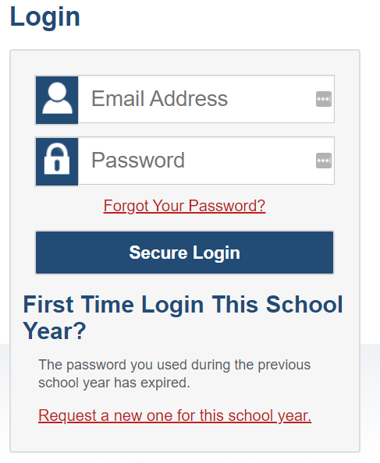
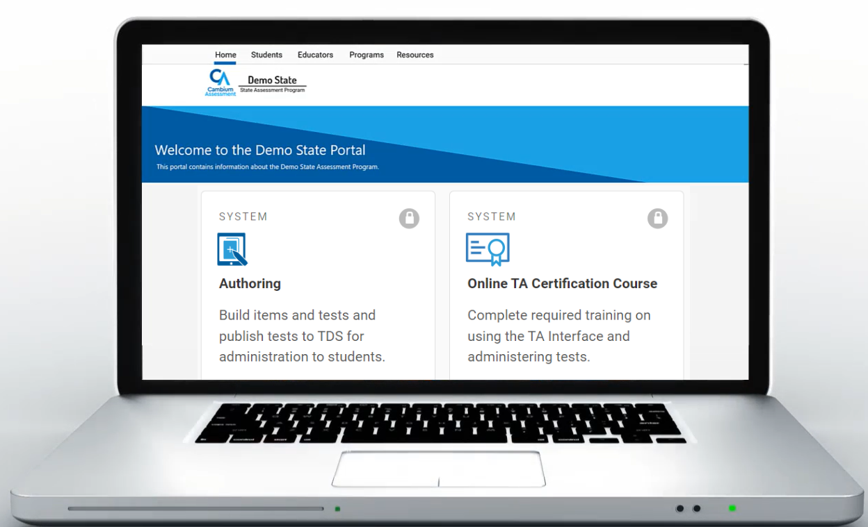
Log In to Reporting
id.portal.cambiumast.com
Notes:
Educator-authored test results are reported in the Centralized Reporting System. To log in to Reporting, go to your portal. Select the appropriate user role and the Centralized Reporting System card. Enter the email address associated with your Test Information Distribution Engine (TIDE) account and your password. Then select Secure Login.

Slide 4
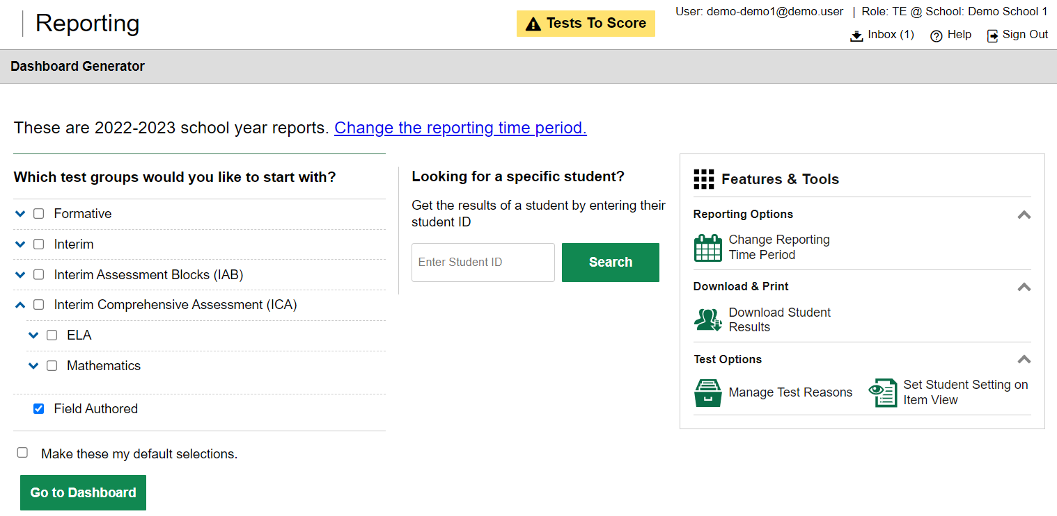
Dashboard Generator
1
2
3
Notes:
The Dashboard Generator page displays. This page is queued to display BEFORE the appearance of the dashboard so you can easily customize your results in order to view only the data that are most helpful to you. The banner displays your username and your role. Underneath is the Inbox, a Help button, and a Sign Out button.
There are three prominent sections on the page. In section 1, you will find the test group selection section where you can check only the tests that apply to your needs and make those your default selections. In section 2, you can access an individual Student Portfolio report by entering a student ID number in the search box. In section 3, you see the Features & Tools menu where you can take some actions prior to viewing data on the dashboard.
To save your selections, mark the checkbox Make these my default selections. These selections will be set in the Dashboard Generator whenever you log in.
Click Go to Dashboard.

Slide 5
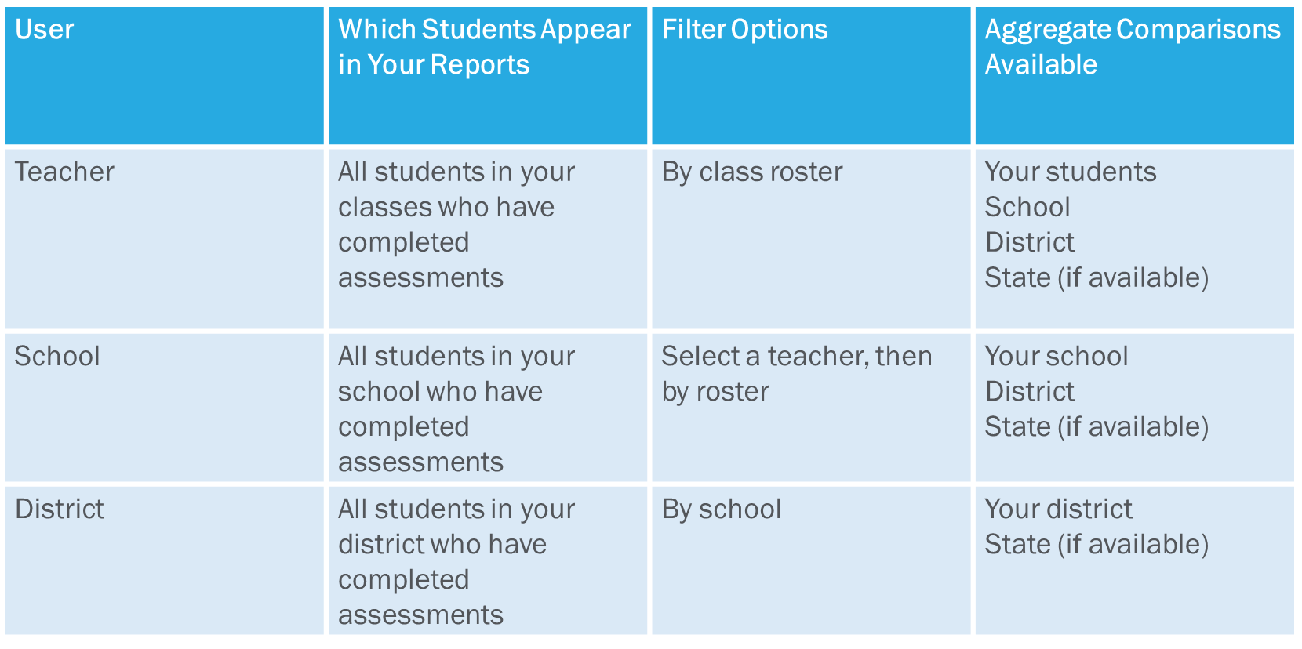
Understand Different User Roles
Notes:
Teachers, school-level users, and district-level users have access to different features and data in the Reporting System. This chart summarizes which students will appear in your reports, the filter options, and the aggregate comparisons available for each of the three roles.

Slide 6
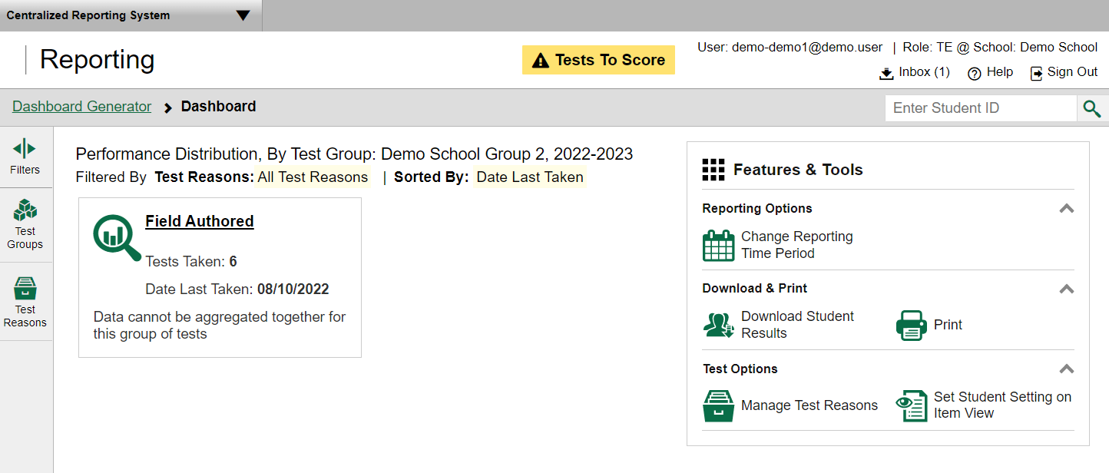
Dashboard
Notes:
The Dashboard is where you can view overall test results on educator-authored tests. For educator-authored tests created in Authoring, a Field Authored test group card will display listing the number of tests taken and the date a test was last taken. The only measure that is reported for the field-authored tests is raw score.
To view results for educator-authored tests, click the underlined test group card name or the magnifying glass view button to the left of it. The Performance on Tests report appears.

Slide 7
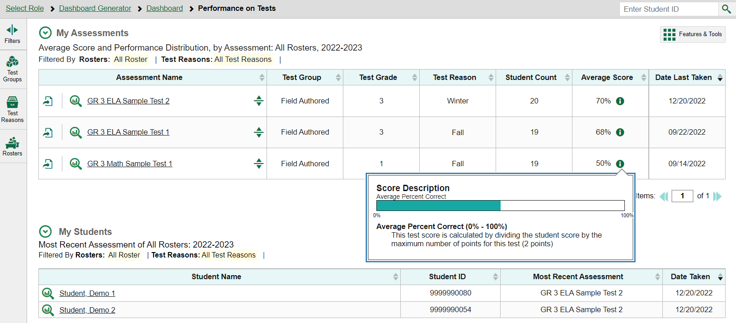
Performance on Tests Report — Teacher
Notes:
Here you see the Performance on Tests report for a teacher. The My Assessments table lists the educator-authored tests the teacher’s students have taken. Each row in the table displays the assessment’s name, test group, test grade, test reason, the number of students who have completed the assessment, the average percent correct for those students, and the date the assessment was last taken. You can use this table to get an overall snapshot of how students have performed across tests.
Click the green information button to display a Score Description and bar graph showing the average percent correct for the students who took that test.
If you’re a teacher, the My Students table lists your students, their student IDs, their most recent assessments, and the dates their most recent assessments were taken. When you click on a student’s name or the magnifying glass view button next to the name, you will see a Student Portfolio Report which includes a list of all assessments taken by that specific student. This report will give you an overall snapshot of how a single student performed over multiple tests.

Slide 8
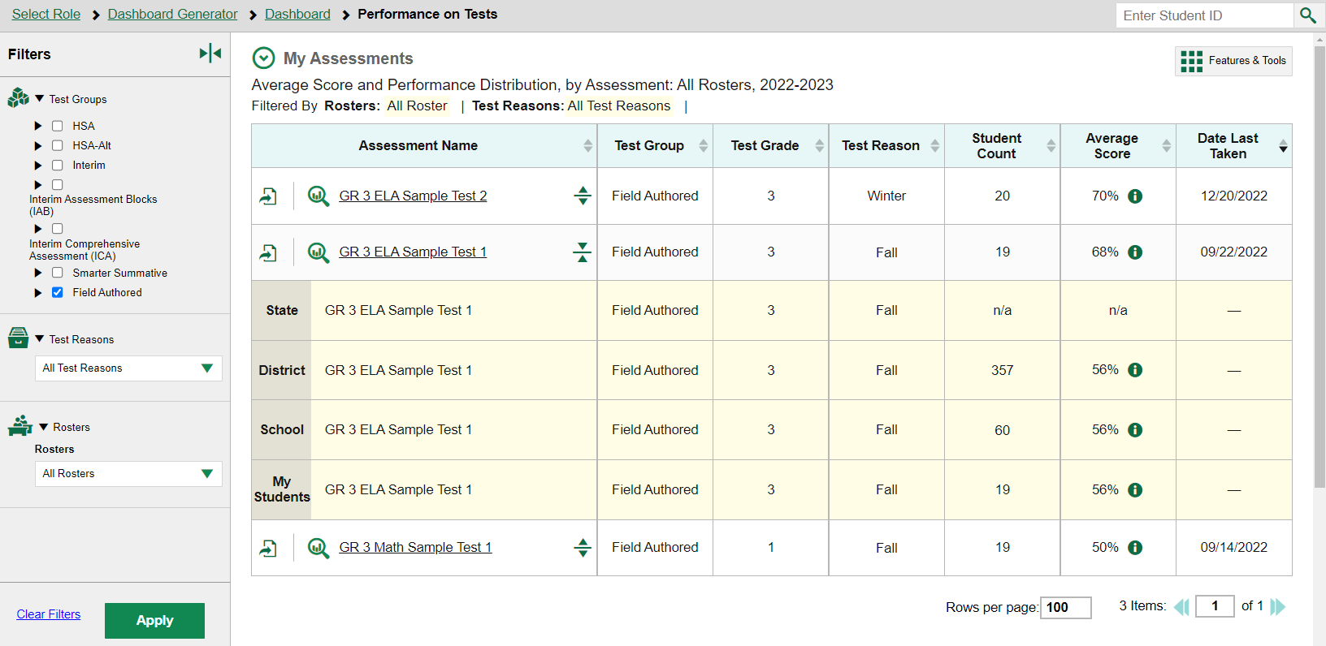
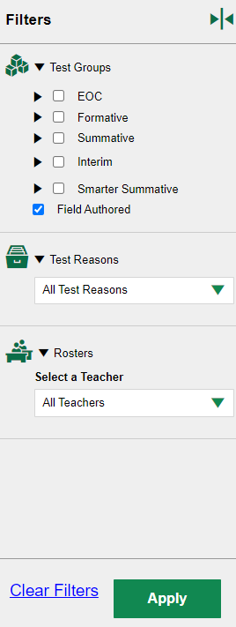
Key Features of Reports
Notes:
CRS provides many helpful tools for customizing reports. These tools are available on many reporting pages and you can use them to help you understand the results of educator-authored tests. These tools include the following:
Sort: You can sort the results in a report by clicking each column header that has a set of sorting arrows in it.
Filter: You may wish to filter a report to show only certain information. To filter a report, select the Filters tool on the left and then select the desired filter criteria from the drop-down menu and click Apply. The available criteria will depend on the report type and the assessment you are viewing. On the dashboard and the Performance on Tests report, you can quickly focus only on data for the test groups you want to see by selecting those test groups from the drop-down menu and clicking Apply.
Compare: In addition, you can compare your results to your district and school data depending on your user role and if the authored test has been administered by other educators. Simply click the compare with aggregates button, which displays as a set of expansion arrows, to the right of the assessment name.
Export: The Export buttons in each row to the right of the Assessment Name allow you to export that specific test report as a PDF or CSV file.
Features & Tools: Click the Features & Tools button to display a menu of actions you can take, such as Print, and Download Student Results.
Search: You can search for a specific student by entering the Student ID number in the search field at the upper-right corner.
To view results for a specific assessment, click on the assessment name or the magnifying glass view button beside it. The My Students’ Performance on Test report appears.

Slide 9
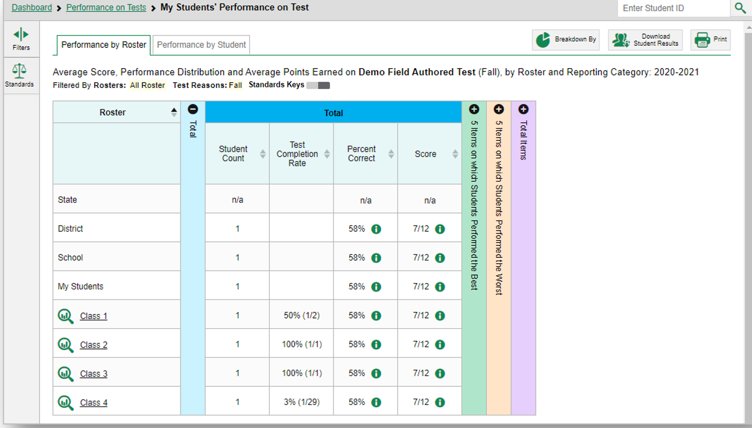
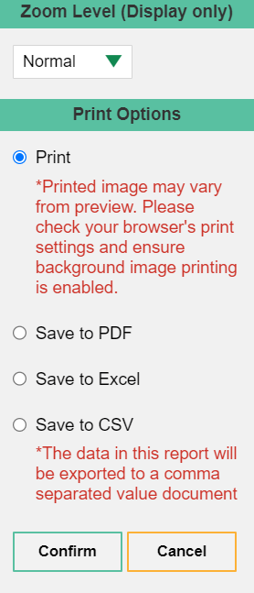
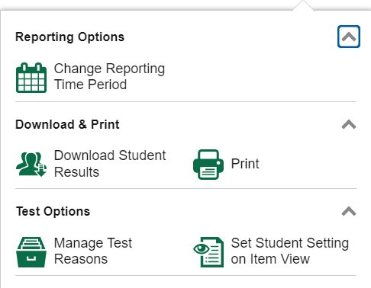
My Students’ Performance on Test — Overall Result
Notes:
Here is the teacher’s My Students’ Performance on Test report. The navigation trail displays in the gray bar at the top of the report. You can return to a previous report by clicking the underlined name of the report.
School-level users see the similar School Performance on Test report and can drill down to individual teachers in the school. District-level users see the District Performance on Tests report, from which they can drill down to the school report by clicking the name of a school or the magnifying glass view button beside it.
This sample report shows performance by roster. You can toggle between performance by roster and performance by student by using the tabs above the table. You can view aggregate scores for your district, your school, and/or your students on the top rows and underneath that, performance on each roster.
Aggregate overall test results are shown on the left. They include the total number of students who completed the test, test completion rate, percent correct, and the average raw score. Unlike other interim or summative assessments, teacher-authored tests are reported with raw scores because the items are not on a scale and there are no item statistics. You can use this roster report to identify which groups of students are struggling and which groups of students are excelling on the test.
You can use the plus and minus signs at the top of the columns to expand or collapse the sections. The section includes all items on the educator authored test (Total Items). If there are 10 or more items in the educator-authored test, 5 Items on which Students Performed the Best and 5 Items on which Students Performed the Worst sections would also appear.
You can print any report you see on your screen. Open the Features & Tools button and select the Print button. Make selections from an options panel, click Confirm, and follow the directions on your browser Print window.
To drill down to a specific roster, click the name or the magnifying glass view button.
We now show you how to interpret the reporting sections and details included in the specific item data.

Slide 10
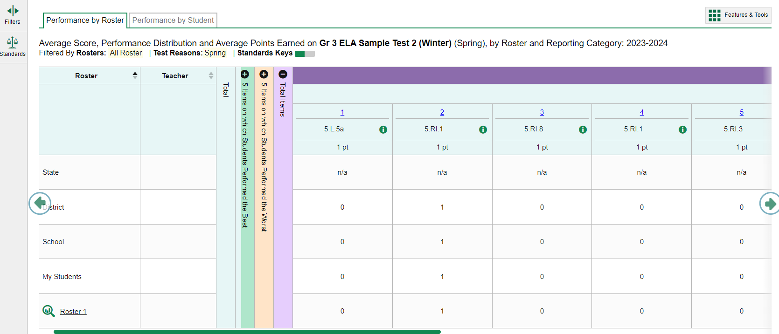
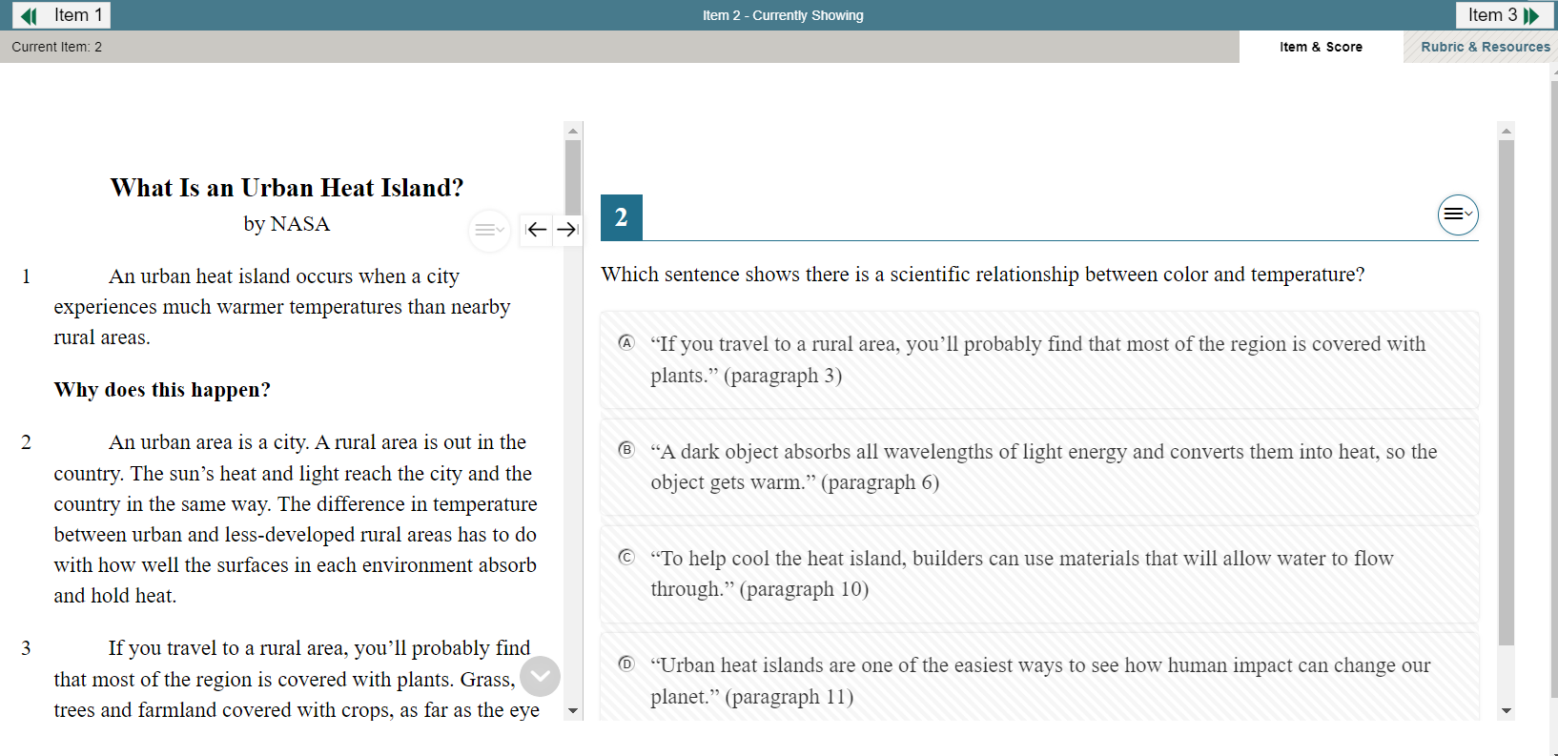
My Students’ Performance on Test: Total Items
Notes:
In this report, we have expanded the Total Items column. The item number is displayed as a blue item link and the maximum points for the item is displayed under the link. By clicking the blue item link, you can view the actual educator-authored test item. Note that from here you can only see the item, not the student’s response to the item. The data under each item shows the average points earned for each of the aggregate levels. For example, students in Class 1 have earned an average of 1 point on item 1, which is a 1-point item.

Slide 11
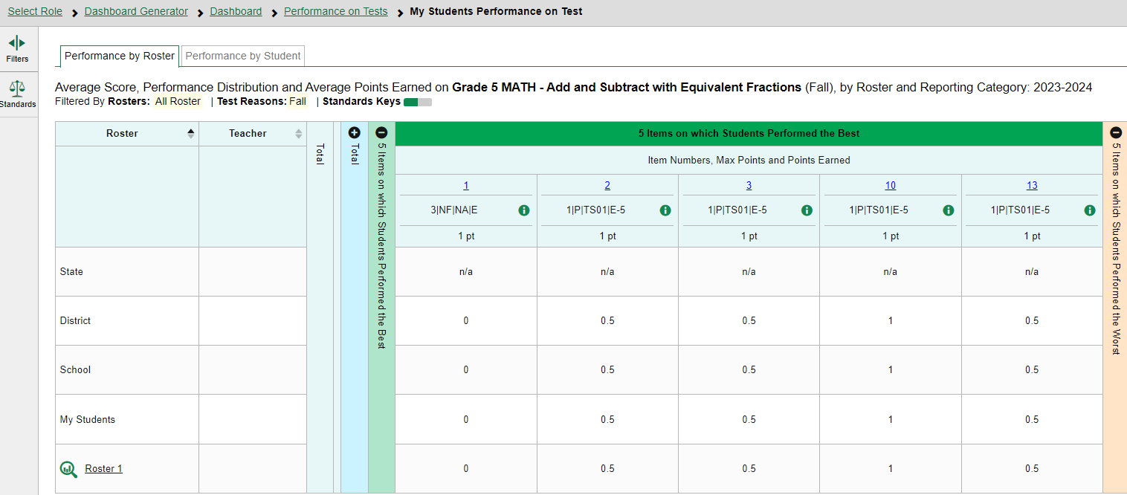
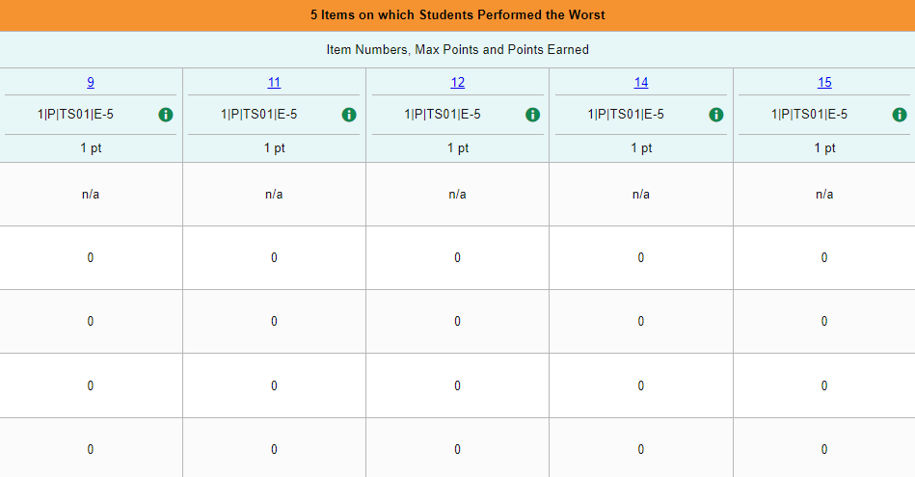
My Students’ Performance on Test: 5 Best and 5 Worst Items
Notes:
In this report, we have expanded the 5 items on which Students Performed Best and the 5 items on which Students Performed the Worst columns. Please note that the 5 best and 5 worst columns will not appear on tests with less than 10 items.
The students in this school performed the best on items #1, 2, 3, 10, and 13 and performed the worst on items #9, 11, 12, 14, and 15. The data under each item shows the average points earned for each of the classes.
For example, students in Roster 1 have earned an average of 1 point on item #10, which is a 1-point item. By viewing the five assessment items with the highest or lowest average score for students, you can analyze students’ strengths and weaknesses and discuss how they can build on the strengths and address the weaknesses.

Slide 12
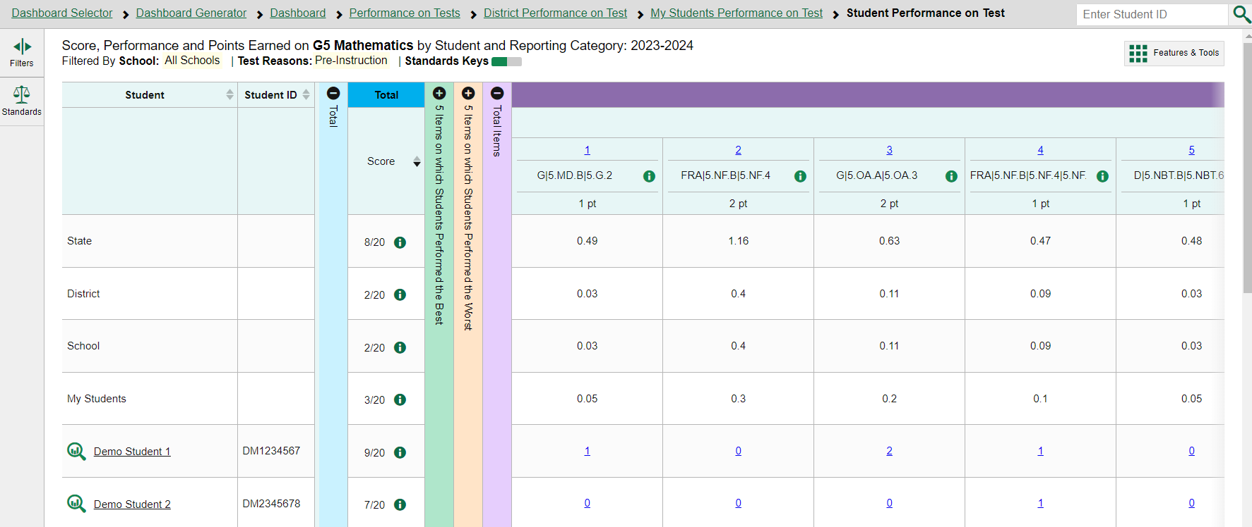
Performance by Student
Notes:
Now let’s look at the same report using the Performance by Student tab. This is a sample Performance by Student report.
The layout and information presented in this report is the same as the Performance by Roster page, but this report shows the student-level data. You can also use this report to view the student’s response to the item. We will discuss more about this in the next few slides.
This report allows teachers to compare students’ performance among different students. Teachers can also evaluate how their students performed compared with other students in the school and district.

Slide 13
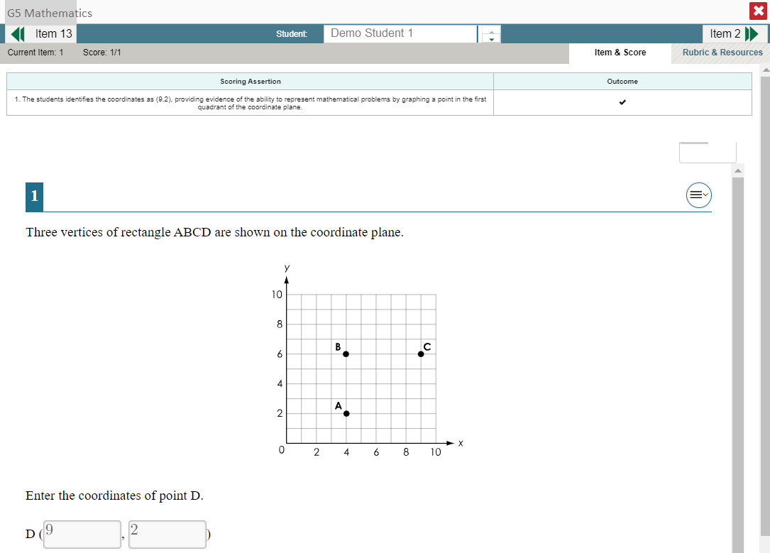
Viewing Student Responses
Notes:
To view a student’s response to an item, find that student’s name in the Student column on the left. Then click the blue score link under the numbered item. In this example we look at item #2 for Demo Student. The item view window displays the item along with the answer provided by that student. The student answered correctly for a score of 1 out of 1 point on item #2. The Scoring Assertion lists what the student needed to do to earn full credit for the item and the Outcome is marked with a checkmark.
In the teal-colored bar at the top of the window are three navigation tools to help you move between students and items without returning to the report. The name of the selected student displays in the middle box. Clicking the down arrow takes you to the next student listed in the report table. Clicking the up arrow takes you to the previous student. The arrow button on the left moves you to the previous item for the selected student. The arrow button on the right takes you to the next item for the selected student.
You can show or hide a student’s visual settings, like large fonts or different color contrasts, on a per-item basis. To do so, click the toggle above the item on the right side.
You can click the Rubric & Resources tab for associated information.

Slide 14
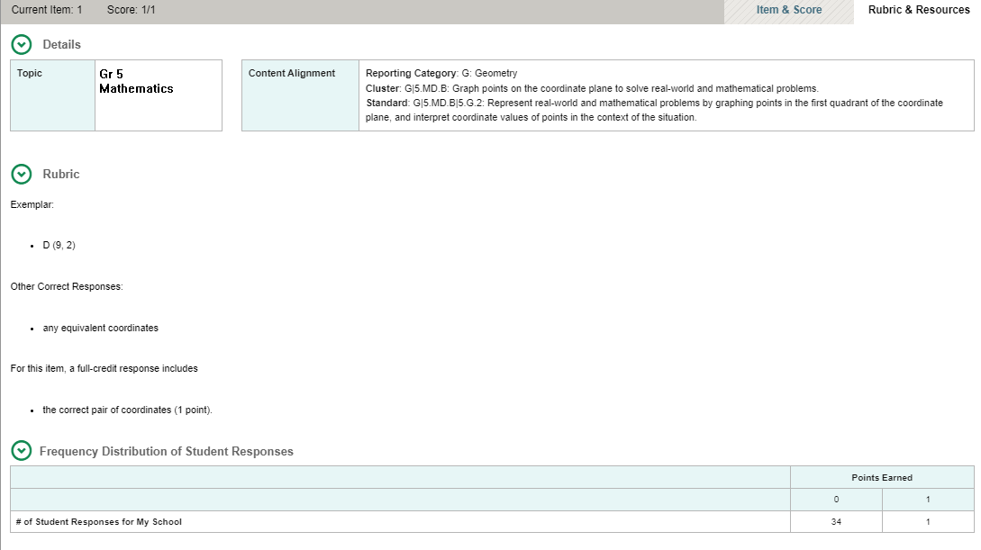
Rubric & Resources Tab
14
Notes:
The Rubric & Resources tab may contain the following, depending on the item and report:
Item Details, which may include the item’s topic, difficulty level, and content alignment
Rubric, which displays the criteria used to score an item
Frequency Distribution of Student Responses, which provides a breakdown of how many students earned each possible point value available for the item (not shown)
By seeing actual student responses, especially for items that demand higher cognitive complexity, teachers can more precisely identify potential gaps in understanding and use that information to provide targeted instruction.

Slide 15
The Student Portfolio Report
31
Notes:
The Student Portfolio Report allows you to view all the assessments an individual student has completed over time. As a teacher, you can access the student portfolio report by clicking the student name or the magnifying glass view button from the My Students table on Performance by Tests page. Alternatively, any user can simply type in the student ID number into the search box.

Slide 16
The Student Portfolio Report (continued)
Notes:
Here’s a sample student portfolio report for Demo Student. The table shows a list of all the tests the student has taken in the current school year. This report can be particularly useful as teachers prepare for the parent-teacher conference, where teachers need to quickly access how a particular student performed across tests.

Slide 17
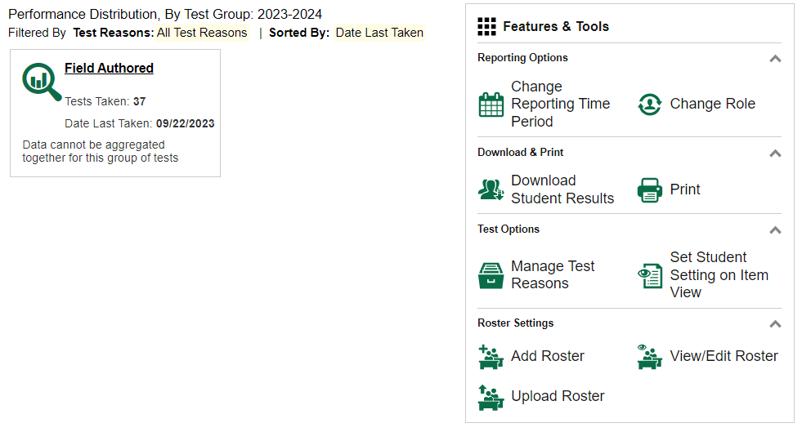
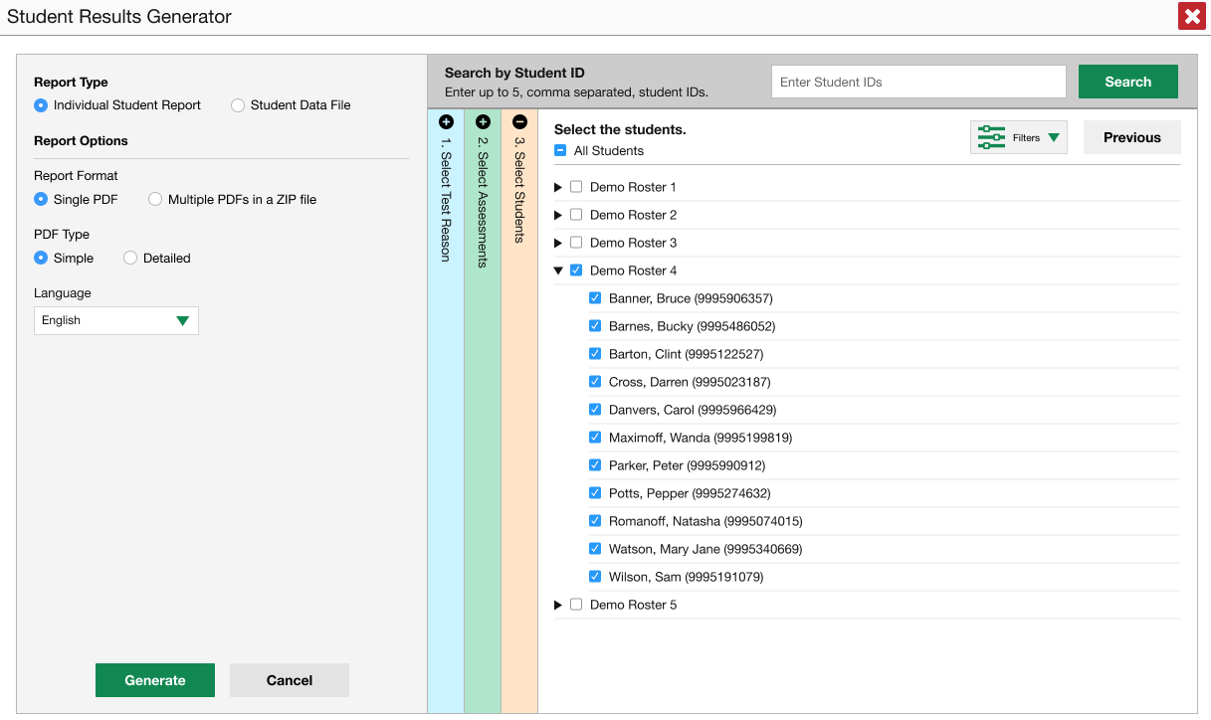
Student Results Generator
Notes:
As an educator, you might want to batch-print Individual Student Reports (ISRs) or download students’ data into Excel. To generate and export an Individual Student Report (ISR) for a test, use the Student Results Generator. The Student Results Generator can be accessed from almost any Reporting page using the Download Student Results button located in the Features & Tools panel. You can specify the report type and options and elect any combination of test reasons, assessments using the color-coded columns. You can generate either a single ISR or multiple ISRs at once. You can also generate a Student Data File (SDF) in the same way, but your report will be in the form of an Excel or CSV spreadsheet. Once the files are generated, they will be available in the Inbox.

Slide 18
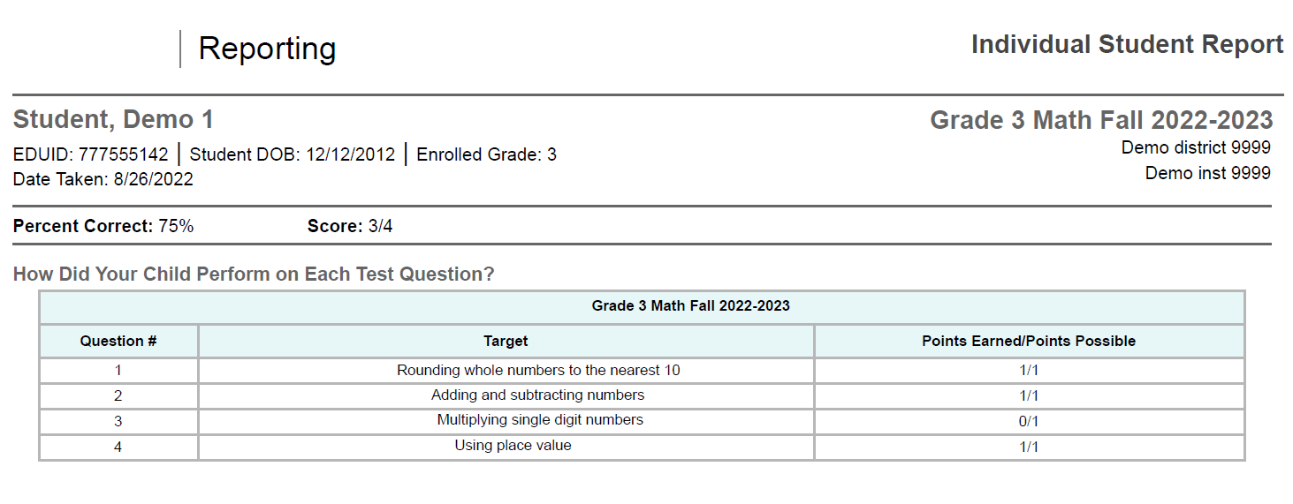
Individual Student Report (ISR)
Notes:
Here is an Individual Student Report for an educator-authored test. Like any other ISR, it includes information about the student, test, and school at the top, and below that a summary of the student’s performance, consisting of percent correct and the score given as a fraction. You can see that this student got seventy-five percent of the test correct, with a score of three out of four points. Below the performance summary is the section How Did Your Child Perform on Each Test Question?, which contains a table for each cluster of standards to which the test is aligned. Each table lists items, the standards (if any) to which the items are aligned, and the scores as fractions.
For more information about ISRs, see your Reporting System User Guide.

Slide 19
For More Help
You can contact the Helpdesk for assistance with any technical issues you encounter. When contacting the Helpdesk, please be ready to provide:
Any error messages that are appearing (including codes)
Your operating system and browser information
Your network configuration information
Your contact information for follow-up by phone or email
Any other relevant information, such as test names or content areas, student IDs, session IDs, and search criteria
For test administration or policy issues, please contact your district test coordinator.
Further Information
Id.portal.cambiumast.com
Idaho Help Desk
Toll-Free Phone Support: 1-844-560-7365
Email Support: IDHelpDesk@cambiumassessment.com
Thank you!
Notes:
You can find additional Authoring resources on the Idaho assessment portal. However, if you still require assistance with troubleshooting a technical issue, you may also contact your Helpdesk. When contacting your Helpdesk, please be ready to provide the following information:
Any error messages that are appearing (including codes)
Your operating system and browser information
Your network configuration information
Your contact information for follow-up by phone or email
Any other relevant information, such as test names or content areas, student IDs, session IDs, and search criteria
For questions about test administration or policy issues, please contact your district test coordinator.
Thank you for taking the time to view this training module. For detailed information, consult your Authoring Guide located on Idaho portal or contact your Help Desk.

Slide 20
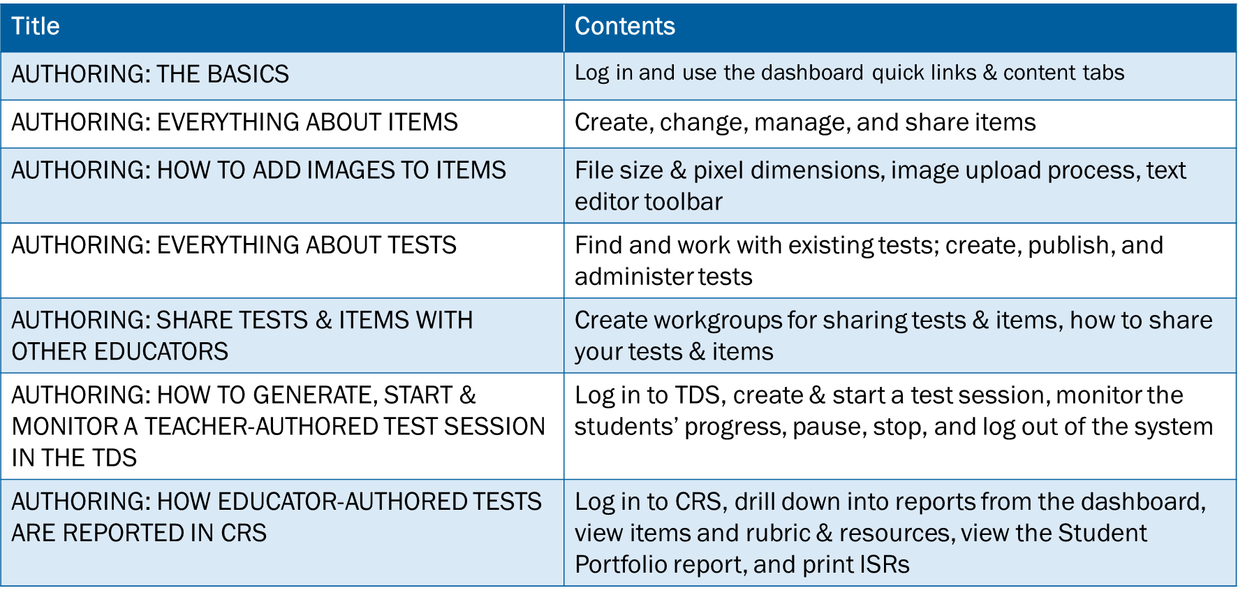
Training Modules in the Series
Notes:
Here are the modules that make up the Authoring system training series. They may be posted on your state assessment portal.

