Slide 1
Test Information Distribution Engine (TIDE)
Notes:
This presentation has been created to provide information about the Test Information Distribution Engine, or TIDE. TIDE is a registration system for users who will access the assessment systems and for students who will take the ISAT Interim, Summative ELA/Math/Science, and Alternate Assessment ELA & Math assessments. This presentation includes tasks in TIDE that must be performed before testing begins, during the test windows, and after testing is completed.
The TIDE User Guide available on the Idaho portal includes more detailed information about the various features in TIDE.
Additional modules covering other testing systems, the Test Delivery System (TDS) and the Reporting system will become available prior to the Summative test window.

Slide 2
TIDE Tasks for Each User Role
District-Level Tasks
[Slides 10-45]
Teacher-Level Tasks
[Slides 71-87]
Test Administrators (TAs)-Level Tasks
[Slides 88-101]
School-Level Tasks
[Slides 46-70]
TIDE Information for all Users
[Slides 1-9 and 102-103]
Notes:
TIDE divides tasks by user role. Users with higher roles will have access to more tasks in TIDE than users with lower roles. District-level users have access to the most tasks, followed by school-level users, teachers, and test administrators. Permissions also limit the scope of data access. A district-level user can only work with data pertaining to their district, and a school-level user can only work with data pertaining to their school.
Users do not need to have multiple roles in a single district. The higher role can do everything the lower role can do and more. For example, users do not need a TA role to proctor an assessment if they already have a role higher in the hierarchy.
The structure of this presentation is based on user role. It includes the following sections:
District-Level Tasks
School-Level Tasks
Teacher-Level Tasks
Test Administrator (TA)-Level Tasks
There is information about TIDE relevant to all users. After reviewing this information, you may go directly to the section of this presentation that is specified for your role
For a complete breakdown of access levels to Idaho Assessment Systems per user role, please refer to the 2019-2020 User Roles and Access to Idaho Assessment Systems document located in the resources section of the ISAT portal under the System Information – User Guides sub-folder.

Slide 3
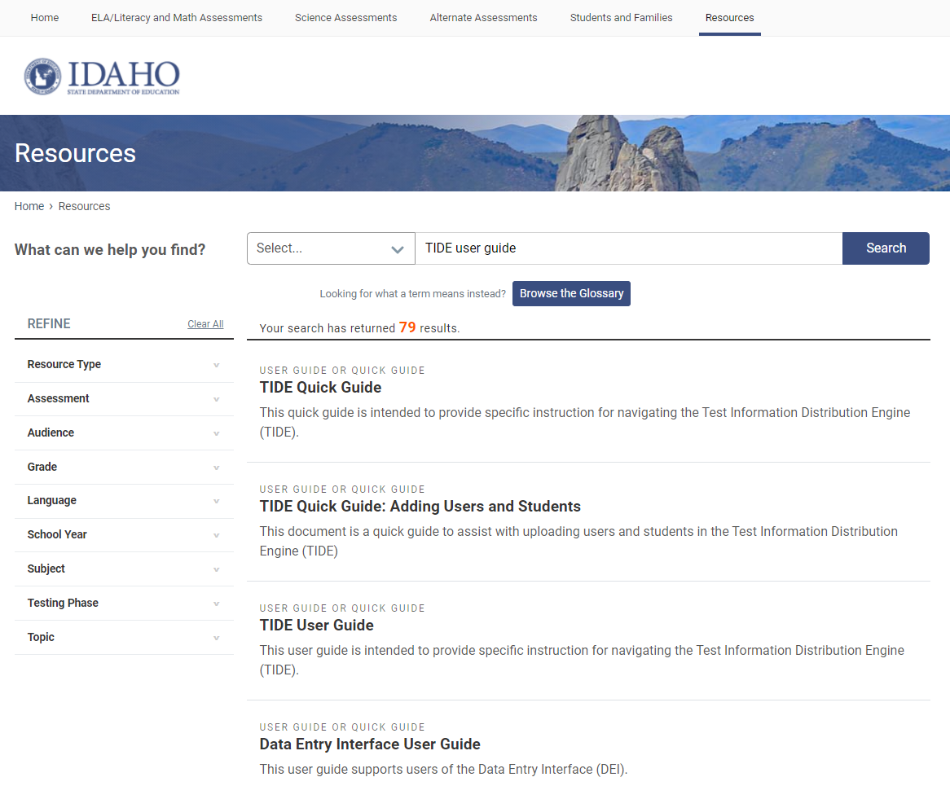
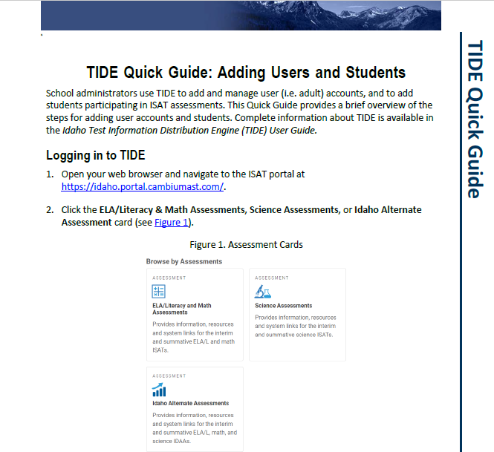
Idaho Portal (Part 1)
Notes:
The TIDE User Guide is available under the Resources tab on the Idaho Portal.
Additional TIDE resources such as the TIDE Quick Guide and the Dual Enrollment in TIDE Quick Guide can be found in Resources.

Slide 4
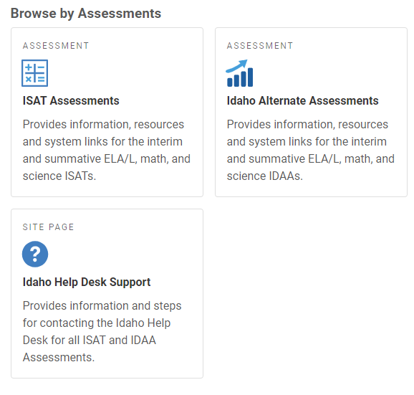
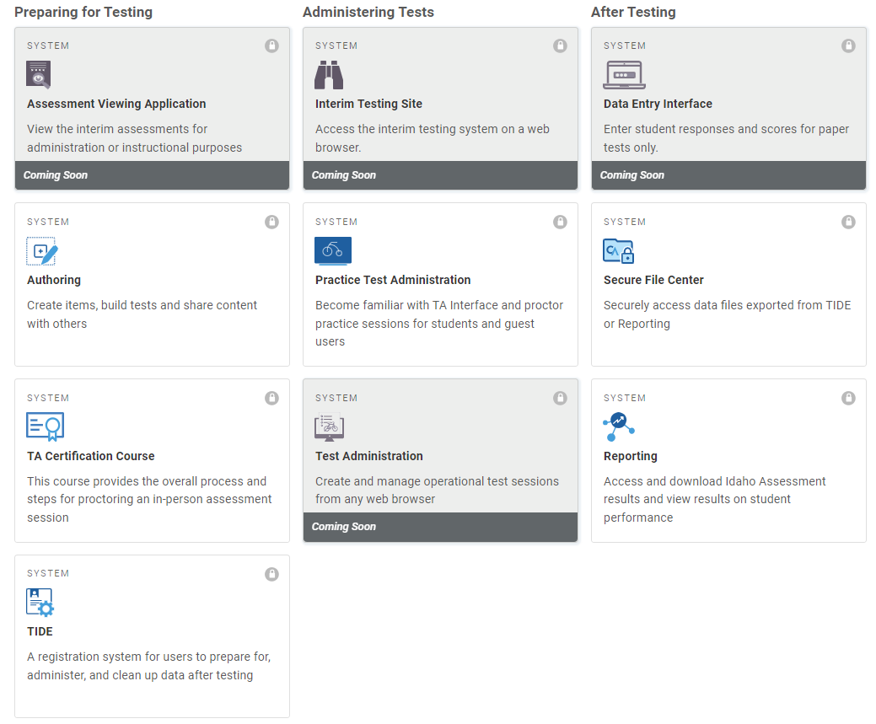
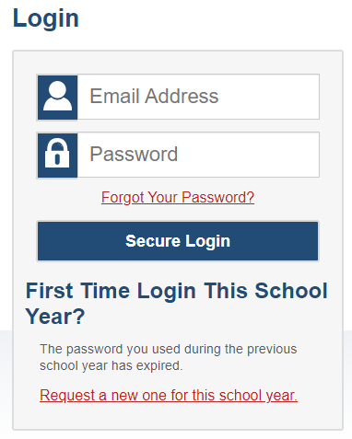
Idaho Portal (Part 2)
Notes:
You can access the TIDE system by clicking on any of the Assessment icons on the home page of the Idaho portal (https://idaho.portal.cambiumast.com/) and then selecting the TIDE card.
Enter the username (email address) and password you created when activating your account. Click Secure Login to go to the TIDE home page.
Please be aware that any card including a lock symbol will require log-in information.

Slide 5
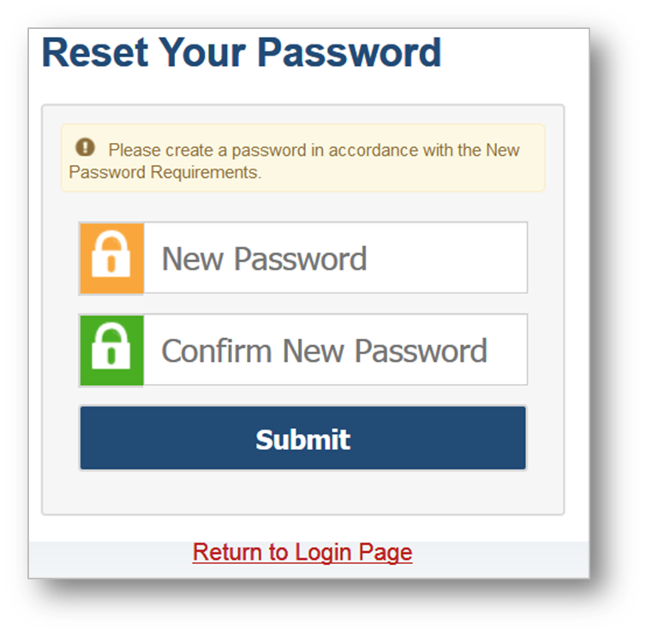
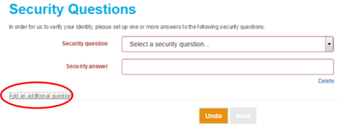
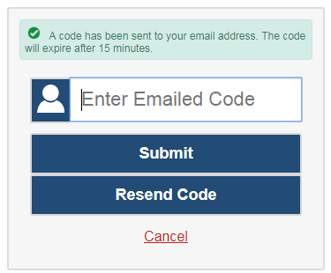
Activating a TIDE Account
When you are initially added to TIDE, you will receive an activation e-mail containing a link that takes you to the Reset Your Password page in TIDE. *Activation link will expire in 15 min*
STEP 1: In the New Password and Confirm New Password fields, enter your new password.
This new password will work on all systems!
Step 2: Click Submit and the Security Questions page appears. From the Security Question drop-down list, select a security question, enter an answer, and click Next.
Activation is complete!
When logging in to the system using a new device or browser, or after clearing the cache on a previously-used browser, you will see an Enter Code page. If you see this screen, you will need to enter the code on this page within 15 minutes of receiving the email.
Important note: The activation link is only valid for 15 minutes. If the link expires, you will need to click either of the links included in the activation email to request new activation information.
If you do not receive an activation email, check your spam folder. Emails are sent from
DoNotReply@cambiumast.com.
Notes:
When you are initially added to TIDE, you will receive an activation e-mail containing a link that takes you to the Reset Your Password page in TIDE.
Step1: In the New Password and Confirm Password fields , enter a new password. You will use this password to access TIDE and all other assessment systems. Please keep in mind passwords have a length requirement and must include different character types; see page 6 of the TIDE User Guide for more details.
Step 2: Click Submit and the Security Questions page appears. From the Security Question drop-down list, select a security question, and enter an answer. You will need this information to reset a forgotten password. Optional: To add an additional security question, click Add an additional question, select a security question and enter your answer. You can add multiple security questions, if desired.
When logging in to the system using a new device or browser, or after clearing the cache on a previously-used browser, you will see an Enter Code page. If you see this screen, you will need to enter the code on this page within 15 minutes of receiving the email.
Important note: The activation link is only valid for 15 minutes. After that time, the link will expire. If the link expires, you will need to click either of the links included in the activation email to request new activation information. If you do not receive an activation email, check your spam folder. Emails are sent from DoNotReply@cambiumast.com.
Be aware that if an account is created for an incorrect email address, it will need to be deleted, and a new account will need to be created for the user.

Slide 6
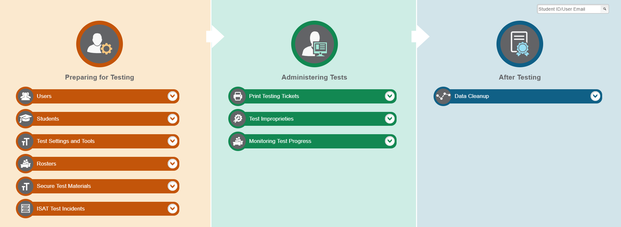
TIDE Home Page
Tasks to complete before testing
Tasks to complete during testing
Tasks to complete after testing
Notes:
The TIDE home page appears after you log in. The home page is designed to reflect the stages of the testing process as directly and simply as possible. Each of TIDE’s three sections list menus for the tasks available in that section.
Tasks in the Preparing for Testing section are typically performed before testing begins. This category includes tasks for managing records for users, students, test settings, and rosters. For example, the Rosters menu contains options for grouping students into rosters. A roster is a collection of students sharing a similar characteristic who are assigned to a specific teacher. Rosters typically represent classrooms but can also be used to group students with special needs or students participating in particular activities or programs. Once scores are calculated, users can visualize how a roster of students performed as a group. To expand a task menu and view its set of related tasks, click the down arrow on the end of that menu. To perform a task, click the name of that task listed in the menu
Tasks in the Administering Tests section are typically performed during the administration window. District Administrators (DAs), District Test Coordinators (DCs), and School Test Coordinators (SCs) may use this section to create test improprieties such as: invalidate a test, reset a test, or reopen a test. Please be aware all tasks available under the Test Improprieties menu will not be available until the spring 2020 test administration. All users may use tasks available in the Monitoring Test Progress task menu to generate various reports that provide information about a test administration's progress.
In the After Testing section, data cleanup operations are performed, such as entering codes to explain student non-participation. Tasks under the Data Cleanup menu will not be available until the spring 2020 test administration.
Please keep in mind tasks available in the interface will vary depending on your user role.

Slide 7
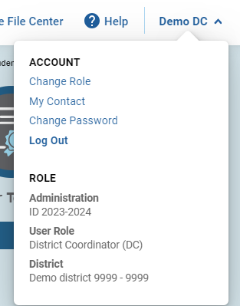
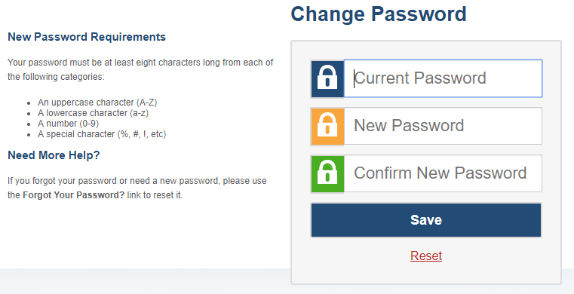
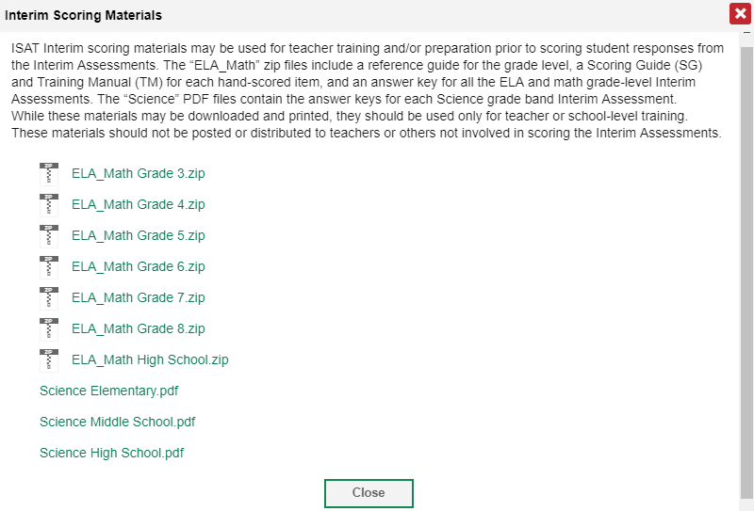
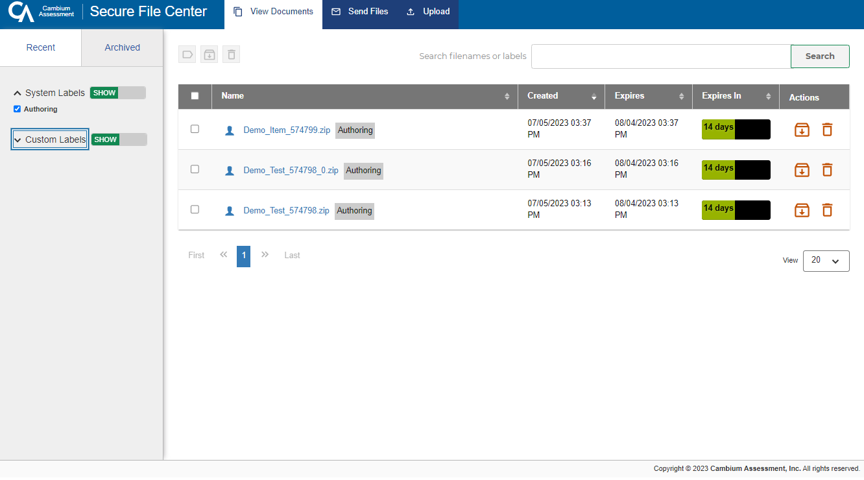
TIDE Banner
Notes:
A banner appears at the top of each TIDE page showing the current test administration and your user role. On the left there is a drop-down list for accessing other assessment systems. You will also find a General Resources drop-down where you can download Interim ELA/Math and Interim Science assessments scoring materials. The Help button displays the Online TIDE User Guide. The Secure File Center allows you to access large student files and secure documents. The Manage Account drop-down allows you to edit your account details and change your password. You can log out of TIDE and other assessment system by clicking the Logout button.

Slide 8
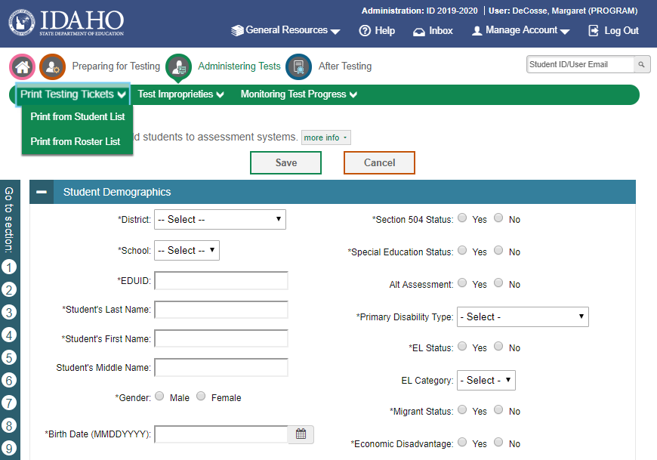
Navigation Toolbars and Help Text
Notes:
When you click into any of the task pages from the homepage dashboard (in this example a user has clicked into the add students page), a navigation toolbar appears at the top of the page. This toolbar allows you to access all tasks and actions that are available on the homepage dashboard. You do not need to return to the homepage dashboard to access any of the other task pages. For example, by clicking Administering Tests you can access any of the Administering Tests tasks available on the homepage dashboard, such as print
Most pages in TIDE have help text that describes the page and how to use it. To show or hide help text on a page, click the gray more info button under the page title.
Some pages in TIDE are divided into multiple panels. Each panel contains a group of related settings and fields that you can edit. You can click the minus sign in the upper-left corner of a panel to collapse it or click the plus sign in a collapsed panel to expand it. Additionally, a floating Go To Section toolbar appears on the left side of pages with multiple panels. This toolbar includes a numbered button for each panel in the form. You can hover over a button to display the label of the associated panel and click the button to jump to that panel.

Slide 9
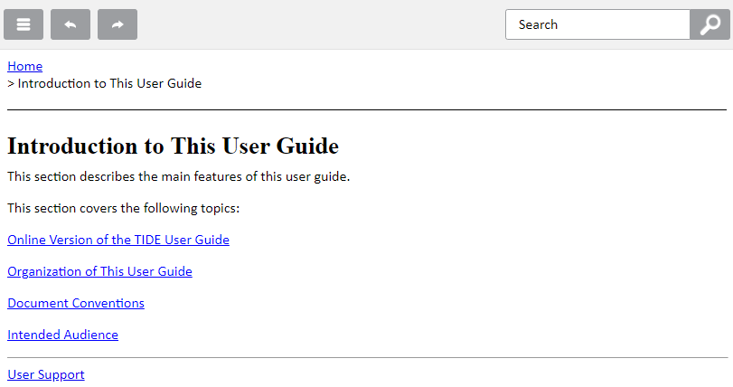
Online TIDE User Guide
Notes:
Every page in TIDE has access to an Online User Guide. To access it, click the Help button and a new window will open with information specific to that page.
The Online User Guide is particularly helpful when having to enter user, student, or roster information via an upload file. By selecting the Help button on the Upload Users, Upload Students, or Upload Rosters pages a new window will open with a table that includes all acceptable values for each corresponding field.

Slide 10
District-Level Tasks
Preparing for Testing
Managing user accounts
Managing student information
Managing rosters
Administering Tests (During Testing)
Printing testing tickets
Managing test improprieties
Monitoring test progress
After Testing
Managing non-participation codes
Notes:
District-level users can perform most of the tasks available in TIDE.

Slide 11
Preparing for Testing
Managing user accounts
Managing student information
Managing rosters

Slide 12
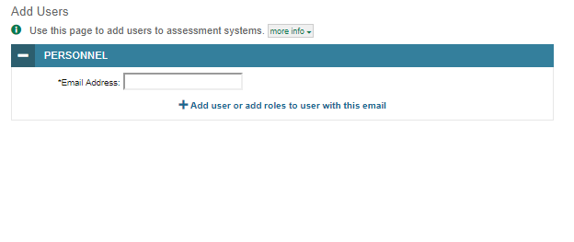
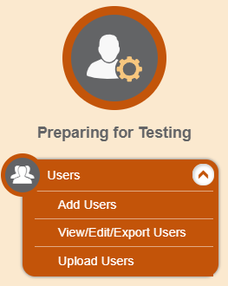
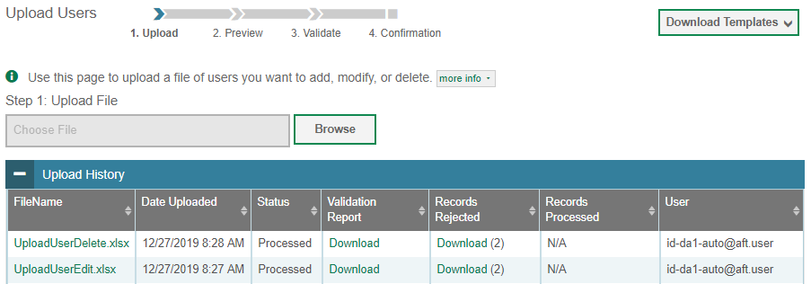
Add Users & Upload Users
Notes:
Before testing begins, and throughout the school year, TIDE is used to manage user accounts for TIDE, the TA Interface, the Online Reporting System (referred to as ORS), the Assessment Viewing Application (referred to as AVA), and Reporting. The Users task menu allows you to add users; view, edit, or export users; and upload users from an external file.
As a DA or DC you can add new users, view/modify users, or delete users in their district and/or school who have a lower role level. For example, DAs cannot add or modify other DA users. In order to add a District Administrator role to your district, please contact the State Department of Education.
There are two ways to add users in TIDE. From the Add User page manually fill out the information on the page and click Save. The new user’s e-mail address will serve as their username when logging in to any assessment system. The second way to add new users in TIDE is to use the Upload Users page to compose an upload file in Excel or CSV format and then upload that file. This method is efficient if you have many new users.
The easiest way to compose an upload file is to download an available template by clicking Download Templates. Open the template, enter information for the users you wish to add, and save the file in Excel or CSV format. We recommend using the Excel template when uploading user information. For a list of the acceptable values in the upload file refer to the Online User Guide by selecting the Help button.
Once you return to TIDE, click Browse, and select the file you just saved. To see a list of the files you have previously uploaded, click the blue plus sign to expand the Upload History panel.
If a user’s role changes within the administration, for example a TE becomes an SC, then a higher-level role, such as a DC will need to delete the user’s former role and add his/her new role. There is never a need to have two or more roles for a user associated to a single district.
If a user needs to transfer to a different district or school, he/she will need to be deleted from his/her former school and then added to his/her new school. If a user requires a user role for two different districts and/or schools two higher level users within each district would need to add this user to their respective districts.

Slide 13
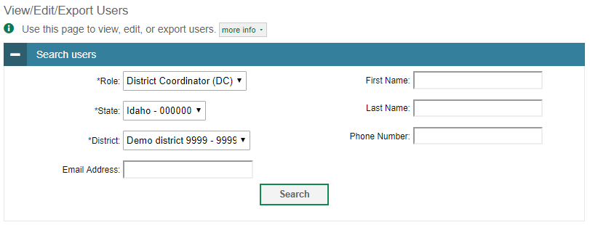
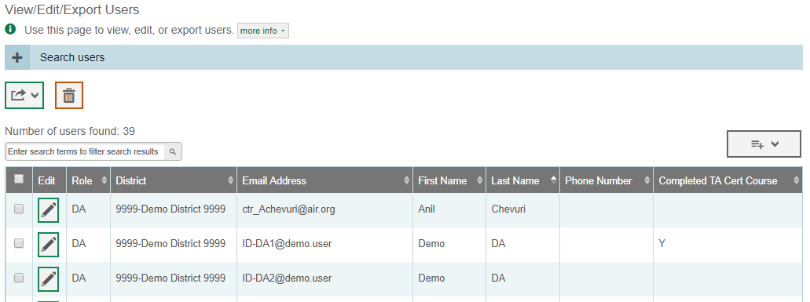
Viewing, Editing, and Exporting Users
Notes:
The View/Edit/Export Users page includes a form for setting selection criteria to retrieve user information. In this example, the required criteria are the user’s role, district, and school. The state field will prepopulate. Other criteria are optional, such as the first or last name. Click Search to continue. The search panel will automatically collapse, and your search results will appear below.
You can edit a user’s information by clicking the green pencil icon. A page will appear where you can edit and save information.
To export user information, mark the checkboxes next to the users you wish to export and click the green export button above the search results.
To delete users, mark the checkboxes next to the users you wish to delete and click the orange trash can button above the search results.
To make the search form re-appear and search for additional users, click the plus sign in the Search users panel, which appears as a blue bar.

Slide 14
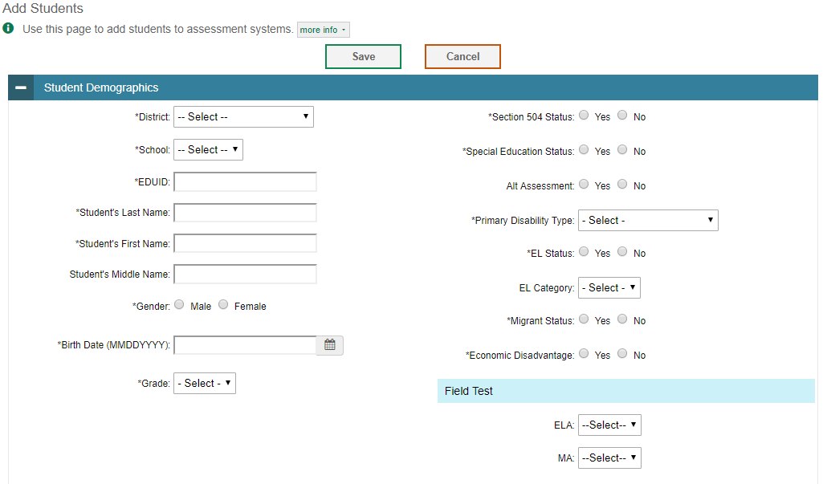
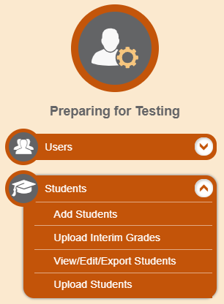
Add Students
Notes:
Students must be registered in TIDE to be eligible to test in the Test Delivery System (TDS). The Students task menu allows you to add students; upload interim grades; view, edit, or export students; and upload students.
You can manually add students from the Add Students page. This page contains six panels: Student Demographics, Race and Ethnicity, Interim Testing Grade, Test Settings and Tools, and Test Eligibility.
You will not be able to add students to TIDE without including required information in the Student Demographics panel. The fields marked with an asterisk are mandatory. As a reminder, EDUIDs are provided by SDE’s ISEE system.
It is also possible to upload students, this process will be covered on slide 19.

Slide 15
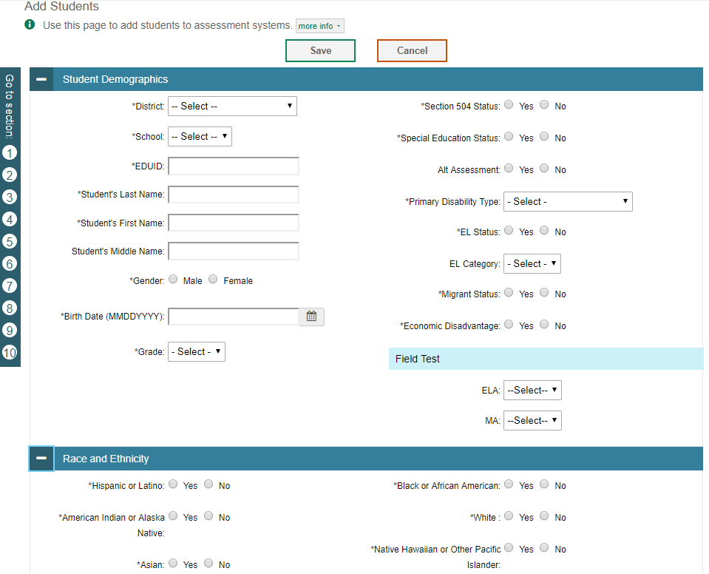
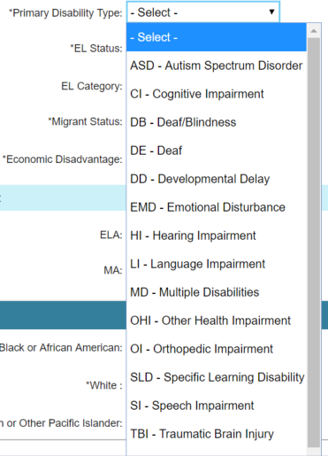
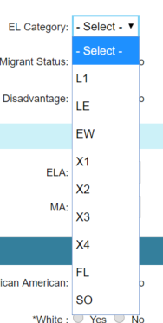
Add Students (continued)
Notes:
The following fields have been changed in the Student Demographics panel:
LEP Category has changed to EL Category.
LEP Status has changed to EL Status.
N/A has been added as an option for Primary Disability Type and is a mandatory field.
Economic Disadvantage Status has been added as a mandatory field that is only viewable at the time of adding a student. This field will not be visible once a student is loaded to TIDE.
It should also be noted that official student demographic information used in federal reporting, including assessment data in state, district, and school report cards, will always come from data collected in ISEE.

Slide 16
English Language Learner Designations
English Language Learners can be designated in TIDE using the Limited English Proficiency (EL) Categories field.
L1, LE, EW, X1, X2, X3, X4, FL, SO. The codes entered in EL Category should match the data entered into ISEE. Please contact the SDE if you have any questions concerning these values. As a reminder, these fields indicate the following:
L1: Receiving EL Services and new to a US school in the last 12 months
LE: Continuing EL Services
EW: English Learner; services waived or refused
X1: Exited – 1st Year
X2: Exited – 2nd Year
X3: Exited – 3rd Year
X4: Exited – 4th Year
FL: Was formerly receiving EL services, no longer monitored
SO: Screened Out
Notes:
This slide provides further detail about what the EL categories presented in TIDE mean. For additional information, please contact the SDE.

Slide 17
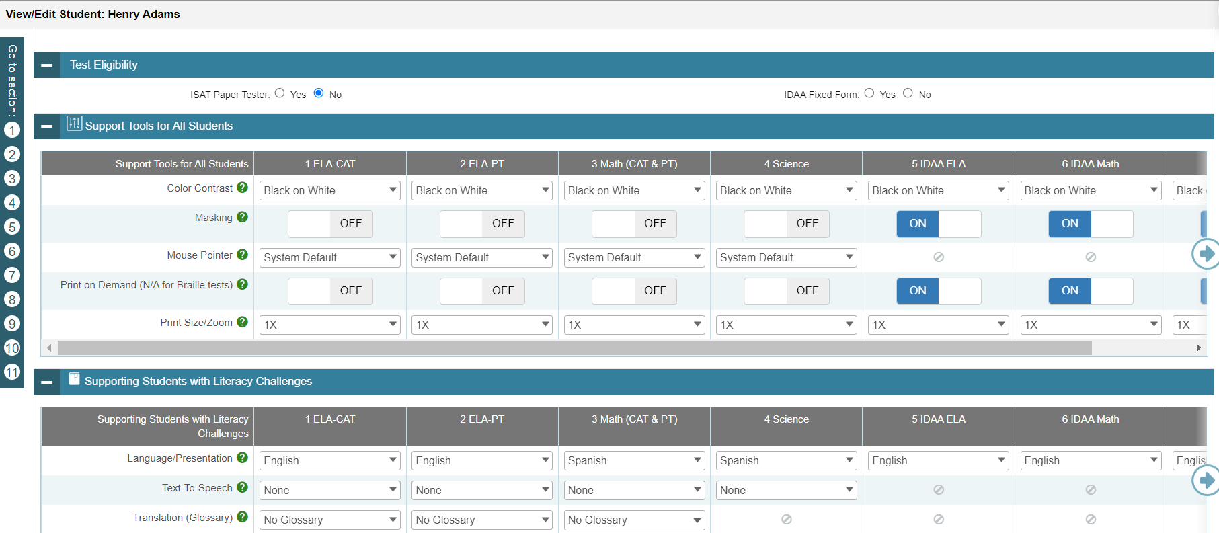
Add Student (continued)
Notes:
In the student test settings and tools panels, select the appropriate test tools for each test using the drop-down lists and on-off switches.
The Test Settings and Tools categories include the following:
Support Tools for All Students
Supporting Students with Literacy Challenges
Supporting Students with Hearing Impairments
Supporting Students with Visual Impairments
Supporting Students Using Assistive Technology
Non-Embedded Tools
Finally, in the panel for Test Eligibility, mark whether a student eligible to take the paper/pencil tests. As a reminder, paper/pencil tests are only available during the summative spring test administrations.
Click Save to add the student.

Slide 18
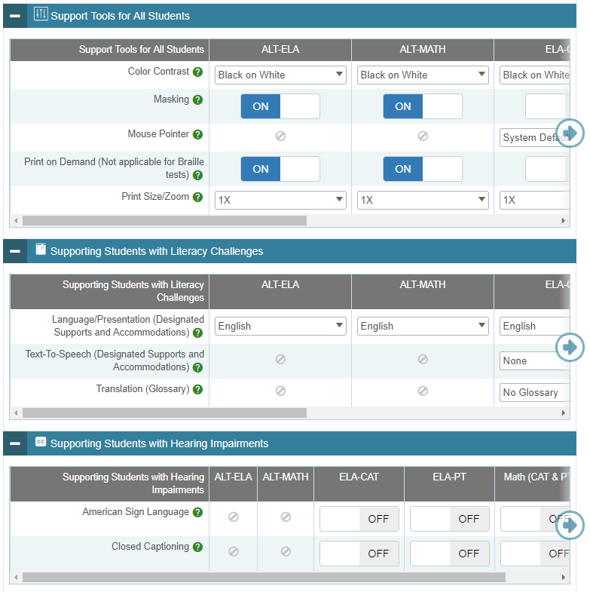
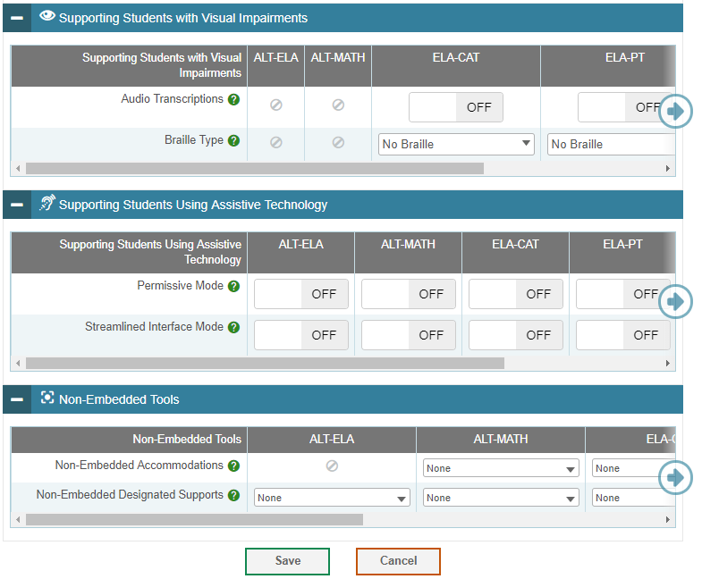
Updates to the Test Settings and Tools Section
Notes:
Changes to test settings and tools section for 2019-2020:
Supporting Tools for All Students section was renamed Support Tools for All Students
Print on Demand moved to this section. The label was updated to read “Print on Demand (Not applicable for Braille tests)”
The Print on Demand tool selection changed to a off/on toggle and is available for all subjects
Supporting Literacy Challenges section was renamed Supporting Students with Literacy Challenges
Removed Text-to-Speech as an option for IDAA ELA
Text-to-Speech options are now “None,” “Designated Support,” and “Accommodation”
Accommodating Auditory Impairments section was renamed Supporting Students with Hearing Impairments
Accommodating Visual Impairments section was renamed Supporting Students with Visual Impairments
Removed Emboss Request Type from this section
Removed the Form Assignment tool completely
Miscellaneous Accommodations section was renamed Supporting Students Using Assistive Technology
Streamlined Interface Mode moved to this section
Non-Embedded Designated Supports
Added to IDAA ELA: Read Aloud
Added to IDAA Math: Read Aloud Spanish
Added to IDAA ELA and IDAA Math: Medical Device, Amplifications, and Noise Buffers
Updated the title of “Read Aloud Items” to “Read Aloud”
Updated the title of “Read Aloud Stimuli” to “Read Aloud”
Updated the title of "Scribe Items (Non-Writing)" to "Scribe"
Added Somali and Hmong Glossaries as tools for Math (CAT & PT) and Science
Non-Embedded Accommodations
Updated the title of "Read Aloud Stimuli" to "Read Aloud"
Updated the title of "Scribe Items (Writing)" to "Scribe (Writing)”
Added to IDAA Math: Calculator

Slide 19
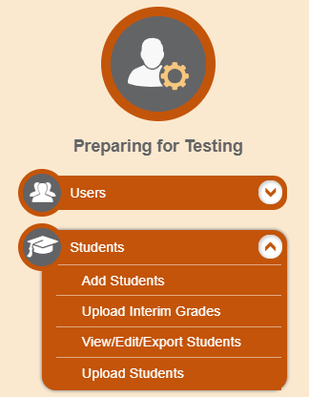
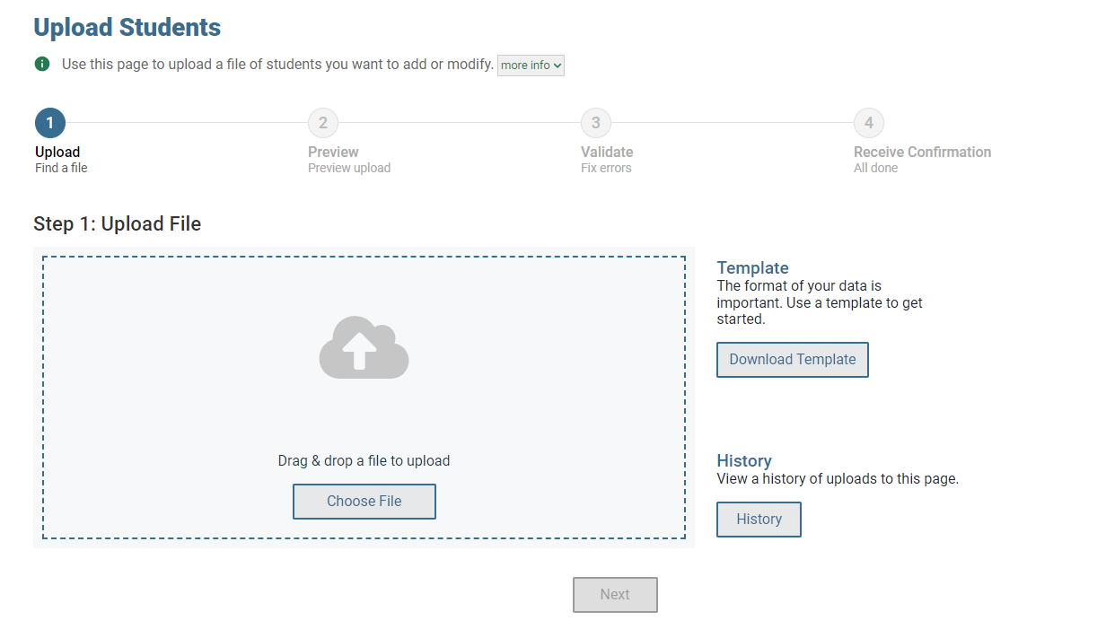
Upload Students
17
Notes:
A second way to add new students into TIDE is to use the Upload Students page to compose an upload file in Excel or CSV format. This method is easiest if you have many new students and you don’t want to add them one at a time from the Add Students page.
The easiest way to compose an upload file is to download an available template by clicking Download Templates. Open the template, enter information for the students you wish to add using Excel or another program, and save the file in Excel or CSV format.
Once you return to TIDE, click Browse, and select the file you just saved.
Click Next to upload the file. A file preview page will appear, allowing you to verify you uploaded the correct file. If the preview is correct, click Next to continue.
TIDE will validate the file and display any errors or warnings according to the legend on the page. Because not all columns can fit on the screen at once, you may need to click the blue arrow on the right side of the screen to scroll right and display more information. Click the error and warning icons in the validation results to view the reason why a field is invalid. If a record contains an error, that record will not be included in the upload. If a record contains a warning, that record will be uploaded, but the field with the warning will be invalid.
To complete the upload, click Continue with Upload.
To upload a different file, click Upload Revised File.
To cancel the upload, click Cancel.
If your file contains a large number of records, TIDE will process it offline and send you a confirmation e-mail when complete. While TIDE is validating the file, do not press Cancel, because TIDE may have already started processing some of the records.
When the upload is complete, a confirmation page will appear with a message that summarizes how many records were committed and how many were excluded.
To view a PDF file listing the validation results for the upload file, click Download Validation Report in the upper-right corner. To see a list of the files you have previously uploaded, first click the blue plus sign to expand the Upload History panel.
The Help button on the top banner will also provide an Online TIDE User Guide with detailed instructions for composing an upload file.

Slide 20
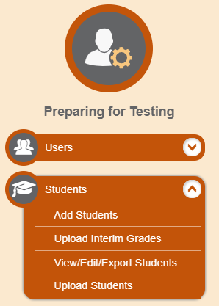
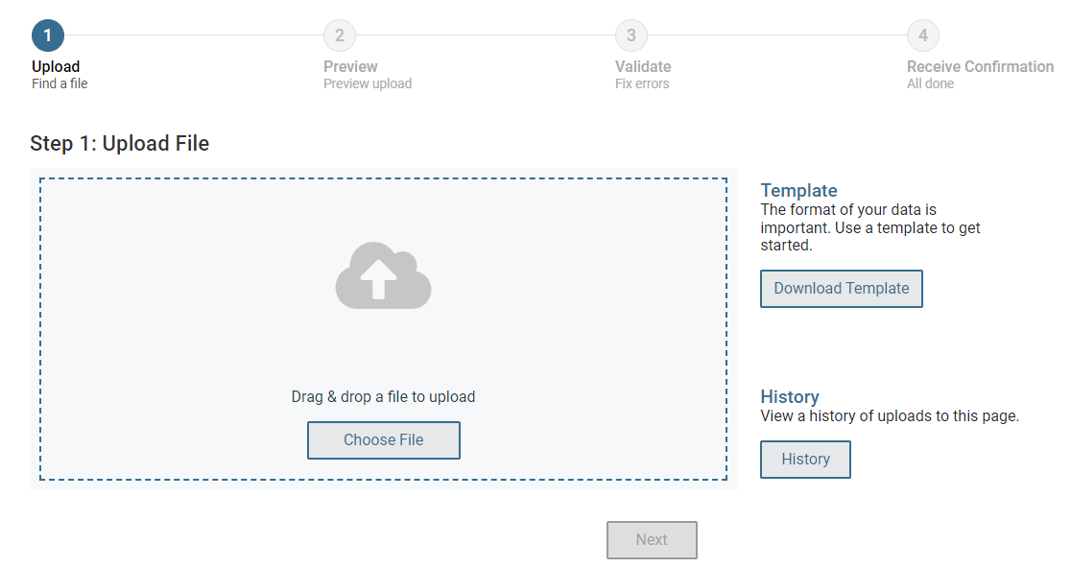
Upload Students Interim Testing Grade
If the upload file includes two rows specifying different grades for the same student and subject, then both grades will be set up as interim grades for the student’s subject
If the upload file includes two rows for the same student and subject and the second row has a value “None”, then all interim grades established for the student’s subject up to that point will be removed.
If a student is manually added to TIDE, then you will need to select an Interim testing grade for that student. However, if the student is added to TIDE using the upload feature, the student will automatically be able to take the Interim tests at his/her enrolled grade.
Notes:
You can set up interim grades for multiple students through file uploads. This task requires familiarity with composing comma-separated value (CSV) files or working with Microsoft Excel.
To upload interim grades through file uploads:
From the Students task menu on the TIDE dashboard, select the Upload Interim Grades page.
Download the Interim Upload file and enter the following information: EDUID, Subject, and the Interim Grade
Note:
If the upload file includes two rows specifying different grades for the same student and subject, then both grades will be set up as interim grades for the student’s subject.
If the upload file includes two rows for the same student and subject and the second row has a value “None”, then all interim grades established for the student’s subject up to that point will be removed.
If a student is manually added to TIDE, then you will need to select an Interim testing grade for that student. However, if the student is added to TIDE using the upload feature, the student will automatically be able to take the Interim tests at his/her enrolled grade.

Slide 21
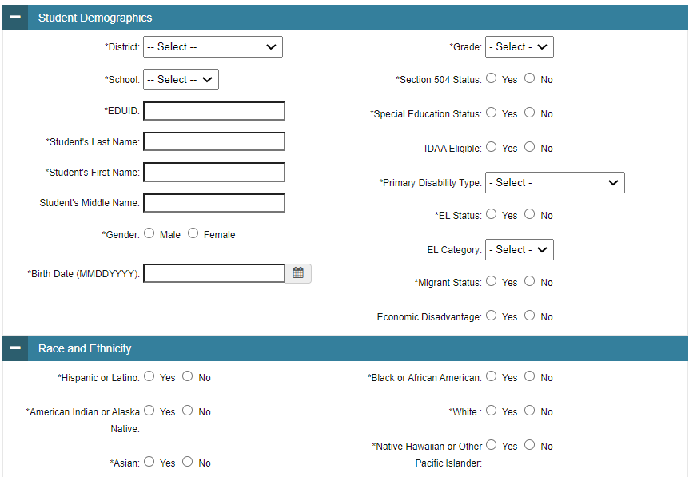
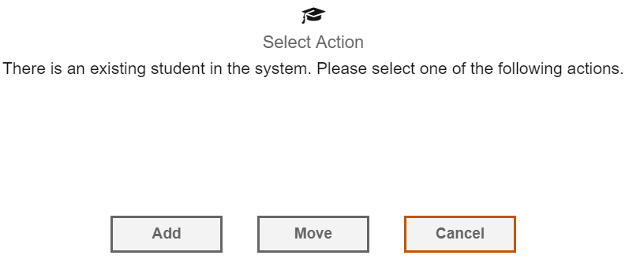
Dual-Enrolling Students (Part 1)
In general, a student is associated with one school and district at a time. However, due to certain circumstances, a student may need to be enrolled in two or more schools within the same district or different district(s) at the same time.
A pop-up confirmation message will appear when you attempt to dual-enroll that student. You can choose from the following three options:
Add – This will dual-enroll the student in the new school.
Move – This will transfer the student to the new school.
Cancel – This will terminate the action and take you back to the Add Students page Moved this note up as it applies to manually adding students from the Add Students page and not upload students.
Students can be added individually using the Add Students feature.
Notes:
Students can be enrolled in more than one school or district simultaneously (referred to as “dual-enrolled” students). To dual-enroll a student, users must add the student using the “Add Students” feature or the upload file. When using the “Add Students” feature, if a student is already loaded in TIDE at a district, the user will receive a pop-up message indicating that the student already exists in TIDE.
Confirm the action you would like to take:
add the student to your school (this step dual-enrolls the student);
move the student to your school (this step removes the student from the previous school and does NOT dual-enroll the student)
or cancel. Cancel this step if you were not expecting the student to already be enrolled in TIDE and you are not sure how to proceed.

Slide 22
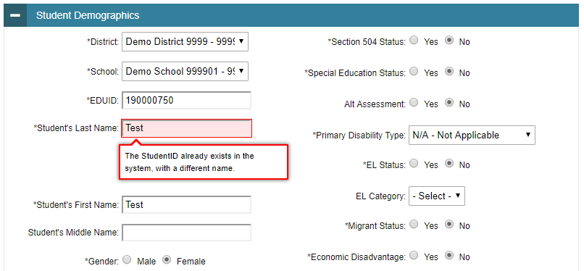
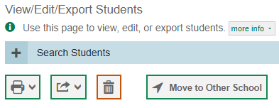
Dual-Enrolling Students (Part 2)
For a student to be dual enrolled, the student’s first name, last name, and EDUID must match.
If a district-level user tries to dual enroll a student with the same EDUID but a different name than what currently exists in TIDE, the system will display a validation error message indicating: “The StudentID already exists in the system, with a different name.”
NOTE: If a user intends to move a student to a different school, they should use the Move to Other School feature only. Only, district-level users have access to move students.
20

Slide 23
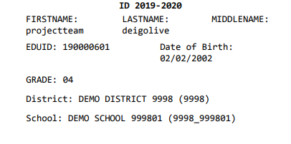
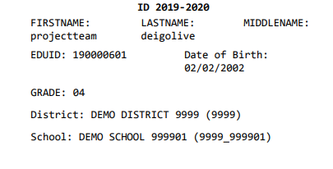
Dual-Enrolling Students (Part 3)
Once students are dual-enrolled they will be ready to test in all locations!
Test tickets for dual-enrolled students will be available for both districts/schools.
21
Notes:
All dual-enrolled students will have a test ticket available for each district and school they are enrolled in.

Slide 24
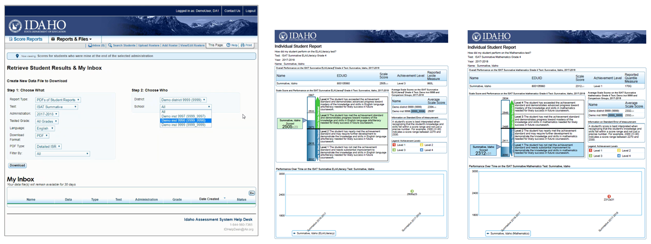
Dual-Enrolling Students (Part 4)
If a student is enrolled in multiple schools (school A and B), then the student's scores will appear in both schools.
School A (or 9998)
School B (or 9999)
Notes:
If a student is enrolled in multiple schools (school A and B), then the student's scores will be aggregated to both schools A and B and both schools will be able to access student’s score reports.

Slide 25
Deleting Students
District-level users are able to DELETE student(s) through the Upload Students feature only. The DELETE function is particularly helpful when trying to remove students who should NOT be dual enrolled. It is important to delete students who are no longer enrolled at your district for student privacy laws.
To DELETE a student:
Download the student upload template from the Upload Students page.
Complete all required fields within the template.
Enter “Y” in the “DeleteStudent” column. This field will not accept “Yes” as a value.
When deleting a record of a student who has been dual-enrolled, only the selected record will be deleted. For example, if a student is enrolled in School A and School B and you delete the student’s record for School A, the student’s record for School B will not be deleted. If you do not wish to DELETE a student, this field should be left blank.

Slide 26
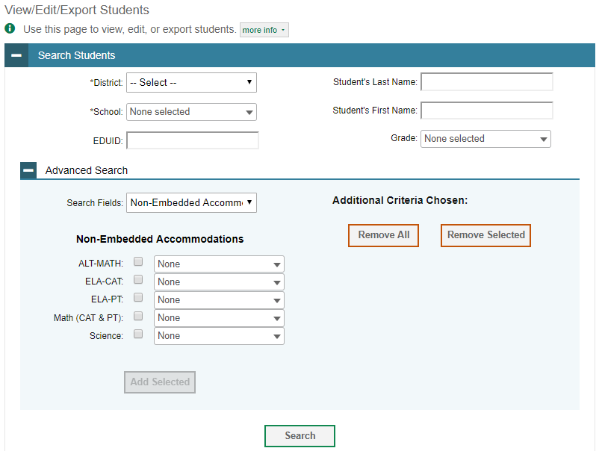
Viewing, Editing, and Exporting Students
Notes:
From the Students task menu, the View/Edit/Export Students page includes a form for setting selection criteria to retrieve students. Required criteria, such as the district and school, are marked with asterisks. Other criteria are optional, such as the EDUID, the student’s first or last name, and the grade level.
You can further refine your search by entering additional demographic information or test settings in the Advanced Search panel.
The students you can retrieve on this page are limited by your role’s scope. As a district-level user, you can retrieve students enrolled within your district.
Click Search to continue. The search panel will automatically collapse, and your search results will appear below.

Slide 27
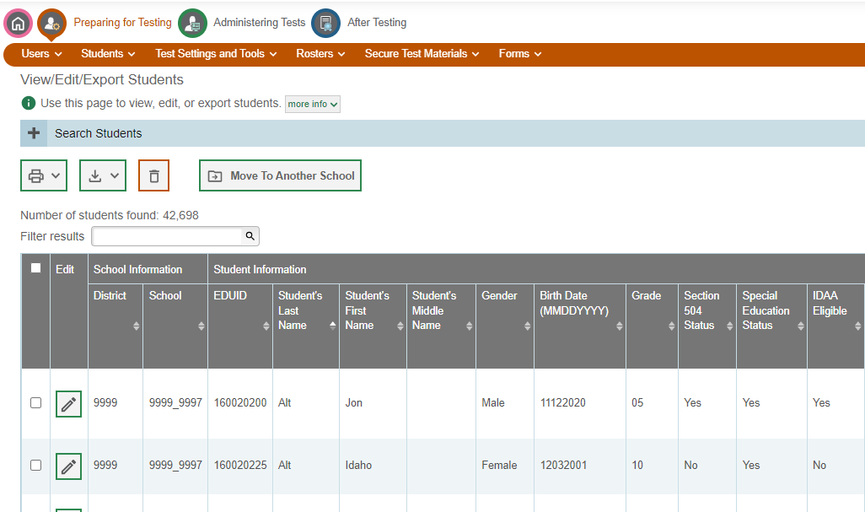
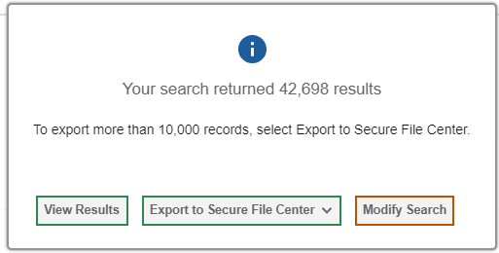
Searching for Students
Notes:
After you click Search, you’ll see a message asking whether you would like to view the results of your search, export the list of students to the Secure File Center, or modify your search criteria and try again. If you choose to export the results to the Secure File Center, you will receive an email when the file is ready for you to download.
When you click View Results, TIDE will display all the students satisfying the search criteria. You can edit a student’s information, including test settings and accommodations, by clicking the green pencil icon.
Print or export student information or delete students from TIDE by selecting the desired students and clicking the Print, Export, or Delete button above the search results.
To export the retrieved results to the Secure File Center, click Export to Secure File Center and select the file format (CSV or Excel) in which the data should be exported. You can navigate away from the page and perform other tasks if required. When your file is available for download, you will receive an email to the email account registered in TIDE. After receiving the email, you can download the exported file from the Secure File Center.
To make the search form re-appear and search for additional students, click the plus sign in the Search Students panel, which appears as a blue bar.

Slide 28
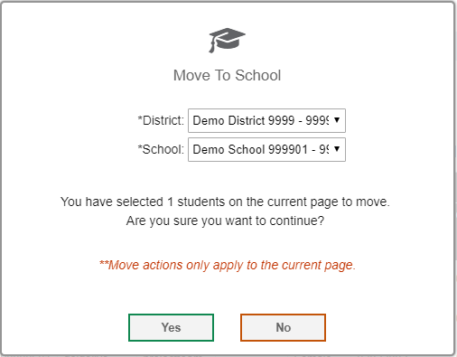
Moving Students
Notes:
A student can also be moved to a different school as long as you are associated with both schools. This task can be performed by your user role only.
On the Search Students results page, select the student and click the Move to Other School button. A pop-up page will appear. From the District drop-down list, select the district to which you want to move the student. From the School drop-down list, select the school to which you want to move the student. Click Yes. After TIDE moves the student, an affirmation message appears.
Please note, this button should only be used to move students; it should not be used to delete them from your district/school. A student should no longer be moved via an Upload Students file. If a user attempts to move the student this way, the student will automatically be dual-enrolled. In which case, the student will need to be deleted from their old school.

Slide 29
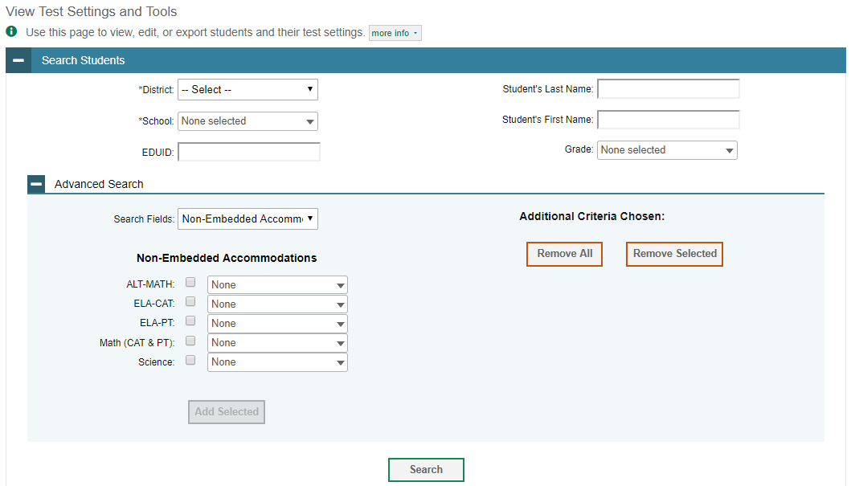
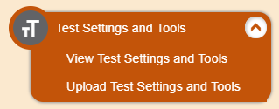
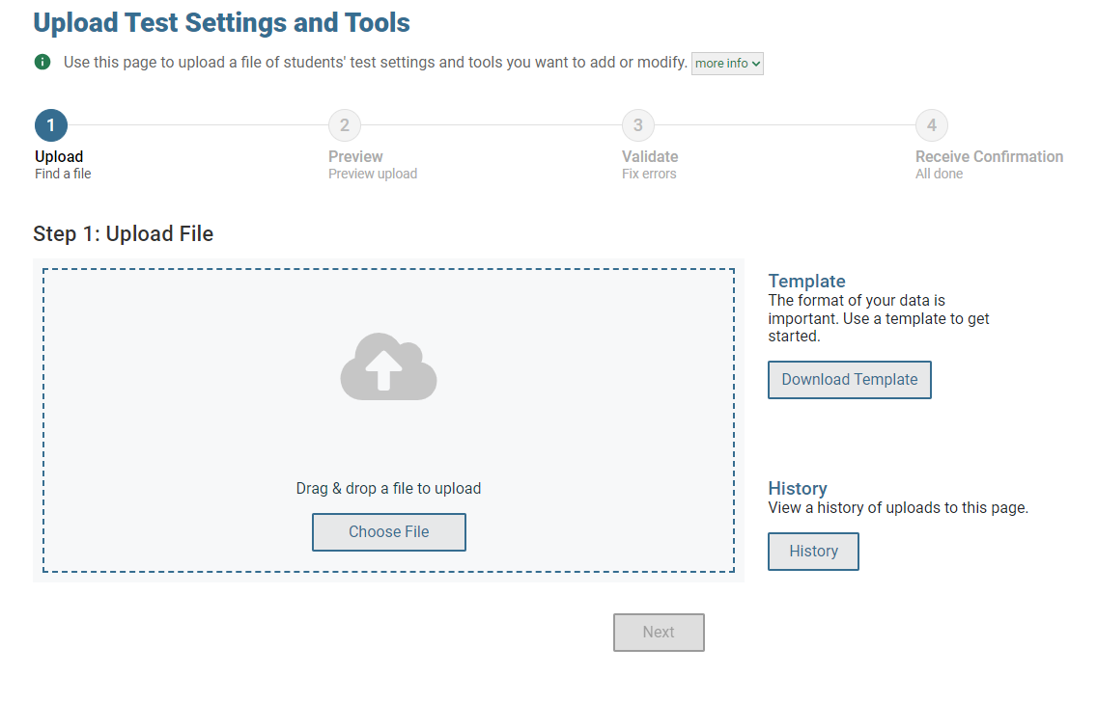
Test Settings and Tools
Notes:
TIDE maintains student test settings and accommodations, such as print on demand and text-to-speech. The Test Settings and Tools task menu allows you to view, edit, or upload test settings and tools.
Test Settings and Tools can be added in the same two ways as Users or Students: via individual edits or through a mass file upload. The upload file template is available in Excel or CSV formats. No changes have been made to the format of the Upload Students Settings file this year.
The search feature works similarly to the Users and Students search features. You can further refine your criteria by entering additional demographic information or test settings in the Advanced Search panel, if it is available.
Test Settings and Tools can be printed, exported or deleted from the Search Results page.

Slide 30
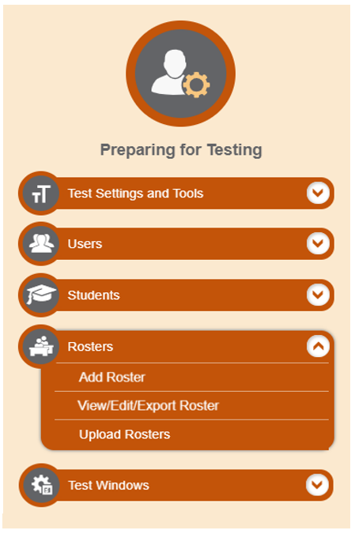
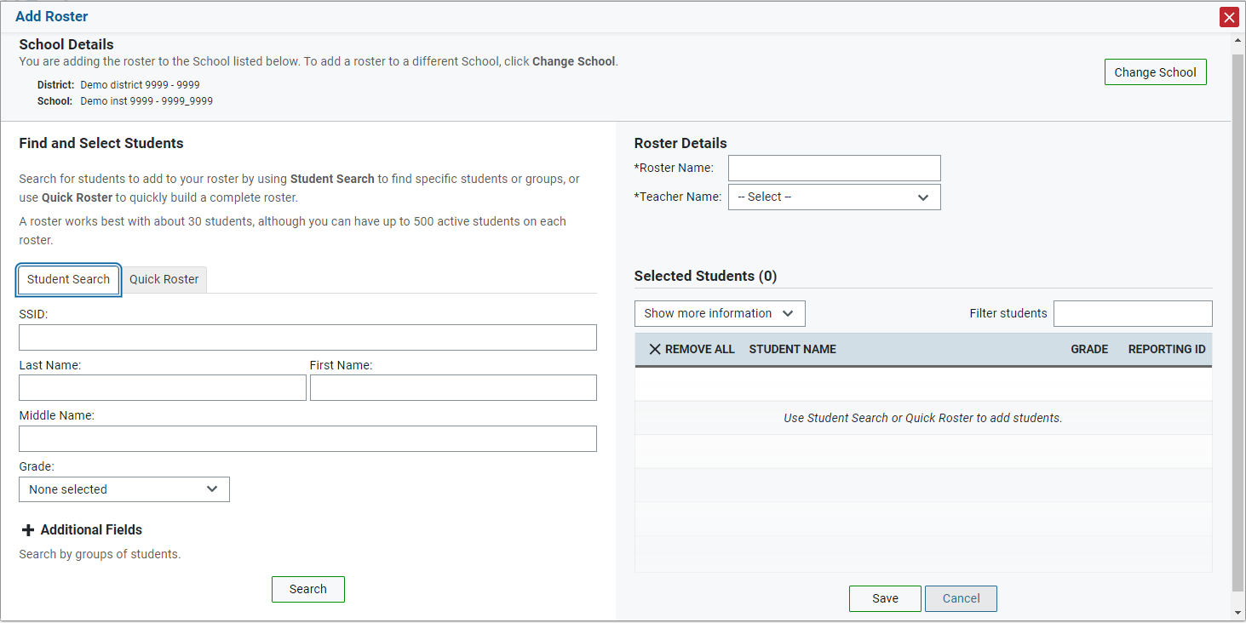
Add Rosters One at a Time
Notes:
The Add Roster page contains two panels, a Find and Select Students panel and a Roster Details panel.
To search for students, complete the student search fields in the Find and Select Students panel. The fields marked with an asterisk are mandatory. You can further refine your search by selecting criteria under the Additional Fields section.
Refine the list of available students by completing the fields in the Add Students to the Roster panel. Then, click Search.

Slide 31
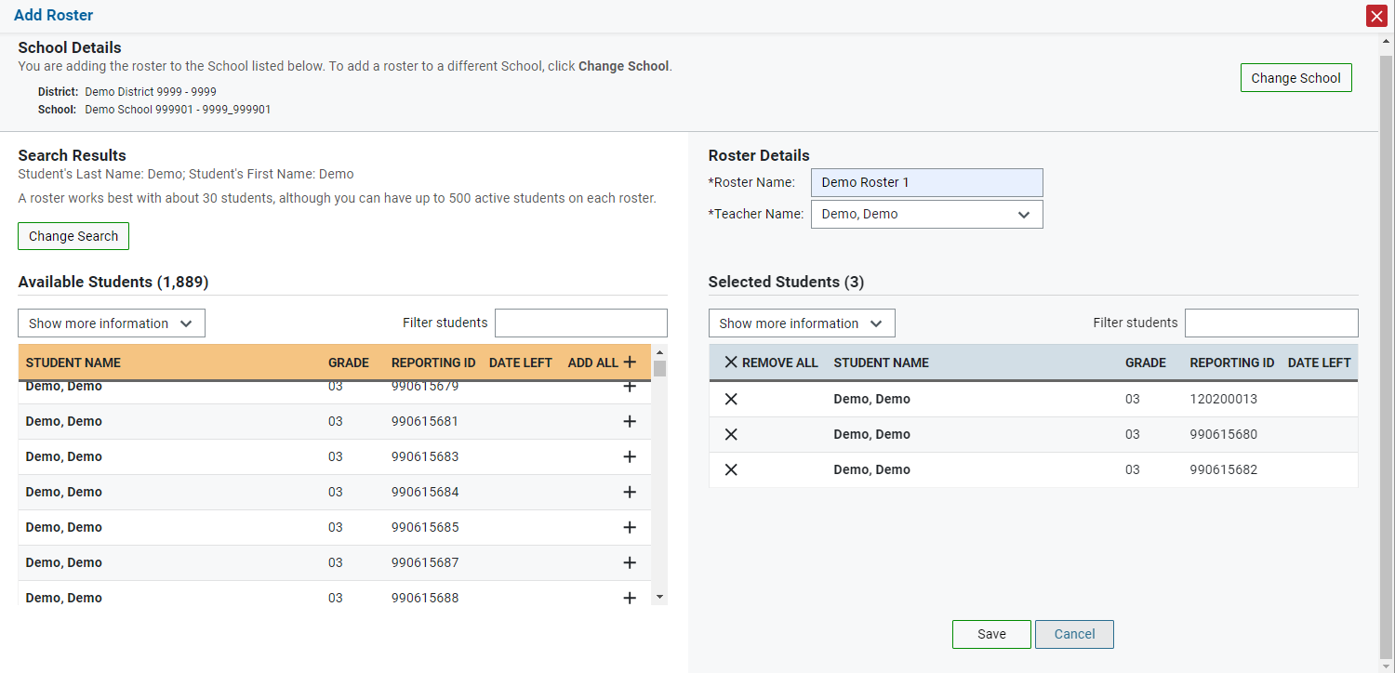
Add Rosters One at a Time, continued
Notes:
The students listed in the Search Results panel are available to be added to the roster.
First, in the Roster Details panel, enter a name for the roster and select the teacher who should be associated with the roster.
Next, add students to the new roster. To add a single student to the roster, click the plus sign next to a student in the left column. You can add all available students to the roster by clicking Add All.
Students will display under Selected Students as they are added to the roster.
To remove a single student from the roster, click the X next to a student in the right column. Remove all students from the roster by clicking Remove All. click Save to save the roster.

Slide 32
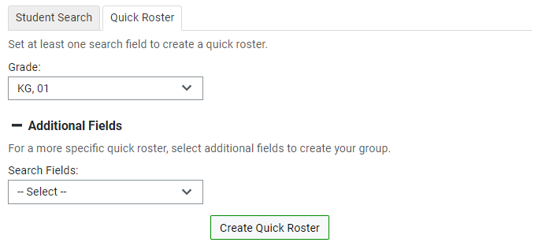
Add Rosters One at a Time, continued
Notes:
The Quick Roster tab can be utilized to create a complete roster from a group of students. To search for students, complete the fields in the Quick Roster panel. You can further refine your search by selecting criteria under the Additional Fields section. click Create Quick Roster.
All students who meet the criteria in your search are automatically added to the roster. You can manually remove students by clicking the X next to individual students or click Remove All from the top of the grid. click Save to create your roster.

Slide 33
View, Edit, Export and Upload Rosters
33
Notes:
A second way to add new rosters into TIDE is to use the Upload Rosters page to compose an upload file in Excel or CSV format and then upload that file.
This task is performed by following the same steps used to upload new users and students: download a template file, enter information into the template, save, and click the Browse button to locate the file and upload it to TIDE.
The View/Edit/Export Roster page includes a form for setting selection criteria to retrieve rosters. In this example, the district, school criteria, and roster type are required. Please be aware Idaho only uses User Defined rosters. Click Search to display a list of rosters matching your criteria.
Print or delete rosters from TIDE by selecting the desired rosters and clicking the Print or Delete button above the search results.
Click the pencil icon next to a roster to view or edit its details. The Edit Roster form will appear. This form is similar to the form used to add rosters, and you may edit the roster name, teacher name, and students in the roster in the same way that you would for a new roster.

Slide 34
Troubleshooting Tips for Uploading Files
Ensure all leading zeros are maintained in the files by formatting all numeric fields/cells in TEXT format. NOTE: If the original document is a CSV file, opening the document in Excel will cause the leading zeros to be wiped out. To retain them, continue to open the file using CSV format.
Ensure dates are formatted properly using MMDDYYYY (no spaces or dashes). NOTE: If using the template in TIDE, an error message will appear if the correct format is not entered in these fields.
Ensure all values contain only the acceptable values for the field you are trying to enter. When in doubt, select the button in the Upload page or refer to the TIDE User Guide for a list of acceptable values.
Unlike the other fields, the “Paper Tester,” “Economics Disadvantage Status” and “Delete Student” columns in the upload file accepts “Y” or a blank value rather than “Yes” or “No.”

Slide 35
Secure Test Materials
Notes:
The Secure Testing Materials page stores secure documentation. Materials that can only be accessed by your user role will be stored here. You can also access your Secure File Center on this page. The Secure File Center serves as a secure repository for files containing data that you have exported in TIDE and other CAI systems. When you choose to export search results to the Secure File Center, TIDE sends you an email when the export task in completed and the file is available in the Secure File Center for download.

Slide 36
Administering Tests
Printing testing tickets
Managing test improprieties
Monitoring test progress

Slide 37
Print Testing Tickets Student Information
Print from Student List
Print from Roster List
Notes:
Using the Print Testing Tickets feature allows users to print a hard-copy form from either a student list or a roster list that includes a student’s name as it must appear when the student logs in to test. TIDE generates the test tickets as PDF files that you download.
After searching for students from the Student List, TIDE will display all the students satisfying the search criteria. You can mark the checkboxes for the specific students you want to print or mark the checkbox at the top of the table for all students listed on the page to print test tickets for all retrieved students. Using similar steps, test tickets can be printed using the Print from Roster List page as well.
Click the Print button above the search results and select either My Selected Test Tickets or All Test Tickets. A layout model appears for selecting the printed layout.

Slide 38
Print Testing Tickets: Layout Model (Part 1)
Notes:
As students prepare to start testing, you can print all the associated test tickets. Whether you select to print test tickets from a student list or a roster list, a new browser window will open displaying options for selecting the printed layout. Click on the layout you require and then click Print.
Your browser downloads the generated PDF.

Slide 39
Print Testing Tickets: Layout Model (Part 2)
Notes:
Users may also print the test settings associated with each student who is ready to start testing. When users print the test settings associated with their students, they will see a list of any accommodations that were specifically selected in TIDE. The list will not include default test settings or universal tools.

Slide 40
Test Improprieties – Creating a Test Impropriety
Search Student By:
Result ID
Session ID
EDUID
Notes:
In the Administering Tests section of the TIDE dashboard, the Test Improprieties task menu allows district- or school-level users only to create new test improprieties. All users in TIDE can view any created test impropriety.
In the normal flow of a test opportunity, a student takes the test in TDS and then submits it. Next, TDS forwards the test for scoring, and ORS reports the test scores.
Test Improprieties are a way of interrupting this normal flow. Reasons for Test Improprieties can vary. For example, a student may need to have their test reset if test settings are not in place at the start of the testing session. Or a district- or school-level users may need to invalidate a test because of a hardware malfunction.
To create a test impropriety:
From the Test Improprieties task menu, select the Create Test Improprieties page.
Select a Request Type.
From the Search Student By drop-down, enter search criteria. District- or school-level users can search by: Result ID, Session ID, or EDUID.
Click Search.
Mark the checkbox for each result for which you want to create a test impropriety, and then click Create.
While not required, users should make sure more specific details are entered in the “Additional Comments” box regarding their submission for faster review and processing.
Click Submit.

Slide 41
Test Improprieties – Creating a Test Impropriety Through File Uploads
Columns in the Test Improprieties Upload File:
Type: Select one of the 6 options available.
Search Type: Result ID, EDUID, and Session ID.
Search Value: The values (EDUID, Result ID, and Session ID) must exist in TDS or TIDE. EDUIDs are available in TIDE, Session IDs are created in the TA Interface, and Results ID can be found in Plan and Manage Testing reports.
Reason: Reason for creating the test impropriety available from the pre-populated drop-down.
Comments: Enter additional information detailing reason for submission.
Notes:
If you have many test improprieties to create, it may be easier to perform those transactions via a file upload.
To submit a test improprieties upload file:
From the Test Improprieties task menu, select the Upload Test Improprieties page.
Download one of the file templates by clicking Download Excel Template or Download CSV Template.
Open the file in a spreadsheet application and add a row for each test impropriety you want to add. Save the file on your computer.
In the Upload Test Improprieties page, click Browse, and navigate to the upload file you created.
Click Upload File. TIDE displays a preview of the uploaded file. Use this preview to verify you uploaded the correct file.

Slide 42
Test Improprieties – Viewing a Test Impropriety
To view the status of a test impropriety that was created manually or via an upload file:
From the Test Improprieties task menu, select the View Test Improprieties page.
Retrieve the test improprieties you want to view by selecting the Request Type, Request Status, and Additional Request Criteria.
Click Search.
Notes:
To view the status of a test impropriety that was created manually or via an upload file:
From the Test Improprieties task menu, select the View Test Improprieties page.
Retrieve the test improprieties you want to view by selecting the Request Type, Request Status, and Additional Request Criteria.
Click Search.

Slide 43
Plan and Manage Testing (Part 1)
43
Notes:
The tasks available in the Monitoring Test Progress task menu allow you to generate and/or export various reports that provide information about a test administration's progress.
Several types of participation reports are available:
The Plan and Manage Testing Report details all student test opportunities and the status of those test opportunities.
The Test Completion Rates Report summarizes the number and percentage of students who have started or completed a test.
And the Test Status Code Report displays all the non-participation codes for a test administration.
As mentioned before, Plan and Manage Testing report detail all student test opportunities and the status of each test opportunity. Because the report lists testing opportunities, a student can appear more than once on the report.
To generate or export a report from the Plan and Manage Testing page, first go to the Step 1: Choose What panel and select a test category and a test administration. Optionally, you may also choose a test name, enrolled grade, or filter by a specific test accommodation or demographic to filter this report. If you select a test accommodation or demographic, a Values field is displayed. Select the required filter criteria from the available options.
Next, in the Step 2: Search Students panel, select a district and school, if applicable. Users can select All from the School drop-down to view a report containing all schools in your selected district. If a school is selected, you may choose a teacher from the Teacher drop-down list.
Finally, in the Step 3: Get Specific panel, choose one of the options as desired and select parameters for that option. We will discuss this step in more detail on the next slide.
Click Generate Report to view your Plan and Manage Testing report or click Export Report to open the report in Excel. Clicking Generate Report will display the report and collapse the Choose What, Search Students, and Get Specific panels. Because not all columns can fit on the screen at once, you may need to click the blue arrow on the right side of the screen to scroll right and display more information.

Slide 44
Plan and Manage Testing (Part 2)
Did all the students in a test session submit their test?
Which students’ test opportunities are about to expire?
Which students have not yet tested?
Notes:
The Plan and Manage Testing report details all of a student’s test opportunities and the status of those test opportunities.
In the Get Specific panel, select the radio button for one of the options and then set the parameters for that option. The following options are available (parameters for each option are listed in {brackets}):
Students whose most recent {Session ID/TA Name} was {Optional Session ID/TA Name} between {start date} and {end date}.
Students whose current opportunity will expire {in/between} {number/range} days.
Students who {have/have not} {completed/started} the {1st/2nd/Any} opportunity in the selected administration.

Slide 45
Plan and Manage Testing (Part 3)
Which students have paused their test?
Search by EDUID
Notes:
Students on their {1st/2nd/Any} opportunity in the selected administration, and have a status of {student test status}.
Search student(s) by {EDUID/Name}: {EDUID/Student Name}.

Slide 46
Test Session Status Report
Notes:
District-level users can view status reports of active and inactive test sessions happening in their district. These reports show how many students in each school are testing and how many have started, paused, and completed their test.
From the District drop-down list, select a district. From the School drop-down list, select an individual school to view a detailed report for that school or select multiple schools to view a summary report for the schools you select. To view a summary report for all schools in your district, select All Schools. Select Generate Report.
If you selected multiple schools, a summary report page appears. Select a school from the summary report page to view a detailed report for that school. You can choose to view inactive sessions clicking the Include inactive sessions button.

Slide 47
Test Completion Rates
Notes:
The Test Completion Rates report summarizes the number and percentage of students who have started or completed a test.
To export a report from the Test Completion Rates page, choose whether to export a district or school report from the Report drop-down list. Select a district and school from the corresponding drop-down lists, if available. If desired, select a test name.
To open the report in Excel, click Export Report.

Slide 48
Test Status Code Report
Notes:
If students do not start or complete tests to which they are assigned, district-level users can assign non-participation codes to those tests indicating why students did not start or complete the test.
The Test Status Code report displays all the non-participation codes for a test administration. To generate a report from the Test Status Code Report page, select the current test and administration from the drop-down lists. To view the report on the page, click Generate Report. The report will appear below the Report Criteria panel. To open the report in Excel, click Export Report.

Slide 49
Participation Search by EDUID
Notes:
You can generate participation reports for specific students by EDUID. To enter students’ EDUIDs, select Enter. Next, enter one or more EDUIDs, separated by commas, in the Student IDs field. You can enter up to 1000 EDUIDs.
To upload EDUIDs, select Upload. Next, select Browse and then use the file browser to select an Excel or CSV file with Student IDs listed in a single column. You can upload up to 1000 EDUIDs.
Select Generate Report. The Participation Report by EDUID appears. Because the report lists testing opportunities, a student can appear more than once on the report.

Slide 50
After Testing
Managing non-participation codes

Slide 51
Non-Participation (Special) Codes
A non-participation event occurs when a student does not take a test as scheduled. Users should assign a special code to explain the non-participation.
There are 9 non-participation (special) codes available. These codes include:
Absent
Invalidated
Medical
Refusal-Parent
Refusal-Student
Year 1 EL
Withdrawn
Dual Enrolled
Foreign Exchange
Refusal-Student
Year 1 LEP
Withdrawn
Notes:
There are circumstances in which a student did not participate in an expected test or participated in a test but in a non-standard way. Examples could include a student being absent for the entire test window, a parent opt-out, or student withdrawal. In such instances, you need to assign a non-participation (special) code to the student’s test.
In the After Testing section of TIDE, the Data Cleanup task menu is the location where district- and school-level users enter or view these non-participation (special) codes.
Please be aware any tasks related to non-participation (special) codes will not be available until the spring 2020 test administrations.

Slide 52
Searching for Non-Participation Codes
Notes:
To view or edit a student’s non-participation codes from the Non-Participation Codes page, select a district and school from the drop-down lists, if available. You may enter a student’s first or last name, EDUID, or grade if desired. You can further refine your criteria by entering additional demographic information or test settings in the Advanced Search panel.
Click Search to retrieve a list of students matching your selected criteria. Click the pencil icon for the student whose non-participation codes you want to edit.
When you click the green pencil icon, a pop-up window will appear, listing the student’s demographic information in the Student Information panel and the student’s available tests and non-participation codes in the Non-Participation Codes panel. From the drop-down lists, select the non-participation code for each available test, as required, and click Save.

Slide 53
School-Level Tasks
Preparing for Testing
Managing user accounts
Managing student information
Managing rosters
Administering Tests (During Testing)
Printing testing tickets
Managing test improprieties
Monitoring test progress
After Testing
Managing non-participation codes
Notes:
School-level users have access to many of the same tasks as district-level users and perform these tasks the same way a district-level user performs them.

Slide 54
Preparing for Testing
Managing user accounts
Managing student information
Managing rosters

Slide 55
Add Users & Upload Users
Notes:
Before testing begins, and throughout the school year, TIDE is used to manage user accounts for TIDE, the TA Interface, the Online Reporting System (ORS), the Assessment Viewing Application (AVA), and Reporting. The Users task menu allows you to add users; view, edit, or export users; and upload users from an external file.
As an SC you can add new users, view/modify users, or delete users in their school who have a lower user level. For example, SCs cannot add or modify other SC users. In order to add an SC role to your district, please contact your District Administrator (DA) or District Coordinator (DC).
There are two ways to add users in TIDE. From the Add User page manually fill out the information on the page and click Save. The new user’s e-mail address will serve as their username when logging in to any assessment system. The second way to add new users in TIDE is to use the Upload Users page to compose an upload file in Excel or CSV format and then upload that file. This method is efficient if you have many new users.
The easiest way to compose an upload file is to download an available template by clicking Download Templates. Open the template, enter information for the users you wish to add, and save the file in Excel or CSV format. We recommend using the Excel template when uploading user information. For a list of the acceptable values on the User Upload template refer to the Online User Guide by selecting the Help button.
Once you return to TIDE, click Browse, and select the file you just saved. To see a list of the files you have previously uploaded, first click the blue plus sign to expand the Upload History panel.
If a user’s role changes within the administration, for example a TA becomes an TE, then an SC will need to delete the user’s former role and add his/her new role. There is never a need to have two or more roles for a user associated to a single school.
If a user needs to transfer to a different school, he/she will need to get deleted from his/her former school and then added to his/her new school. If a user requires a user role for two different schools then two higher level users within each school would need to add this user to their respective school.

Slide 56
Viewing, Editing, and Exporting Users
Notes:
The View/Edit/Export Users page includes a form for setting selection criteria to retrieve users. In this example, the required criteria are the user’s role, district, and school. The state field prepopulates. Other criteria are optional, such as the first or last name. Click Search to continue. The search panel will automatically collapse, and your search results will appear below.
If your user role permits, you can edit a user’s information by clicking the green pencil icon. Another page will appear where you can edit and save information.
To export user information, mark the checkboxes next to the users you wish to export and click the green export button above the search results.
To delete users from TIDE, mark the checkboxes next to the users you wish to delete and click the orange trash can button above the search results.
To make the search form re-appear and search for additional users, click the plus sign in the Search users panel, which appears as a blue bar.

Slide 57
Add Students
Notes:
TIDE manages student information and keeps track of which assessments students are eligible to take. The Students task menu allows you to add students; upload interim grades; and view, edit, or export students.
You can manually add students from the Add Students page. This page contains six panels: Student Demographics, Race and Ethnicity, Interim Testing Grade, Test Settings and Tools, and Test Eligibility.
You will not be able to add students to TIDE without including the mandatory information in the Student Demographics panel. The fields marked with an asterisk are mandatory. As a reminder, EDUIDs are provided by SDE’s ISEE system.

Slide 58
Add Students (continued)
Notes:
The following fields have been changed in the Student Demographics panel:
LEP Category has changed to EL Category.
LEP Status has changed to EL Status.
N/A has been added as an option for Primary Disability Type and is a mandatory field.
Economic Disadvantage Status has been added as a mandatory field that is only viewable at the time of adding a student. This field will not be visible once a student is loaded to TIDE.
It should also be noted that official student demographic information used in federal reporting, including assessment data in state, district, and school report cards, will always come from data collected in ISEE.

Slide 59
English Language Learner Designations
English Language Learners can be designated in TIDE using the Limited English Proficiency (EL) Categories field.
L1, LE, EW, X1, X2, X3, X4, FL, SO. The codes entered in EL Category should match the data entered into ISEE. Please contact the SDE if you have any questions concerning these values. As a reminder, these fields indicate the following:
L1: Receiving EL Services and new to a US school in the last 12 months
LE: Continuing EL Services
EW: English Learner; services waived or refused
X1: Exited – 1st Year
X2: Exited – 2nd Year
X3: Exited – 3rd Year
X4: Exited – 4th Year
FL: Was formerly receiving EL services, no longer monitored
SO: Screened Out
Notes:
This slide provides further detail about what the EL categories presented in TIDE mean. For additional information, please contact the SDE.

Slide 60
Add Student (continued)
Notes:
In the available student test settings and tools panels, select the appropriate settings for each test using the drop-down lists and on-off switches. These categories will appear under all Idaho tests: ALT-ELA, ALT-MATH, ELA-CAT, ELA-PT, MATH (CAT & PT), and Science.
Test Settings and Tools categories include the following:
Support Tools for All Students
Supporting Students with Literacy Challenges
Supporting Students with Hearing Impairments
Supporting Students with Visual Impairments
Supporting Students Using Assistive Technology
Non-Embedded Tools
In the panel for Test Eligibility, mark whether a student is eligible to take the paper/pencil tests. As a reminder, paper/pencil tests are only available during the summative spring test administrations.
Click Save to add the student.

Slide 61
Updates to Test Settings and Tools Section
Notes:
Changes to test settings and tools section for 2019-2020:
Supporting Tools for All Students section was renamed Support Tools for All Students
Print on Demand moved to this section. The label was updated to read “Print on Demand (Not applicable for Braille tests)”
The Print on Demand tool selection changed to a off/on toggle and is available for all subjects
Supporting Literacy Challenges section was renamed Supporting Students with Literacy Challenges
Removed Text-to-Speech as an option for IDAA ELA
Text-to-Speech options are now “None,” “Designated Support,” and “Accommodation”
Accommodating Auditory Impairments section was renamed Supporting Students with Hearing Impairments
Accommodating Visual Impairments section was renamed Supporting Students with Visual Impairments
Removed Emboss Request Type from this section
Removed the Form Assignment tool completely
Miscellaneous Accommodations section was renamed Supporting Students Using Assistive Technology
Streamlined Interface Mode moved to this section.
Non-Embedded Designated Supports
Added to IDAA ELA: Read Aloud
Added to IDAA Math: Read Aloud Spanish
Added to IDAA ELA and IDAA Math: Medical Device, Amplifications, and Noise Buffers
Updated the title of “Read Aloud Items” to “Read Aloud”
Updated the title of “Read Aloud Stimuli” to “Read Aloud”
Updated the title of "Scribe Items (Non-Writing)" to "Scribe"
Added Somali and Hmong Glossaries as tools for Math (CAT & PT) and Science
Non-Embedded Accommodations
Updated the title of "Read Aloud Stimuli" to "Read Aloud"
Updated the title of "Scribe Items (Writing)" to "Scribe (Writing)”
Added to IDAA Math: Calculator

Slide 62
Upload Students Interim Testing Grade
If the upload file includes two rows specifying different grades for the same student and subject, then both grades will be set up as interim grades for the student’s subject.
If the upload file includes two rows for the same student and subject and the second row has a value “None”, then all interim grades established for the student’s subject up to that point will be removed.
If a student is manually added to TIDE, then you will need to select an Interim testing grade for that student. However, if the student is added to TIDE using the upload feature, the student will automatically be able to take the Interim tests at his/her enrolled grade.
Notes:
You can set up interim grades for multiple students through file uploads. This task requires familiarity with composing comma-separated value (CSV) files or working with Microsoft Excel.
To upload interim grades through file uploads:
From the Students task menu on the TIDE dashboard, select Upload Interim Grades.
Download the Interim Upload file and enter the following information: EDUID, Subject, and the Interim Grade.
Note:
If the upload file includes two rows specifying different grades for the same student and subject, then both grades will be set up as interim grades for the student’s subject.
If the upload file includes two rows for the same student and subject and the second row has a value “None”, then all interim grades established for the student’s subject up to that point will be removed.
If a student is manually added to TIDE, then you will need to select an Interim testing grade for that student. However, if the student is added to TIDE using the upload feature, the student will automatically be able to take the Interim tests at his/her enrolled grade.

Slide 63
Deleting Students
District- and School-level users are now able to DELETE student(s) through the Upload Students feature only. The DELETE function is particularly helpful when trying to remove students who should NOT be dual enrolled. It is important to delete students who are no longer enrolled at your district for student privacy laws.
To DELETE a student:
Download the student upload template from the Upload Students page
Complete all required fields within the template
Enter “Y” in the “DeleteStudent” column. This field will not accept “Yes” as a value.
When deleting a record of a student who has been dual-enrolled, only the selected record will be deleted. For example, if a student is enrolled in School A and School B and you delete the student’s record for School A, the student’s record for School B will not be deleted. If you do not wish to DELETE a student, this field should be left blank.

Slide 64
Viewing, Editing, and Exporting Students
Notes:
From the Students task menu, select View/Edit/Export Students. This page includes a form for setting selection criteria to retrieve students. Required criteria, such as the district and school in this example, are marked with asterisks. Other criteria are optional, such as the EDUID, the student’s first or last name, and the grade level.
If available, you can further refine your criteria by entering additional demographic information or test settings in the Advanced Search panel.
The students you can retrieve on this page are limited by your role’s scope. As a school-level user, you can only retrieve students enrolled within his/her school.
Click Search to continue. The search panel will automatically collapse, and your search results will appear below.

Slide 65
Searching for Students
Notes:
After you click Search, you’ll see a message asking whether you would like to view the results of your search, export the list of students to your Secure File Center, or modify your search criteria and try again. If you choose to export the results to your Secure File Center, you will receive an email when the file is ready for you to download.
When you click View Results, TIDE will display all the students satisfying the search criteria. You can edit a student’s information, including test settings and accommodations, by clicking the green pencil icon.
Print or export student information or delete students from TIDE by selecting the desired students and clicking the Print, Export, or Delete button above the search results.
To export the retrieved results to the Secure File Center, click Export to Secure File Center and select the file format (CSV or Excel) in which the data should be exported. You can navigate away from the page and perform other tasks if required. When your file is available for download, you will receive an email to the email account registered in TIDE. After receiving the email, you can download the exported file from the Secure File Center.
To make the search form re-appear and search for additional students, click the plus sign in the Search Students panel, which appears as a blue bar.

Slide 66
Test Settings and Tools
Notes:
TIDE maintains student test settings and accommodations, such as font size and text-to-speech. The Test Settings and Tools task menu allows you to view, edit, or upload test settings and tools.
Test Settings and Tools can be added in the same two ways as Users or Students: via individual edits or through a mass file upload. The upload file template is available in Excel or CSV formats. No changes have been made to the Upload Students Settings file this year.
The search feature works similarly to the Users and Students search features. You can further refine your criteria by entering additional demographic information or test settings in the Advanced Search panel, if it is available.
Test Settings and Tools can be printed, exported or deleted from the Search Results page.

Slide 67
Add Rosters One at a Time
Notes:
The Add Roster page contains two panels, a Find and Select Students panel and a Roster Details panel.
To search for students, complete the student search fields in the Find and Select Students panel. The fields marked with an asterisk are mandatory. You can further refine your search by selecting criteria under the Additional Fields section.
Refine the list of available students by completing the fields in the Add Students to the Roster panel. Then, click Search.

Slide 68
Add Rosters One at a Time, continued
Notes:
The students listed in the Search Results panel are available to be added to the roster.
First, in the Roster Details panel, enter a name for the roster and select the teacher who should be associated with the roster.
Next, add students to the new roster. To add a single student to the roster, click the plus sign next to a student in the left column. You can add all available students to the roster by clicking Add All.
Students will display under Selected Students as they are added to the roster.
To remove a single student from the roster, click the X next to a student in the right column. Remove all students from the roster by clicking Remove All. click Save to save the roster.

Slide 69
Add Rosters One at a Time, continued
Notes:
The Quick Roster tab can be utilized to create a complete roster from a group of students. To search for students, complete the fields in the Quick Roster panel. You can further refine your search by selecting criteria under the Additional Fields section. click Create Quick Roster.
All students who meet the criteria in your search are automatically added to the roster. You can manually remove students by clicking the X next to individual students or click Remove All from the top of the grid. click Save to create your roster.

Slide 70
View, Edit, Export and Upload Rosters
70
Notes:
A second way to add new rosters into TIDE is to use the Upload Rosters page to compose an upload file in Excel or CSV format and then upload that file.
This task is performed by following the same steps used to upload new users and students: download a template file, enter information into the template, save, and click the Browse button to locate the file and upload it to TIDE.
The View/Edit/Export Roster page includes a form for setting selection criteria to retrieve rosters. In this example, the district, school criteria, and roster type are required. Please be aware Idaho only uses User Defined rosters. Click Search to display a list of rosters matching your criteria.
Print or delete rosters from TIDE by selecting the desired rosters and clicking the Print or Delete button above the search results.
Click the pencil icon next to a roster to view or edit its details. The Edit Roster form will appear. This form is similar to the form used to add rosters, and you may edit the roster name, teacher name, and students in the roster in the same way that you would for a new roster.

Slide 71
Troubleshooting Tips for Uploading Files
Ensure all leading zeros are maintained in the files by formatting all numeric fields/cells in TEXT format. NOTE: If the original document is a CSV file, opening the document in Excel will cause the leading zeros to be wiped out. To retain them, continue to open the file using CSV format.
Ensure dates are formatted properly using MMDDYYYY (no spaces or dashes). NOTE: If using the template in TIDE, an error message will appear if the correct format is not entered in these fields.
Ensure all values contain only the acceptable values for the field you are trying to enter. When in doubt, select the button in the Upload page or refer to the TIDE User Guide for a list of acceptable values.
Unlike the other fields, the “Paper Tester,” “Economics Disadvantage Status” and “Delete Student” columns in the upload file accepts “Y” or a blank value rather than “Yes” or “No.”

Slide 72
Secure Test Materials
Notes:
The Secure Testing Materials page stores secure documentation. Materials that can only be accessed by your user role will be stored here. You can also access the Secure File Center on this page. The Secure File Center serves as a secure repository for files containing data that you have exported in TIDE and other CAI systems. When you choose to export search results to the Secure File Center, TIDE sends you an email when the export task in completed and the file is available in the Secure File Center for download.

Slide 73
Administering Tests
Printing testing tickets
Managing test improprieties
Monitoring test progress

Slide 74
Print Testing Tickets Student Information
Print from Student List
Print from Roster List
Notes:
Using the Print Testing Tickets feature allows users to print a hard-copy form from either a student list or a roster list that includes a student’s name as it must appear when the student logs in to test. TIDE generates the test tickets as PDF files that you download.
After searching for students from the Student list, TIDE will display all the students satisfying the search criteria. You can mark the checkboxes for the specific students you want to print or mark the checkbox at the top of the table for all students listed on the page to print test tickets for all retrieved students. Using similar steps, test tickets can be printed using the Print from Roster List page as well.
Click the Print button above the search results and select either My Selected Test Tickets or All Test Tickets. A layout model appears for selecting the printed layout.

Slide 75
Print Testing Tickets: Layout Model (Part 1)
Notes:
As students prepare to start testing, you can print all the associated test tickets. Whether you select to print test tickets from a student list or a roster list, a new browser window will open displaying options for the print format. Click on the layout you require and then click Print.
Your browser downloads the generated PDF.

Slide 76
Print Testing Tickets: Layout Model (Part 2)
Notes:
SCs may also print the test settings associated with each student who is ready to start testing. When users print the test settings associated with their students, they will see a list of any accommodations that were specifically selected in TIDE. The list will not include default test settings or universal tools.

Slide 77
Test Improprieties – Creating a Test Impropriety
Search Student By:
Result ID
Session ID
EDUID
Notes:
In the Administering Tests section of the TIDE dashboard, the Test Improprieties task menu allows district- or school-level users only to create new test improprieties. All users in TIDE can view any created test impropriety.
In the normal flow of a test opportunity, a student takes the test in TDS and then submits it. Next, TDS forwards the test for scoring, and ORS reports the test scores.
Test Improprieties are a way of interrupting this normal flow. Reasons for Test Improprieties can vary. For example, a student may need to have their test reset if test settings are not in place at the start of the testing session. Or a school-level users may need to invalidate a test because of a hardware malfunction.
To create a test impropriety:
From the Test Improprieties task menu, select Create Test Improprieties.
Select a Request Type.
From the Search Student By drop-down, enter search criteria. School-level users can search by: Result ID, Session ID, or EDUID.
Click Search.
Mark the checkbox for each result for which you want to create a test impropriety, and then click Create.
School-level users will need to enter a reason for the request from the drop-down that pops up after they click Create. While not required, users should enter more specific details in the “Additional Comments” box regarding their submission for faster review and processing.
Click Submit.

Slide 78
Test Improprieties – Creating a Test Impropriety Through File Uploads
Columns in the Test Improprieties Upload File:
Type: Select one of the 6 options available.
Search Type: Result ID, EDUID, and Session ID.
Search Value: The values (EDUID, Result ID, and Session ID) must exist in TDS or TIDE. EDUIDs are available in TIDE, Session IDs are created in the TA Interface, and Results ID can be found in Plan and Manage Testing reports.
Reason: Reason for creating the test impropriety available from the pre-populated drop-down.
Comments: Enter additional information detailing reason for submission.
Notes:
If you have many test improprieties to create, it may be easier to perform them via a file upload.
To submit a test improprieties upload file:
From the Test Improprieties task menu, select Upload Test Improprieties.
Download one of the file templates by clicking Download Template. You can download the file in Excel or CSV format.
Open the file in a spreadsheet application and add a row for each test impropriety. Save the file on your computer.
On the Upload Test Impropriety page, click Browse, and navigate to the upload file you created.
Click Upload File. TIDE displays a preview of the uploaded file. Use this preview to verify you uploaded the correct file.

Slide 79
Test Improprieties – Viewing a Test Impropriety
To view the status of a test impropriety that was created manually or via an upload file:
From the Test Improprieties task menu, select the View Test Improprieties page.
Retrieve the test improprieties you want to view by selecting the Request Type, Request Status, and Additional Request Criteria.
Click Search.
Notes:
To view the status of a test impropriety that was created manually or via an upload file:
From the Test Improprieties task menu, select the View Test Improprieties page.
Retrieve the test improprieties you want to view by selecting the Request Type, Request Status, and Additional Request Criteria.
Click Search.

Slide 80
Plan and Manage Testing (Part 1)
80
Notes:
The tasks available in the Monitoring Test Progress task menu allow you to generate and/or export various reports that provide information about a test administration's progress.
Several types of participation reports are available:
The Plan and Manage Testing Report details all student test opportunities and the status of those test opportunities.
The Test Completion Rates Report summarizes the number and percentage of students who have started or completed a test.
And the Test Status Code Report displays all the non-participation codes for a test administration.
As mentioned before, Plan and Manage Testing report detail all student test opportunities and the status of each test opportunity. Because the report lists testing opportunities, a student can appear more than once on the report.
To generate or export a report from the Plan and Manage Testing page, first go to the Step 1: Choose What panel and select a test category and a test administration. Optionally, you may also choose a test name, enrolled grade, or filter by a specific test accommodation or demographic to filter this report. If you select a test accommodation or demographic, a Values field is displayed. Select the required filter criteria from the available options.
Next, in the Step 2: Search Students panel, select a district and school, if applicable. Users can select All from the School drop-down to view a report containing all schools in your selected district. If a school is selected, you may choose a teacher from the Teacher drop-down list.
Finally, in the Step 3: Get Specific panel, choose one of the options as desired and select parameters for that option. We will discuss this step in more detail on the next slide.
Click Generate Report to view your Plan and Manage Testing report or click Export Report to open the report in Excel. Clicking Generate Report will display the report and collapse the Choose What, Search Students, and Get Specific panels. Because not all columns can fit on the screen at once, you may need to click the blue arrow on the right side of the screen to scroll right and display more information.

Slide 81
Plan and Manage Testing (Part 2)
Did all the students in a test session submit their test?
Which students’ test opportunities are about to expire?
Which students have not yet tested?
Notes:
The Plan and Manage Testing report details all of a student’s test opportunities and the status of those test opportunities.
In the Get Specific panel, select the radio button for one of the options and then set the parameters for that option. The following options are available (parameters for each option are listed in {brackets}):
Students whose most recent {Session ID/TA Name} was {Optional Session ID/TA Name} between {start date} and {end date}.
Students whose current opportunity will expire {in/between} {number/range} days.
Students who {have/have not} {completed/started} the {1st/2nd/Any} opportunity in the selected administration.

Slide 82
Plan and Manage Testing (Part 3)
Which students have paused their test?
Search by EDUID
Notes:
Students on their {1st/2nd/Any} opportunity in the selected administration, and have a status of {student test status}.
Search student(s) by {EDUID/Name}: {EDUID/Student Name}.

Slide 83
Test Session Status Report
Notes:
School-level users can view status reports of active and inactive test sessions happening in their school. These reports show how many students in a school are testing and how many have started, paused, and completed their test.
From the District drop-down list, select your district. From the School drop-down list, select an individual school to view a detailed report for that school. Select Generate Report.
You can choose to view inactive sessions clicking the Include inactive sessions button.

Slide 84
Test Completion Rates
Notes:
The Test Completion Rates report summarizes the number and percentage of students who have started or completed a test.
To export a report from the Test Completion Rates page, select school report from the Report Types drop-down list. Select a school from the corresponding drop-down lists. If desired, select a test name.
To open the report in Excel, click Export Report.

Slide 85
Test Status Code Report
Notes:
If students do not start or complete tests to which they are assigned, district-level users can assign non-participation codes to those tests indicating why students did not start or complete the test.
The Test Status Code report displays all the non-participation codes for a test administration. To generate a report from the Test Status Code Report page, select the current test and administration from the drop-down lists. To view the report on the page, click Generate Report. The report will appear below the Report Criteria panel. To open the report in Excel, click Export Report.

Slide 86
Participation Search by EDUID
Notes:
You can generate participation reports for specific students by EDUID. To enter students’ EDUIDs, select Enter. Next, enter one or more EDUIDs, separated by commas, in the Student IDs field. You can enter up to 1000 EDUIDs.
To upload EDUIDs, select Upload. Next, select Browse and then use the file browser to select an Excel or CSV file with Student IDs listed in a single column. You can upload up to 1000 EDUIDs.
Select Generate Report. The Participation Report by EDUID appears. Because the report lists testing opportunities, a student can appear more than once on the report.

Slide 87
After Testing
Managing non-participation codes

Slide 88
Non-Participation (Special) Codes
A non-participation event occurs when a student does not take a test as scheduled. Users should assign a special code to explain the non-participation.
There are 9 non-participation (special) codes available. These codes include:
Absent
Invalidated
Medical
Refusal-Parent
Refusal-Student
Year 1 EL
Withdrawn
Dual Enrolled
Foreign Exchange
Refusal-Student
Year 1 LEP
Withdrawn
Notes:
There are circumstances in which a student did not participate in an expected test or participated in a test but in a non-standard way. Examples could include a student being absent for the entire test window, a parent opt-out, or student withdrawal. In such instances, you need to assign a non-participation (special) code to the student’s test.
In the After Testing section of TIDE, the Data Cleanup task menu is the location where school-level users enter or view these non-participation (special) codes.
Please be aware any tasks related to non-participation (special) codes will not be available until the spring 2020 test administrations.

Slide 89
Searching for Non-Participation Codes
Notes:
To view or edit a student’s non-participation codes from the Non-Participation Codes page, select a district and school from the drop-down lists. You may enter a student’s first or last name, EDUID, or grade if desired. You can further refine your search by entering additional demographic information or test settings in the Advanced Search panel.
Click Search to retrieve a list of students matching your selected criteria. Click the pencil icon for the student whose non-participation codes you want to edit.
When you click the green pencil icon, a pop-up window will appear, listing the student’s demographic information in the Student Information panel and the student’s available tests and non-participation codes in the Non-Participation Codes panel. From the drop-down lists, select the non-participation code for each available test, as required, and click Save.

Slide 90
Teacher-Level Tasks
Preparing for Testing
Viewing user accounts
Managing student information
Uploading interim grades
Viewing students
Managing rosters
Administering Tests (During Testing)
Printing testing tickets
Viewing test improprieties
Monitoring test progress
After Testing
Viewing non-participation codes
Notes:
Teachers have access to some of the same tasks as district-level and school-level users and perform these tasks the same way a district-level or school-level user performs them.

Slide 91
Preparing for Testing
Viewing user accounts
Managing student information
Uploading interim grades
Viewing students
Managing rosters

Slide 92
Viewing and Exporting Users
Notes:
The View/Edit/Export User page includes a form for setting selection criteria to retrieve users. TEs can only view and export users. In this example, the required criteria are the user’s role, district, and school. Other criteria are optional, such as the first or last name. Click Search to continue. The search panel will automatically collapse, and your search results will appear below.
To export user information, mark the checkboxes next to the users you wish to export and click the green export button above the search results.
To make the search form re-appear and search for additional users, click the plus sign in the Search users panel, which appears as a blue bar.

Slide 93
Upload Students Interim Testing Grade
If the upload file includes two rows specifying different grades for the same student and subject, then both grades will be set up as interim grades for the student’s subject.
If the upload file includes two rows for the same student and subject and the second row has a value “None”, then all interim grades established for the student’s subject up to that point will be removed.
If a student is manually added to TIDE, then you will need to select an Interim testing grade for that student. However, if the student is added to TIDE using the upload feature, the student will automatically be able to take the Interim tests at his/her enrolled grade.
Notes:
You can set up interim grades for multiple students through file uploads. This task requires familiarity with composing comma-separated value (CSV) files or working with Microsoft Excel.
To upload interim grades through file uploads:
From the Students task menu on the TIDE dashboard, select Upload Interims page.
Download the Interim Upload file and enter the following information: EDUID, Subject, and the Interim Grade.
Note:
If the upload file includes two rows specifying different grades for the same student and subject, then both grades will be set up as interim grades for the student’s subject.
If the upload file includes two rows for the same student and subject and the second row has a value “None”, then all interim grades established for the student’s subject up to that point will be removed.
If a student is manually added to TIDE, then you will need to select an Interim testing grade for that student. However, if the student is added to TIDE using the upload feature, the student will automatically be able to take the Interim tests at his/her enrolled grade.

Slide 94
Viewing and Exporting Students
Notes:
From the Students task menu, the View/Edit/Export Student page includes a form for setting selection criteria to retrieve students. TEs can only view and export students. Required criteria, such as the district and school in this example, are marked with asterisks. Other criteria are optional, such as the EDUID, the student’s first or last name, and the grade level.
If available, you can further refine your criteria by entering additional demographic information or test settings in the Advanced Search panel, if it is available.
The students you can retrieve on this page are limited by your role’s scope. For example, if you are a district-level user, you can retrieve students enrolled within your district. If you are a school-level user, you can only retrieve students enrolled within your school.
Click Search to continue. The search panel will automatically collapse, and your search results will appear below.

Slide 95
Searching for Students
Notes:
After you click Search, you’ll see a message asking whether you would like to view the results of your search, export the list of students to your Secure File Center, or modify your search criteria and try again. If you choose to export the results to your Secure File Center, you will receive an email when the file is ready for you to download.
When you click View Results, TIDE will display all the students satisfying the search criteria. You can edit a student’s information, including test settings and accommodations, by clicking the green pencil icon.
Print or export student information by selecting the desired students and clicking the Print or Export button above the search results.
To export the retrieved results to the Secure File Center, click Export to Secure File Center and select the file format (CSV or Excel) in which the data should be exported. You can navigate away from the page and perform other tasks if required. When your file is available for download, you will receive an email to the email account registered in TIDE. After receiving the email, you can download the exported file from the Secure File Center.
To make the search form re-appear and search for additional students, click the plus sign in the Search Students panel, which appears as a blue bar.

Slide 96
Viewing Test Settings and Tools
Notes:
TIDE maintains student test settings and accommodations, such as font size and text-to-speech. The Test Settings and Tools task menu allows you to view test settings and tools.
The search feature works similarly to the Users and Students search features. You can further refine your criteria by entering additional demographic information or test settings in the Advanced Search panel, if it is available.
Test Settings and Tools can be printed, exported or deleted from the Search Results page.

Slide 97
Add Rosters One at a Time
Notes:
The Add Roster page contains two panels, a Find and Select Students panel and a Roster Details panel.
To search for students, complete the student search fields in the Find and Select Students panel. The fields marked with an asterisk are mandatory. You can further refine your search by selecting criteria under the Additional Fields section.
Refine the list of available students by completing the fields in the Add Students to the Roster panel. Then, click Search.

Slide 98
Add Rosters One at a Time, continued
Notes:
The students listed in the Search Results panel are available to be added to the roster.
First, in the Roster Details panel, enter a name for the roster and select the teacher who should be associated with the roster.
Next, add students to the new roster. To add a single student to the roster, click the plus sign next to a student in the left column. You can add all available students to the roster by clicking Add All.
Students will display under Selected Students as they are added to the roster.
To remove a single student from the roster, click the X next to a student in the right column. Remove all students from the roster by clicking Remove All. click Save to save the roster.

Slide 99
Add Rosters One at a Time, continued
Notes:
The Quick Roster tab can be utilized to create a complete roster from a group of students. To search for students, complete the fields in the Quick Roster panel. You can further refine your search by selecting criteria under the Additional Fields section. click Create Quick Roster.
All students who meet the criteria in your search are automatically added to the roster. You can manually remove students by clicking the X next to individual students or click Remove All from the top of the grid. click Save to create your roster.

Slide 100
View, Edit, Export and Upload Rosters
100
Notes:
A second way to add new rosters into TIDE is to use the Upload Rosters page to compose an upload file in Excel or CSV format and then upload that file.
This task is performed by following the same steps used to upload new users and students: download a template file, enter information into the template, save, and click the Browse button to locate the file and upload it to TIDE.
The View/Edit/Export Rosters page includes a form for setting selection criteria to retrieve rosters. In this example, the district, school criteria, and roster type are required. Please be aware Idaho only uses User Defined rosters. Click Search to display a list of rosters matching your criteria.
Print or delete rosters from TIDE by selecting the desired rosters and clicking the Print or Delete button above the search results.
Click the pencil icon next to a roster to view or edit its details. The Edit Roster form will appear. This form is similar to the form used to add rosters, and you may edit the roster name, teacher name, and students in the roster in the same way that you would for a new roster.

Slide 101
Troubleshooting Tips for Uploading Files
Ensure all leading zeros are maintained in the files by formatting all numeric fields/cells in TEXT format. NOTE: If the original document is a CSV file, opening the document in Excel will cause the leading zeros to be wiped out. To retain them, continue to open the file using CSV format.
Ensure all values contain only the acceptable values for the field you are trying to enter. When in doubt, select the button in the Upload page or refer to the TIDE User Guide for a list of acceptable values.

Slide 102
Secure Test Materials
Notes:
The Secure Testing Materials page stores secure documentation. Materials that can only be accessed by your user role will be stored here. You can also access the Secure File Center on this page. The Secure File Center serves as a secure repository for files containing data that you have exported in TIDE and other CAI systems. When you choose to export search results to the Secure File Center, TIDE sends you an email when the export task in completed and the file is available in the Secure File Center for download.

Slide 103
Administering Tests
Printing testing tickets
Viewing test improprieties
Monitoring test progress

Slide 104
Print Testing Tickets Student Information
Print from Student List
Print from Roster List
Notes:
Using the Print Testing Tickets feature allows users to print a hard-copy form from either a student list or a roster list that includes a student’s name as it must appear when the student logs in to test. TIDE generates the test tickets as PDF files that you download.
After searching for students from the Student list, TIDE will display all the students satisfying the search criteria. You can mark the checkboxes for the specific students you want to print or mark the checkbox at the top of the table for all students listed on the page to print test tickets for all retrieved students. Using similar steps, test tickets can be printed using the Print from Roster List page as well.
Click the Print button above the search results and select either My Selected Test Tickets or All Test Tickets. A layout model appears for selecting the printed layout.

Slide 105
Print Testing Tickets: Layout Model (Part 1)
Notes:
As students prepare to start testing, you can print all the associated test tickets. Whether you select to print test tickets from a student list or a roster list, a new browser window will open displaying the options for the print layout. Click on the layout you require and then click Print.
Your browser downloads the generated PDF.

Slide 106
Print Testing Tickets: Layout Model (Part 2)
Notes:
TEs may also print the test settings associated with each student who is ready to start testing. When users print the test settings associated with their students, they will see a list of any accommodations that were specifically selected in TIDE. The list will not include default test settings or universal tools.

Slide 107
Test Improprieties – Viewing a Test Impropriety
To view the status of a test impropriety that was created manually or via an upload file:
From the Test Improprieties task menu, select the View Test Improprieties page.
Retrieve the test improprieties you want to view by selecting the Request Type, Request Status, and Additional Request Criteria.
Click Search.
Notes:
To view the status of a test impropriety that was created manually or via an upload file:
From the Test Improprieties task menu, select the View Test Improprieties page.
Retrieve the test improprieties you want to view by selecting the Request Type, Request Status, and Additional Request Criteria.
Click Search.

Slide 108
Plan and Manage Testing (Part 1)
108
Notes:
The tasks available in the Monitoring Test Progress task menu allow you to generate and/or export various reports that provide information about a test administration's progress.
Several types of participation reports are available:
The Plan and Manage Testing Report details all student test opportunities and the status of those test opportunities.
The Test Completion Rates Report summarizes the number and percentage of students who have started or completed a test.
And the Test Status Code Report displays all the non-participation codes for a test administration.
As mentioned before, Plan and Manage Testing report detail all student test opportunities and the status of each test opportunity. Because the report lists testing opportunities, a student can appear more than once on the report.
To generate or export a report from the Plan and Manage Testing page, first go to the Step 1: Choose What panel and select a test category and a test administration. Optionally, you may also choose a test name, enrolled grade, or filter by a specific test accommodation or demographic to filter this report. If you select a test accommodation or demographic, a Values field is displayed. Select the required filter criteria from the available options.
Next, in the Step 2: Search Students panel, select a district and school, if applicable. Users can select All from the School drop-down to view a report containing all schools in your selected district. If a school is selected, you may choose a teacher from the Teacher drop-down list.
Finally, in the Step 3: Get Specific panel, choose one of the options as desired and select parameters for that option. We will discuss this step in more detail on the next slide.
Click Generate Report to view your Plan and Manage Testing report or click Export Report to open the report in Excel. Clicking Generate Report will display the report and collapse the Choose What, Search Students, and Get Specific panels. Because not all columns can fit on the screen at once, you may need to click the blue arrow on the right side of the screen to scroll right and display more information.

Slide 109
Plan and Manage Testing (Part 2)
Did all the students in a test session submit their test?
Which students’ test opportunities are about to expire?
Which students have not yet tested?
Notes:
The Plan and Manage Testing report details all of a student’s test opportunities and the status of those test opportunities.
In the Get Specific panel, select the radio button for one of the options and then set the parameters for that option. The following options are available (parameters for each option are listed in {brackets}):
Students whose most recent {Session ID/TA Name} was {Optional Session ID/TA Name} between {start date} and {end date}.
Students whose current opportunity will expire {in/between} {number/range} days.
Students who {have/have not} {completed/started} the {1st/2nd/Any} opportunity in the selected administration.

Slide 110
Plan and Manage Testing (Part 3)
Which students have paused their test?
Search by EDUID
Notes:
Students on their {1st/2nd/Any} opportunity in the selected administration, and have a status of {student test status}.
Search student(s) by {EDUID/Name}: {EDUID/Student Name}.

Slide 111
Test Session Status Report
Notes:
Teacher-level users can view status reports of active and inactive test sessions happening in their school. These reports show how many students in a school are testing and how many have started, paused, and completed their test.
From the District drop-down list, select your district. From the School drop-down list, select an individual school to view a detailed report for that school. Select Generate Report.
You can choose to view inactive sessions clicking the Include inactive sessions button.

Slide 112
Test Completion Rates
Notes:
The Test Completion Rates report summarizes the number and percentage of students who have started or completed a test.
To export a report from the Test Completion Rates page, choose whether to export a district or school report from the Report drop-down list. Select a district and school from the corresponding drop-down lists, if available. If desired, select a test name.
To open the report in Excel, click Export Report.

Slide 113
Test Status Code Report
Notes:
If students do not start or complete tests to which they are assigned, district-level users can assign non-participation codes to those tests indicating why students did not start or complete the test.
The Test Status Code report displays all the non-participation codes for a test administration. To generate a report from the Test Status Code Report page, select the current test and administration from the drop-down lists. To view the report on the page, click Generate Report. The report will appear below the Report Criteria panel. To open the report in Excel, click Export Report.

Slide 114
Participation Search by EDUID
Notes:
You can generate participation reports for specific students by EDUID. To enter students’ EDUIDs, select Enter. Next, enter one or more EDUIDs, separated by commas, in the Student IDs field. You can enter up to 1000 EDUIDs.
To upload EDUIDs, select Upload. Next, select Browse and then use the file browser to select an Excel or CSV file with Student IDs listed in a single column. You can upload up to 1000 EDUIDs.
Select Generate Report. The Participation Report by EDUID appears. Because the report lists testing opportunities, a student can appear more than once on the report.

Slide 115
After Testing
Viewing non-participation codes

Slide 116
Non-Participation (Special) Codes
A non-participation event occurs when a student does not take a test as scheduled. Users should assign a special code to explain the non-participation.
There are 9 non-participation (special) codes available. These codes include:
Absent
Invalidated
Medical
Refusal-Parent
Refusal-Student
Year 1 EL
Withdrawn
Dual Enrolled
Foreign Exchange
Refusal-Student
Year 1 LEP
Withdrawn
Notes:
There are circumstances in which a student did not participate in an expected test or participated in a test but in a non-standard way. Examples could include a student being absent for the entire test window, a parent opt-out, or student withdrawal.
In the After Testing section of TIDE, the Data Cleanup task menu is the location where teacher-level users view these non-participation (special) codes.
Please be aware any tasks related to non-participation (special) codes will not be available until the spring 2020 test administrations.

Slide 117
Searching for Non-Participation Codes
Notes:
To view a student’s non-participation codes from the Non-Participation Codes page, select a district and school from the drop-down lists. You may enter a student’s first or last name, EDUID, or grade if desired. You can further refine your search by entering additional demographic information or test settings in the Advanced Search panel.
Click Search to retrieve a list of students matching your selected criteria.
When you click the green pencil icon, a pop-up window will appear, listing the student’s demographic information in the Student Information panel and the student’s available tests and non-participation codes in the Non-Participation Codes panel.

Slide 118
Test Administrator (TA)-Level Tasks
Preparing for Testing
Viewing user accounts
Managing student information
Uploading interim grades
Viewing students
Administering Tests (During Testing)
Printing testing tickets
Monitoring test progress
After Testing
Viewing non-participation codes
Notes:
TAs have access to some of the same tasks as district-level, school-level and teacher-level users and perform these tasks the same way those users perform them.

Slide 119
Preparing for Testing
Viewing user accounts
Managing student information
Uploading interim grades
Viewing students

Slide 120
Viewing and Exporting Users
Notes:
The View/Edit/Export User page includes a form for setting selection criteria to retrieve users. TAs can only view and export users. In this example, the required criteria are the user’s role, district, and school. Other criteria are optional, such as the first or last name. Click Search to continue. The search panel will automatically collapse, and your search results will appear below.
To export user information, mark the checkboxes next to the users you wish to export and click the green export button above the search results.
To make the search form re-appear and search for additional users, click the plus sign in the Search users panel, which appears as a blue bar.

Slide 121
Upload Students Interim Testing Grade
If the upload file includes two rows specifying different grades for the same student and subject, then both grades will be set up as interim grades for the student’s subject.
If the upload file includes two rows for the same student and subject and the second row has a value “None”, then all interim grades established for the student’s subject up to that point will be removed.
If a student is manually added to TIDE, then you will need to select an Interim testing grade for that student. However, if the student is added to TIDE using the upload feature, the student will automatically be able to take the Interim tests at his/her enrolled grade.
Notes:
You can set up interim grades for multiple students through file uploads. This task requires familiarity with composing comma-separated value (CSV) files or working with Microsoft Excel.
To upload interim grades through file uploads:
From the Students task menu on the TIDE dashboard, select Upload Interims page.
Download the Interim Upload file and enter the following information: EDUID, Subject, and the Interim Grade.
Note:
If the upload file includes two rows specifying different grades for the same student and subject, then both grades will be set up as interim grades for the student’s subject.
If the upload file includes two rows for the same student and subject and the second row has a value “None”, then all interim grades established for the student’s subject up to that point will be removed.
If a student is manually added to TIDE, then you will need to select an Interim testing grade for that student. However, if the student is added to TIDE using the upload feature, the student will automatically be able to take the Interim tests at his/her enrolled grade.

Slide 122
Troubleshooting Tips for Uploading Files
Ensure all leading zeros are maintained in the files by formatting all numeric fields/cells in TEXT format. NOTE: If the original document is a CSV file, opening the document in Excel will cause the leading zeros to be wiped out. To retain them, continue to open the file using CSV format.
Ensure all values contain only the acceptable values for the field you are trying to enter. When in doubt, select the button in the Upload page or refer to the TIDE User Guide for a list of acceptable values.

Slide 123
Viewing and Exporting Students
Notes:
From the Students task menu, the View/Edit/Export Student page includes a form for setting selection criteria to retrieve students. TAs can only view and export students. Required criteria, such as the district and school in this example, are marked with asterisks. Other criteria are optional, such as the EDUID, the student’s first or last name, and the grade level.
If available, you can further refine your criteria by entering additional demographic information or test settings in the Advanced Search panel, if it is available.
The students you can retrieve on this page are limited by your role’s scope. You can only retrieve students enrolled within your school.
Click Search to continue. The search panel will automatically collapse, and your search results will appear below.

Slide 124
Searching for Students
Notes:
After you click Search, you’ll see a message asking whether you would like to view the results of your search, export the list of students to the Secure File Center, or modify your search criteria and try again. If you choose to export the results to your Secure File Center, you will receive an email when the file is ready for you to download.
When you click View Results, TIDE will display all the students satisfying the search criteria. You can edit a student’s information, including test settings and accommodations, by clicking the green pencil icon.
Print or export student information or delete students from TIDE by selecting the desired students and clicking the Print, Export, or Delete button above the search results.
To export the retrieved results to the Secure File Center, click Export to the Secure File Center and select the file format (CSV or Excel) in which the data should be exported. You can navigate away from the page and perform other tasks if required. When your file is available for download, you will receive an email to the email account registered in TIDE. After receiving the email, you can download the exported file from the Secure File Center.
To make the search form re-appear and search for additional students, click the plus sign in the Search Students panel, which appears as a blue bar.

Slide 125
Viewing Test Settings and Tools
Notes:
TIDE maintains student test settings and accommodations, such as font size and text-to-speech. The Test Settings and Tools task menu allows you to view test settings and tools.
The search feature works similarly to the Users and Students search features. You can further refine your criteria by entering additional demographic information or test settings in the Advanced Search panel, if it is available.
Test Settings and Tools can be printed, exported or deleted from the Search Results page.

Slide 126
Secure Test Materials
Notes:
The Secure Testing Materials page stores secure documentation. Materials that can only be accessed by your user role will be stored here. You can also access the Secure File Center on this page. The Secure File Center serves as a secure repository for files containing data that you have exported in TIDE and other CAI systems. When you choose to export search results to the Secure File Center, TIDE sends you an email when the export task in completed and the file is available in the Secure File Center for download.

Slide 127
Administering Tests
Printing testing tickets
Monitoring test progress

Slide 128
Print Testing Tickets Student Information
Print from Student List
Notes:
Using the Print Testing Tickets feature allows users to print a hard-copy form from either a student list or a roster list that includes a student’s name as it must appear when the student logs in to test. TIDE generates the test tickets as PDF files that you download.
After searching for students from the Student list, TIDE will display all the students satisfying the search criteria. You can mark the checkboxes for the specific students you want to print or mark the checkbox at the top of the table for all students listed on the page to print test tickets for all retrieved students.
Click the Print button above the search results and select either My Selected Test Tickets or All Test Tickets. A layout model appears for selecting the printed layout.

Slide 129
Print Testing Tickets: Layout Model (Part 1)
Notes:
As students prepare to start testing, you can print all the associated test tickets. Whether you select to print test tickets from a student list, a new browser window will open displaying options for the print layout. Click on the layout you require and then click Print.
Your browser downloads the generated PDF.

Slide 130
Print Testing Tickets: Layout Model (Part 2)
Notes:
TAs may also print the test settings associated with each student who is ready to start testing. When users print the test settings associated with their students, they will see a list of any accommodations that were specifically selected in TIDE. The list will not include default test settings or universal tools.

Slide 131
Test Improprieties – Viewing a Test Impropriety
To view the status of a test impropriety that was created manually or via an upload file:
From the Test Improprieties task menu, select the View Test Improprieties page.
Retrieve the test improprieties you want to view by selecting the Request Type, Request Status, and Additional Request Criteria.
Click Search.
Notes:
To view the status of a test impropriety that was created manually or via an upload file:
From the Test Improprieties task menu, select the View Test Improprieties page.
Retrieve the test improprieties you want to view by selecting the Request Type, Request Status, and Additional Request Criteria.
Click Search.

Slide 132
Plan and Manage Testing (Part 1)
132
Notes:
The tasks available in the Monitoring Test Progress task menu allow you to generate and/or export various reports that provide information about a test administration's progress.
Several types of participation reports are available:
The Plan and Manage Testing Report details all of a student’s test opportunities and the status of those test opportunities.
The Test Completion Rates Report summarizes the number and percentage of students who have started or completed a test.
And the Test Status Code Report displays all the non-participation codes for a test administration.
As mentioned before, Plan and Manage Testing report detail all of a student’s test opportunities and the status of each test opportunity. Because the report lists testing opportunities, a student can appear more than once on the report.
To generate or export a report from the Plan and Manage Testing page, first go to the Step 1: Choose What panel and select a test category and a test administration. Optionally, you may also choose a test name, enrolled grade, or filter by a specific test accommodation or demographic to filter this report. If you select a test accommodation or demographic, a Values field is displayed. Select the required filter criteria from the available options.
Next, in the Step 2: Search Students panel, select a district and school, if applicable. Users are able to select All from the School drop-down to view a report containing all schools in your selected district. If a school is selected, you may choose a teacher from the Teacher drop-down list.
Finally, in the Step 3: Get Specific panel, choose one of the options as desired and select parameters for that option. We will discuss this step in more detail on the next slide.
Click Generate Report to view your Plan and Manage Testing report or click Export Report to open the report in Excel. Clicking Generate Report will display the report and collapse the Choose What, Search Students, and Get Specific panels. Because not all columns can fit on the screen at once, you may need to click the blue arrow on the right side of the screen to scroll right and display more information.

Slide 133
Plan and Manage Testing (Part 2)
Did all the students in a test session submit their test?
Which students’ test opportunities are about to expire?
Which students have not yet tested?
Notes:
The Plan and Manage Testing report details all of a student’s test opportunities and the status of those test opportunities.
In the Get Specific panel, select the radio button for one of the options and then set the parameters for that option. The following options are available (parameters for each option are listed in {brackets}):
Students whose most recent {Session ID/TA Name} was {Optional Session ID/TA Name} between {start date} and {end date}.
Students whose current opportunity will expire {in/between} {number/range} days.
Students who {have/have not} {completed/started} the {1st/2nd/Any} opportunity in the selected administration.

Slide 134
Plan and Manage Testing (Part 3)
Which students have paused their test?
Search by EDUID
Notes:
Students on their {1st/2nd/Any} opportunity in the selected administration, and have a status of {student test status}.
Search student(s) by {EDUID/Name}: {EDUID/Student Name}.

Slide 135
Test Completion Rates
Notes:
The Test Completion Rates report summarizes the number and percentage of students who have started or completed a test.
To export a report from the Test Completion Rates page, choose whether to export a district or school report from the Report drop-down list. Select a district and school from the corresponding drop-down lists, if available. If desired, select a test name.
To open the report in Excel, click Export Report.

Slide 136
Test Status Code Report
Notes:
If students do not start or complete tests to which they are assigned, district-level users can assign non-participation codes to those tests indicating why students did not start or complete the test.
The Test Status Code report displays all the non-participation codes for a test administration. To generate a report from the Test Status Code Report page, select the current test and administration from the drop-down lists. To view the report on the page, click Generate Report. The report will appear below the Report Criteria panel. To open the report in Excel, click Export Report.

Slide 137
Participation Search by EDUID
Notes:
You can generate participation reports for specific students by EDUID. To enter students’ EDUIDs, select Enter. Next, enter one or more EDUIDs, separated by commas, in the Student IDs field. You can enter up to 1000 EDUIDs.
To upload EDUIDs, select Upload. Next, select Browse and then use the file browser to select an Excel or CSV file with Student IDs listed in a single column. You can upload up to 1000 EDUIDs.
Select Generate Report. The Participation Report by EDUID appears. Because the report lists testing opportunities, a student can appear more than once on the report.

Slide 138
After Testing
Viewing non-participation codes

Slide 139
Non-Participation (Special) Codes
A non-participation event occurs when a student does not take a test as scheduled. Users should assign a special code to explain the non-participation.
There are 14 non-participation (special) codes available. These codes include:
Absent
Invalidated
Medical
Refusal-Parent
Refusal-Student
Missed Test Window
Challenged Up
Year 1 EL
Withdrawn
Dual Enrolled
Foreign Exchange
Remote Tester
Home School
Homebound
Refusal-Student
Year 1 LEP
Withdrawn
Notes:
There are circumstances in which a student did not participate in an expected test or participated in a test but in a non-standard way. Examples could include a student being absent for the entire test window, a parent opt-out, or student withdrawal.
In the After Testing section of TIDE, the Data Cleanup task menu is the location where TA-level users view these non-participation (special) codes.
Please be aware any tasks related to non-participation (special) codes will not be available until the spring 2020 test administrations.

Slide 140
Searching for Non-Participation Codes
Notes:
To view a student’s non-participation codes from the Non-Participation Codes page, select a district and school from the drop-down lists. You may enter a student’s first or last name, EDUID, or grade if desired. You can further refine your search by entering additional demographic information or test settings in the Advanced Search panel.
Click Search to retrieve a list of students matching your selected criteria.
When you click the green pencil icon, a pop-up window will appear, listing the student’s demographic information in the Student Information panel and the student’s available tests and non-participation codes in the Non-Participation Codes panel.

Slide 141
Contact the Idaho Help Desk
If you have general questions or need further information visit the Idaho portal or consult the Idaho Help Desk for assistance.
Idaho Portal: https://idaho.portal.cambiumast.com/
Idaho Help Desk Contact Information:
Customer Support Email: IDHelpDesk@cambiumassessment.com
Customer Support Phone: 1-844-560-7365
Hours of Operation: Monday – Friday 8:00 am to 8:00 pm MT
When contacting the Idaho Help Desk, please be ready to provide the following information:
Any error messages that are appearing (including codes)
Your operating system and browser information
Your network configuration information
Your contact information for follow-up by phone or email
Any other relevant information, such as test names or content areas, student EDUIDs, session IDs, and search criteria
For questions about test administration or policy issues, please contact your District Test Coordinator.
Notes:
You can find The TIDE User Guide and other helpful resources on the Idaho portal. However, if you still require assistance with troubleshooting a technical issue, you may also contact the Idaho Help Desk. When contacting the Idaho Help Desk, please be ready to provide the following information:
Any error messages that are appearing (including codes)
Your operating system and browser information
Your network configuration information
Your contact information for follow-up by phone or email
Any other relevant information, such as test names or content areas, student EDUIDs, session IDs, and search criteria
For questions about test administration or policy issues, please contact your District Test Coordinator.

